Slide 1
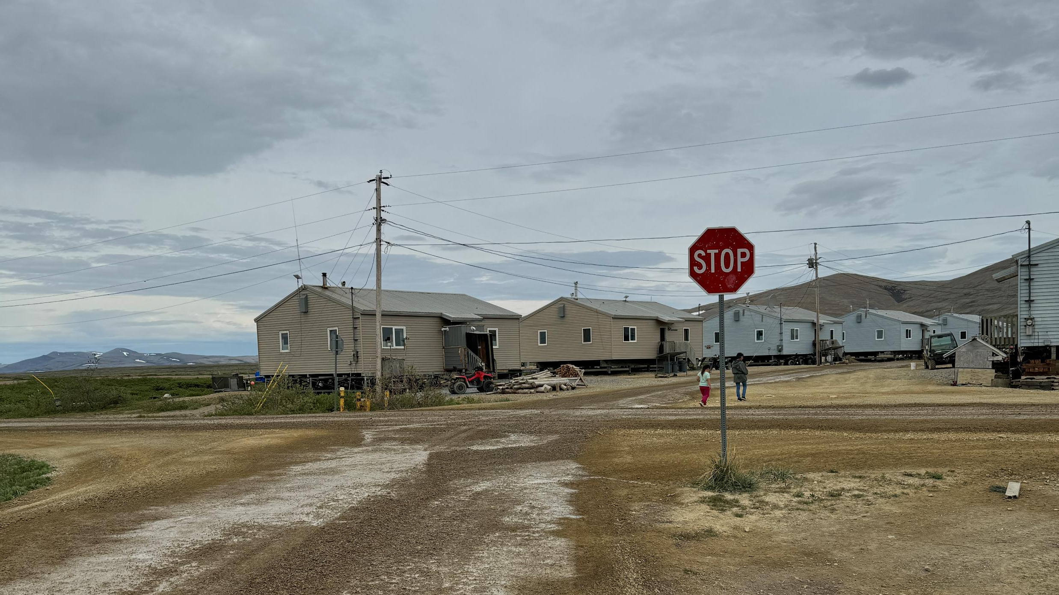
Alaska TTAP
Tribal Technical Assistance Program

Slide 2
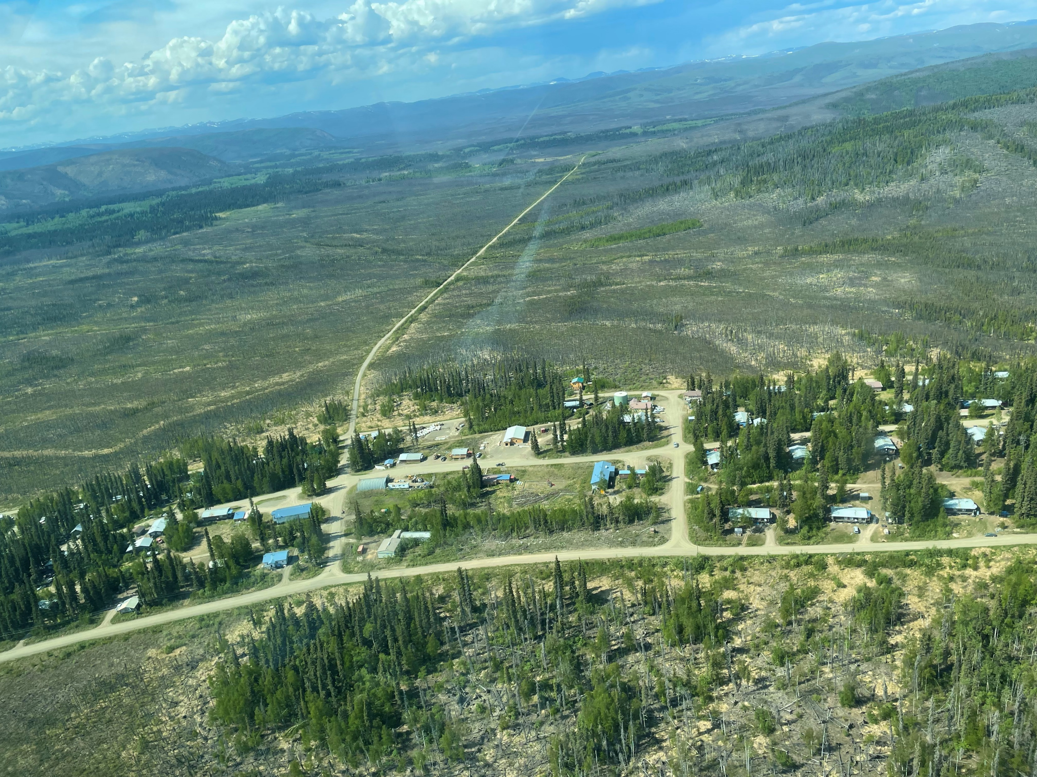
Located at UAF
Funded by the US DOT Federal Highway Administration (FHWA) and Bureau of Indian Affairs (BIA) through a cooperative agreement.
Agreement signed Fall 2022, Kick-off meeting held December 2022.
Focused on training and technical assistance

Slide 3
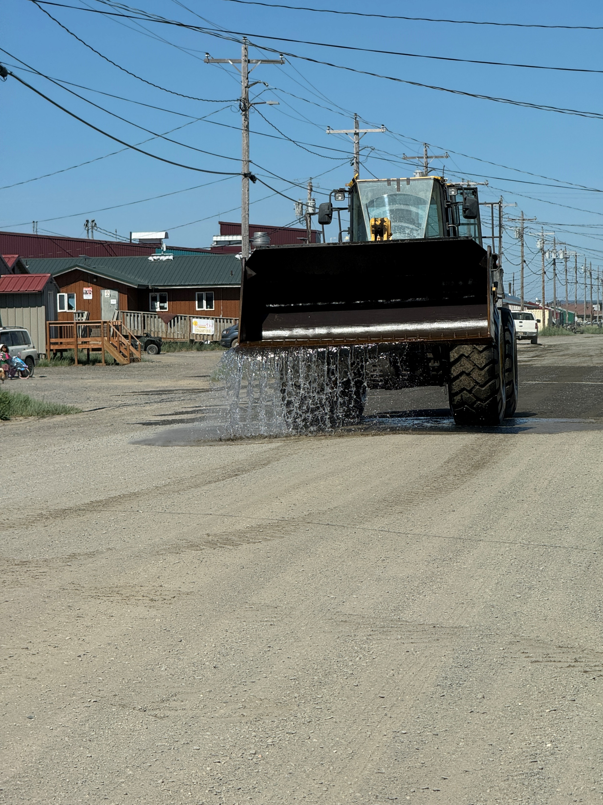
Alaska TTAP Goals
Safe and equitable transportation
The Tribal Technical Assistance Program, TTAP, provides a quality, safe and equitable transportation program through training and technical assistance.
A knowledge & training resource
The AK TTAP Center was established to serve as the go-to resource for Tribal transportation training, technical assistance, technology transfer needs, and assisting in the performance of Tribal transportation agency duties in Alaska.
Maximizing benefits
We will operate in a safe, efficient, environmentally sound, and cost-effective manner while also allowing tribes to maximize benefits from their often limited fiscal and staffing resources.

Slide 4
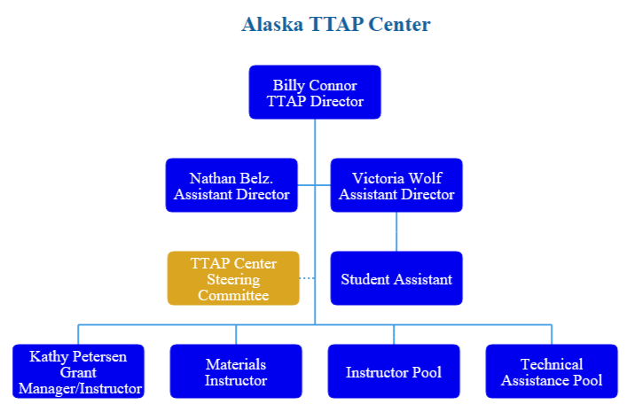
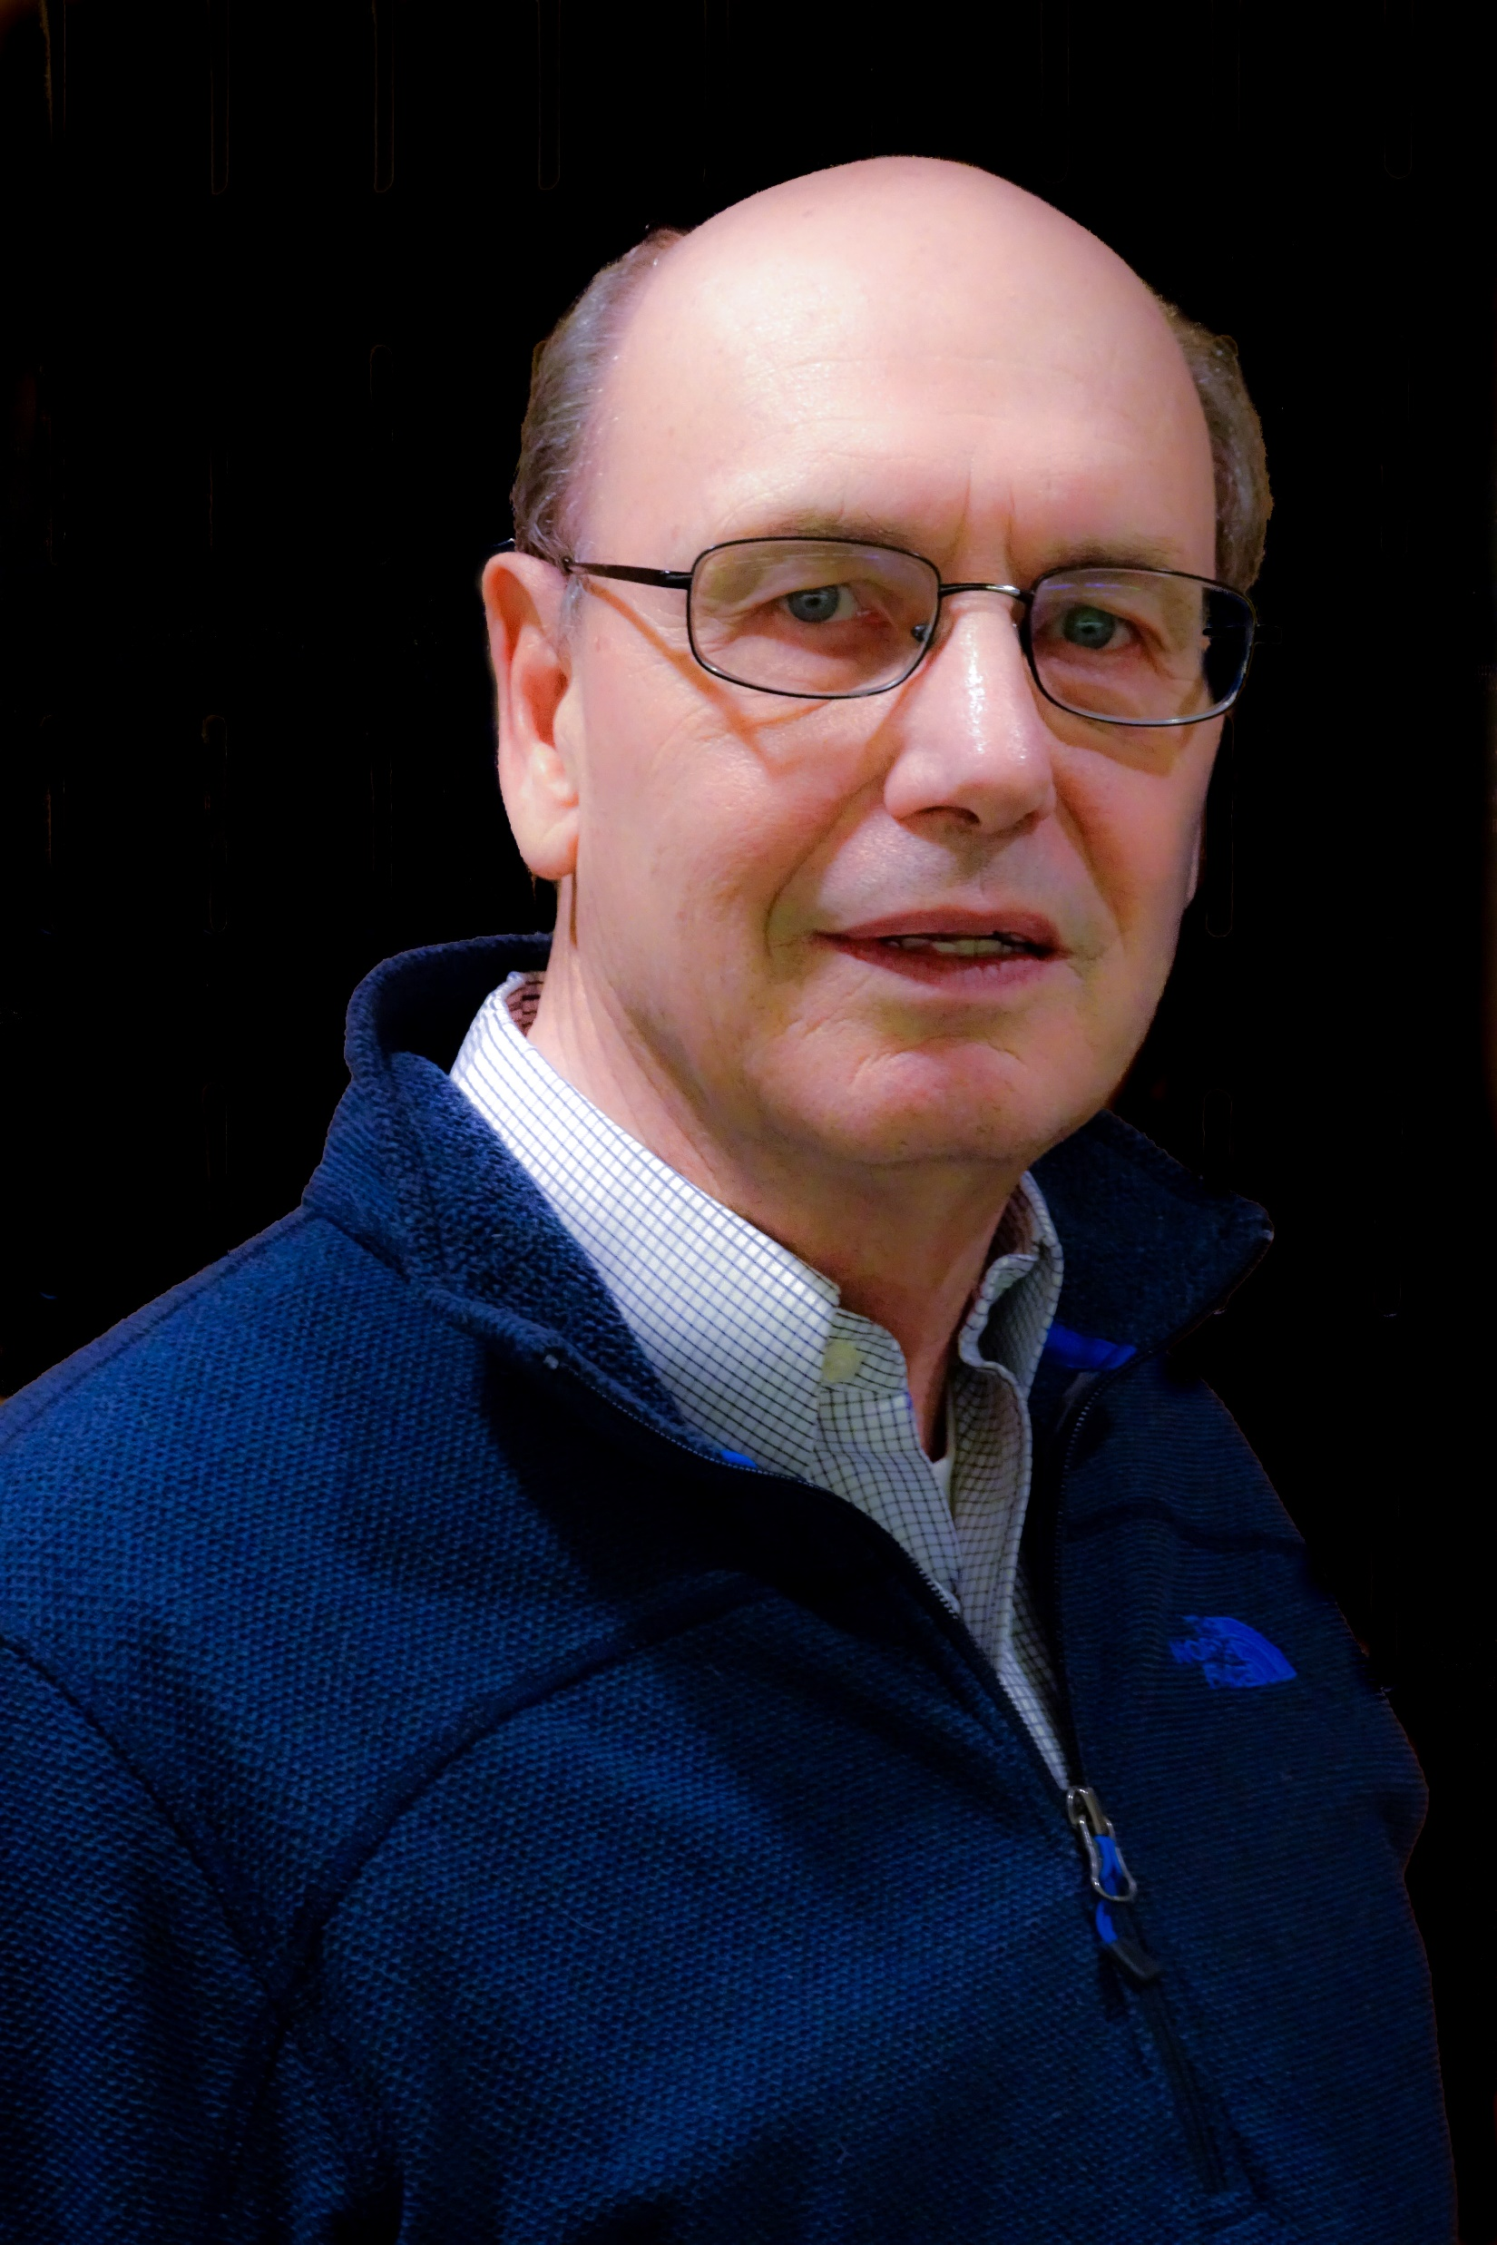
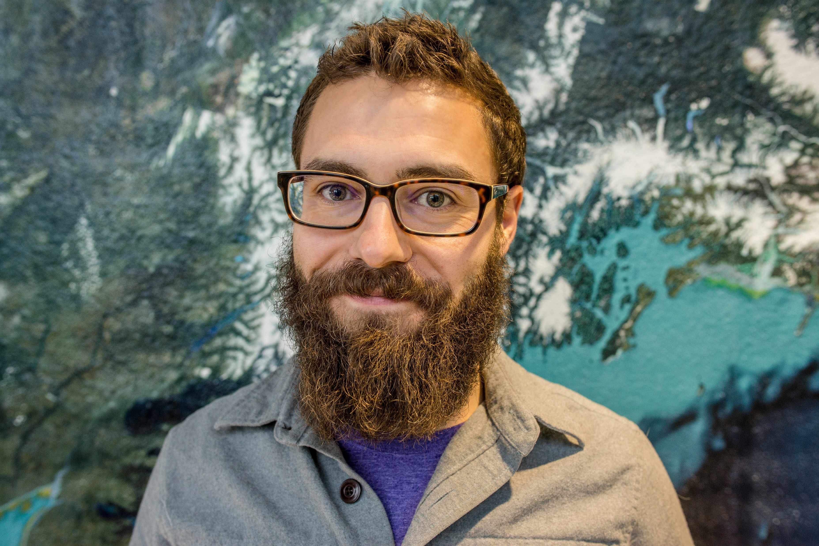
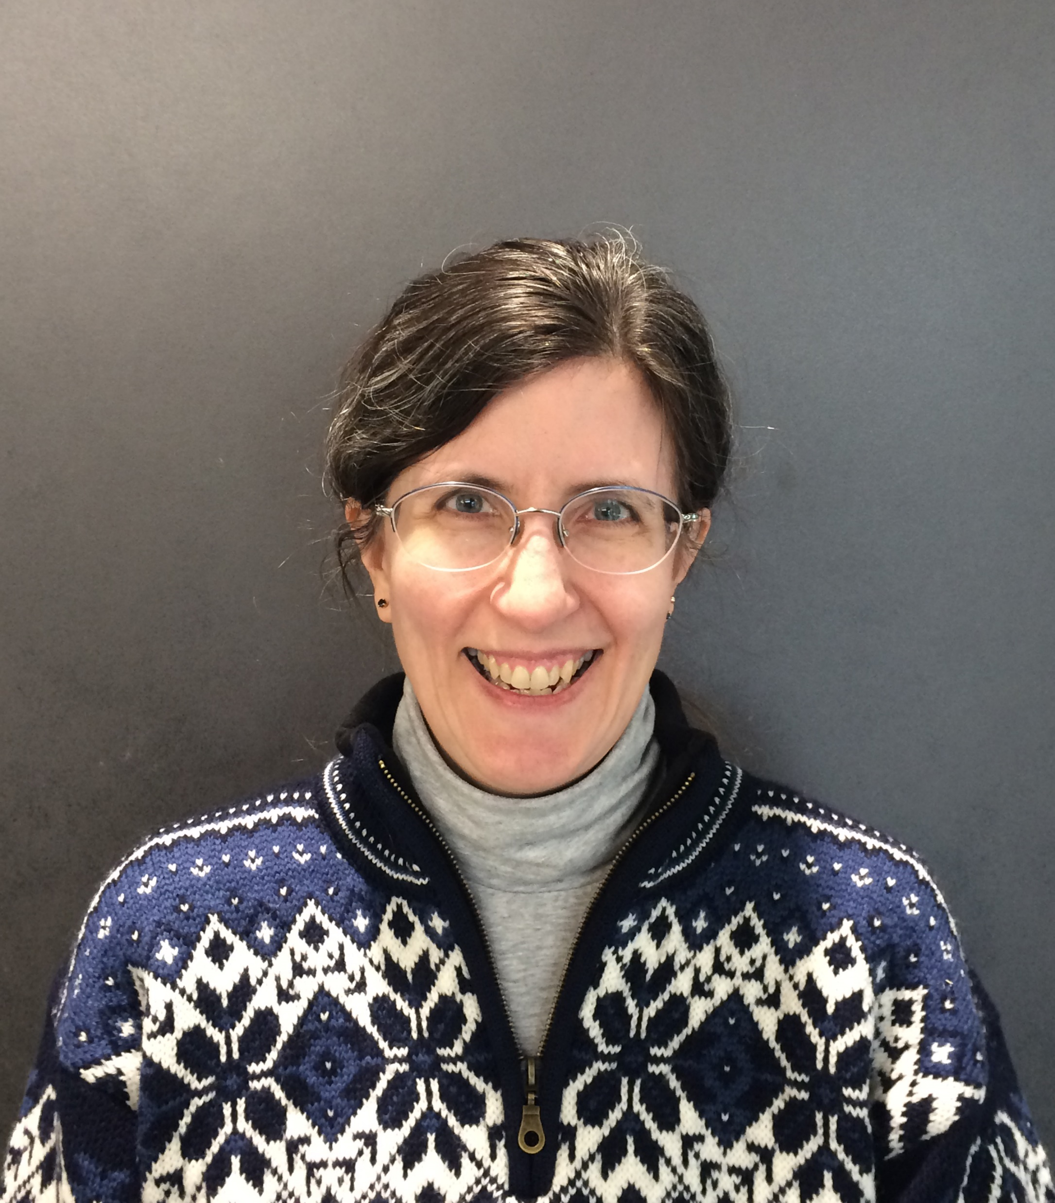

Slide 5
AK TTAP Steering Committee Members
Name | Affiliation/Region
Eric Evon | Bethel Region
Dan Breeden | Southwest Alaska
Miles Brookes | OTT/FHWA
Marina Evans | TCC/ Interior
Gerry Hope | Southeast Alaska
Scott Evans | North Slope
Yusuf Rida | Nome/Seward Penninsula
David "Jeff" Harman | BIA
Cina Fisher | AK LTAP

Slide 6
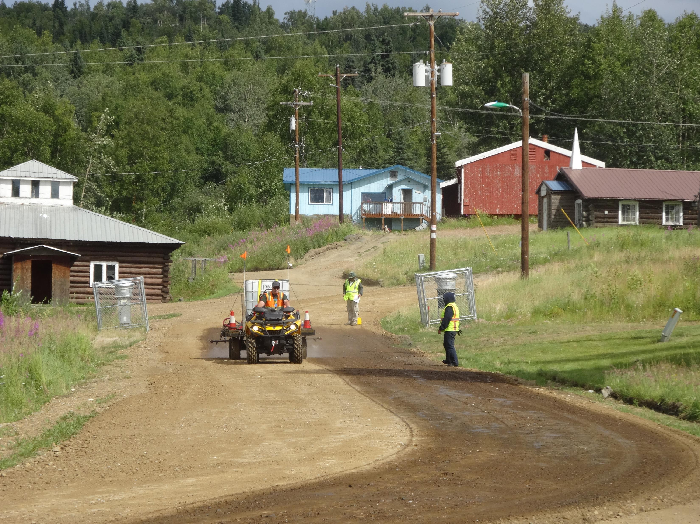
Training Partners
USDOT
FHWA
BIA
Alaska LTAP
Alaska Dept. of Labor & Workforce Development
UAF Community and Technical College
RAHI
American Traffic Safety Services Association
FEMA
AFN Navigator Training Archive
ANTHC
ATTSA
AlaskaX
UAA CTC Programs
NHI

Slide 7
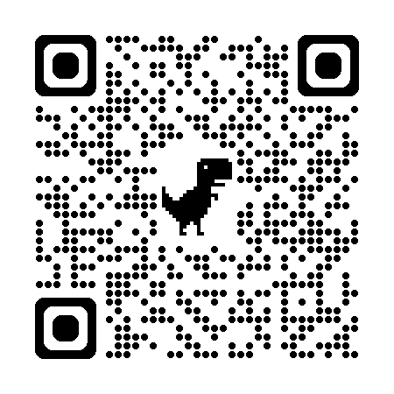
Alaska LTAP Partnership
Seats reserved for AK native villages and tribes in classes sponsored by the AK LTAP
  Seats are limited, waitlists are available by contacting AK LTAP
Create Account on the Registration System once, then able to register for any class
Classes offered in Fairbanks, Anchorage and Juneau
Upcoming classes include:
  ATSSA Traffic Control (multiple levels)
  Introduction to Project Management
  Driven Pile Foundation Inspection
https://dot.alaska.gov/ltap/

Slide 8
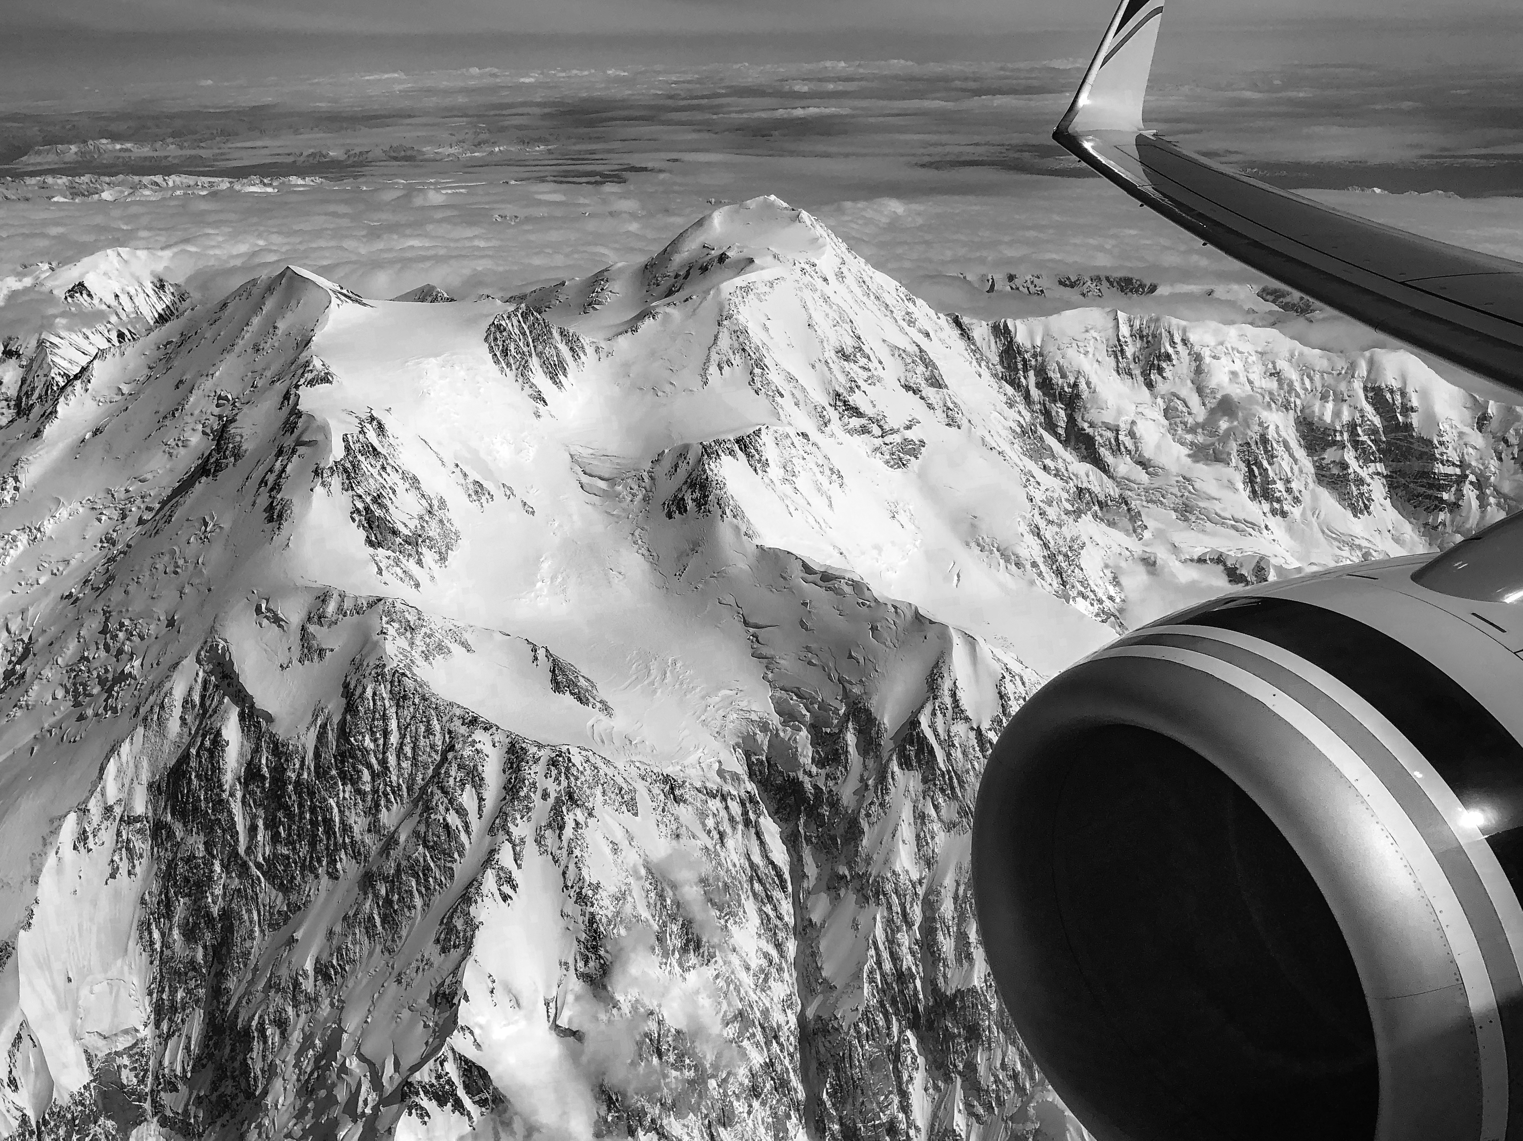
Visit us at aidc.uaf.edu/ttap
Announcements
Grant Opportunities
Training
Webinars
Resources
Partners
How to contact us

Slide 9
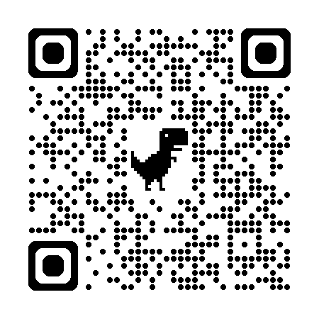
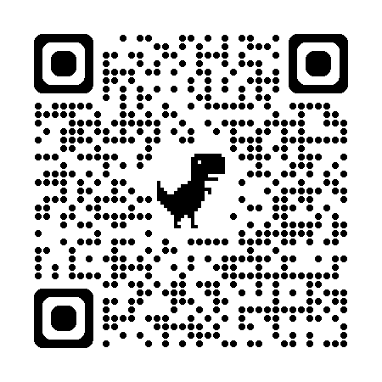
CDL Training Resources
Alaska Off-Highway Driver License and Commercial Driver License (CDL)
  Eligible if live in a community not connected to the road system
  Do not have access to DMV services
Web Resources
  Alaska DMV - https://dmv.alaska.gov/credential-services/guide-to-rural-driving-information/#cdl
  CDL Theory Training – Available online through the Ohio LTAP for free https://www.transportation.ohio.gov/programs/ltap/elearning/cdl

Slide 10
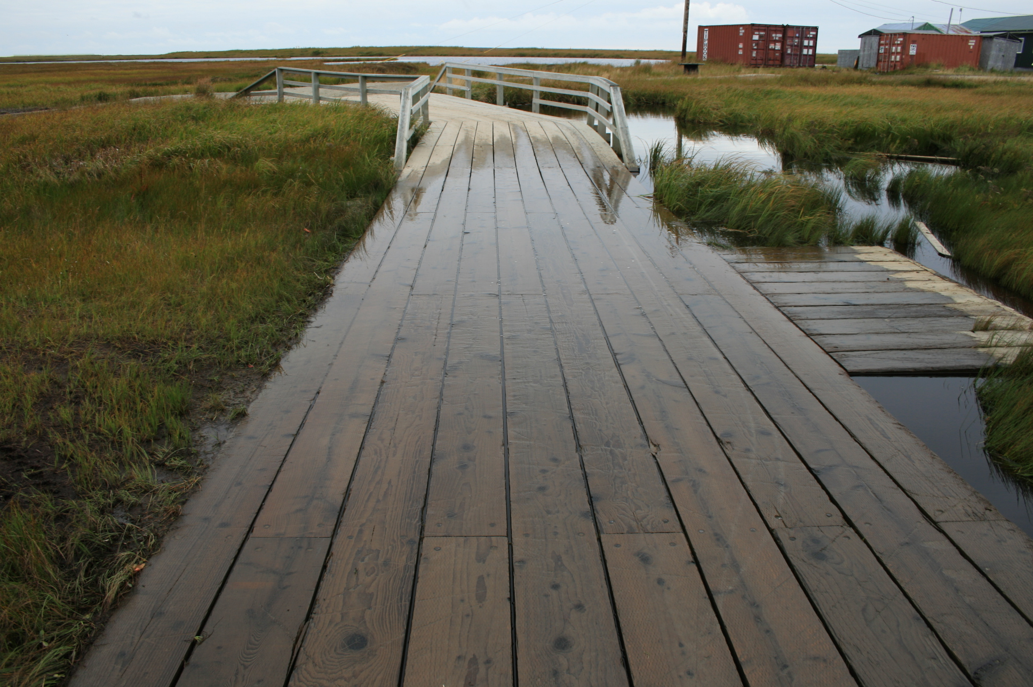
Classroom Training
Generally, in Anchorage and Fairbanks.
We are willing to provide classroom training in regional hubs
    Minimum required attendance is 10 students
Typically, one to three days
Often partnered with Alaska LTAP or other DOT&PF training
Requests for classes are welcome

Slide 11
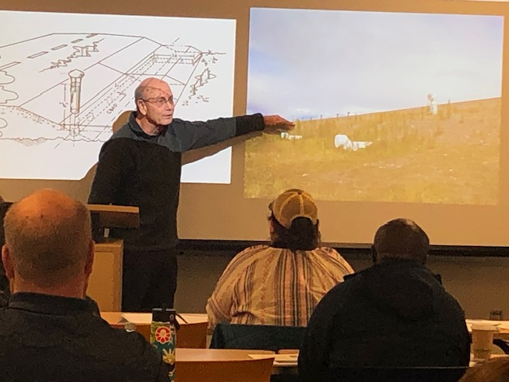
Recurring Classes
Ice Road Construction and Maintenance Class (1-day)
  Next offered August 2025 in Anchorage
Construction on Permafrost Class (1-day)
  Offered jointly with Alaska LTAP
  Next offered November 2025
Gravel Roads: Construction and Maintenance (2-day)
  Offered jointly with Alaska LTAP
  Next offered April 2025 in Anchorage and Ketchikan

Slide 12
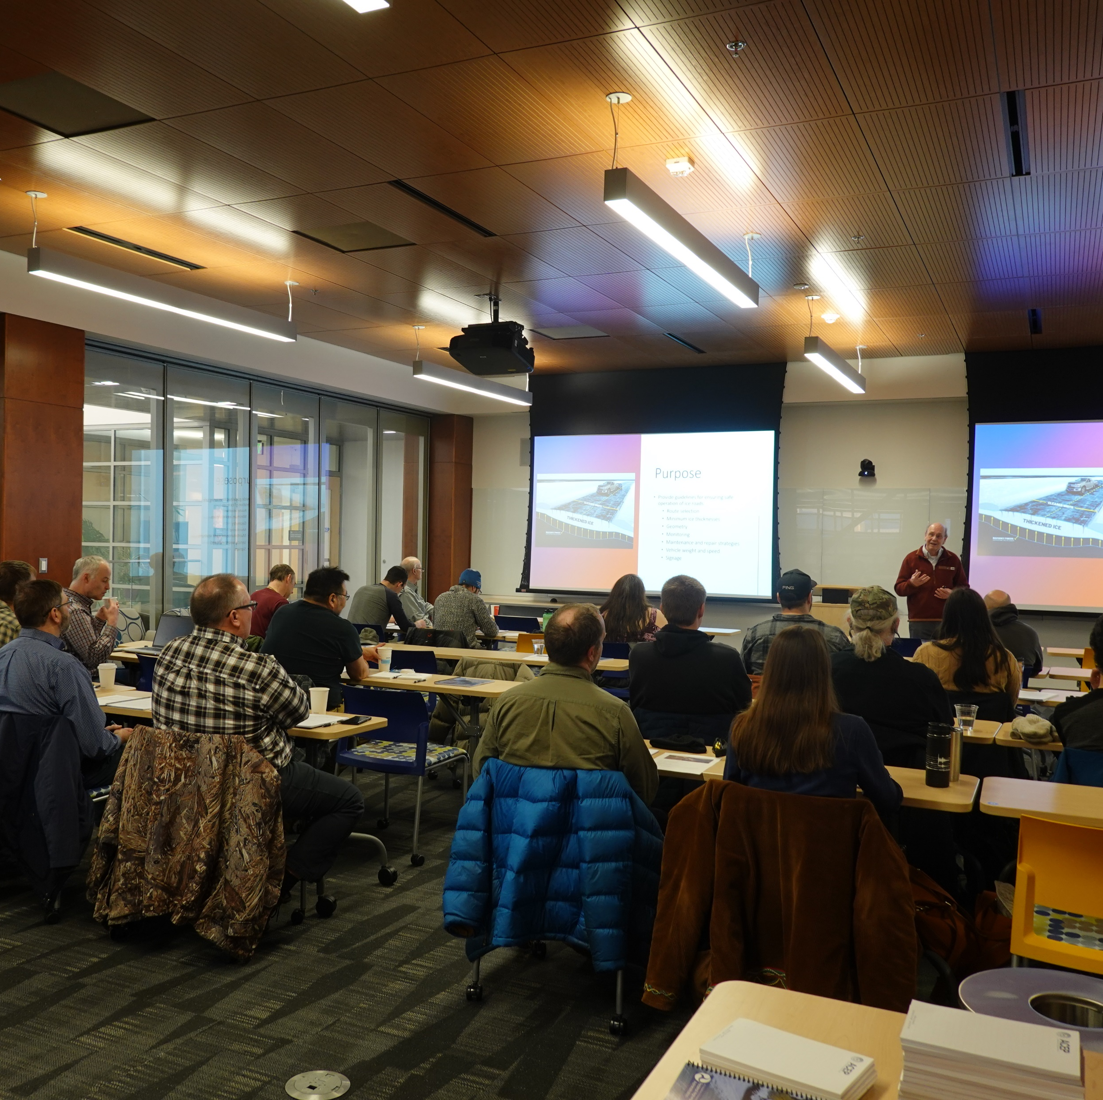
Diversity in the Classroom
Knowledge
Experience
Available Resources
Position
Location
Expectations
Networking

Slide 13
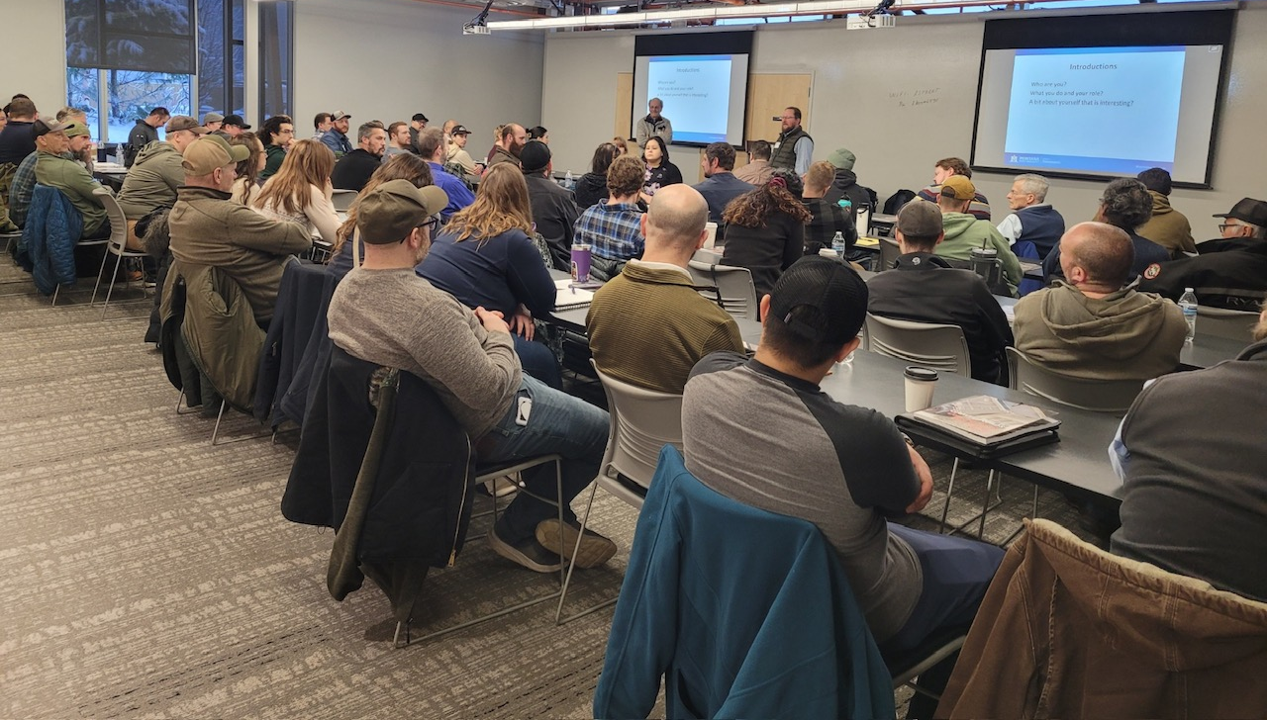

Slide 14
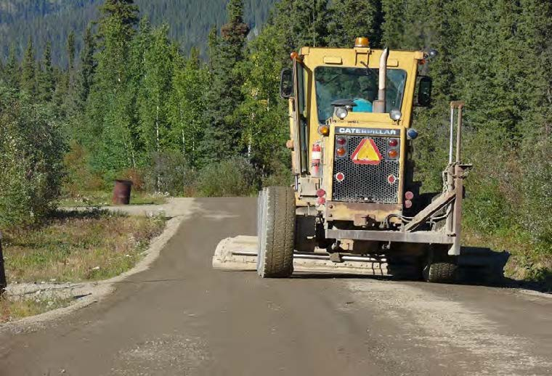
Requesting Training
Contact Vicky Wolf at
uaf-cset@alaska.edu

Slide 15
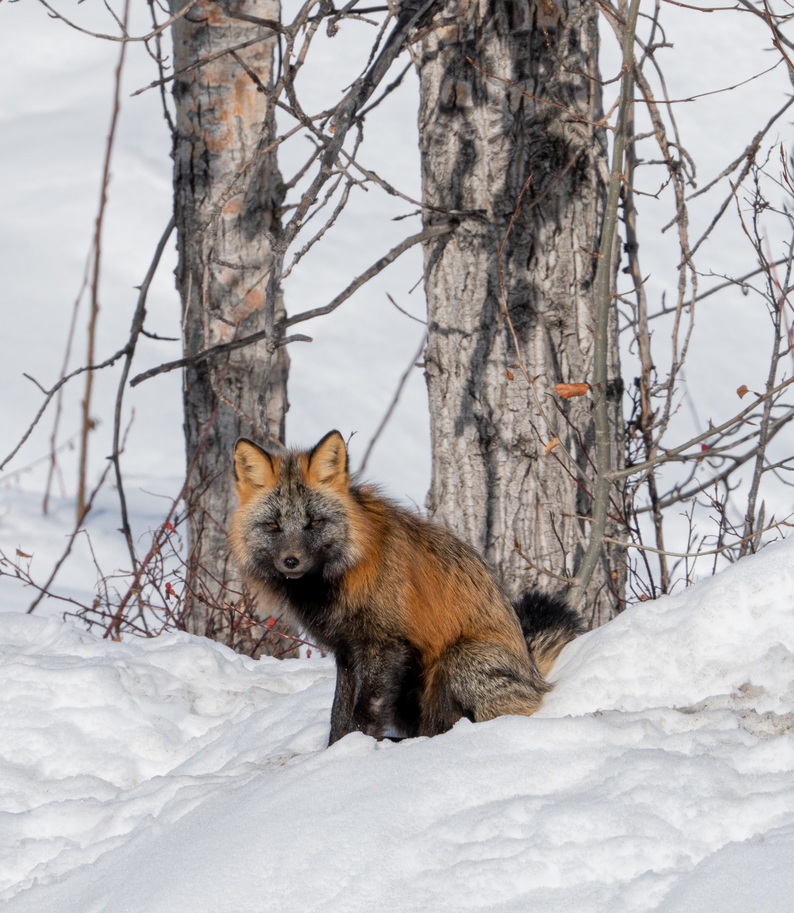
Webinars
Approximately Monthly
45 minutes to 1 hour
Past Topics include
  Dust Management
  LTRPs and TTIPs
  TTP Funding Formula
Upcoming Webinars include:
  Federal Surplus Property Process on December 11
  Drone Use in Alaska on January 23, 2025
Announced via email

Slide 16
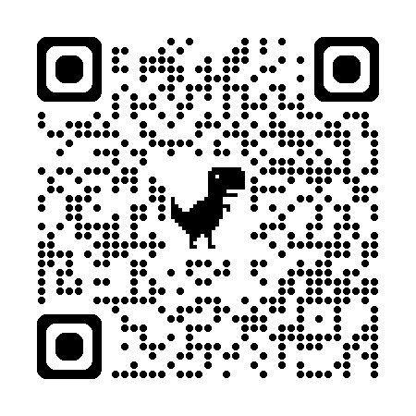
Past Webinars
Past webinars available in dedicated playlist on AIDC YouTube Channel (QR code provided)
Webinar recordings posted within a day of presentation
Links to webinars also available from the AKTTAP website https://aidc.uaf.edu/ttap/webinars/,
  If the slides from the presentation are available they can be accessed from the website.

Slide 17
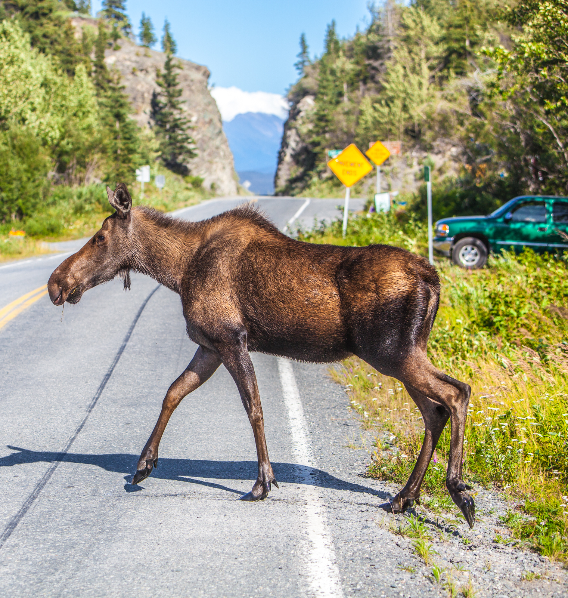
Requesting Webinars
Contact Vicky Wolf at
uaf-cset@alaska.edu

Slide 18

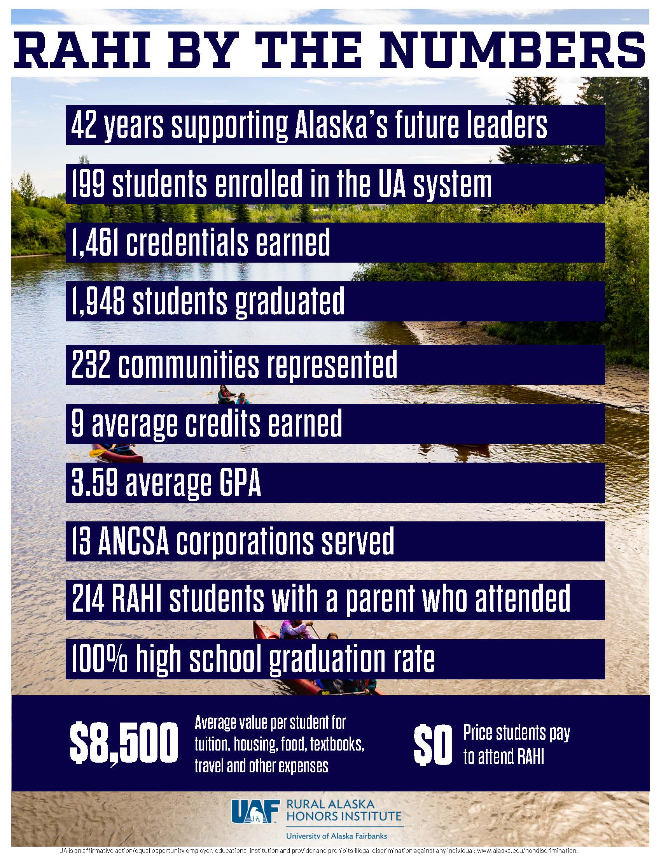

Slide 19
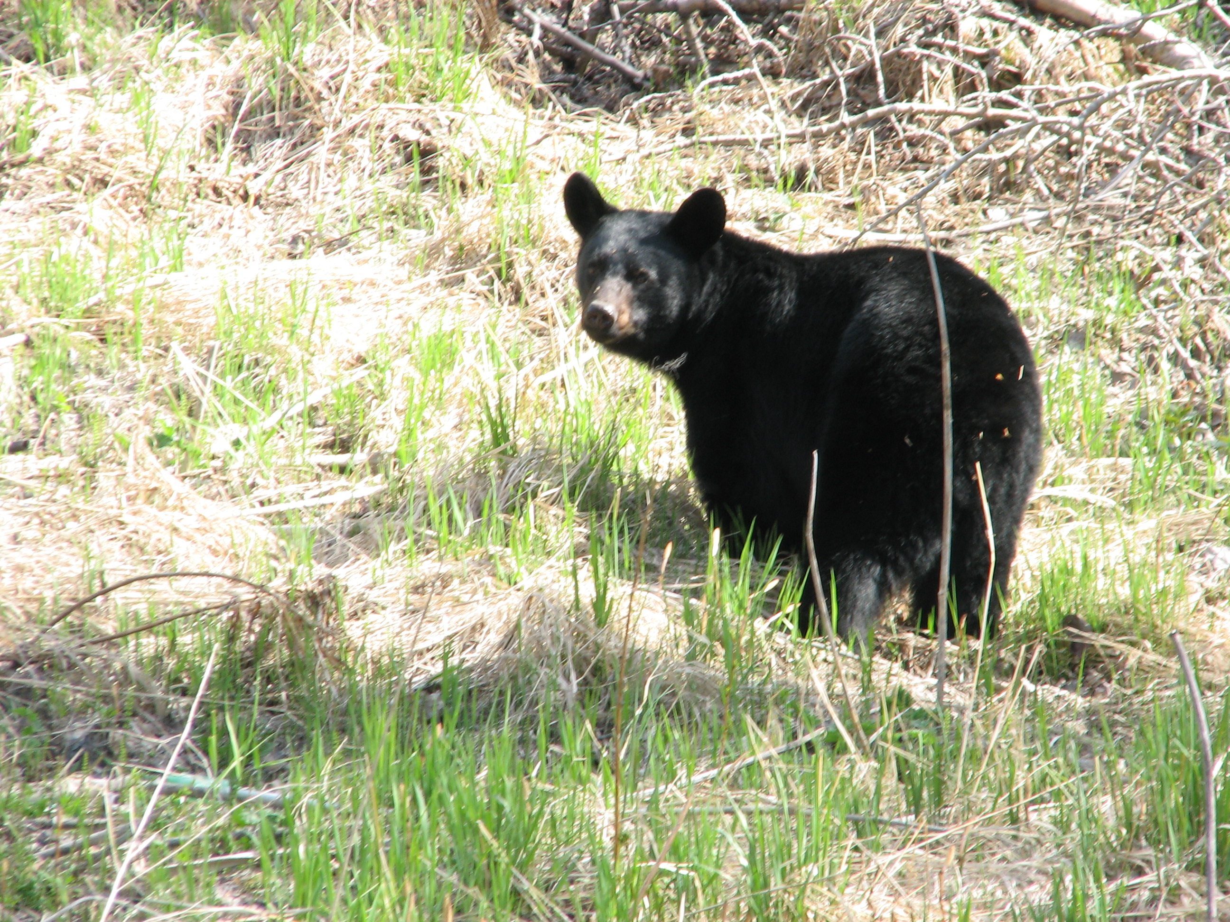
Technical Assistance
If you have need for technical assistance, ask. If we don’t have the expertise, we will connect you to that expertise.
uaf-cset@alaska.edu

Slide 20
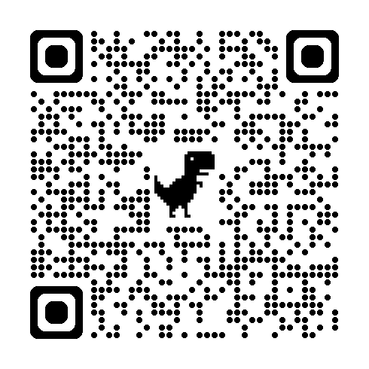
Needs Assessment Survey
Sent out annually to everyone on the email list
Used to set training priorities for the next year
Everyone welcome to submit a response

Slide 21
AKTTAP Plans
Name | Date | Type | Link/Notes
Heavy Equipment from Federal Surplus for Alaskans | December 11 | Webinar | Speaker from AK DOT
ATTWG and BBNA Meetings | March 24-28, 2025 | Meeting | Technical assistance workshop and presentations
Gravel Roads Class | April 2025 | Class | Collaboration with AK LTAP
TTP 101 | Early May | Class | Will be taught by FHWA in Anchorage
Heavy Equipment Training for HS Seniors – Pilot Program | Summer 2025 | Class | Collaboration with RAHI and CTC, proposal at FHWA for funding approval
Trail Design, Construction and Maintenance | November 2025 | Workshop | Proposal being developed
Safety Training | TBD | Webinar/ Virtual Class | 1 per quarter is the goal

Slide 22
Visit us at aidc.uaf.edu/ttap
Announcements
Grant Opportunities
Training
Webinars
Resources
Partners
How to contact us

Slide 23
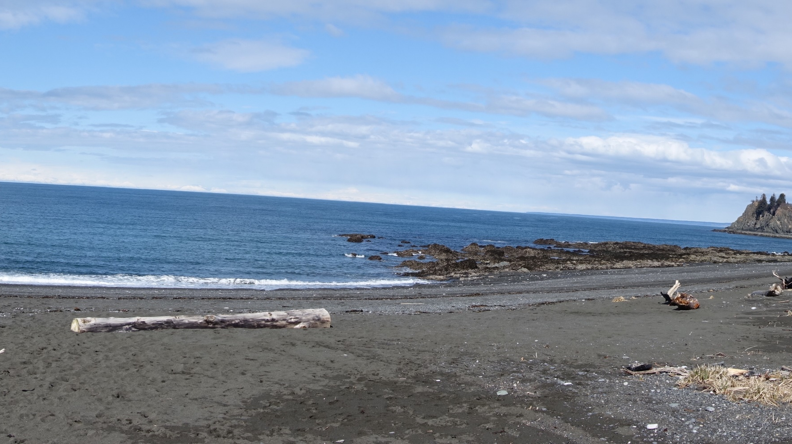
QUESTIONS?

Slide 24
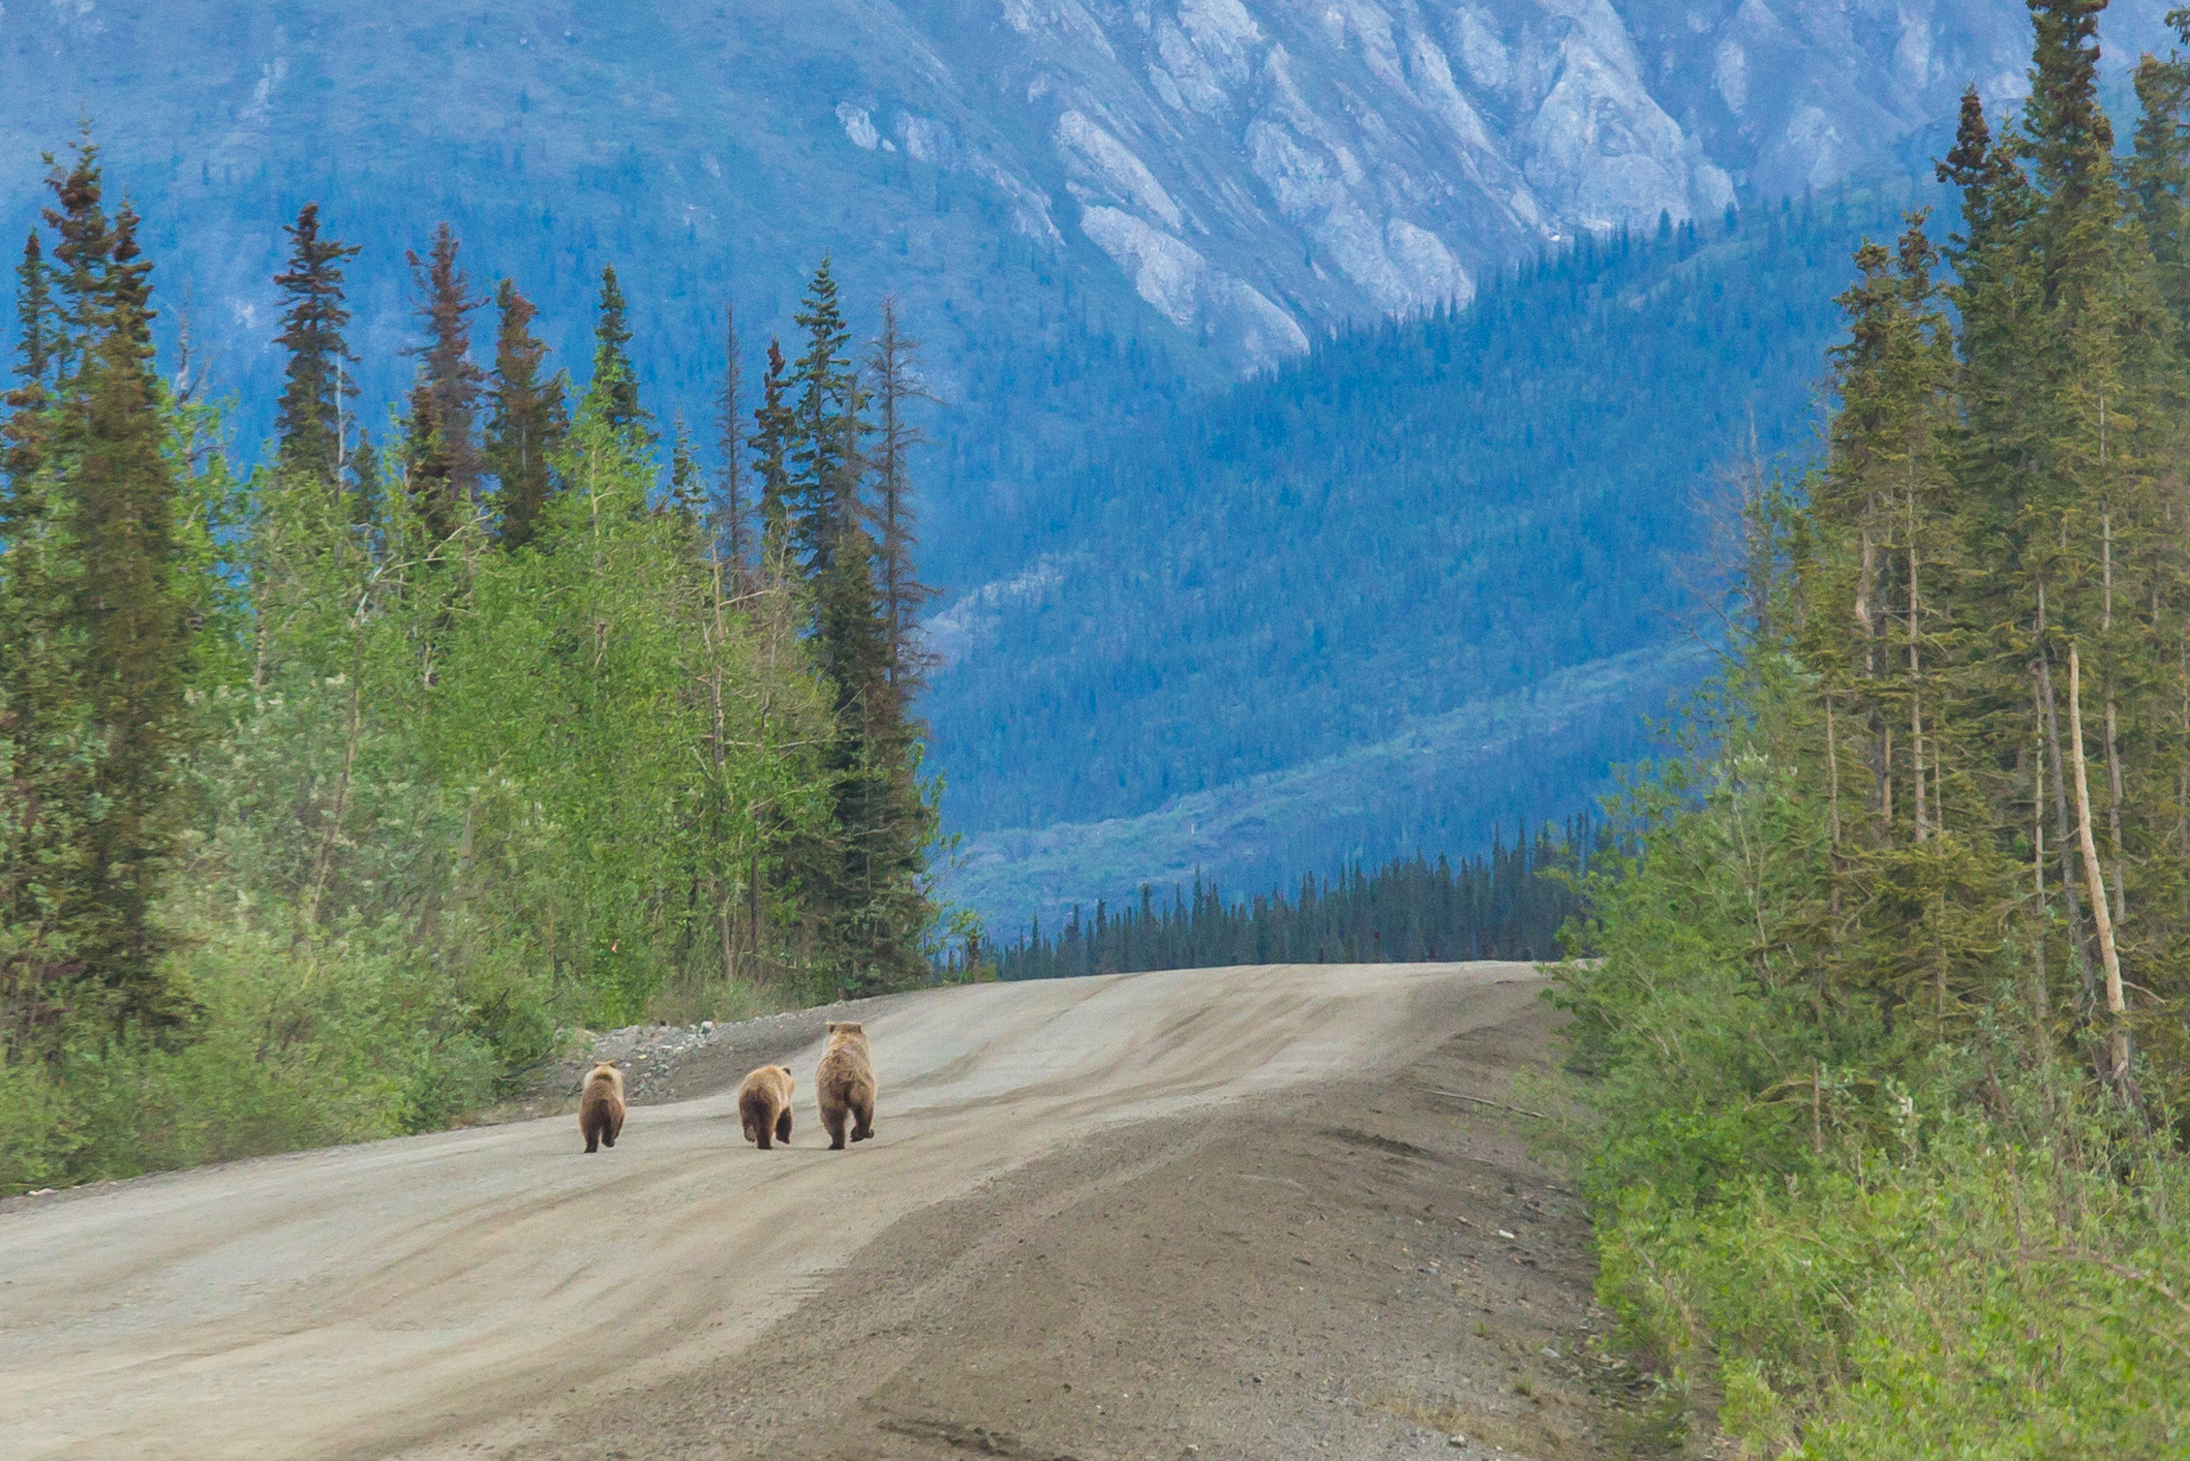
Uaf-cset@Alaska.edu https://aidc.uaf.edu/ttap

