Slide 2
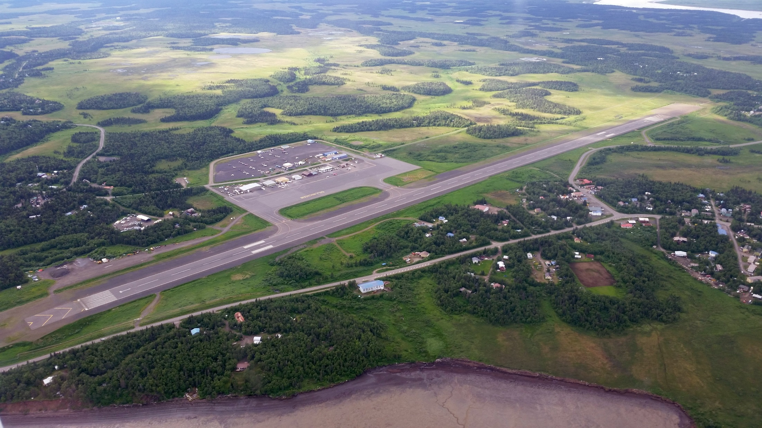

Mission Statements
Alaska DOT&PF
“Keep Alaska Moving through service
and infrastructure”
Statewide Aviation (SWA)“To sustain and improve the quality of life
throughout Alaska”
2

Slide 3
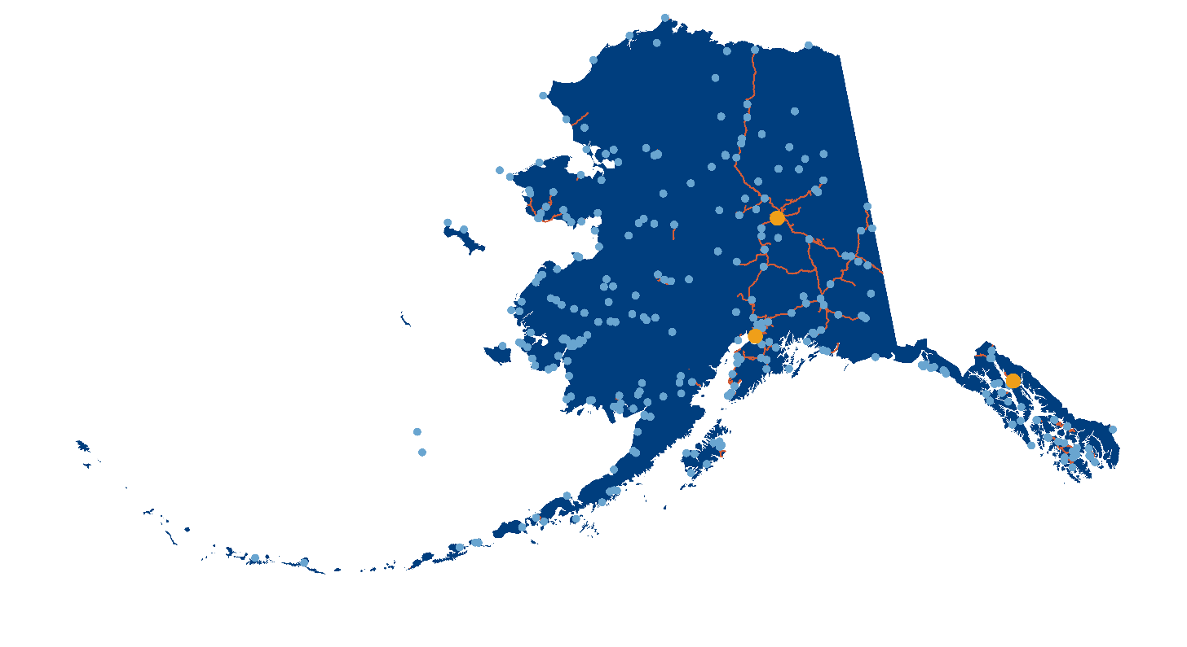
235 Rural Airports

Slide 4
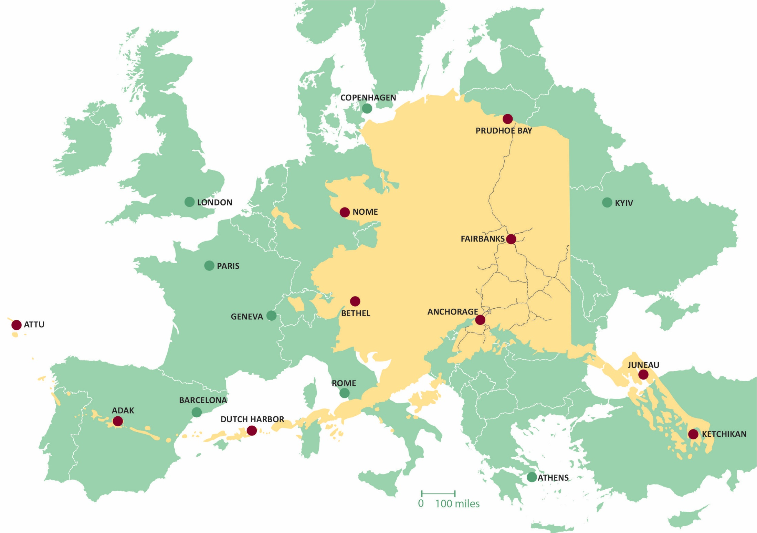
Notes:
PHOTO: Shungnak Airport, summer 2023.

Slide 5
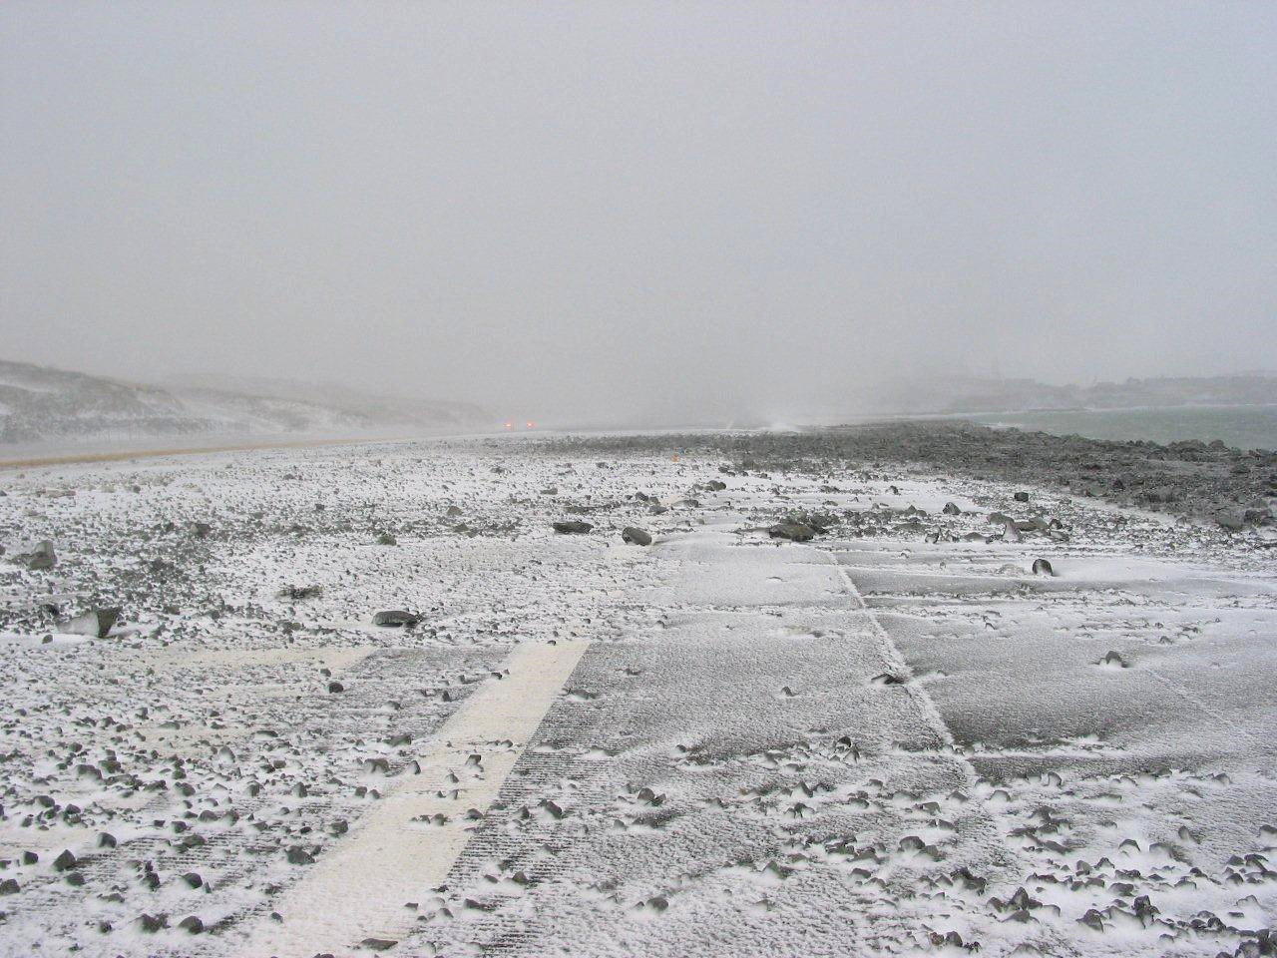
Airport Environment
Challenges
Warming climate impacting coastal erosion, precipitation patterns, airport surface stability
Increase in freezing rain / ice events
Equipment utilization is more complicated
Higher aircraft performance requirements
Solutions
Chemical / deicing programs
Weather prediction / RWS utilization (road weather stations)
Surface stabilization solutions
Notes:
Unalaska airport

Slide 6
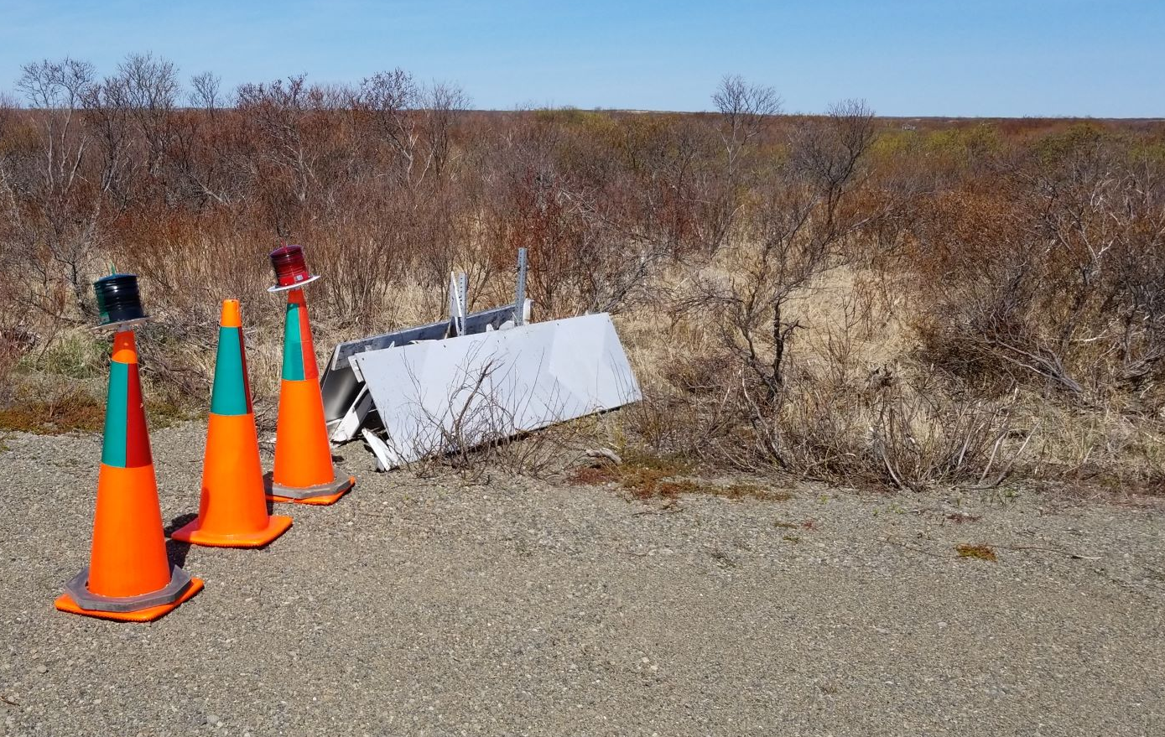
Remote Airport Lighting
Challenges
Aging lighting systems that are extremely expensive to maintain / replace
Harsh arctic climate
Damage & vandalism
Solutions
Focused airport lighting program
Electrical training for current staff
Emergency lighting systems
Training / Public outreach / communication efforts
Notes:
PHOTO:

Slide 7

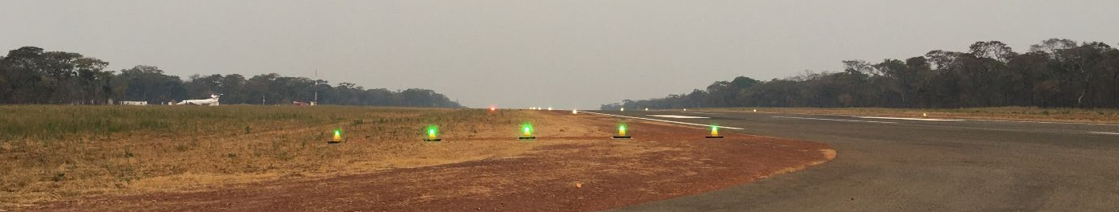
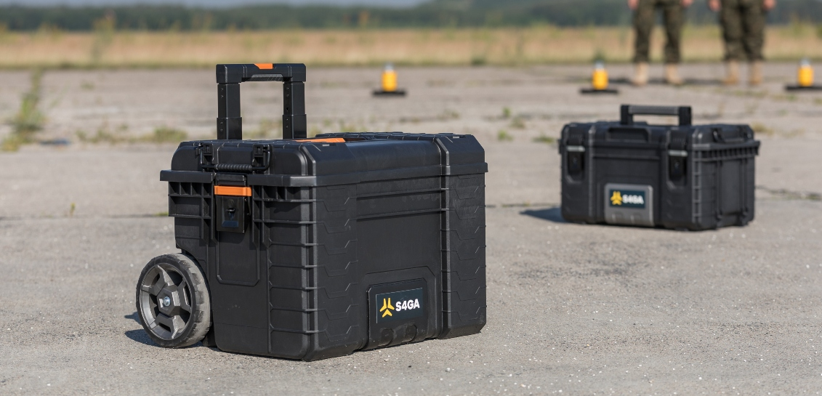
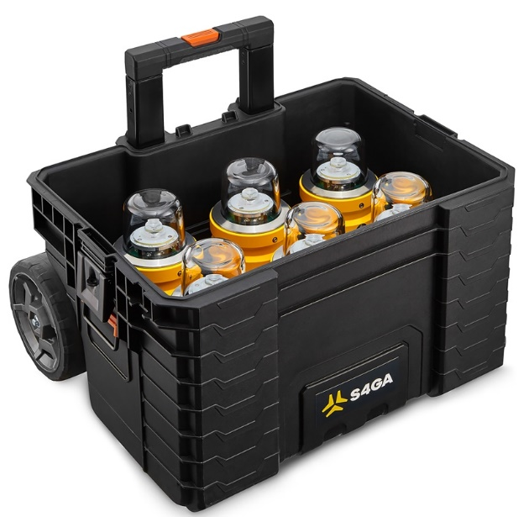
Emergency Lighting System
Cost of old system in 2007: $74,000 ( $112,000 today).
New system: $40,000 per set, excluding shipping costs.
A full set of 36 lights will cover a 3,600’ runway when placed at the maximum interval of 200’ between lights.
New system Features:
  High/Med/Low intensity, Flashing, Dusk-till dawn, IR
  15-year lifespan
  lightweight
Current plan
  Using remaining CARES funds to purchase 3-4 sets of lights
  Moving forward purchasing 1-2 sets per year
  Keep several sets in cases and build out mobile trailers for remaining sets.
  Sets of lights will be staged at strategic hubs for deployment when needed.

Slide 8

Equipment Needs
Estimated cost of all equipment currently needed = $67M
  Immediate = estimated $7.7M immediate,
  Near future = $48.3M
  Mid-term = $6.8M
  Long term = $4.6M
To prevent backlog and keep equipment in good operating condition, acquisition needs are estimated at $25M annually.

Slide 9
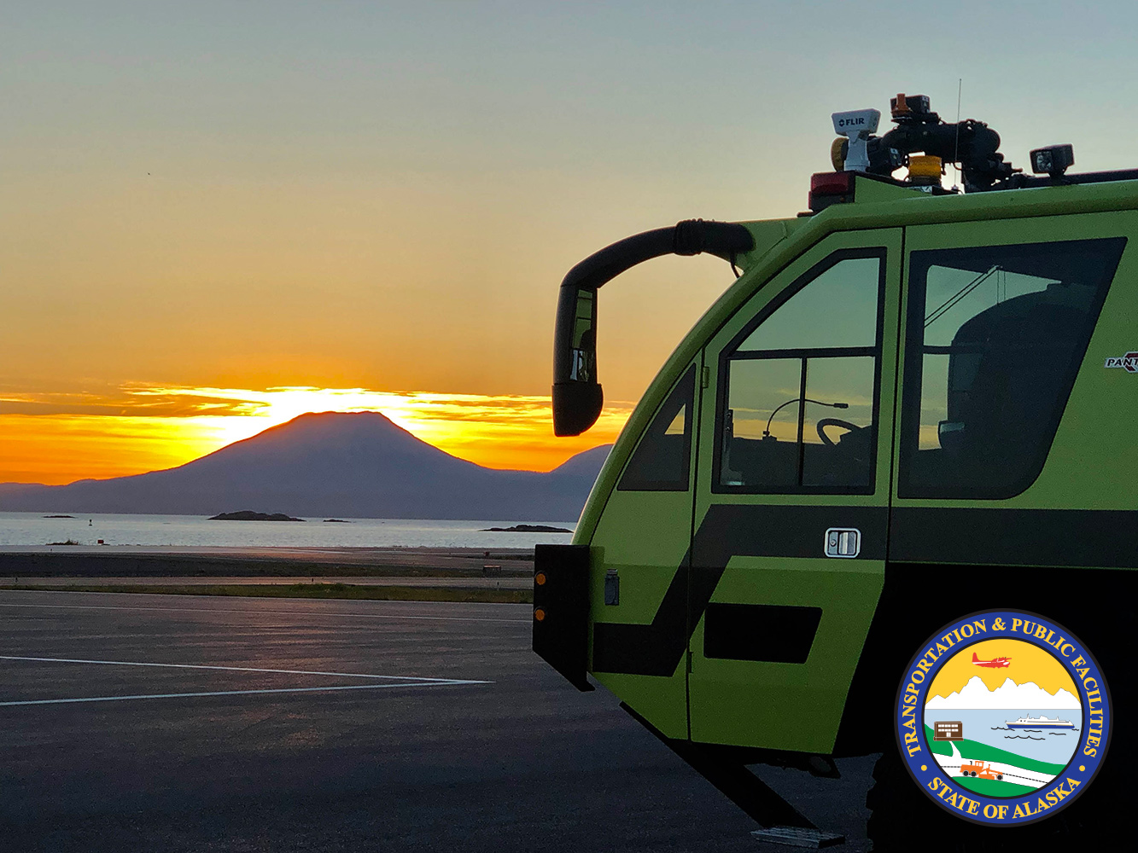
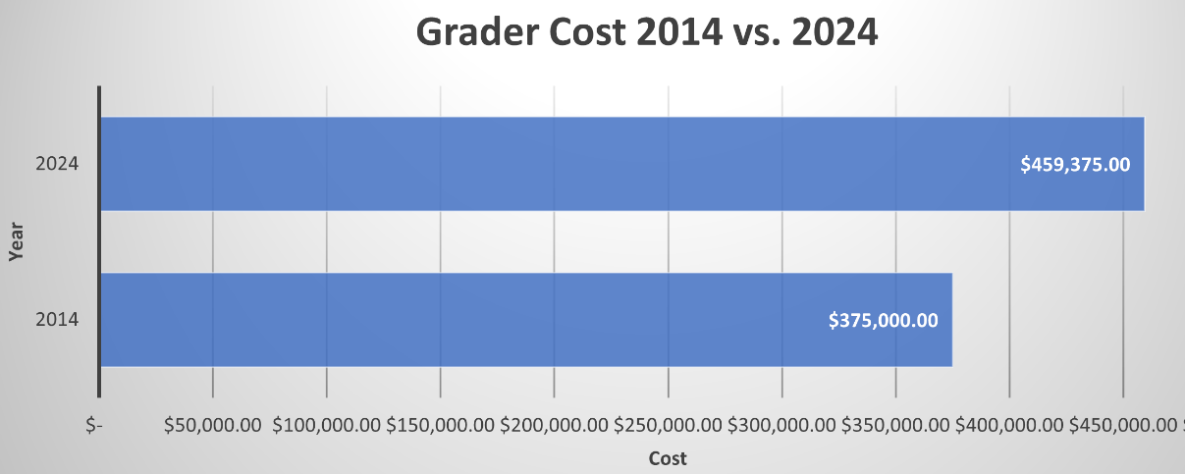
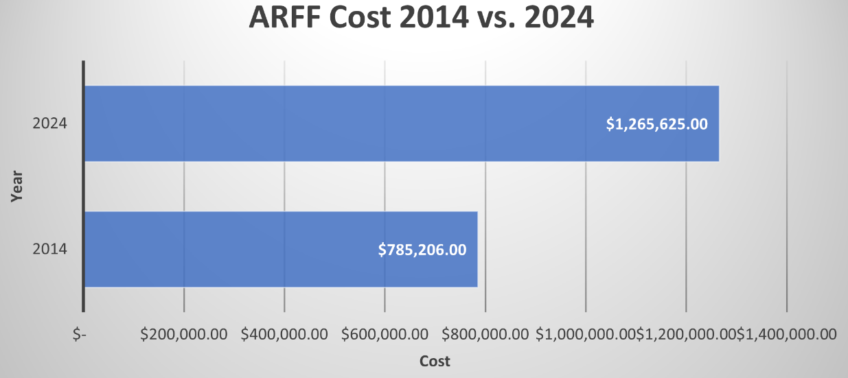
Increased Cost of Equipment/Materials
Cost of Grader
  2014: $375,000
  2024: $459,375
  A 22% increase
Cost of ARFF Truck
  2014: $785,206
  2024: $1,265,625
  A 61% increase
Cost per Metric Ton of Crushed Aggregate
  2010: $55
  2021: $93 --> This is a 69% increase!

Slide 10
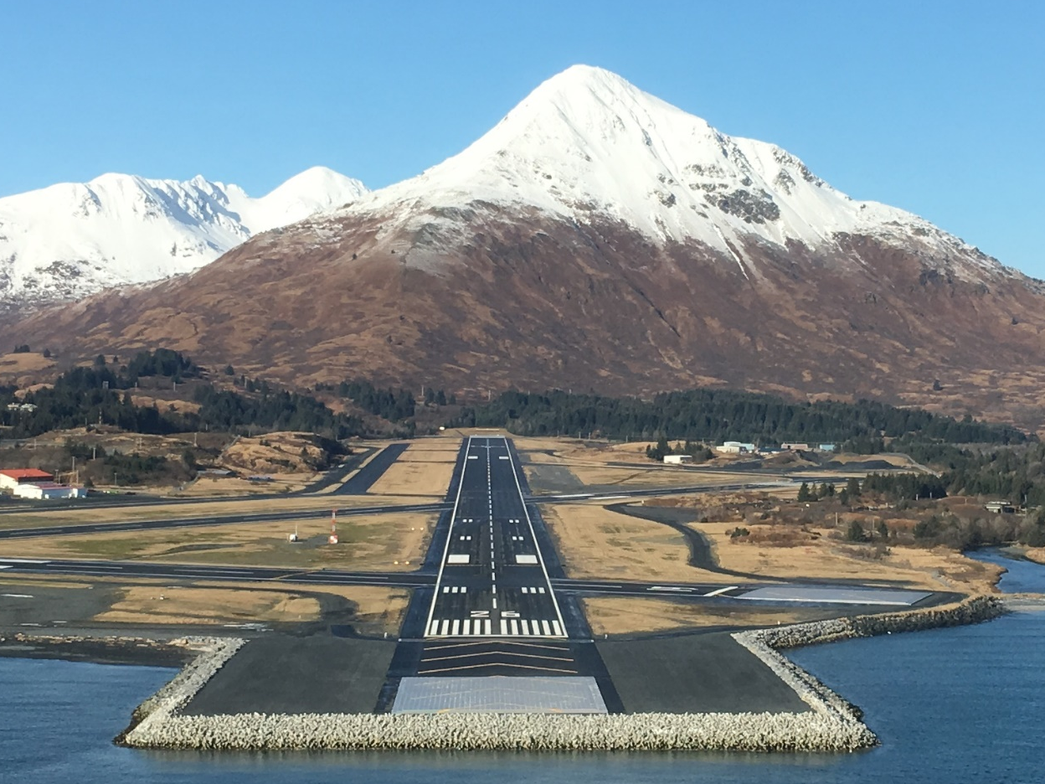
FFY2024 AIP Grant Program (Federal Portion)
AIP Program = $213,387,998
Rural airport system = 163,623,774
AIAS airport system = $49,764,224
BIL (Stimulus) = $95,607,711
Rural airport system = $81,150,918
AIAS airport system = $14,456,793

Slide 11
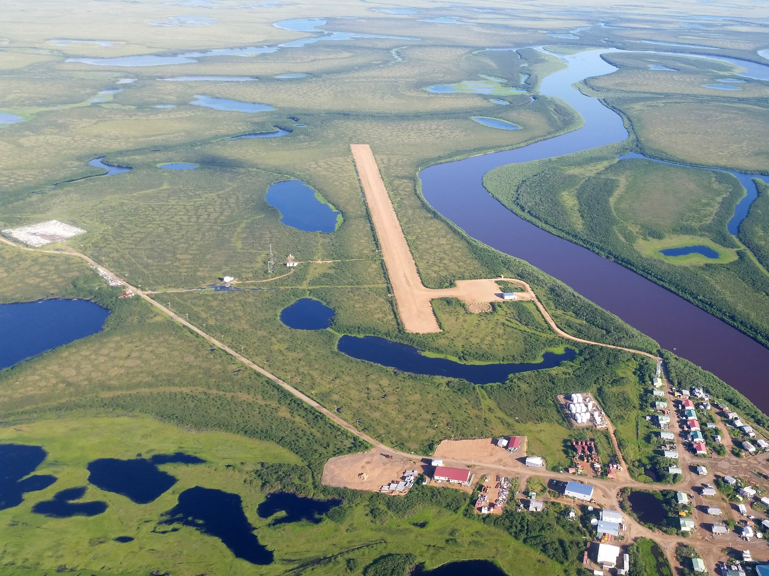
  3-Year Rural System Capital Funding
FFY 2022 AIP = ~$236.4M / BIL = $19.6M
FFY 2023 AIP = ~$172.9M / BIL = $56.4M
FFY 2024 AIP = ~$163.6M / BIL = $81.1M
Notes:
PHOTO: Take off at Homer Airport. Photo by Valerie Gomez, Alaska DOT&PF
State Apportionment at $22.6 M and AK Supplemental at $21.3 M are relatively constant and are available for all airports in the state. The variability in funding to DOT&PF results from the funding FAA assigns to Municipal Sponsor projects each year from these funding types.

Slide 12

FAA Reauthorization
Sec. 317. GAO Study on Expansion of the FAA Weather Camera Program
  Evaluates the impact of FAA weather cameras, widely used in Alaska, on improving safety and operations.
Sec. 332. ASOS/AWOS service report dashboards
  This section requires the FAA and the Administrator of the National Oceanic and Atmospheric Administration (NOAA) to work in collaboration to collect the real-time service status of all automated surface observation systems (ASOS) and automated weather observing systems
  (AWOS). The FAA shall make available on a public website certain status information, including the service status of ASOS/AWOS, information on action to repair ASOS/AWOS, and any outages of ASOS/AWOS.
Sec. 342. Don Young Alaska Aviation Safety Initiative
  This section renames the FAA Alaska Aviation Safety Initiative as the “Don Young Alaska Aviation Safety Initiative” and sets forth objectives to work cooperatively with aviation stakeholders towards the goal of reducing the rate of fatal aircraft accidents by 90 percent from 2019-2033 and eliminating fatal accidents of commercial aircraft by 2033 in Alaska, Hawaii, and the territories of the United States. Furthermore, the section designates the Regional Administrator for the Alaskan Region of the Administration to serve as the Director of the Initiative and requires the Director to build upon the existing activities under the Initiative.
  This section also directs the FAA to ensure installation and operation of automated weather reporting systems and the reliability and availability of information from those systems. Further, it directs the FAA to deploy visual weather observation systems and continue to assess the state of weather camera systems. Additionally, this section requires the FAA to identify and implement reasonable mitigations to improve maintenance of FAA-owned weather observing systems that experience frequent service outages. This section also requires the FAA to encourage and incentivize equipage of automatic dependent surveillance broadcast out equipment on commercial aircraft operating in the covered locations.
  This section also requires the FAA to submit to Congress an annual report on the Initiative, including an itemized description of how the FAA budget meets the goals of the Initiative. Furthermore, it requires GAO to conduct a study on Alaska aviation safety, including the effectiveness of the Initiative to improve safety, service and infrastructure and identify challenges within the FAA to accomplishing safety improvements.
  Finally, this section prohibits the FAA from restricting funding from being used at an airport in Alaska to rehabilitate, resurface, or reconstruct the full length and width of an existing runway. This section also allows the Administrator to consider hiring locally for safety critical FAA position in the covered locations if the Administrator has determined there are unique circumstances affecting the ability to hire for those positions. It also directs the FAA to take such actions as may be necessary to implement NTSB recommendations A-22-25 and A-22-26, in coordination with various Alaska stakeholders.
Sec. 564. Essential air service in parts of Alaska
  This section requires DOT, in consultation with the appropriate State authority of Alaska, to review all domestic points in the State of Alaska that were deleted from carrier certificates between July 1, 196 8, and October 24, 1978, and that were not subsequently determined to be an eligible place prior to January 1, 1982, as a result of being unpopulated at that time due to destruction during the 1964 earthquake and its resultant tidal wave, to determine whether such points have been resettled or relocated and should be designated as an eligible place entitled to receive a determination of the level of essential air service supported, if necessary, with Federal funds.
Notes:
These were the most relevant so figured I would add them all, we can narrow this down.
Alaska
Sec. 318. Development of low-cost voluntary ADS-B
This section requires the FAA, working with aviation stakeholders with technical expertise, to develop a report regarding the development of a portable, low-cost position reporting system for voluntary use in airspace not mandated for Automatic Dependent Surveillance-Broadcast Out equipment and use under part 91.
Sec. 604. Updating United States Government’s share of project costs
This section increases the Federal share to 95% for medium hub, small hub, nonhub, and nonprimary airports located in States containing unappropriated and unreserved public lands and nontaxable Indian lands (individual and tribal) of more than 5 percent of the total area of all lands in the State.
It increases the Federal share to 95% for small hub, nonhub, and nonprimary airports located in economically distressed communities, regardless of whether the airport is receiving essential air service.
For fiscal years 2024 through 2026, this section increases the Federal share to 95% for all nonhub and nonprimary airports.

Slide 13
FAA Reauthorization
Sec. 605. FAA contract tower workforce audit
  This section directs the DOT IG to conduct an audit of the workforce needs for the FAA Contract Tower Program. The audit will review contract tower staffing levels and examine efforts to establish an air traffic controller training program or curriculum for initial technical and on-the-job training for these controllers, among other considerations. This section requires the DOT IG to submit a report on the results of the audit to Congress, and further requires the FAA to implement any relevant recommendations.
Sec. 620. Contract Tower Program
  This section requires DOT/FAA to coordinate with air traffic control contractors to create air traffic controller training programs and shall incorporate the use of such programs into new contracts, or the exercise of future options entered under the Contract Tower Program and the Cost-share Program. This section authorizes approved air traffic control contractors under the program to provide initial training to trainees who do not have a Control Tower Operator certificate or FAA tower credential and provide training to certain controllers who have completed an approved Air Traffic-Collegiate Training Initiative (AT-CTI) program from an accredited school that has a demonstrated successful curriculum.
Sec. 731. Runway Infrastructure
  This section requires FAA to not restrict funding to resurface the full length of an existing runway within the State of Alaska based solely on reduced current or forecast aeronautical activity levels or critical design type standards; to review requests for runway rehabilitation or reconstruction projects at airports on a case-by-case basis within 60 days; and to not reject requests for projects with critical community needs, such as projects in rural communities and villages off the road system, or economic development projects to expand a runway to meet new demands.
Sec. 733. AIP handbook review
  This section requires FAA, in consultation with the Governor of Alaska, to identify reasonable exceptions to the AIP Handbook to be implemented by FAA to meet unique regional circumstances and advance the safety needs of airports in Alaska.
Sec. 767. PFAS- related resources for airports
  This section establishes a formula grant program with a 100-percent Federal share to reimburse airports for the reasonable and appropriate costs associated with: a one-time acquisition of fluorine-free firefighting alternatives; disposal of PFAS-containing AFFF products; cleaning or disposal of existing equipment to facilitate the transition to an acceptable fluorine-free agent; any equipment or components necessary to facilitate the transition; and replacement of ARFF equipment as determined necessary by FAA. This section authorizes appropriations of $350,000,000 to carry out this program.
Notes:
These were the most relevant so figured I would add them all, we can narrow this down.
Alaska
Sec. 318. Development of low-cost voluntary ADS-B
This section requires the FAA, working with aviation stakeholders with technical expertise, to develop a report regarding the development of a portable, low-cost position reporting system for voluntary use in airspace not mandated for Automatic Dependent Surveillance-Broadcast Out equipment and use under part 91.
Sec. 604. Updating United States Government’s share of project costs
This section increases the Federal share to 95% for medium hub, small hub, nonhub, and nonprimary airports located in States containing unappropriated and unreserved public lands and nontaxable Indian lands (individual and tribal) of more than 5 percent of the total area of all lands in the State.
It increases the Federal share to 95% for small hub, nonhub, and nonprimary airports located in economically distressed communities, regardless of whether the airport is receiving essential air service.
For fiscal years 2024 through 2026, this section increases the Federal share to 95% for all nonhub and nonprimary airports.

Slide 14
FAA Reauthorization
FAA 5100-142 (2/7/24)
The State of Alaska was mentioned 68 times.
Sponsor Request for FAA Acknowledgment for Cold Weather Early Start
  Airport sponsors and/or their representatives use this form to request FAA acknowledgment to issue a Notice to Proceed prior to a grant award. To use this form, the airport must be in an area that experiences a shortened construction season due to climactic conditions.
  Sec. 332 ASOS/AWOS service report dashboard
    The FAA will make a real time public dashboard to provide the current status of weather instruments.

Slide 15
FAA Reauthorization
Sec 342 Started at the FAA Alaska Aviation Safety Initiative and is now the Don Young Alaska Safety Initiative (DYASI)
  Reduce the rate of fatal accidents by 90% by 2033
  Install weather instruments and develop alternatives
  Report annually to Congress on the DYASI progress
  This section prohibits the FAA from restricting funding from being used at an airport in Alaska to rehabilitate, resurface or reconstruct the full length and width of an existing runway.

Slide 16
FAA Reauthorization
AIP Handbook review
The AIP Handbook was adopted in 2014 and has had several changes since then that has resulted in restrictions in AIP eligibility absent a public process.
Sec. 733 requires the FAA to update the AIP handbook to account for legislative changes to the program and for the unique circumstances in Alaska. It also requires the FAA to release a draft handbook for public comment.

Slide 17
FAA Reauthorization Sec 733
SEC. 733. AIP HANDBOOK UPDATE.
(a) IN GENERAL.—Not later than 3 years after the date of enactment of this Act, the Administrator shall revise the Airport Improvement Program Handbook (FAA Order 5100.38D) (in this section referred to as the ‘‘AIP Handbook’’) to account for legislative changes to the airport improvement program under subchapter I of chapter 471 and chapter 475 of title 49, United States Code, and to make such other changes as the Administrator determines necessary.
(b) REQUIREMENTS RELATING TO ALASKA.—In revising the AIP Handbook under subsection (a) (and in any 656 MUR24377 T19 S.L.C. subsequent revision), the Administrator, in consultation with the Governor of Alaska, shall identify and incorporate reasonable exceptions to the general requirements of the AIP Handbook to meet the unique circumstances, and advance the safety needs, of airports in Alaska, including with respect to the following:
(1) Snow Removal Equipment Building size and configuration.
(2) Expansion of lease areas.
(3) Shared governmental use of airport equipment and facilities in remote locations.
(4) Ensuring the resurfacing or reconstruction of legacy runways to support—
(A) aircraft necessary to support critical health needs of a community;
(B) remote fuel deliveries; and
(C) firefighting response.
(5) The use of runway end identifier lights at airports in Alaska.

Slide 18
Shared use of Airport Equipment
Requirements for Shared Use of Airport Equipment
a. Eligibility and Applicability Airport Eligibility: This exemption applies exclusively to airports located off the contiguous road system where no practical alternative for heavy equipment is available to local tribal governments or villages. Equipment Eligible for Shared Use: Only airport-owned rolling stock equipment necessary for maintaining the airport's operational safety and efficiency may be considered for shared use. The equipment’s primary purpose must remain dedicated to airport operations.
b. Conditions for Shared Use Primary Airport Use: The shared use of equipment must not interfere with the primary airport operations. Airport operations must take precedence, and equipment should be promptly available for airport use as needed. Approval and Documentation: All shared use must be pre-approved by the Airport District Office (ADO). Airport sponsors must maintain detailed records of each use, including duration, purpose, and the extent of the equipment's use by the local tribe or village. Geographical Limitations: The equipment must remain within the airport premises or the immediate community unless otherwise expressly approved by the ADO. Equipment should not be transported off the premises without such approval.
c. Cost Recovery and Maintenance Cost-Sharing Arrangements: Airport sponsors are encouraged to establish cost-sharing arrangements with local tribal governments or villages. These arrangements may include reimbursement for costs associated with equipment use, including wear and tear, fuel, and operator time. Maintenance Responsibilities: Airport sponsors are responsible for maintaining equipment according to FAA standards. If additional maintenance is required due to non-airport use, the local tribe or village must reimburse these costs.
d. Restrictions and Agreements Written Agreements: A formal written agreement outlining the terms of use, cost recovery, and responsibilities must be established between the airport sponsor and the local tribe or village. This agreement must be submitted to and approved by the ADO before the commencement of any shared use. Prohibited Uses: The equipment may not be used for activities that could compromise its availability or readiness for airport use, nor for activities that are beyond the immediate needs of the local community as defined in the agreement.
e. Reporting and Compliance Annual Reporting: The airport sponsor must submit an annual report to the ADO detailing the shared use activities, including equipment maintenance records and cost recovery activities. Compliance Monitoring: The ADO reserves the right to audit shared use activities and records to ensure compliance with FAA standards and policies.
f. Non-Compliance and Revocation Failure to adhere to these provisions may result in the revocation of the shared use privileges and may require the airport sponsor to reimburse the FAA for any costs deemed inappropriate or unauthorized.
X-XX. Exemption for Shared Use of Airport Equipment
This section outlines the provisions under which airports located off the road system can allow shared use of airport equipment with local communities. These provisions are applicable to airport-owned rolling stock equipment, such as graders, front-end loaders, and snow removal equipment, particularly in remote areas where such equipment represents the only available heavy machinery.

Slide 19
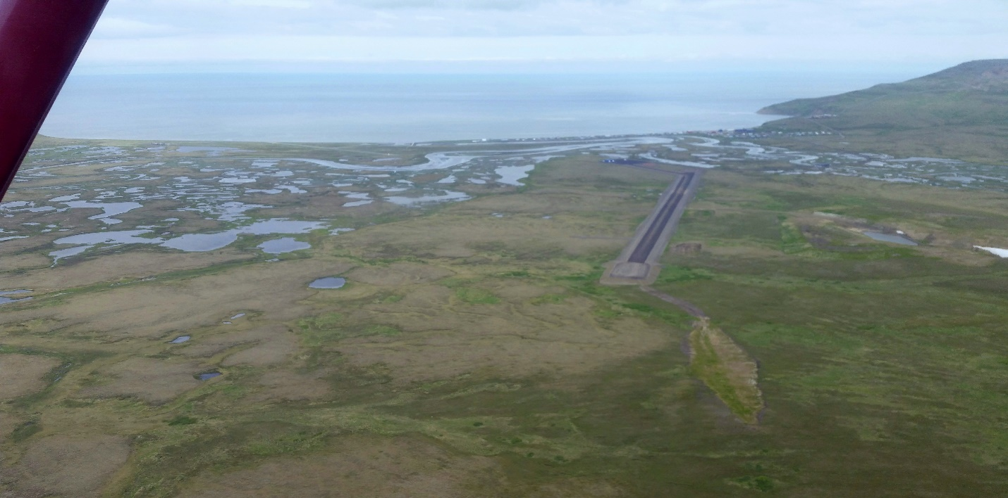
Airport Access Roads
Access Road Definition and Policy Inconsistency: The FAA's AIP Handbook lacks a clear definition of "access roads," particularly differentiating between rural and urban access needs. Current references and policies, like FAA Order 6940.1, are outdated or inconsistent with contemporary guidance.
Exclusivity Requirement for Airport Traffic: Current FAA guidelines mandate that access roads must serve exclusively airport traffic. Mixed-use situations, such as driveways or roads connecting off-airport properties, render the access road segments ineligible for AIP funding. Roads or driveways leading to non-aeronautical areas, such as residential housing or non-airport facilities, are explicitly prohibited from being funded under the AIP, limiting the flexibility for rural communities to integrate airport access roads into broader community infrastructure.
Impact on Funding Eligibility: Allowing incidental public use of access roads (e.g., driveways or boardwalks branching off) jeopardizes future AIP funding eligibility for road maintenance, deterring sponsors like DOT&PF from supporting community-driven infrastructure expansions
Notes:
Tununak Airport

Slide 20
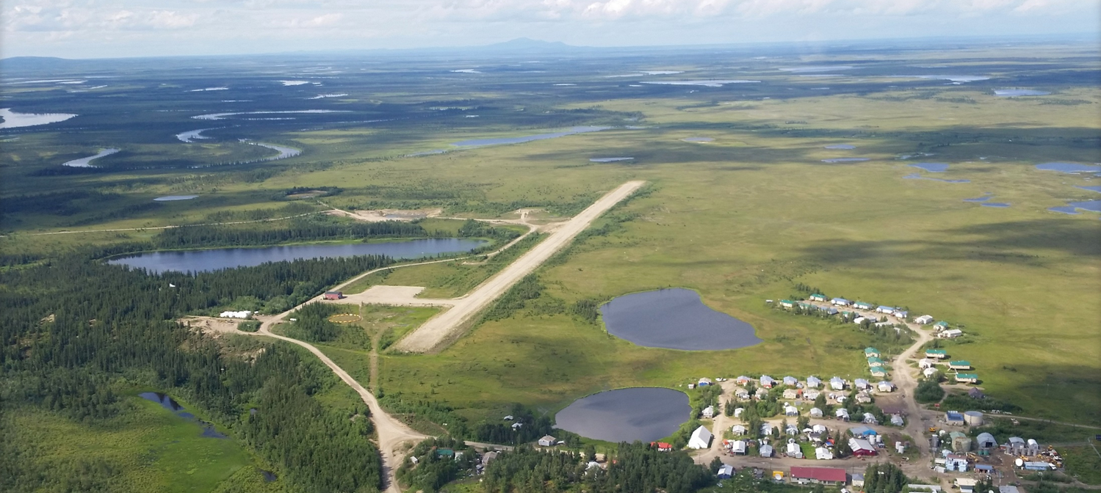
Airport Access Roads
DOT&PF believes that all residents of communities off the road system should be seen as airport users.
DOT&PF is requesting revisions to the AIP Handbook in an effort to support rural Alaskan community needs to expand onto constructible land, utilizing their limited financial resources, consistent with the Justice40 Initiative. Minor changes and exemptions in Table A-1, C-2, and P3, that would bring the AIP Handbook language into compliance with 2024 Reauthorization Language and R-PGL 19-03, would make this possible. Additionally, allowing this minor public use of airport property would encourage local public support for their airport, consistent with FAA Order 5190.6B, Change 3, for Airport Compliance.

Slide 21
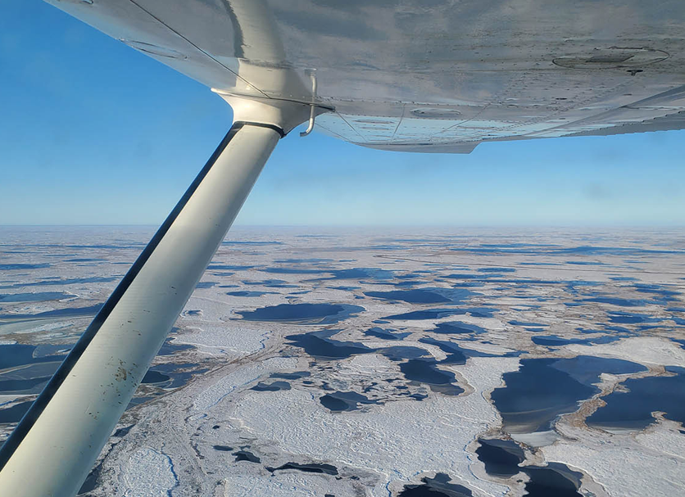
Thank you. Questions?
Andrew Warner
Aviation Policy Planner
Statewide Aviation
907-269-0730
Andrew.warner@alaska.gov
Notes:
PHOTO: Aerial view leaving Kipnuk, and heading to Bethel at an altitude of 1500ft. Kipnuk Airport Rehabilitation Project. October 2022. By Ryan Bailey, Alaska DOT&PF

