Slide 1
FHWA Tribal Transportation
Program (TTP) Update
Rachel LeVee, Field Operations Manager
FHWA - Office of Tribal Transportation
December 3, 2024

Slide 2
Today’s Topics
FHWA Office of Tribal Transportation (OTT) Overview
TTP BIL Funding
TTP Safety Program
TTF Bridge Program
TTP High Priority Projects
Discretionary Grants Administration
Tribal Transportation Funding Opportunities
Planning & Consultation Updates
Tribal Transportation Assistance Program (TTAP)
Notes:
Good morning and so glad to be here to share the latest updates for OTT.

Slide 3
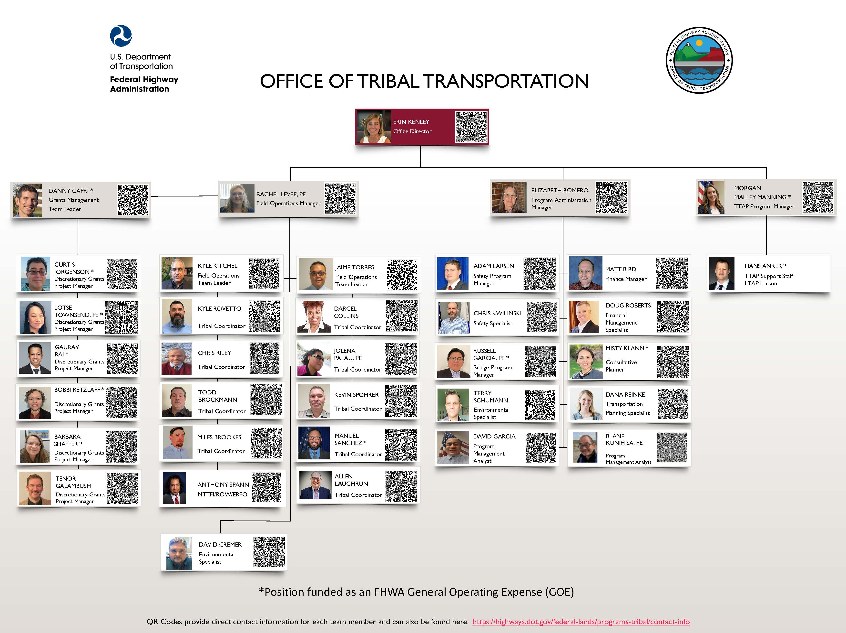
Notes:
Finally, here is our current org chart which illustrates the growth of our program adding TTAP and our new Discretionary Grants Team. We are fully staffed! Rachel Levee is our newest staff member leading the Field Operations Team. She has taken over the reins from Brian Allen, who recently retired, loving life in Idaho with his family.

Slide 4
Tribal Transportation Program – BIL*
TTP Funding
  FY22 $578,460,000 (Contract Authority)
  FY23 $589,960,000 (Contract Authority)
  FY24 $602,460,000 (Contract Authority)
  + $150,000,000 Appropriations Increase
  FY25 $612,960,000 (Contract Authority)
  FY26 $627,960,000 (Contract Authority)
Total: $3,011,800,000 + $150,000,000
*Also known as the Infrastructure Investment and Jobs Act (IIJA)

Slide 5
Tribal Transportation Program Safety Fund
BIL
  4% set-aside (Approximately $21 M available)
FY24
  About $20M awarded.
  Low participation; 90% of applications were funded

Slide 6




Tribal Transportation Program Safety Fund
  About $21M available
  Applications to be accepted October 1, 2024 – January 15, 2025
Adam.Larsen@dot.gov
Safety Program Manager

Slide 7
Safe Streets and Roads for All (SS4A)
$1-billion / year
Safety Planning, Demonstration, and Implementation
Check “SS4A Safety Action Plan” requirements checklist to see if your existing plan needs any update to qualify for implementation.
Details on 2025 SS4A expected in late winter or early spring
2022-2024 Tribes have been less than 1% of applicants
TTP and TTPSF may be the non-federal match.
https://www.transportation.gov/grants/SS4A

Slide 8
Tribal Transportation Facility Bridge Program (TTFBP) Funds in FY 2025
Bridge Formula Program (BFP):
$165M
(General Fund)
Bridge Investment Program (BIP):
$20M
(General Fund)
Bridge Investment Program (BIP):
$22M
(Highway Trust Fund)
Russell.Garcia@dot.gov
Bridge Program Manager
Notes:
Under BIL, no longer a set-aside from TTP but still administered through TTP, OTT and BIA.
In 2024 we have over 200M available from the 3 funding sources

Slide 9
TTBFP Applications FY22-25
FY22-24 Total of 303 applications funded at $268.5M
FHWA Tribes – 191 applications funded at $180.9M
DOT Self Governance Tribe – 13 applications at $12.5M
BIA Tribes – 99 applications funded at $75.1M
Preliminary Engineering (PE) – 195 applications funded
Construction (CN) – 108 applications funded
FY25 Total of 18 applications funded to date at $37.4M
FHWA Tribes – 14 applications at $18.9M
DOT Self Governance Tribe – 3 applications at $6.2M
BIA Tribes – 1 applications at $12.3M
Preliminary Engineering (PE) – 15 applications funded
Construction (CN) – 3 applications funded
Notes:
Total applications funded to date = 303 applications, including additional funding requests
Total TTFBP funds obligated (all from General Fund) = $268.5

Slide 10
FY22-25 TTFBP Funds
Total TTFBP funds obligated to date - $305.9M
  FY22 BFP Funds from General Fund - $165M fully obligated
  FY22 BIP Funds from General Fund - $20M fully obligated
  FY23 BFP Funds from General Fund - $120.9M fully obligated
Total unobligated TTFBP funds to date - $503M+/-
  FY23 BFP Funds from General Fund - $44.1M unobligated
  FY23 BIP Funds from General Fund - $20M unobligated
  FY24 BFP Funds from General Fund - $165M unobligated
  FY24 BIP Funds from General Fund - $20M unobligated
  FY25 BFP Funds from General Fund - $165M unobligated
  FY25 BIP Funds from General Fund - $20M unobligated
  FY22-FY25 BIP from Highway Trust Fund - $68.8M+/- unobligated
Notes:
Total TTFBP funds obligated (all from General Fund) = $268.5
Total unobligated TTFBP funds to date = $335M +/-

Slide 11
What is the Tribal HPP Program?
Key Messages
Priority Program only for Tribes when:
  funding received under the TTP is insufficient to complete the highest priority project; or
  any Indian Tribe that has an emergency or disaster occur on a tribal transportation facility
Modeled after IRRHPP
$9M annual set-aside ($30M authorized yet not received to date in the President’s annual budget)
$1M limitation on funding request
Up to 100% Federal Share
Blane.Kunihisa@dot.gov
Tribal HPP Program Manager
Notes:
HPP - PS&E or Construction only
$750,000
The Tribal HPP Program is a nationwide priority program for:
An Indian Tribe or governmental subdivision of an Indian Tribe whose annual allocation of TTP funds is insufficient to complete the highest priority project; or
Any Indian Tribe that has an emergency or disaster with respect to a transportation facility included on the NTTFI.
In addition to the $9,000,000 set aside, there is authorized to be appropriated $30,000,000 out of the general fund of the Treasury for each fiscal years 2022 through 2026, if Congress passes this funding in their legislation.
“Insufficient to complete the highest priority project” means that only Tribes receiving less than
$1,000,000 in annual allocation of statutory formula Tribal shares through the TTP may apply
for a priority project.

Slide 12
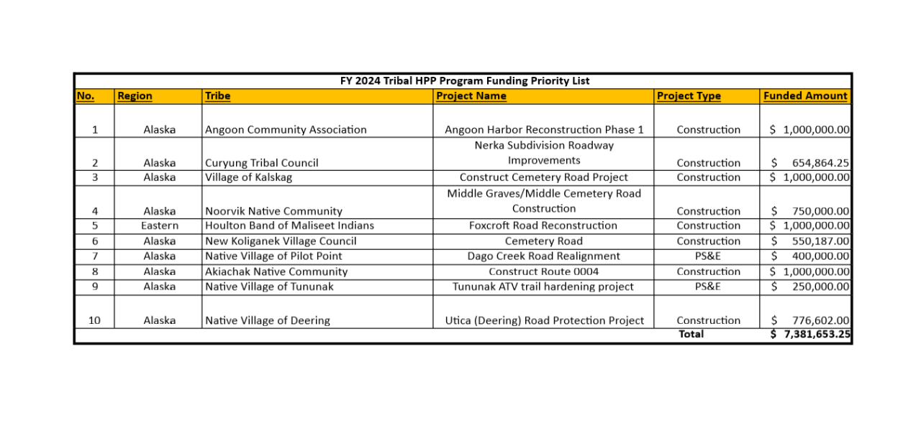
FY 2024 Tribal HPP Program Funding Priority List
Notes:
Latest FY24 Funding was awarded to 10 projects 8 Construction and 2 PE
FY22-23 is also available on our website.

Slide 13
FY 2025 Tribal HPP Program Timeline
October 2024 – kickoff webinar for FY 2025 Funding (recorded webinar and additional application information can be found at https://highways.dot.gov/federal-lands/programs-tribal/high-priority-projects
January 31, 2025 – application deadline for FY 2025 Funding
End of April 2025 – Final Funding Priority List developed
Mid-May 2025 – Earliest distribution of funds if project is on an FHWA-approved TTIP
https://highways.dot.gov/federal-lands/programs-tribal/high-priority-projects
Outreach
Notes:
This slide illustrates the latest HPP Program Timeline for FY25 starting October 1.

Slide 14
Discretionary Grants Administration:
Administered by the OTT Discretionary Grants Management Team
Aid in the following tasks:
  Grant Agreement Development
  Reporting Requirements
  Review and Approval of reimbursement requests
  Project Stewardship and Oversight
  Info on COMPETITIVE GRANT PROGRAMS
  https://www.fhwa.dot.gov/bipartisan-infrastructure-law/grant_programs.cfm
Danny.Capri@dot.gov
Grants Management Team Leader
Notes:
Discretionary Grants Management Team (DGMT) is responsible for the full range of technical, policy, and administrative obligations related to development and delivery of FHWA discretionary grant projects awarded to Tribes. The DGMT serves as the liaison between the Tribes and the discretionary grant program offices administering the program award.

Slide 15
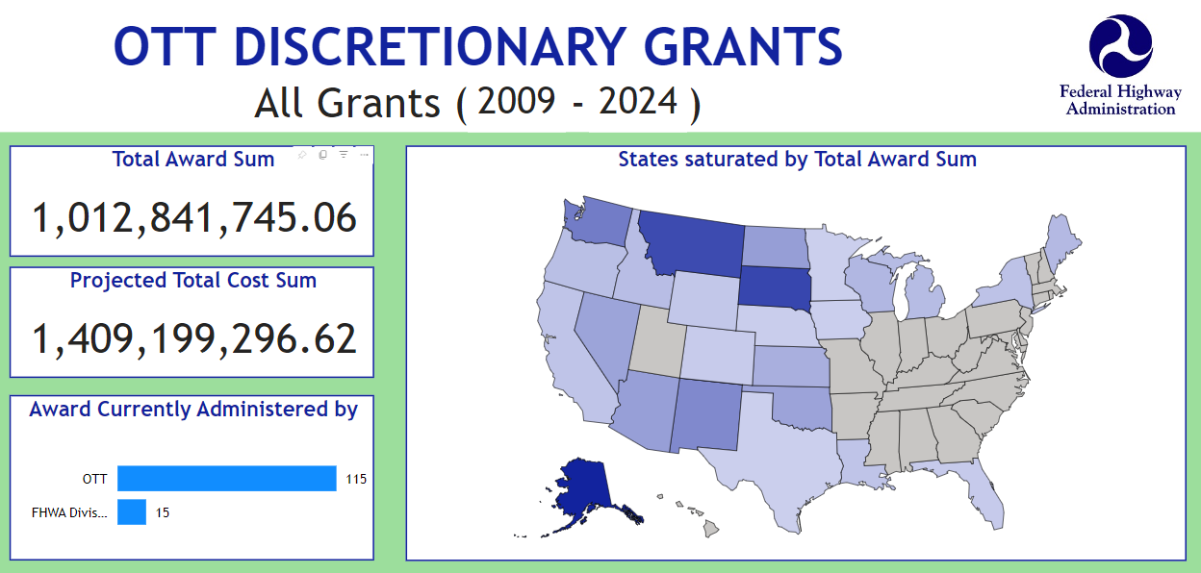
Current
Notes:
Current, all Tribal awards since FY12.
Since BIL began in FY22, Tribal selections have increased by over $705M so far. This includes just two programs that have announced FY24 awards so far.

Slide 16
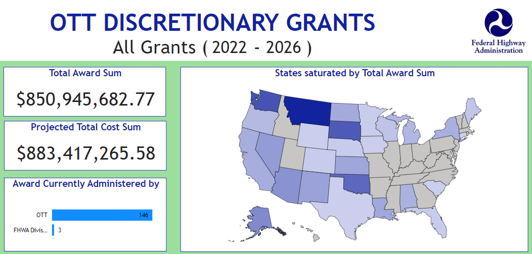
BIL Grant Selections
Notes:
With the creation of the Discretionary Grants Management Team in 2023, OTT is handling the majority of this over $850M growth in Tribal awards and administering over 145 grants.

Slide 17
Tribal Selections under BIL
BIL Grant Program | Tribal Selections
Safe Streets and Roads for All (SS4A) | 64
Rebuilding American Infrastructure with Sustainability & Equity (RAISE) | 32
National Culvert Removal, Replacement & Restoration Grants (Culvert AOP) | 14
Charging & Fueling Infrastructure (CFI) | 10
Promoting Resilient Operations for Transformative, Efficient, & Cost-saving Transportation (PROTECT) | 7
Reconnecting Communities Pilot (RCP/RCN) | 6
Scenic Byways (SBP) | 4
Nationally Significant Federal Lands and Tribal Projects (NSFLTP) | 4
Wildlife Crossings Pilot (WCP) | 4
Rural Surface Transportation | 2
Nationally Significant Multimodal Freight & Highway Projects program (INFRA) | 1
Bridge Investment Program (BIP) | 1
Notes:
110 Tribal selections in total under BIL under these 10 grant programs to date (OTT is administering 107 of these).
CFI -This # will need to be updated based on the earlier announcements.

Slide 18
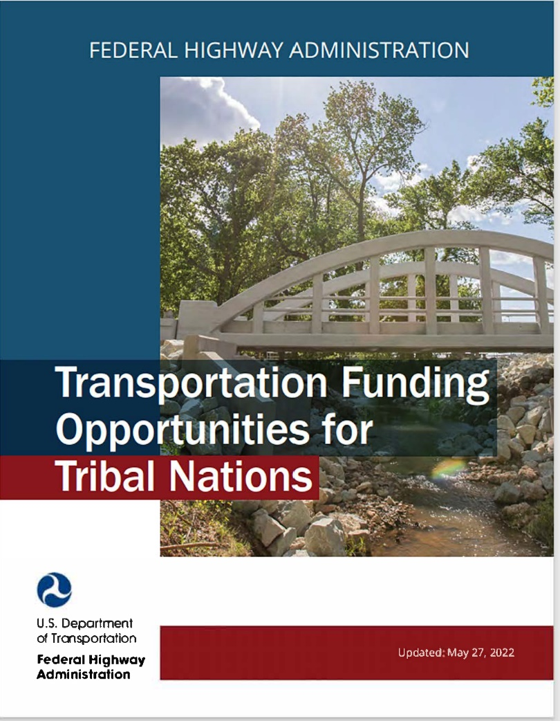
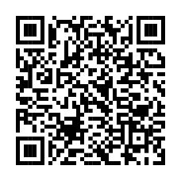
Transportation Funding Opportunities for Tribal Nations (dot.gov)
Federal Role
How to Access Fundings
Dedicated Tribal Programs + Other Programs
Outlines:
  Purpose
  Funding
  Program Type
  Federal Share
  Eligible activities
  BIL Changes to TTP
  Additional Information and Assistance
Notes:
QR Code

Slide 19
OTT Planning
TTP Planning
  Oversight
    Consistent delivery with applicable laws and regulations (25 CFR 170.400s)
  Stewardship
    Supporting Tribal transportation planning capacity through technical assistance, problem solving, etc.
  Serving Tribes in partnership with OTT Tribal Coordinators, BIA DOT, and BIA Regions
  Approve all Tribal TIPs
Consultative Planning
  Tribal involvement in transportation planning decision-making per applicable laws, regulations, and U.S. DOT Tribal Policy (5301.1A)
  Serving FHWA planners, State DOTs, MPOs, COGs, RTPOs, and partners
    Intergovernmental relations
    Training and technical assistance to agencies
    Facilitate information exchange
    Tribal consultation planning related reporting per 5301.1A
Dana.Reinke@dot.gov
Transportation Planning Specialist
Misty.Klaan@dot.gov
Consultative Planner
Notes:
OTT has two planners Dana Reinke and Misty Klann focused on different aspects of planning but have complementary roles to support Tribal presence in transportation planning.

Slide 20
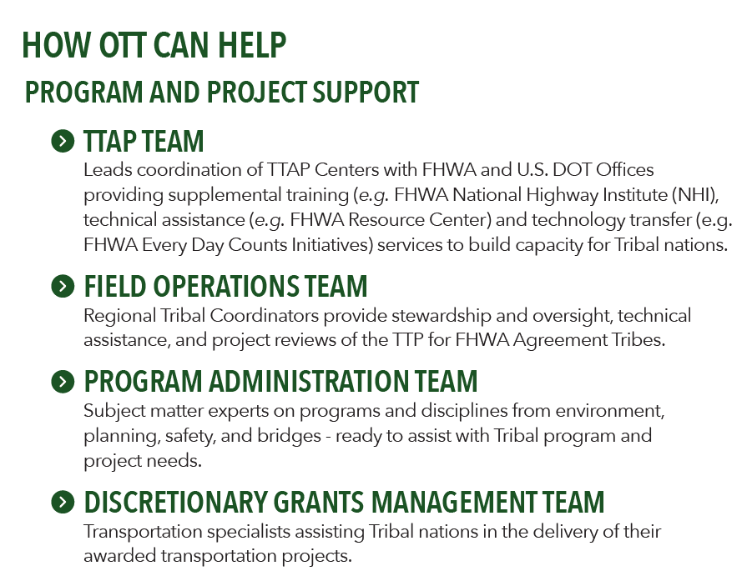
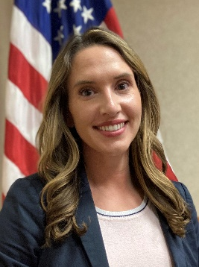

FHWA
TTAP Team
Morgan Malley Manning,
OTT TTAP
Program Manager
Hans Anker,
Local Aid Support
LTAP/TTAP Coordinator

Slide 21

FY25 OTT TTAP Coordination
Technical Assistance- Tools & Resources
  Categorical Exclusion (Cat Ex) Check-list
  Tribal Public Engagement Toolkit
  Regional Workshops- technical assistance workshops for Tribes to get hands-on help to advance their programs and projects
    Tribal Coordinators- “All things TTP”
  Expert Trainings
    SMEs- Environment, Planning, Safety, Bridge
    Program Support- Bridge, Safety, Grants

Slide 22

FY25 OTT TTAP On Demand Resources
Available Now
Tribal Long Range Transportation Planning (LRTP)
TTP Reporting 101
Tribal Transportation Program 101 (TTP 101)
Tribal Transportation Improvement Programs (TTIP)
In the Works
NEPA 101- to include Cat Ex Check-list
Grants 101- to address Tribal specific FAQs
Notes:
The Tribal Transportation Facilities are public roads which provide access to and within Indian reservations, Indian trust land, restricted Indian land, and Alaska native villages. The inventory of proposed and existing roads in the NTTFI is approximately 157,000 miles. Approximately 31,400 miles are BIA system roads, 26,000 miles of Tribal system roads, and 101,000 miles that are under State and local ownership. Tribal Transportation Program funds can be used for eligible Title 23 transportation related activities on tribal transportation facility and may also be used for the State/local matching share for apportioned Federal-aid Highway Funds.
The BIA and Tribal governments undertake most of the design and construction of Tribal Transportation Program projects. Under tribal self-determination contracts, self-governance agreements, FHWA Program Agreements or other appropriate agreements, Tribal governments can perform, administer and operate portions or all but "inherently Federal functions" of the TTP.

Slide 23
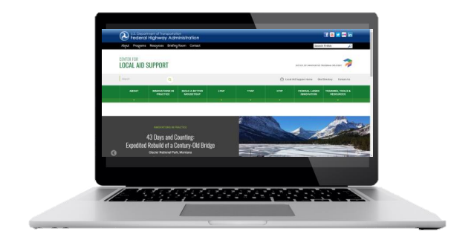
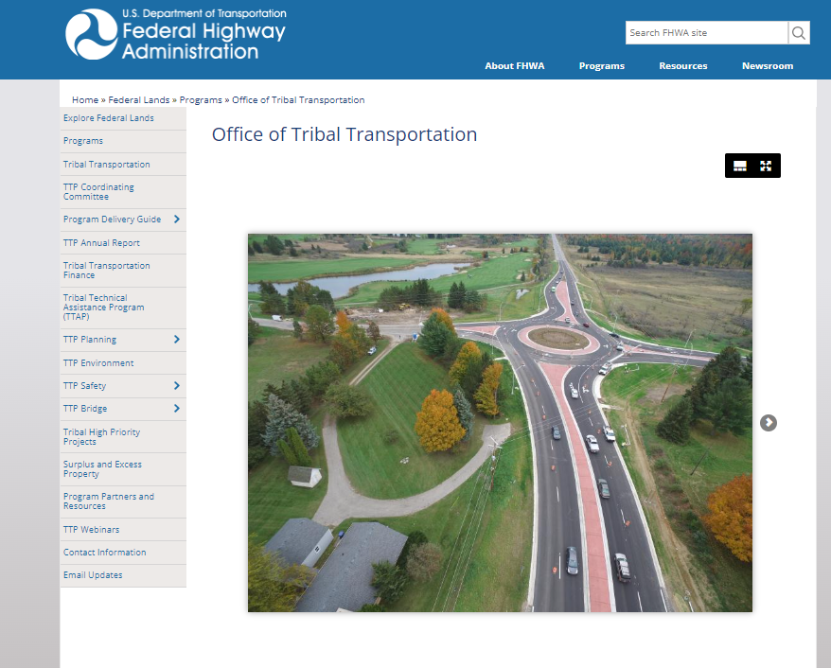
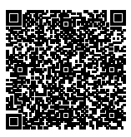
TTP 101 Online Training
    TTP 101, Module 1: Tribal Transportation Program (TTP) Overview
    TTP 101, Module 2: TTP Fund Allocation and the TTP Formula
    TTP 101, Module 3: Using TTP Funds
Through collaboration with FHWA LAS and OTT,
TTAP led the coordinated development of this first TTP online, self-paced training course.
Courtesy: FHWA

Slide 24
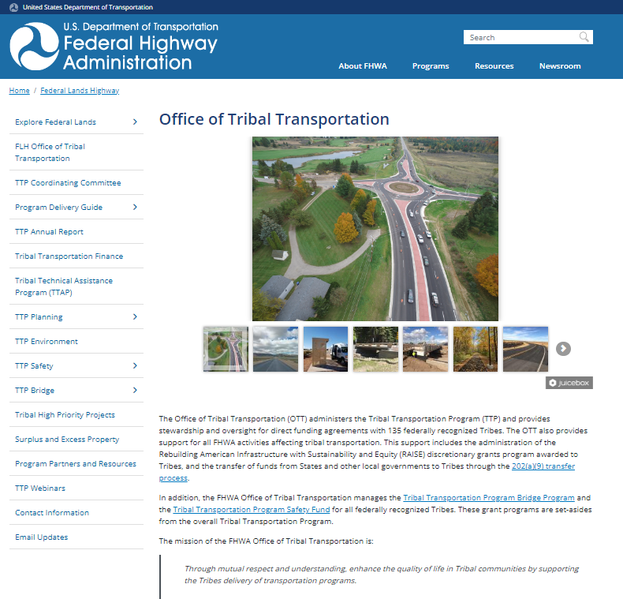
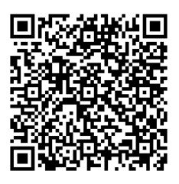
Stay Connected with the Office of Tribal Transportation!
OTT Listserv & Newsletter
The Trailblazer
Website: https://highways.dot.gov/federal-lands/tribal
Courtesy: FHWA

Slide 25
Questions
Rachel LeVee
OTT Field Operations Manager
Rachel.levee@dot.gov
Notes:
Thank for you all for hanging in there with me…I am now going to turn the mike over the Hans to deliver the TTAP portion of our presentations and close things out.

