Slide 1
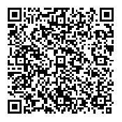
TTP Safety Fund Overview
Adam Larsen
Adam.Larsen@dot.gov
360-619-2601

Slide 2
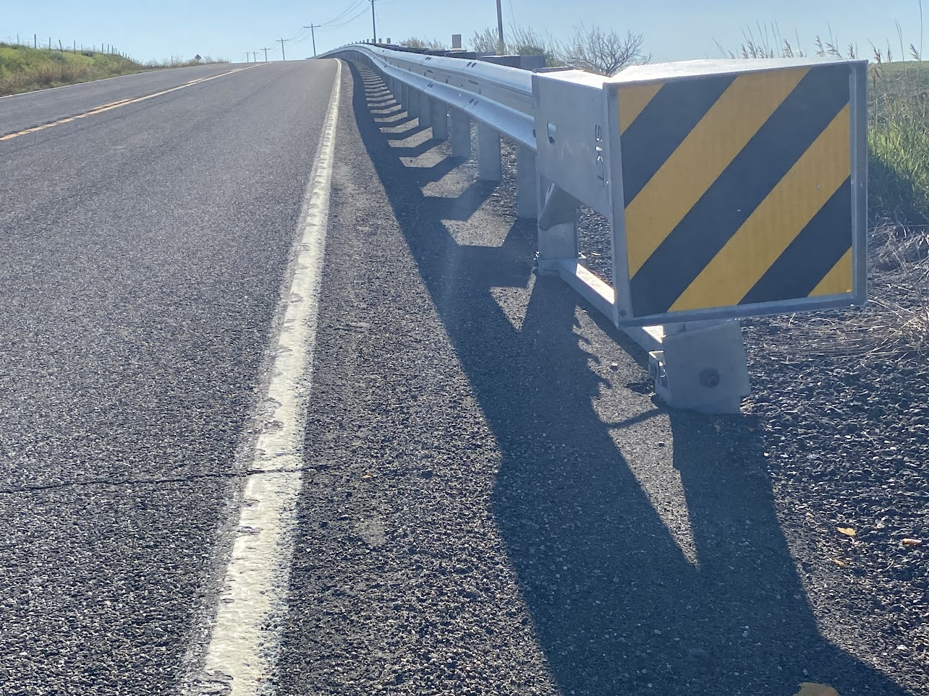
Overview
Funding Opportunities
TTPSF in Alaska
TTPSF Overview
Deadlines
Application Process
Q&A
Photo: Crow Tribe of Montana Source: FHWA

Slide 3
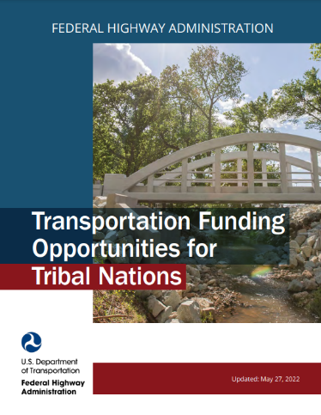
Other Transportation Funding Opportunities
State-managed
  Highway Safety Improvement Program
  Transportation Alternatives
    (includes set-aside for Recreational Trails)
  Safe Routes to School
  Highway-Rail Grade Crossing Program
Federal Discretionary Grants
  Safe Streets and Roads for All (SS4A)
  Rural Surface Transportation Grants
  Wildlife Crossing Pilot Program
  BIA Indian Highway Safety Program
www.TribalSafety.org/Funding
Notes:
Information on other transportation funding options for Tribes:
https://highways.dot.gov/federal-lands/programs-tribal
www.TribalSafety.org/Funding

Slide 4

Safe Streets and Roads for All (SS4A)
Key program that supports the National Roadway Safety Strategy
Funding supports local initiatives to prevent death and serious injury on roads and streets, commonly referred to as “Vision Zero” or “Toward Zero Deaths” Initiatives.
$1 billion in annual funding, FY22-26
Gorodenkoff - stock.adobe.com

Slide 5
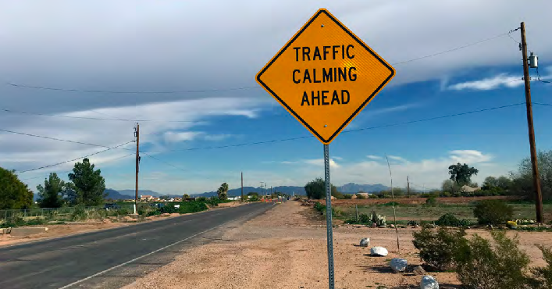
Safe Streets and Roads for All (SS4A)
Eligible applicants are Tribal Governments, Local Agencies, and Metropolitan Planning Organizations
Two categories:
Planning and Demonstration Grants
Implementation Grants
20% non-federal match required
TTP or TTPSF can be used as match
FHWA

Slide 6
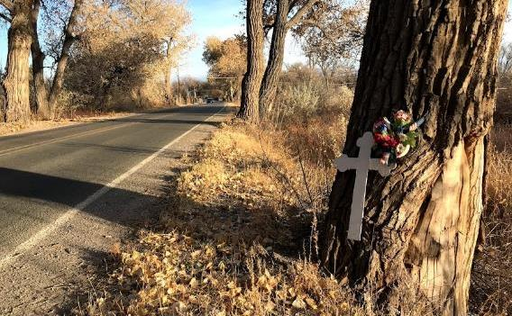
Tribal Transportation Program
Safety Fund Overview
~$21-million per year (2022-2026)
Competitive grant
Tribes are the only eligible applicants
All TTP modes eligible (winter trails, ice roads, etc.)
Prior year awards listed at https://highways.dot.gov/federal-lands/programs-tribal/safety/funds
GOAL: Reduce fatal and serious injury transportation incidents (crashes)
Photo: Okay Owingeh Source: FHWA

Slide 7
Tribal Transportation Program Safety Fund
FY24
  About $20M awarded.
  Low participation; 90% of applications were funded

Slide 8
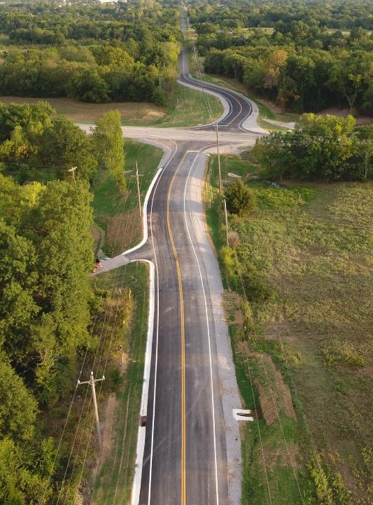
2025 TTP Safety Fund
Photo: Cross Timbers Consulting
Important Dates:
2025 Application Period | Open until deadline January 15, 2025
2025 Award Announcement | Estimated June 2025

Slide 9
TTP Safety Fund Projects in Alaska
Safety Plans
Road Safety Audits
Highway turn lanes
Curve warning signs
Clear intersection sight triangles
School crosswalks, signs
Sidewalks / Pathways
Speed feedback signs
Guardrail
Streetlights
Winter trail safety shelters
Winter trail markers
Ice road monitoring
Airport weather stations
$12-million since 2013

Slide 10




Tribal Transportation Program Safety Fund (TTPSF)
Notes:
The Tribal Transportation Program Safety Fund is an additional opportunity for Tribes to get funding for safety planning and infrastructure improvements. The next application period for this funding starts October 1.

Slide 11
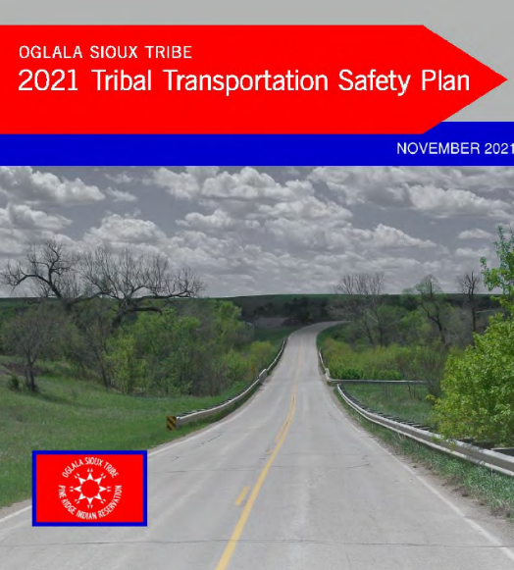

    Development of new transportation safety plans ($15,000)
    Update transportation safety plans that are more than 3 years old ($10,000)
    Safety Planning Resources at
https://www.tribalsafety.org/safety-planning-resources

Slide 12
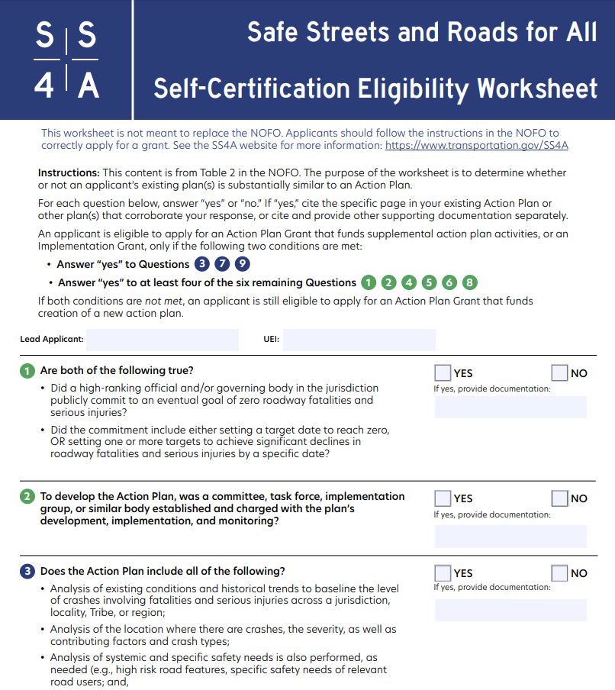
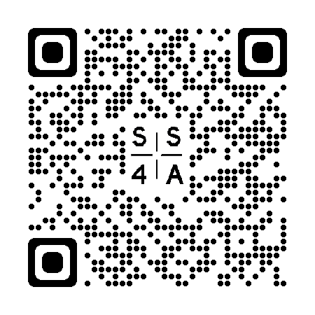
SS4A
Safety Plan Self-Certification https://www.transportation.gov/sites/dot.gov/files/2022-06/SS4A_Self_Certification_Worksheet.pdf

Slide 13
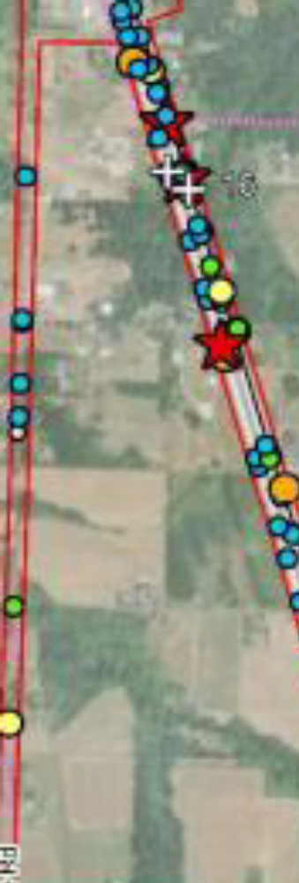
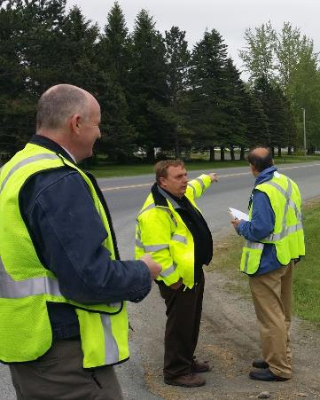
Assessment
  Determine data needs and plan improvements
Improvement
  Electronic crash data collection equipment, software
  Gather traffic / asset data for safety purposes
Analysis
  Road Safety Audits for a specific location
  Risk-based (Systemic) Safety Study
  Crash data mapping
Examples: https://www.tribalsafety.org/data-analysis

Slide 14
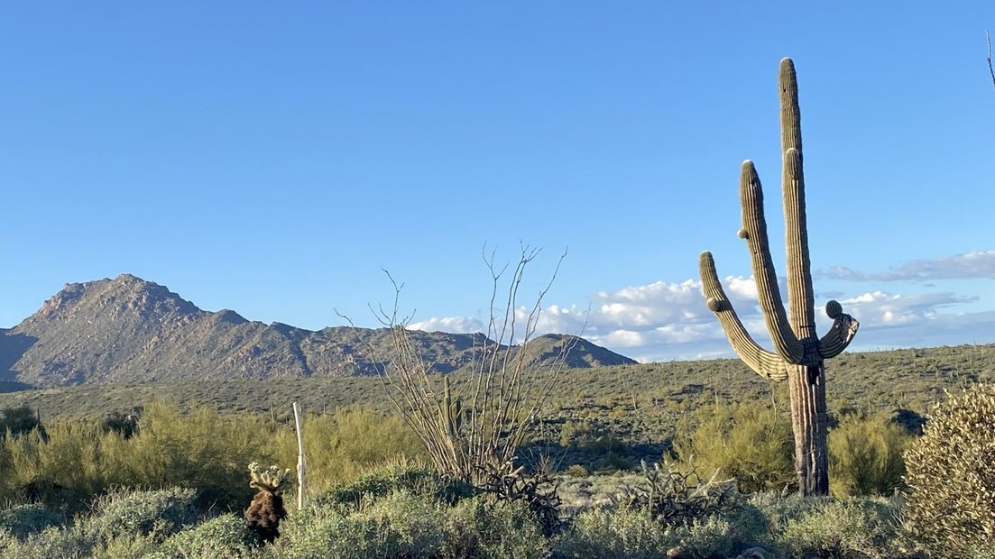
Data Desert
False appearance of safety
Inequitable distribution of resources
Difficult to plan for and justify improvements

Slide 15
Addressing Safety in a Data Desert
Safety plans
Data improvement
  Crash data
  Asset data
  Centerline Data
  Traffic Volumes
Risk-based safety analysis

Slide 16
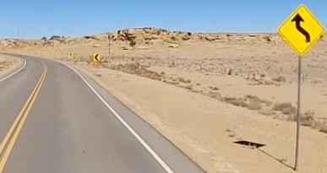
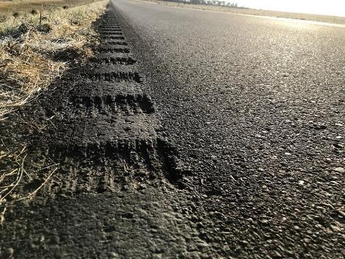
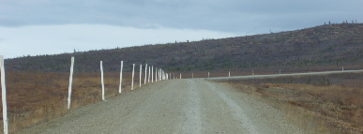
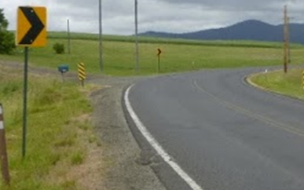
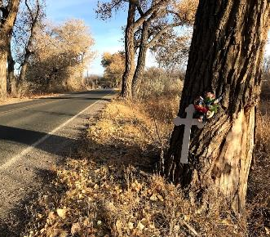
Eligible Improvements
Curve Warning Signs
Delineators
New Center/Edge Striping
Edge Rumbles
Center Rumbles
Mitigation of Roadside Hazards (Clear Zones)
Navajo Nation
Native Village of Minto
Lake Traverse Reservation, SD
Coeur d'Alene Tribe
Ohkay Owingeh

Slide 17
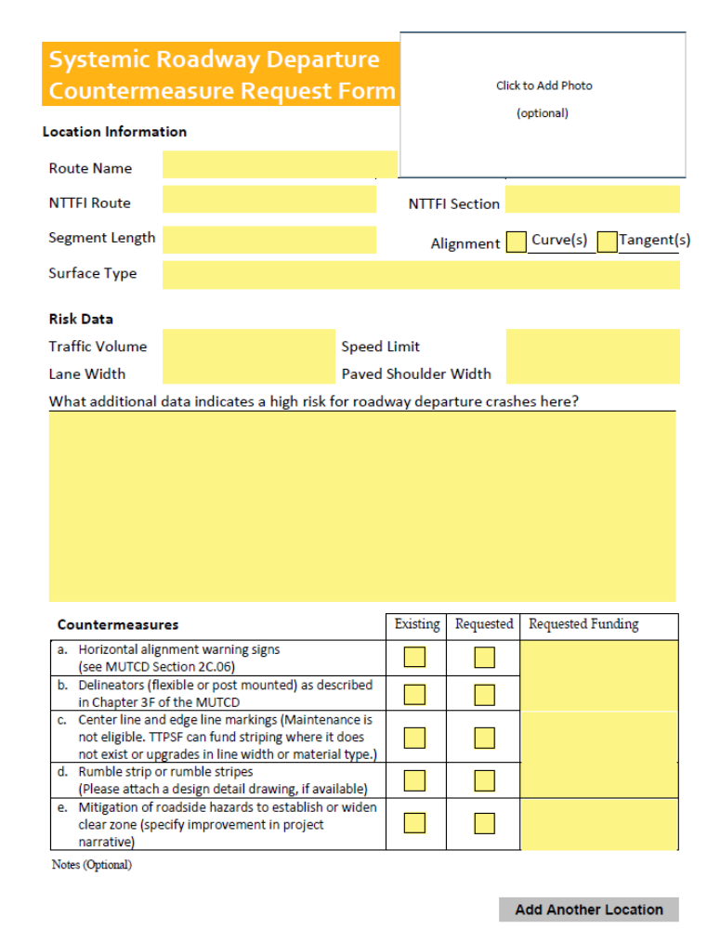
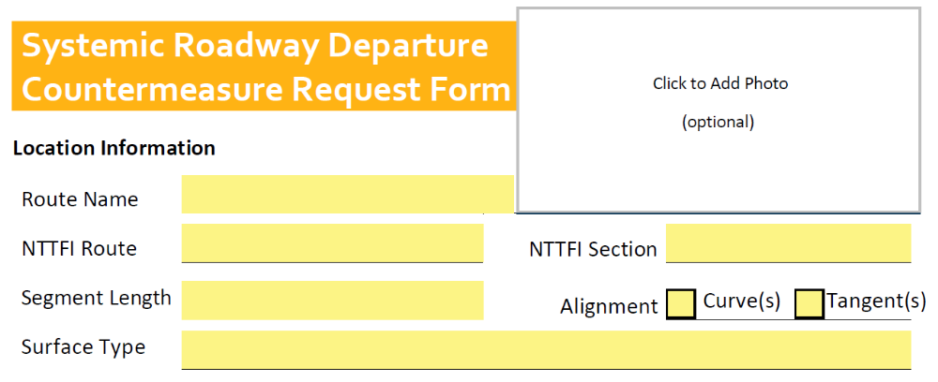
Where?

Slide 18
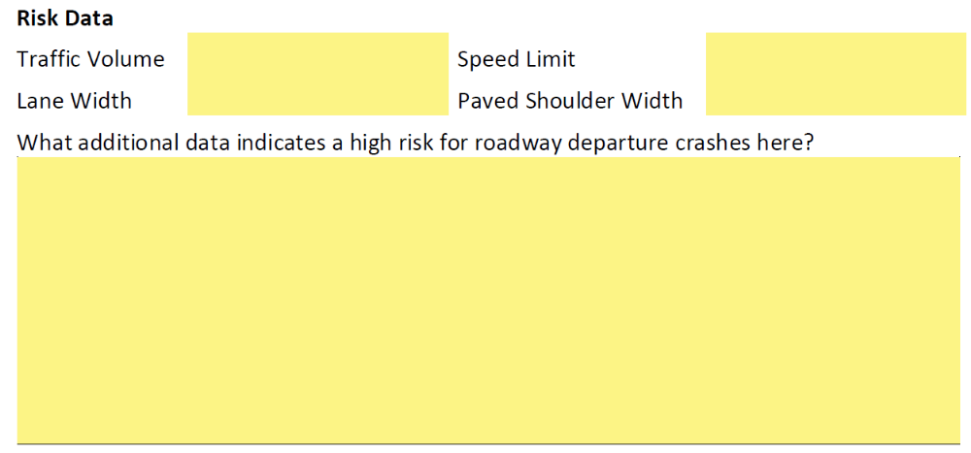
Why is location high risk?

Slide 19
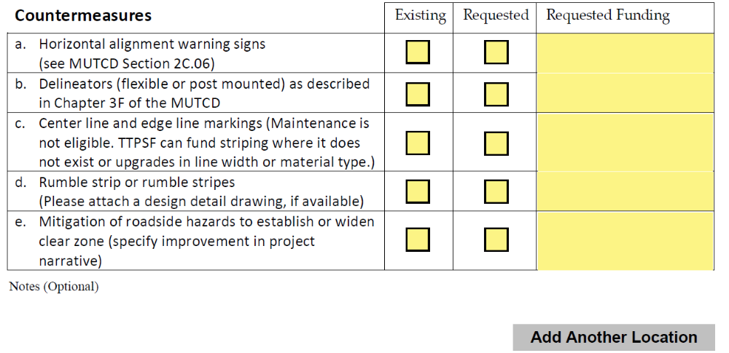
Which low-cost eligible countermeasures?

Slide 20
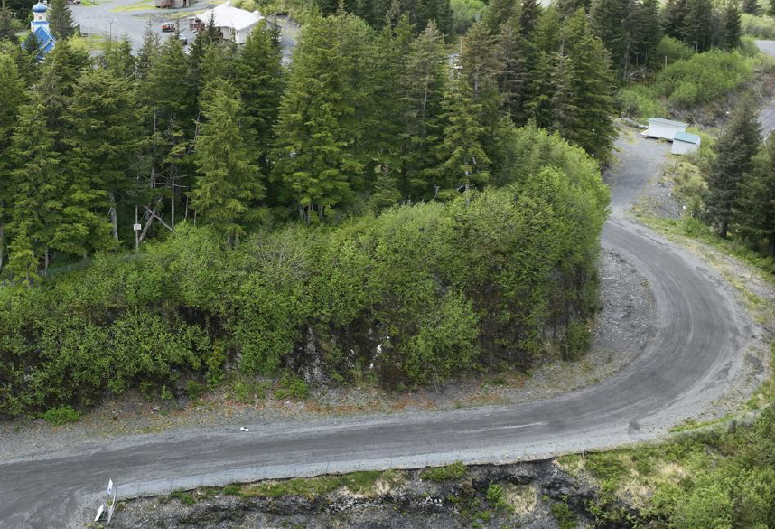
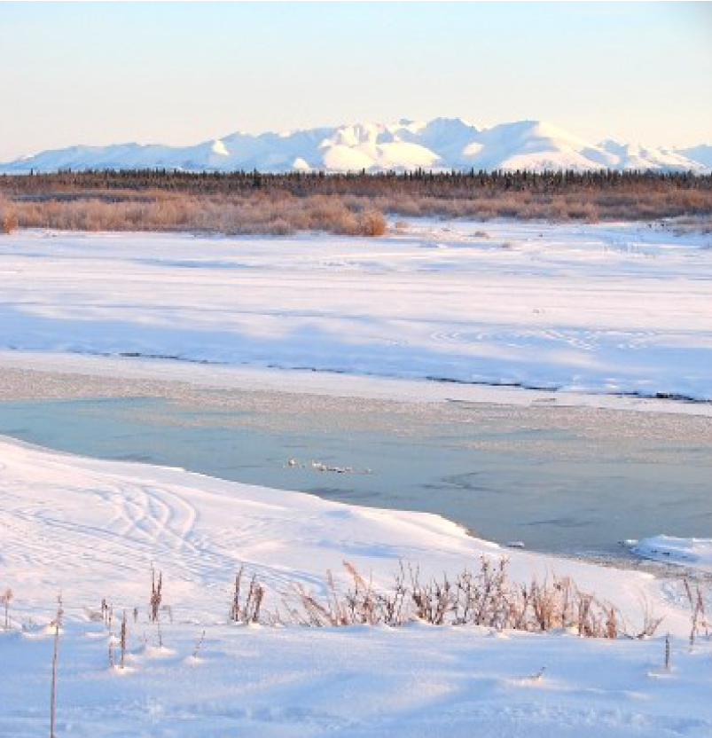

Slide 21
    A complete application for Systemic Roadway Departure Countermeasures category includes:
      Application form
      Countermeasures Request Form (or similar Risk Assessment)
      Project narrative (see Application Guide)
    Selection Criteria – May be evaluated per location
      Strategic safety planning
      Supporting safety risk data
      Systemic prioritization – Curves will be selected before tangents
      Facility ownership

Slide 22
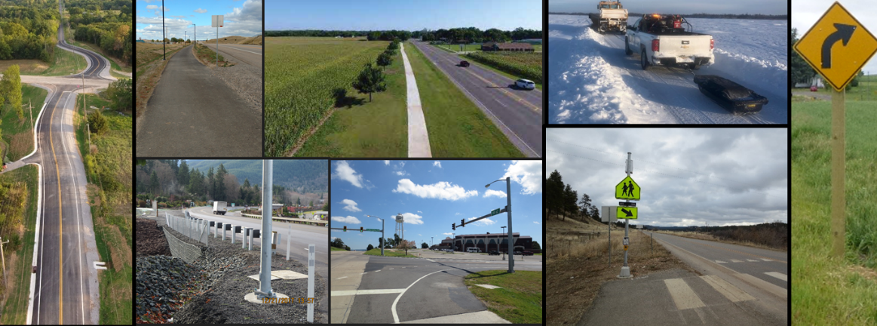
  Other Eligible Activities as listed in 23 USC 148(a)(4)
(xxviii) A physical infrastructure safety project…

Slide 23
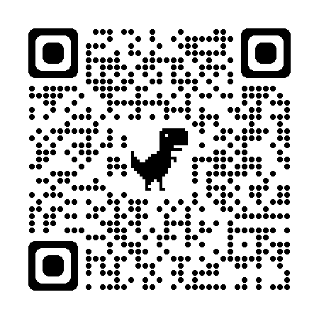
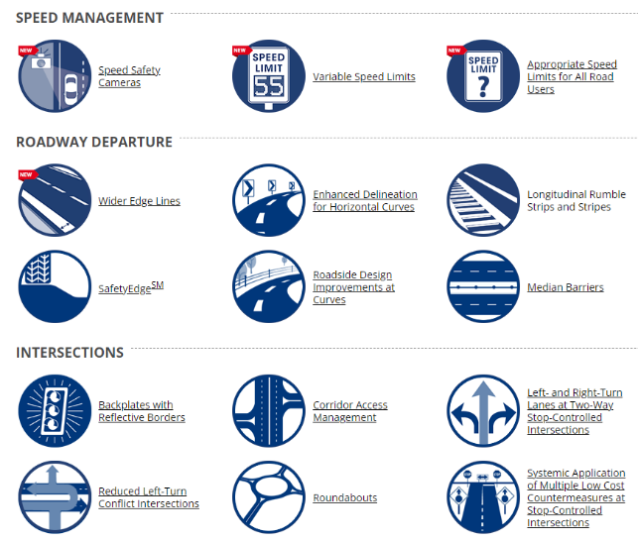
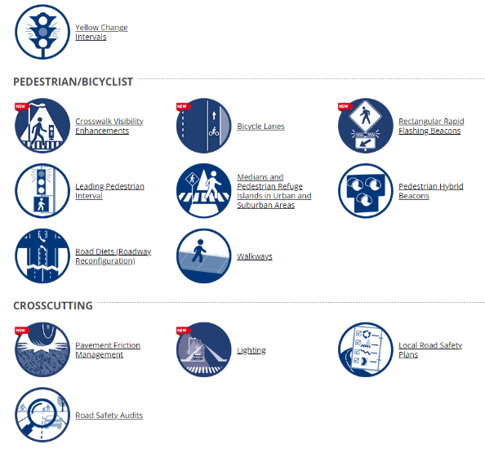
Proven Safety Countermeasures
https://safety.fhwa.dot.gov/provencountermeasures/
Notes:
FHWA Proven Safety Countermeasures http://safety.fhwa.dot.gov/provencountermeasures/

Slide 24
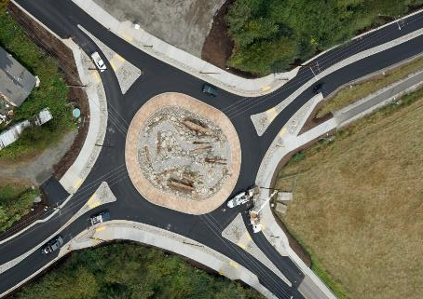
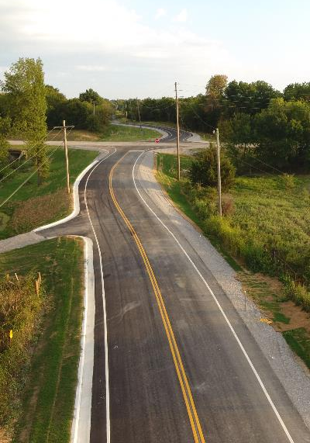
Intersection Improvements
Photo: Cross Timbers
Photo: Lummi Nation

Slide 25

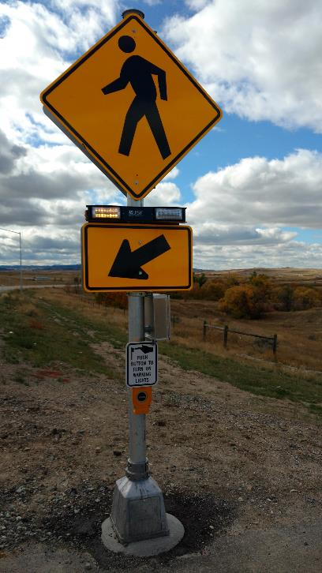
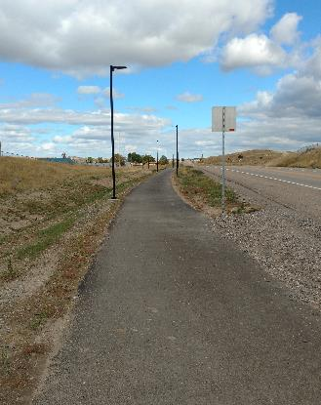
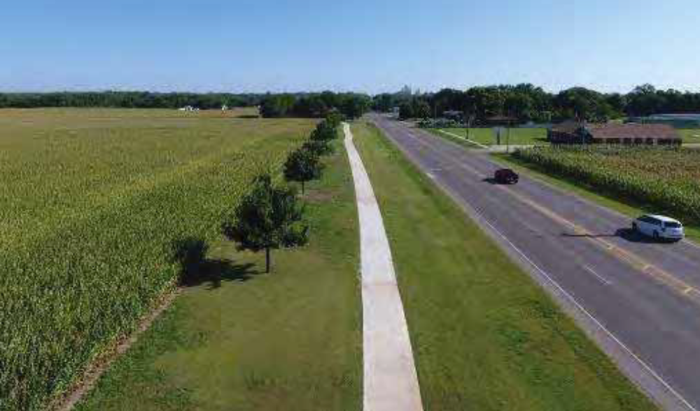
Pedestrian Safety
Northern Cheyenne Reservation
Photo: KLJ Engineering
Photo: KLJ Engineering
Citizen Potawatomi Nation
Photo: Cross Timbers Consulting

Slide 26

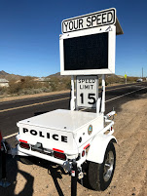
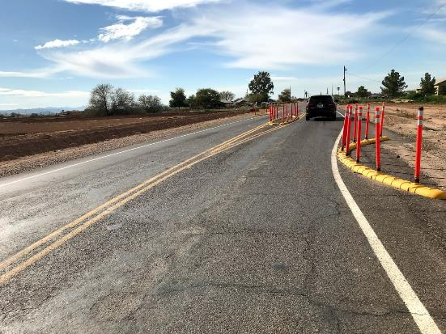
Speed Management
Photo: FHWA
Gila River Indian Community
Source: FHWA
Salt River Pima-Maricopa Indian Community
Source: FHWA

Slide 27
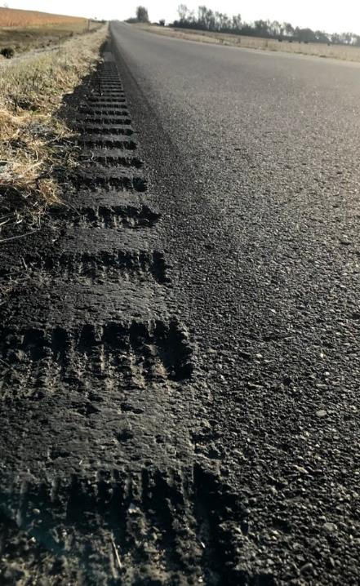
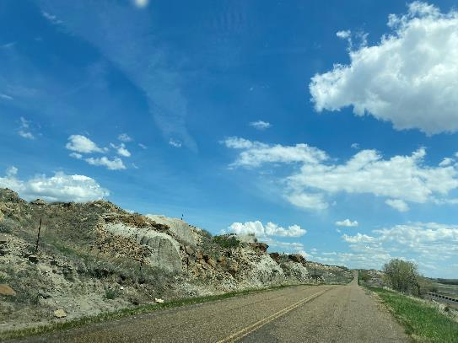
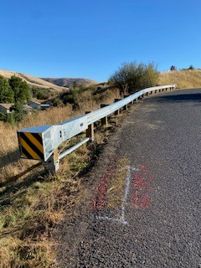
Roadway Departure Strategies
Keep drivers on the Road
Provide for safe recovery
Minimize severity
Sisseton-Wahpeton Oyate of the
Lake Traverse Reservation
Source: FHWA
Assiniboine and Sioux Tribes of the Fort Peck Indian Reservation
Source: FHWA
Source: Nez Perce Tribe

Slide 28
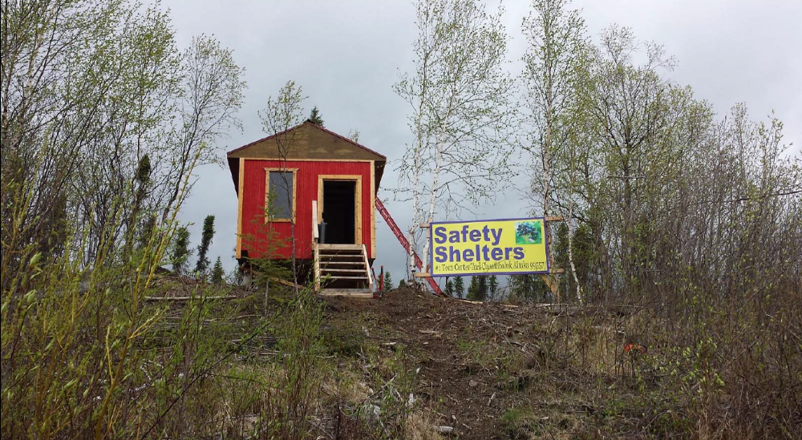
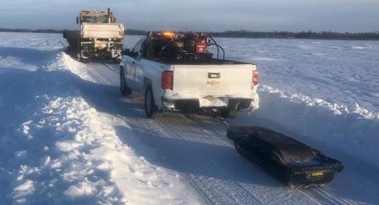
Off-Highway Safety Infrastructure
Source: Tanana Chiefs Conference
Photo: Native Village of Napaimute

Slide 29
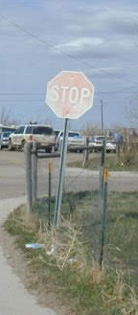
Safety Enhancements and Upgrades are eligible.
Cannot supplant routine maintenance.

Slide 30
Selection Criteria
Included in a Safety Plan, RSA, or other transportation safety study
Supporting Safety Data - Describe the type, severity, and quantity of incidents that directly demonstrate the need for the project.
Expected Crash Reduction – Research, publications, or other evidence that project will reduce crash severity and/or frequency.
Time elapsed since last TTPSF infrastructure award.
Road Ownership (BIA and Tribal roads get some priority; Other ownership requires letter of acknowledgement from road owner.)

Slide 31
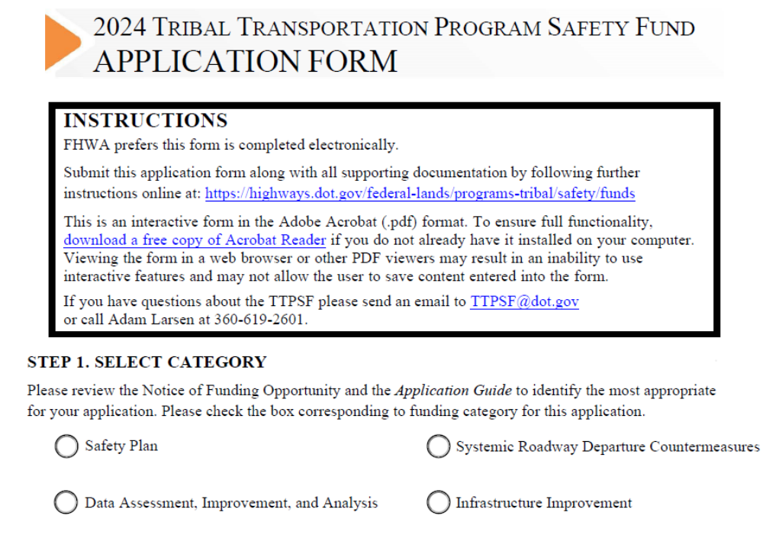

2024 Application Form
One application form for all categories
Must address selection criteria in project narrative (except safety plans).

Slide 32
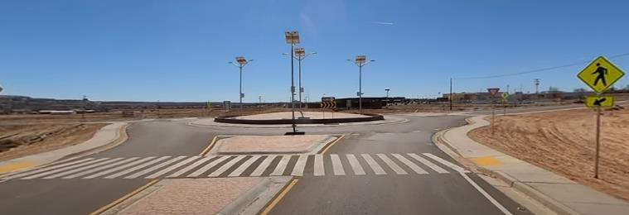
Application Process – All categories
Start Here: https://highways.dot.gov/federal-lands/programs-tribal/safety/funds
Review the FY2022-2026 TTP Safety Fund NOFO.
Complete an application form.
Prepare a project narrative & supporting documentation, if required (see Application Guide)
Email completed application to TTPSF@DOT.GOV
Make sure you get a confirmation email.

Slide 33
Application Process – Project Narrative
Start Here: https://highways.dot.gov/federal-lands/programs-tribal/safety/funds
Use the project narrative template found in the Application Guide
The purpose of the project narrative is to describe the scope of work and convince reviewers that it algins with the selection criteria.
  Basic Outline (see detail in Application Information and Selection Criteria Guide)
    Applicant information
    Project description
    Selection criteria
    Cost estimate
    Schedule
    Contributing resources
    Supporting documentation

Slide 34
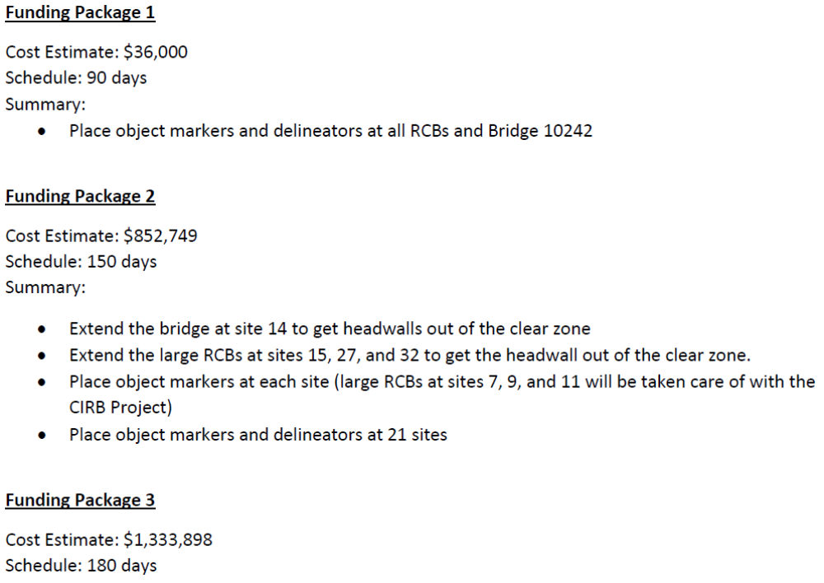
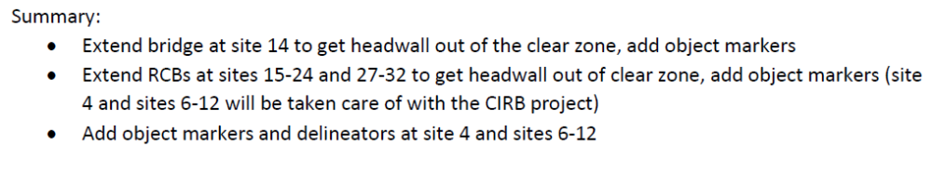
Application Process – Cost Estimate
Historically awards are $1.6-million or less per Tribe.
Average Infrastructure Award $420,00 (2020-2023)
Applicants should present funding packages showing what independent project components can be accomplished with awards of various sizes, especially for requests approaching $1,000,000 or more.

Slide 35
Inventory Requirement
Route must be official and existing on the National Tribal Transportation Facility Inventory to be eligible.
Include documentation of route’s status on the National Tribal Transportation Facility Inventory
One source of inventory data is the “Regional NTTFI Reports” on: https://itims.bia.gov/

Slide 36
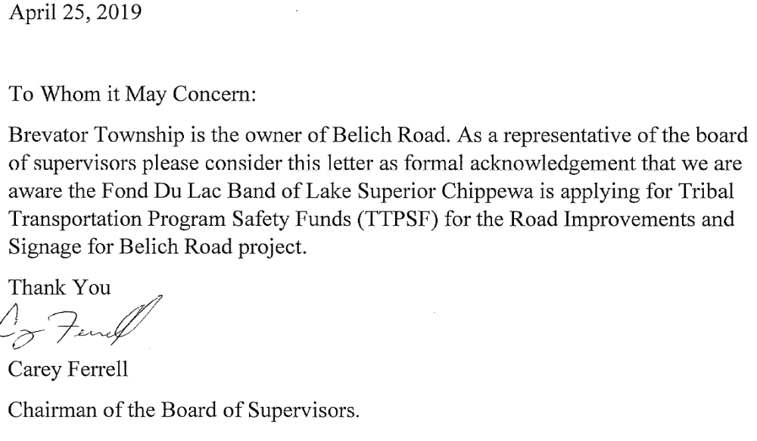
Application Process – Owner’s Letter
Projects to study or improve roads not owned by the BIA or a Tribe require a letter of acknowledgement from the road owner.

Slide 37
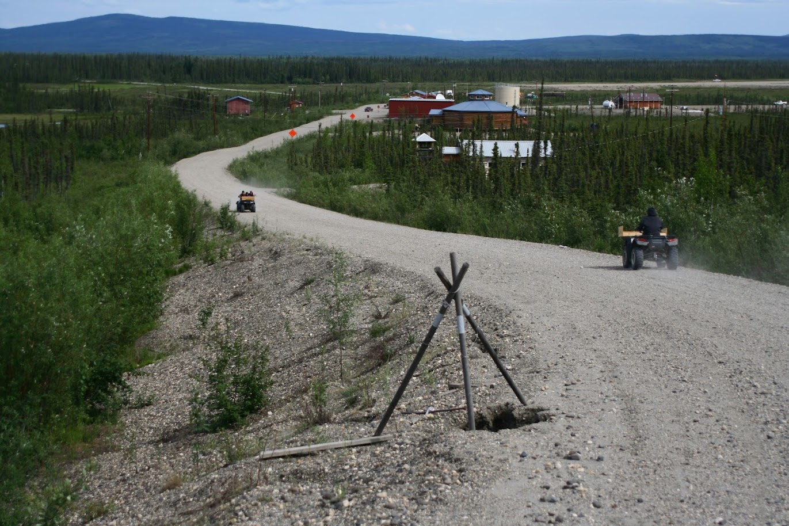
Matching Resources
No match is required.
Leveraging a TTPSF request with other funding sources and in-kind match is encouraged. FHWA may give priority consideration to those projects that show a commitment of other allowable funding sources to complement a TTPSF funding request.
Allowable complementary funding sources are described in 2 CFR § 200.306 and 25 CFR § 170.133

Slide 38
Project Narrative Tips
Start Here: https://highways.dot.gov/federal-lands/programs-tribal/safety/funds
Include a “Selection Criteria” section in the project narrative
Suggest why reviewers should rate your project “Highly Qualified” or “Qualified” for each criterion.

Slide 39
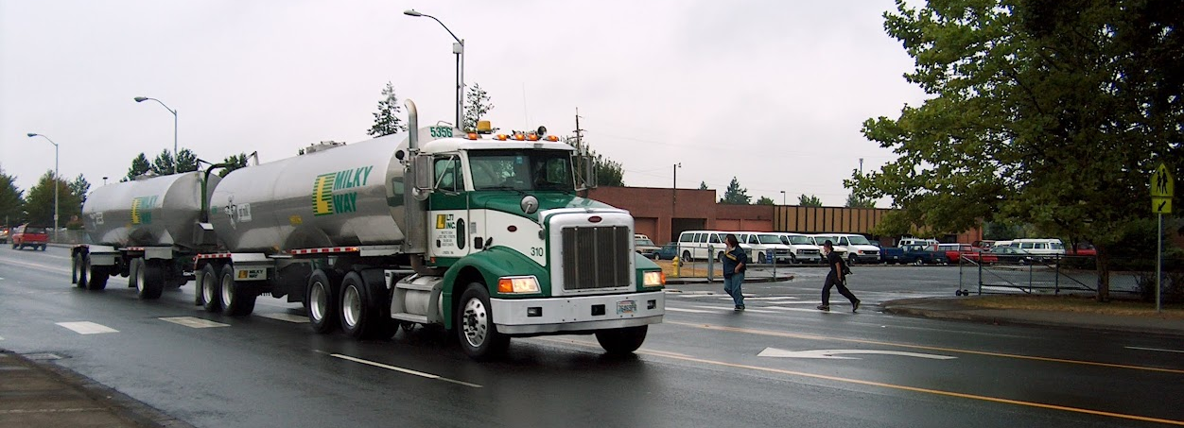
Project Narrative Tips
Read the Notice of Funding Opportunity (NOFO)
Use the provided template.
Detail how project meets selection criteria.
Write a project narrative that thoroughly describes needs
Use visual aids to help describe needs/challenges
Source: FHWA

Slide 40
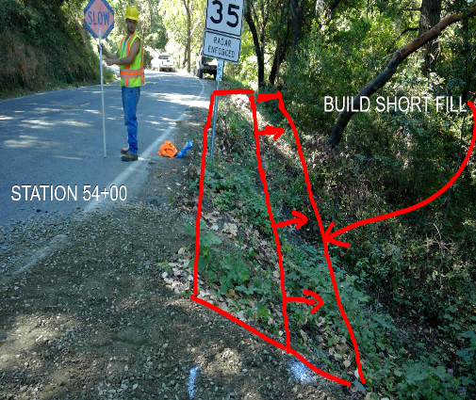
Project Narrative Tips
Start Here: https://highways.dot.gov/federal-lands/programs-tribal/safety/funds
Clearly relate the supporting data to the proposed improvements. What kind of crashes have occurred? What will the project do to reduce those crashes?
Graphs, charts and maps can help reviewers understand the problem and proposed work.
Summarize supporting documentation, don’t depend on the interpretation of reviewers.
Always cite information sources.
Coordinate with funding agency, ask questions
Source: Karuk Tribe

Slide 41
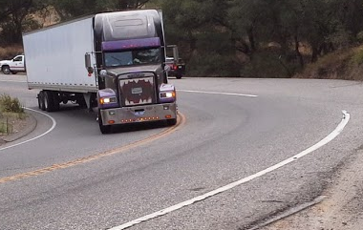
Project Narrative Tips
Clearly identify how you expect your project will be rated and why
Use page numbers
Use a legible font
Follow up after awards are announced to get advice for the next opportunity.
LaJolla Band
Source: FHWA

Slide 42
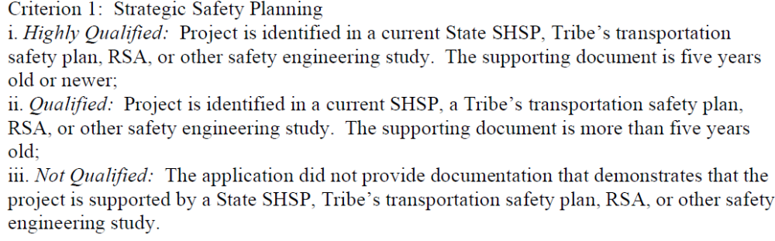
Sample Responses:
Highly Qualified: The Project is identified in a Tribal Safety Plan that is less than 5 years old; the 2022 Windy Canyon Tribe Transportation Safety Plan, page 12.
Qualified: The project is identified in the Tribe’s 2014 Transportation Safety Plan.
Qualified: The project addresses an issue in the 2016 State Strategic Highway Safety Plan.
Not Qualified: The Tribe doesn’t yet have a transportation safety plan but will hopefully compile one next year.

Slide 43

Sample Responses:
Criterion 2
The crash data analysis demonstrates the need for this project.
Criterion 2-Supporting Safety Data: Highly Qualified
    The crash data analysis in Appendix B demonstrates that 75% of the crashes on River Road involve Roadway Departure. From 2017-2022, River Road experienced 20 crashes that lead to 3 injuries. The proposed project will widen shoulders to decrease the risk of roadway departure crashes.
Don’t do this.
Instead, do this.

Slide 44
Sample Responses:
Formal safety data is limited in many Tribal areas; applicants should support their application with documentation summarizing the best available data that demonstrates a history or risk of transportation incidents that are expected to be reduced by the proposed activity.
Notes:
It might feel redundant but tell them again what you’ve already said so it doesn’t get missed.

Slide 45
Sample Responses:
Criterion 2-Supporting Safety Data:
    The Nation has supplied collision data to support this application. See attachments.
Criterion 2-Supporting Safety Data: Highly Qualified
    Over the last 5 years, this intersection has sustained 8 accidents (37.5% injury rate) along with frequent near-misses. Furthermore, Lower Road serves as the exit from the high school where the traffic backs up considerably while school is in session.
    In addition, the Nation is taking a systematic approach for addressing intersection safety hazards and has made Intersections a priority in the transportation safety plan. Across our road network, intersections are involved in 38% of all crashes.
Reviewers might not find it
Don’t do this.
Instead, do this.
Notes:
It might feel redundant but tell them again what you’ve already said so it doesn’t get missed.

Slide 46
Sample Responses:
Criterion 2-Supporting Safety Data:
    A survey showed that 90% of the 40 participants identified this project as a top priority.
Criterion 2-Supporting Safety Data: Qualified
    A survey identified 23 crashes that occurred in the village over the past 10 years. Among these crashes are two pedestrian injuries and a fatality that occurred during hours of darkness. All pedestrians were walking along the road rather than crossing. By adding streetlights pedestrians walking along the road will be more visible to drivers and reduce these crashes in the future.
Not Qualified.
Instead, do this.
Notes:
It might feel redundant but tell them again what you’ve already said so it doesn’t get missed.

Slide 47

Don’t leave this one blank
Sample Responses:
    This application does not reference evidence quantifying these reductions as there is insufficient crash data to calculate a reduction.
Don’t do this.
Crash reduction factors and other research can demonstrate the effectiveness of a strategy at reducing risk of crashes, even future crashes.
Notes:
Demonstrate available resources PSC https://safetyfhwa.dot.gov/provencountermeasures/.

Slide 48
Sample Responses:
The project will implement the following countermeasures identified in the FHWA Proven Safety Countermeasures (PSC, https://safetyfhwa.dot.gov/provencountermeasures/):
  • Walkways – FHWA PSC indicates installing sidewalk is at least 68% effectiveness in reducing crashes involving pedestrians walking along roadways.
  • Rectangular Rapid Flashing Beacons (RRFB) – FHWA PSC indicates that RRFB’s can reduce crashes up to 47% for pedestrian crashes, and the devices increase motorist yielding rates up to 98%.
  • Crosswalk Visibility Enhancements – FHWA PSC describes the effectiveness of such treatments at https://safety.fhwa.dot.gov/provencountermeasues/crosswalk-visability.cfm
Do this.
Notes:
Demonstrate available resources PSC https://safetyfhwa.dot.gov/provencountermeasures/.

Slide 49

Sample Responses:
  The routes improved by this project are official in the NTTFI and are not a proposed road:
  US Highway 6: Route 3006, Section 10
  Forest Road: Route 1090, Section 30
Do this.
Clearly list the routes and sections where the project will be built.
Contact BIA if you need assistance identifying a route number.
Notes:
Demonstrate available resources PSC https://safetyfhwa.dot.gov/provencountermeasures/.

Slide 50

Provide an update on any past awards.
Past TTPSF awards are listed at
https://highways.dot.gov/federal-lands/programs-tribal/safety/ttpsf-grant-awards-history

Slide 51
Adam Larsen
Safety Engineer & Safety Program Manager
Office of Tribal Transportation, FHWA
Adam.Larsen@dot.gov
cell: 360-619-2601
https://highways.dot.gov/federal-lands/programs-tribal/safety/funds
http://www.TribalSafety.org/

