Slide 1


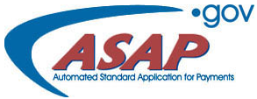
ASAP PRESENTATION
BUREAU OF INDIAN AFFAIRS
34th PROVIDER’S CONFERENCE
2024
JO ANN METCALFE
410-703-3390
jo.metcalfe@bia.gov

Slide 2
IMPORTANCE OF WWW.SAM.GOV
For you to receive your ASAP payments, you must:
Have a UNIQUE ENTITY IDENTIFIER (UEI) and keep it active. If it expires SAM.GOV will suspend your funds.
Vendors are responsible for maintaining an active registration in SAM (see handbook online at www.sam.gov).
To update an active status, the vendor must log into their account yearly at www.sam.gov and renew/update their registration
  If you have problems updating, SAM Help Desk which is the Federal Service desk can be contacted at www.fsd.gov or via calling 1-866 606 8220 (free service).
If the UEI number is not found in SAM, it can mean one of two things.
  You have not registered with DUNS and Bradstreet. If this is the case, contact DUNS and Bradstreet to obtain one, and register it at www.sam.gov.
  You have a UEI number but it expired: If this is the case, start the re-activation process at www.sam.gov.

Slide 3
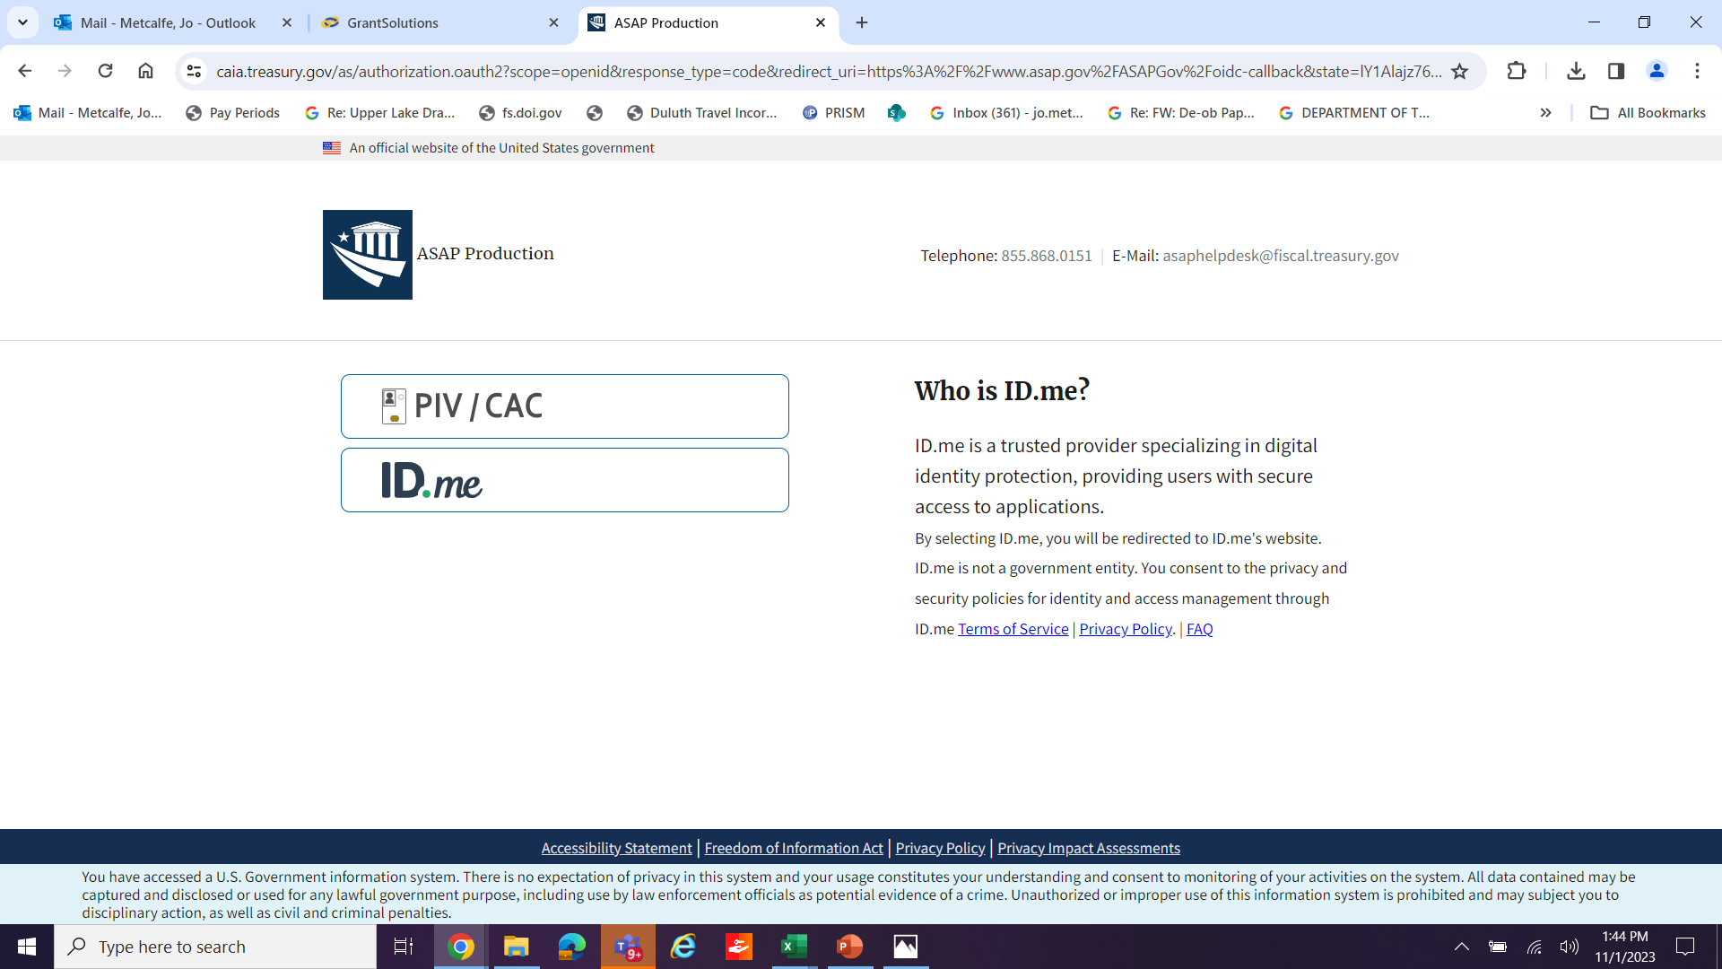
NEW SIGN-IN REQUIREMENTS

Slide 4
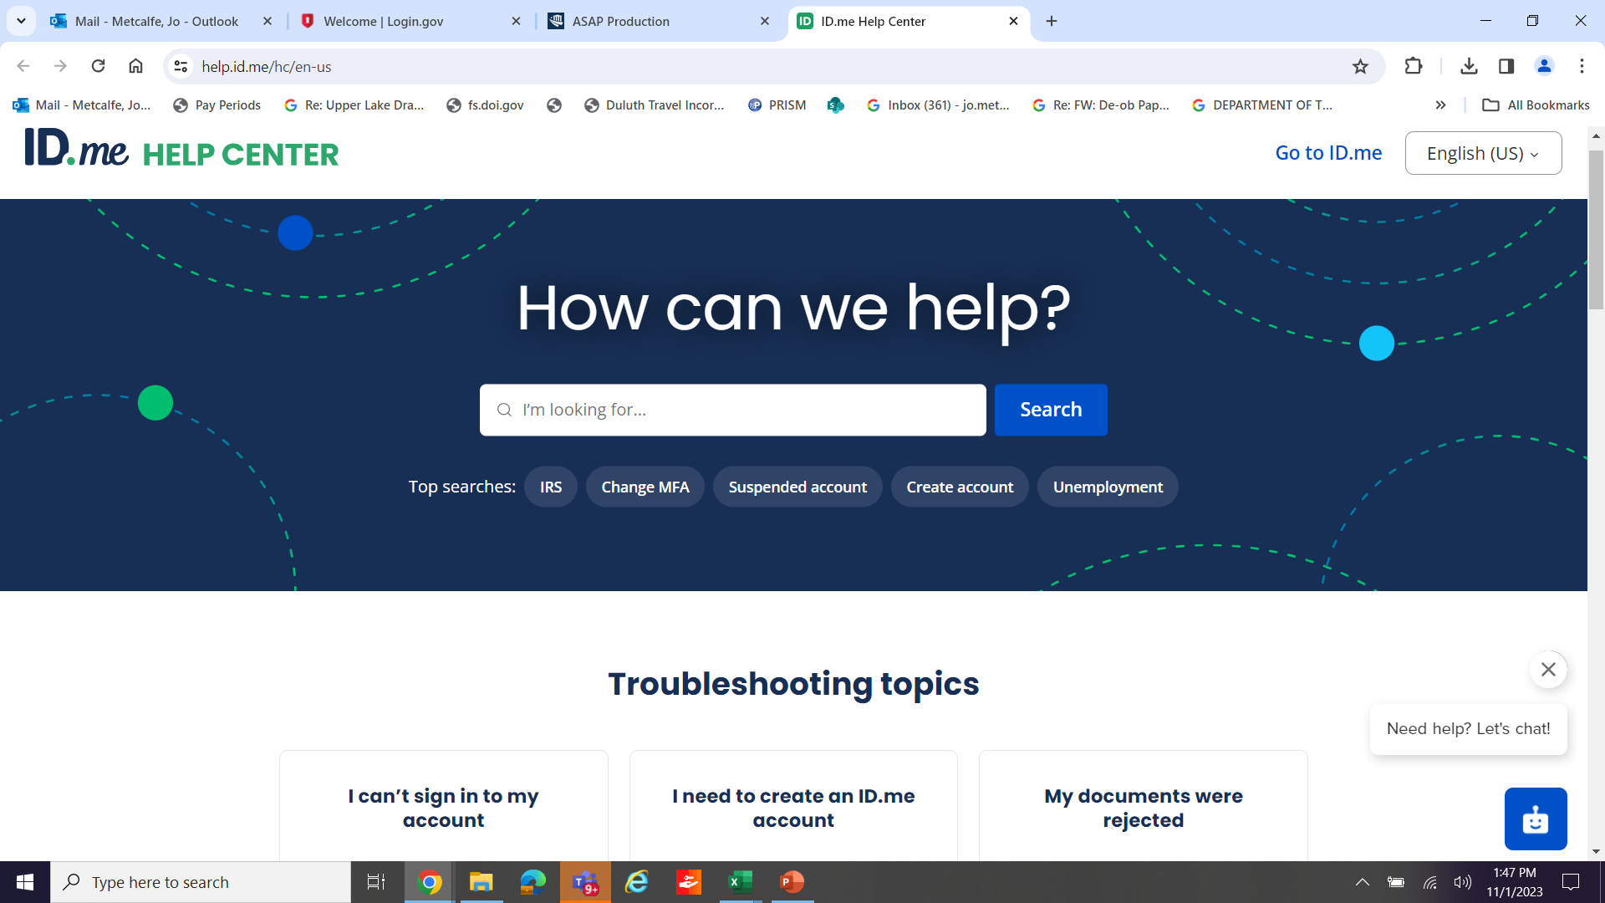
ID.ME HELP PAGE

Slide 5
MORE ID.me INFORMATION
Please go to www.id.me and then at the top right of their home page select “Help Center”, next, you will see a search feature and type in a keyword to find articles related to that topic
Use the word document and you will see the following:
Primary and secondary identification documents – ID.me Help Center
Documents to verify your identity – ID.me Help Center
Please read through the information at the links above that are from ID.me.
For more information, please contact ID.me
Effective September 15th 2023 to access ASAP, all organization users are required to register with ID.me, a multi-factor authentication (MFA) system, and validate their identity
Organization users will not be able to log into ASAP.gov until they register and validate their identity in ID.me.

Slide 6

ASAP Recipient Organization POC
Please fill in the requested information and submit via email to: diane.lahr@bia.gov
Section 1: Organization Information
*Organization Name:
*Organization Recipient ID:
*UEI (Unique Entity Identifier) |  |  | *DUNS: |  |  |  | *TIN/EIN:
POC contact information:
Name:
 | *First Name | Middle Initial |  |  | *Last Name
Title:
Address:
 | *Mailing Address
 | *City |  |  | *State |  | *Zip Code
Contact Information:
 | *Email |  |  |  |  | *Phone Number

Slide 7
Recipient Organization ASAP Enrollment
Please fill in the requested information to initiate the Automated Standard Application for Payments (ASAP) enrollment process. Fields marked with * are required. Failure to provide required data may result in delayed enrollment.
Section 1: Organization Information
Is your organization enrolled in ASAP for a Federal Agency other than BIA? ¡Yes ¡No
If yes, provide your Organization Recipient ID:
*Organization Name:
*UEI (Unique Entity Identifier) |  |  | *DUNS: |  |  |  | *TIN/EIN:
List contact information for the individual responsible for receiving ASAP communications
Name:
 | *First Name |  |  |  |  |  |  | Middle Initial | *Last Name
Title:
Address:
 | *Mailing Address
 | *City |  |  |  | *State | *Zip Code
Contact Information:
 | *Email |  |  |  |  | *Phone Number
Section 3: Organization Type
*Choose the category that most appropriately describes the recipient organization.
Financial Institution For-Profit Non-Profit Local Government Indian Tribal Organization |  |  |  | State Agency University / College University / College-State Other Educational Organization
Section 4: Submission Information
Submit via Email: |  | Email completed request to diane.lahr@bia.gov
Submit via Mail: |  | U. S. Bureau of Indian Affairs Attn: ASAP Enrollment 12220 Sunrise Valley Reston, VA 20191

Slide 8
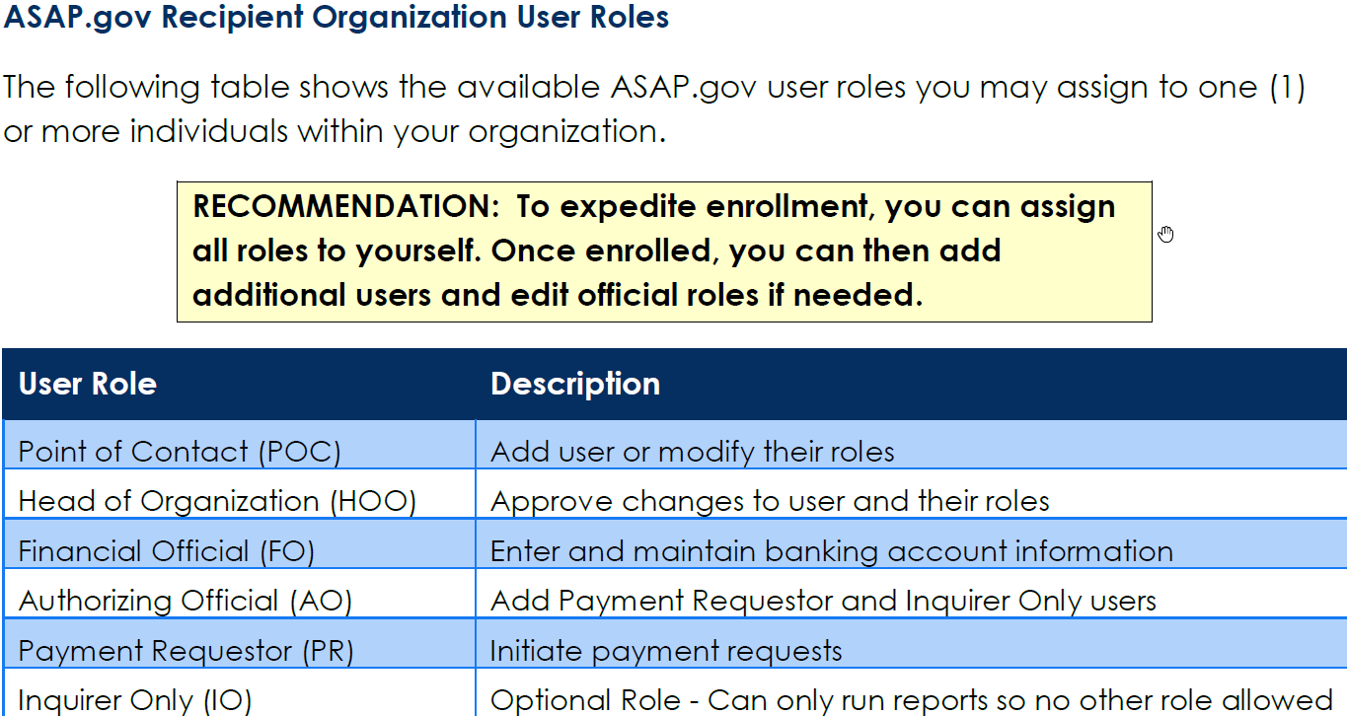
ROLES IN ASAP

Slide 9
WHAT HAPPENS NEXT?
On the same day IA enrolls a recipient, ASAP/Treasury sends an automated email to the recipient’s Point-of-Contact to review all their user information, It is important the POC reviews all information submitted to Treasury and accepts or makes necessary changes. This email also gives them a User ID (print and save) and they are told their password will arrive within 10 business days by US Mail. If this does not happen, please call the ASAP contact at BIA for assistance.
Recipients Log into the system with their User ID and password and completes enrollment per their assigned role.
Each appointed role has 30 days to complete their task to move toward
in the enrollment. On the 31ST day the process must be started all
over again until every role has done their job, or they will be deleted by Treasury.
When the recipient completes the enrollment process, they are considered
“ASAP Active”. However, at this point it takes 7-10 business days while Treasury
verifies banking information; before awards are loaded to their ASAP account.

Slide 10
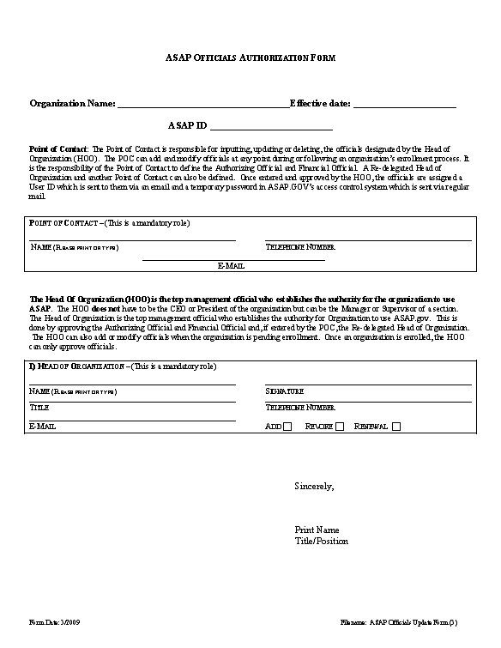
WHAT HAPPENS IF ALL THE ASAP USERS LEAVE?
Request this form

Slide 11
HOW TO DRAW DOWN FUNDS
Initiating Payments in ASAP
When a Payment Requestor wants to request payments in ASAP
The Payment Requestor logs onto ASAP using their ID and password.
Payment Requestor hovers over the Payment Requests Tab.
Payment Requestor Selects “Initiate Payment Requests” from the drop down menu.
Recipient must know the following to proceed
1.BIA’s Agency Locator Code 14200699
2.Recipient’s ASAP ID
3.Account ID Number/award followed by Line Number
(for example only: A14AV0001-0001)
4.Recipient must choose individual payment/never summary payment
5.Choose the following day’s date-never the same date for settlement
6.Follow the steps –fill in amount requesting and submit your request; confirmation occurs

Slide 12
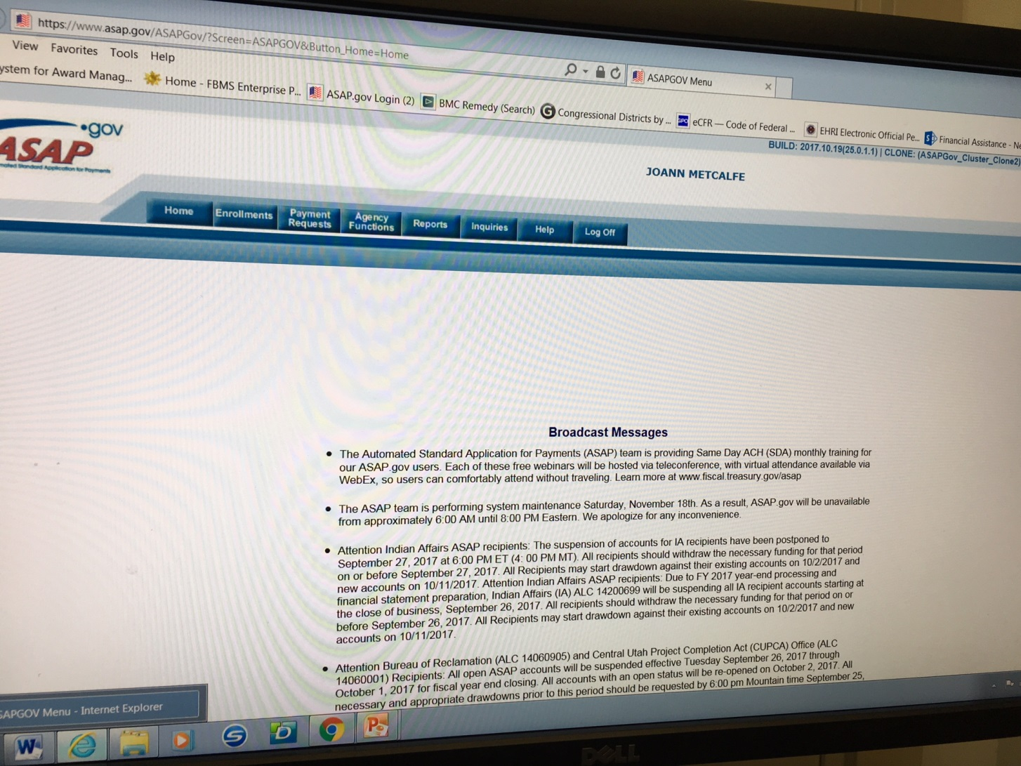
FIRST SCREEN YOU WILL SEE

Slide 13
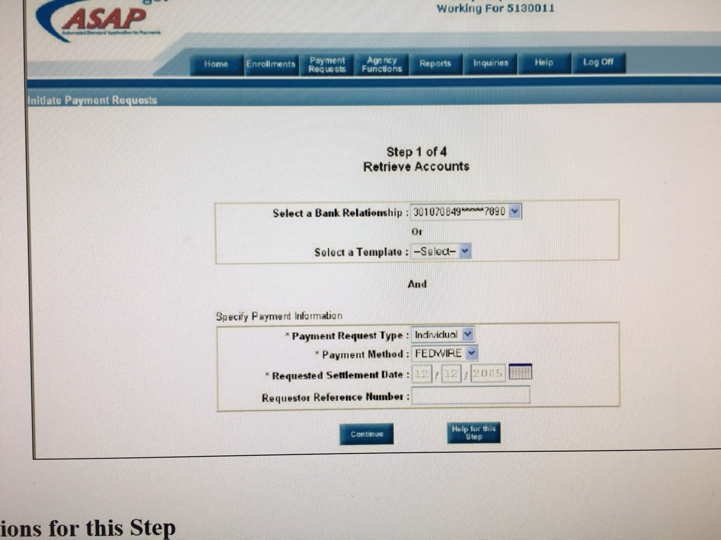

Slide 14
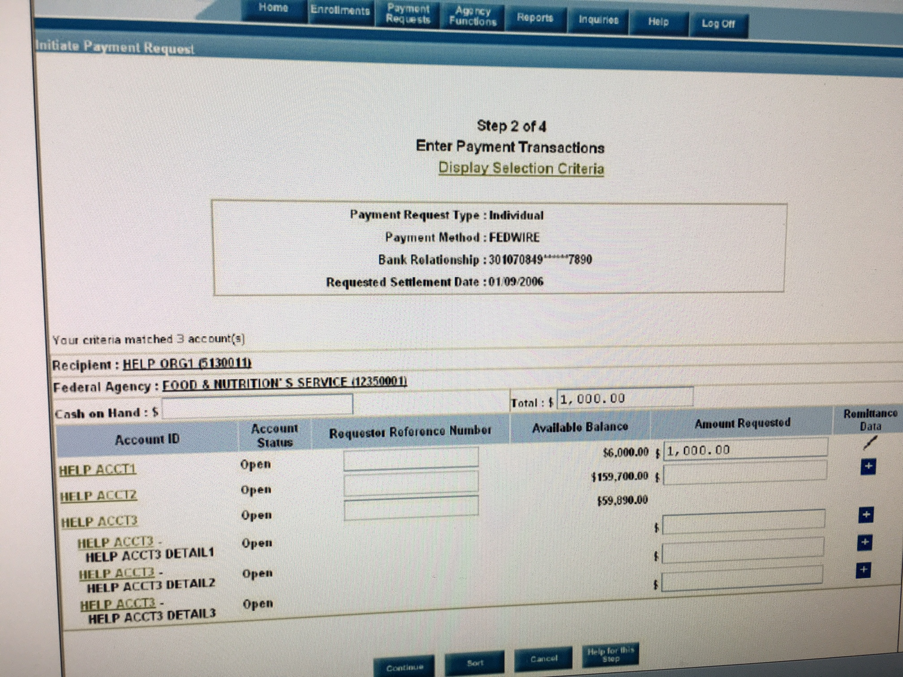

Slide 15
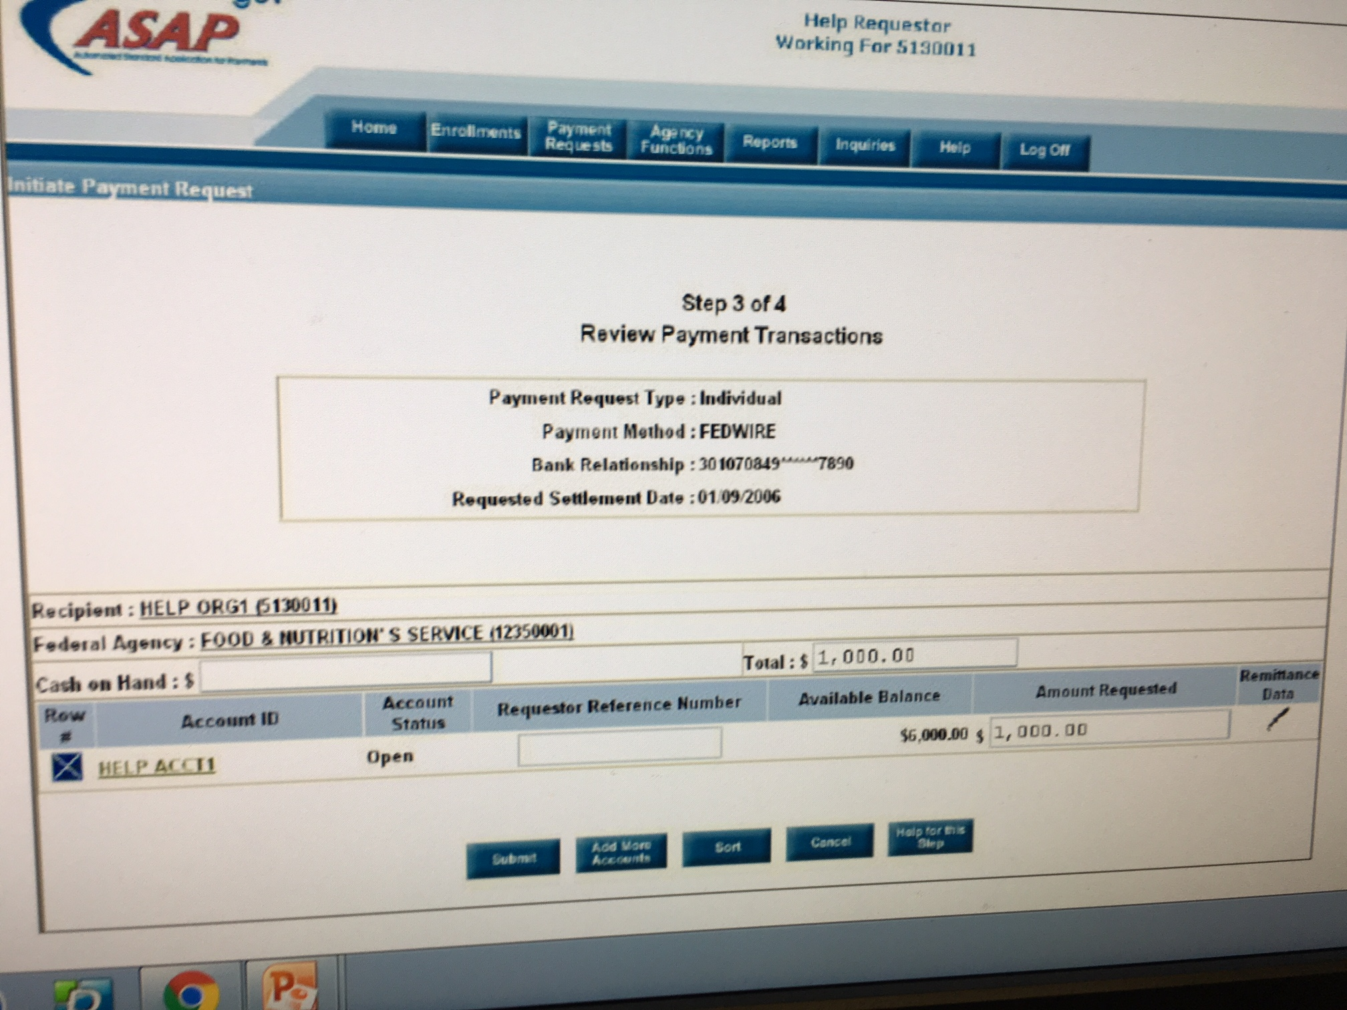

Slide 16
RESEARCHING and TROUBLESHOOTING TYPICAL ASAP SCENARIOS
You are enrolled in ASAP with another Department of Interior Bureau, but not with the Bureau of Indian Affairs.
You have an ASAP account with another federal bureau, but you must enroll with the U.S. Bureau of Indian Affairs, too, and list your ASAP ID on the ASAP.Gov Participation Request Form.
  Award was made, but the recipient is not enrolled and can not access ASAP
Alt Payee accounts established in FFS did not have UEI or TINS associated to the primary account (BIA corrects this)
If the UEI number is not found in SAM, it can mean several things.
ASAP recognized these Alt Payee accounts as separate accounts not registered in ASAP.
Awards may have missing UEI number

Slide 17
RESEARCHING and TROUBLESHOOTING (CONTINUED)
Incorrect UEI numbers registered in ASAP
Your UEI number has expired in www.sam.gov
Awards may have missing ASAP Recipient ID
Bank data errors; linking banking information, changed banks or account numbers-changing bank account will keep you out of the system for about 5-10 days
  If a bank data error exists, the Certifying Officers or ASAP contact notifies the ASAP Account Maintainers about the error, holds the account, keeps trying to certify the award, pending confirmation of a completed enrollment or a change in banking information.
If you are not able to see your awards or the amount of award is incorrect; please contact your awarding official or the ASAP contact to begin the review why they are not in your ASAP account or the amount of money differs.
You are having trouble accessing your ASAP account
You may need additional help with drawing down funds

Slide 18
RETURNING ASAP FUNDS
ONLY ASAP FUNDS THAT WERE DRAWN DOWN IN ASAP CAN BE RETURNED TO ASAP
If Financial Assistance funds were drawn down prior to February 2013, and funds were not originally dispersed by ASAP, funds cannot be returned by the ASAP process.
Or the obligated award was granted to incorrect elements of an account assignment such as an incorrect cost/fund center, incorrect functional area, or an ASAP ID tied to a vendor code in SAP that belongs to another recipient
Or, the recipient drew down too much funding, or received double funds” from one award line as a result of a manual payment

Slide 19
REASONS YOU MIGHT BE ASKED TO RETURN ASAP FUNDS
If an ASAP ID tied to a vendor code in SAP was incorrectly used that belongs to another recipient/the tribe received the wrong tribe’s funds
If the award was granted to incorrect elements of an account assignment such as an incorrect cost/fund center, incorrect functional area
Or, the recipient drew down too much funding, or received double funds” from one award line as a result of a manual payment

Slide 20
RETURNING FUNDS IN ASAP
To account for Financial Assistance funds, the funds must be returned through the same ASAP system from which they were drawn down. If these returned funds are returned by check to the BIA, or to IBC, these checks/funds will be marked as void and returned to the program office with instructions to contact Jo Ann Metcalfe for assistance in processing the return of funds through the ASAP system.

Slide 21
RETURNING FUNDS IN LESS THAN 32 DAYS FROM DRAW DOWN:
The Return ACH Payment feature allows the Payment Requestor to initiate an ACH Debit to their bank account to return an ACH payment made within the last 32 days online at
www.ASAP.gov. The ACH Debit can be for the full or partial amount of the payment. By initiating an ACH Debit, the Payment Requestor will be requesting the U.S. Treasury Department to initiate an ACH debit against the bank account to which the original payment was sent. This feature will not allow a second ACH Debit to be initiated against the same payment.

Slide 22
RETURNING FUNDS MORE THAN 32 DAYS OLD:
If the drawn down date is more than 32 days, ASAP requires the recipient to fill out
Making Adjustments and Returning Funds to ASAP (FUNDS TYPECODE 1000 AND 1002 FORMAT FOR RETURNING FUNDS TO ASAP).
This form will be given to the recipients’ financial institution and requires detailed information which includes the routing number for ASAP which is 051036803. When the bank looks for this routing number, please tell them their wireroom has to manually input the routing number and override the software as it is a Treasury Routing Number which is accurate.

Slide 23
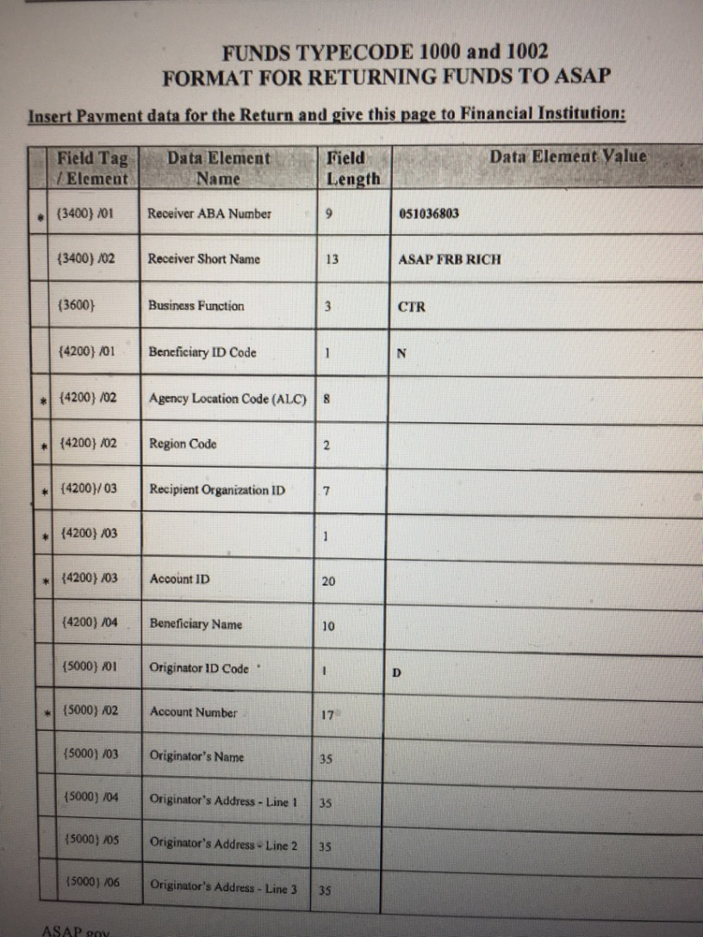
FORM USED TO GIVE TO THE BANK’S WIRE ROOM

Slide 24
STRINGENT COMPLIANCE
Because government grants are funded by tax dollars, they require stringent compliance and reporting measures for ensuring the money is well-spent.
Grants from the federal government are authorized and appropriated through bills passed by Congress and signed by the president. Grant authority varies among agencies.

Slide 25
WHAT IS REQUIRED IF THIS IS NOT A 638 GRANT
THERE ARE TWO SETS OF REPORTS: NARRATIVE REPORT AND FINANCIAL SF425 REPORT
NARRATIVE & PERFORMANCE REPORTS
  The Recipient must submit performance & financial reports to the Bureau Grant Officer pursuant to 2 C.F.R. § 200.328 & 200.329.
  The reports shall, at a minimum, include the following:
    A comparison of actual accomplishments of the Scope of Project established for the period, (What did you do for this quarter- hire a consultant, begin your project)?
    The reasons for slippage if established objectives were not met;
    Additional information including, when appropriate, analysis and explanation of cost overruns or high unit costs; and
    Detailed performance information on the activities conducted.

Slide 26
TREASURY ASAP CONTACT INFORMATION
Richmond Federal Reserve Bank, 804/697-8384
RFC’s Day-to-Day Operational Support
  Kansas City 855/868-0151, Press 2, then Press 3
  Last Name and Email Address Changes
  ASAP Password Resets
FMS ASAP General Information and Program Updates
  http://www.fms.treas.gov/asap

Slide 27
REPORTING CONTINUED
  The Recipient must submit SF425 financial & performance reports to the Bureau Grant Officer pursuant to 2 C.F.R. § 200.327 and 200.328.
  The financial reports shall, at a minimum, include the following:
  AMOUNT OF FUNDS AWARDED/AMPOUNT OF FUNDS DISPERSED/TOTAL REMAINING
  THE NAME OF THE TRIBE OR RECIPIENT
  THE AWARD NUMBER
  THE QUARTER NUMBER FOR WHICH THIS IS BEING SENT
  ALL REPORTS- BOTH NARRATIVE AND SF425’S ARE DUE 30 DAYS FOLLOWING EACH REPORTING DATEAND A FINAL REPORT IS DUE 120 DAYS FOLLOWING THE END OF YOUR PERIOD OF PERFORMANCE.

Slide 28
BIA ASAP CONTACT INFORMATION
571-560-0635
571-560-0635
Jo Ann Metcalfe
ASAP Grant’s Contact
Grant Officer
(410-703-3390) PST
jo.metcalfe@bia.gov
Diane Lahr
ASAP Point of Contact
diane.lahr@bia.gov
571-560-0635
571-560-0635
Andrea Wilson Elizabeth Ayala
Grant Officer Grant Specialist
andrea.Wilson@bia.gov Elizabeth.Ayala@bia.gov

Slide 29

User Questions Open Forum and Wrap-up

