Slide 1
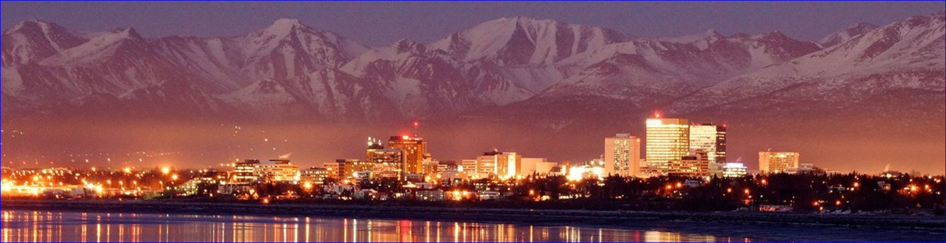

Bureau of Indian Affairs, Alaska Region
2024 Tribal Transportation Program
TTPA 101 Overview
Anchorage, AK 04 Dec 2024
MARLENE D. WATSON, M.S., M.A., Mdiv.
Civil Engineer - TTP
3601 C Street, Suite 1278
Anchorage, AK 99503
(907) 271-2286
Marlene.Watson@bia.gov

Slide 2
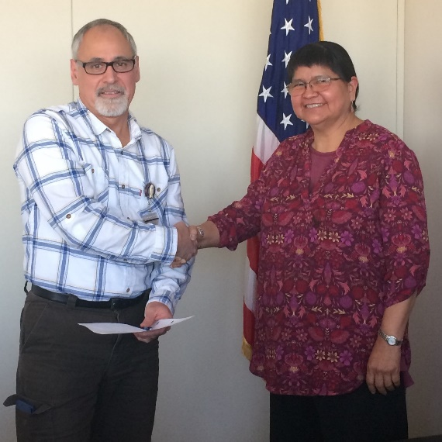
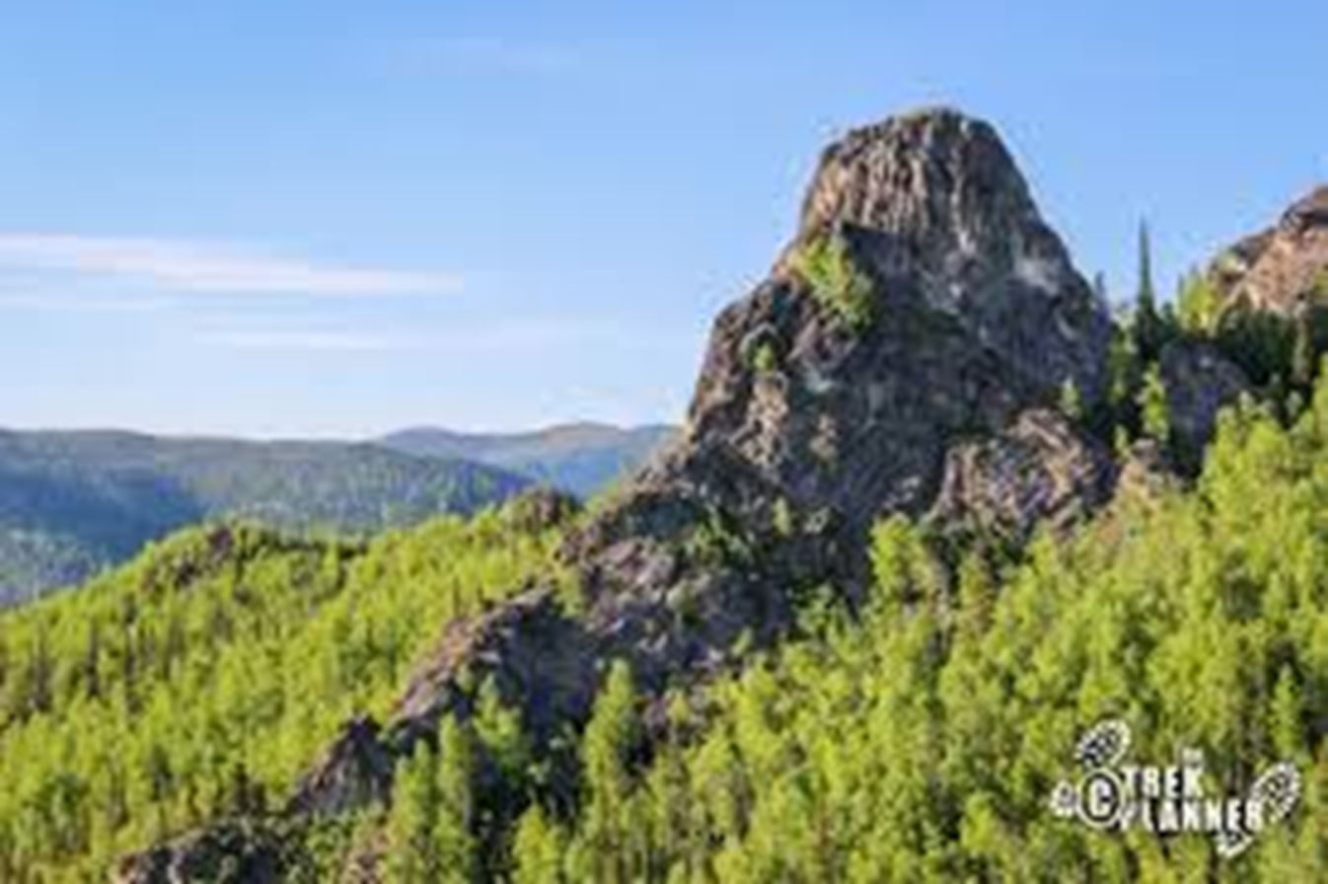

Speaker – Marlene D. Watson
Education
Masters of Civil Engineering
Masters of Architecture
University of California, Berkeley
ANGEL ROCK
BIA - TTP
Enjoy
Joined April 2019
Awarding Official Technical Representative (AOTR)
Hiked to top of Angel Rock
Photo moment with moose and calves

Slide 3
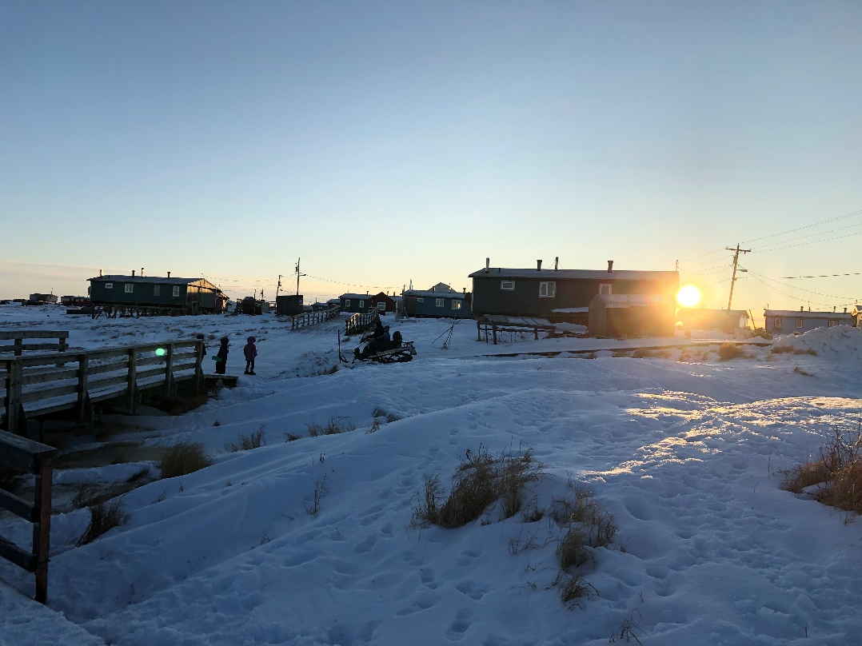
Talking Points
BIA TTPA Agreements: How to Open a New One to Close-Out
  TTPA Historical Agreement
  2025 Fiscal Year Funding and Program Agreement Timelines
  Notice of Funds Availability (NOFA)
  TTPA TTP Funds Under One Roof
  Program Agreement (PA)
  Reference Funding Agreement (RFA)
  Federal Financial Reports (FFR)
  Program Agreement Close-Out
  Questions?

Slide 4
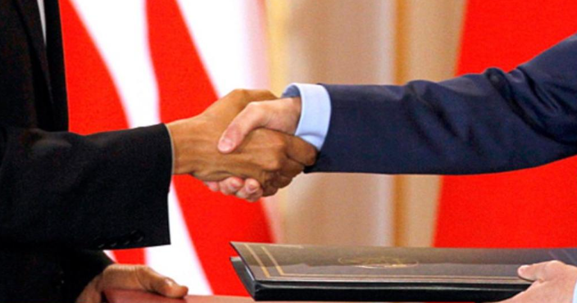

BIA TTPA Agreements
Historical Agreement Took Place
  For Immediate Release: December 15, 2002
  On a chilly, overcast day, leaders from twenty-nine tribal nations stood next to Bureau of Indian Affairs officials, a pen was put to paper and a historic agreement establishing the first government-to-government consultation policy between the BIA and the tribal nations was signed on December 13, 2000 in Seattle, Washington.

Slide 5
2025 Fiscal Year (Oct. 1, 2024)
Funding and Program Agreement Timelines
Date
12/xx/2024 | NOFA, FY2025 TTP xx-Day Tribal Shares
 | - NOFA Letter and Tribal Shares List.
12/xx/2024 | NOFA, FY2025 TTP Final Tribal Shares List.
 | - NOFA Letter and Tribal Shares.
 | No 93-638 Contract Proposal, No 2-day,15-day Comment or contract approval letters.
Begin FY2025 | BIADOT Creates a New TTP Program Agreement, RFAs (Annually), & RFA Amendment Templates.
FY2025 | Tribe Submits TTIPs/Certs/Tribal Resolution/ 3Yrs Single Audit Cert (SACs) or SARs.
FY2025 | BIA TTP Prepares Risk Assessment (RA)/FHWA TIPs.
FY2025 | BIA TTP Sends a Program Agreement and FY2025 RFA Tribe to sign.
FY2025 | BIA TTP Creates a PR and Assembles a Program Agreement/FY25 RFA/Items above.
FY2025 | BIA TTP Submits PR/PA/RFA/SACs/Tribal Resolution/RA/FHWA TIP & Certs.
End FY2025 | BIADOT Signs and Approves a New TTP PA, RFAs or RFA Amendment w/ submittal.
TBD | Tribe withdrawals TTP funds in its entirety or as needed.
TBD | No Drawdown Request Letter or Supporting Documents Required
TBD | Tribe Receives Funds, Expends Entire TTP Program Agreement and Submits Deliverables
TBD | BIA and Tribe Close-Out TTP Program Agreement
Subject

Slide 6
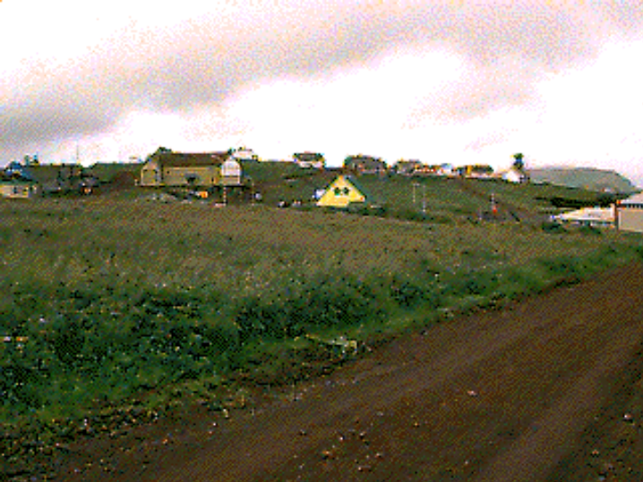
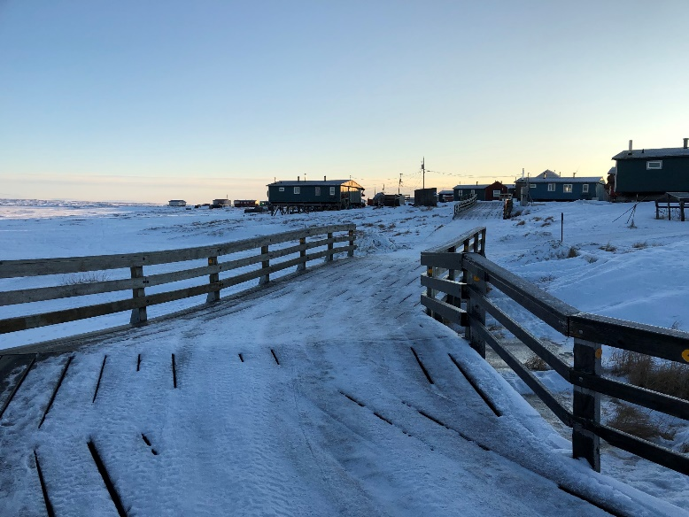
Notice of Funds Availability (NOFA)
BIA TTP Notifies the following to Tribes
  Identifies available funding amounts
  Estimates Final Tribal Share amounts
  Identifies BIA POC by Tribe
  NOFA Letter includes response instructions
Tribes Respond
  Signed Resolution to enter into Program Agreement
  Tribal Transportation Improvement Program (TTIP)
  TTIP Certification
  Prior Year TIP Certification (or eMail from Tribe)
  Single Audit Certification (SAC) OR Report (SAR)
  Signed Program Agreement (PA) & Referenced Funding Agreement (RFA)
Templates
  TTIP Template(s)
  Certification Template(s)
  TTPA Tribal Resolution Template
  Single Year Audit Certification Template(s)
  Program Agreement, RFA, & RFA Amendment Templates.

Slide 7
How Do AK Tribes Spend TTP Funds?
How Tribes Spent TTP Funds
FY2012 – FY2023 ($M)
How Tribes Spent TTP Funds
FY2024 Only ($M)
Notes:
Here are the program elements depicted as a pie chart showing how the TTP dollar is allocated by tribes in Alaska Region.
If you compare the past 11 years FY2010 to FY2023 (circle on left) with FY2024 (circle on right), the following is evident.
42% going to planning and maintenance for the 11 years vs 46% for FY23, a 4% increase
Increasing amounts for design, 6% to 10% and
Decreasing amounts for construction, 42% to 14%
Under the FAST-Act and BIL the upper limit for maintenance was $500K or 25% of tribal shares, whichever is greater. Under SAFETEA-LU the maintenance upper limit was 25% of tribal shares, period.
Our database allows us to analyze each tribes program in the same way which allows us to provide advice on where future resourcing should go and how you might plan to employ that next TTP dollar.

Slide 8
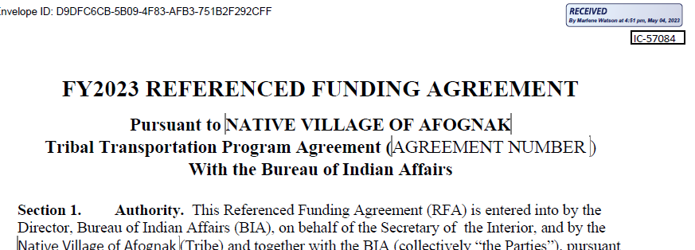
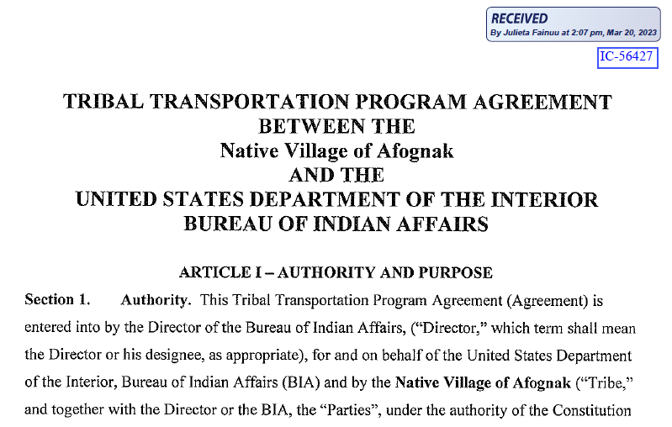
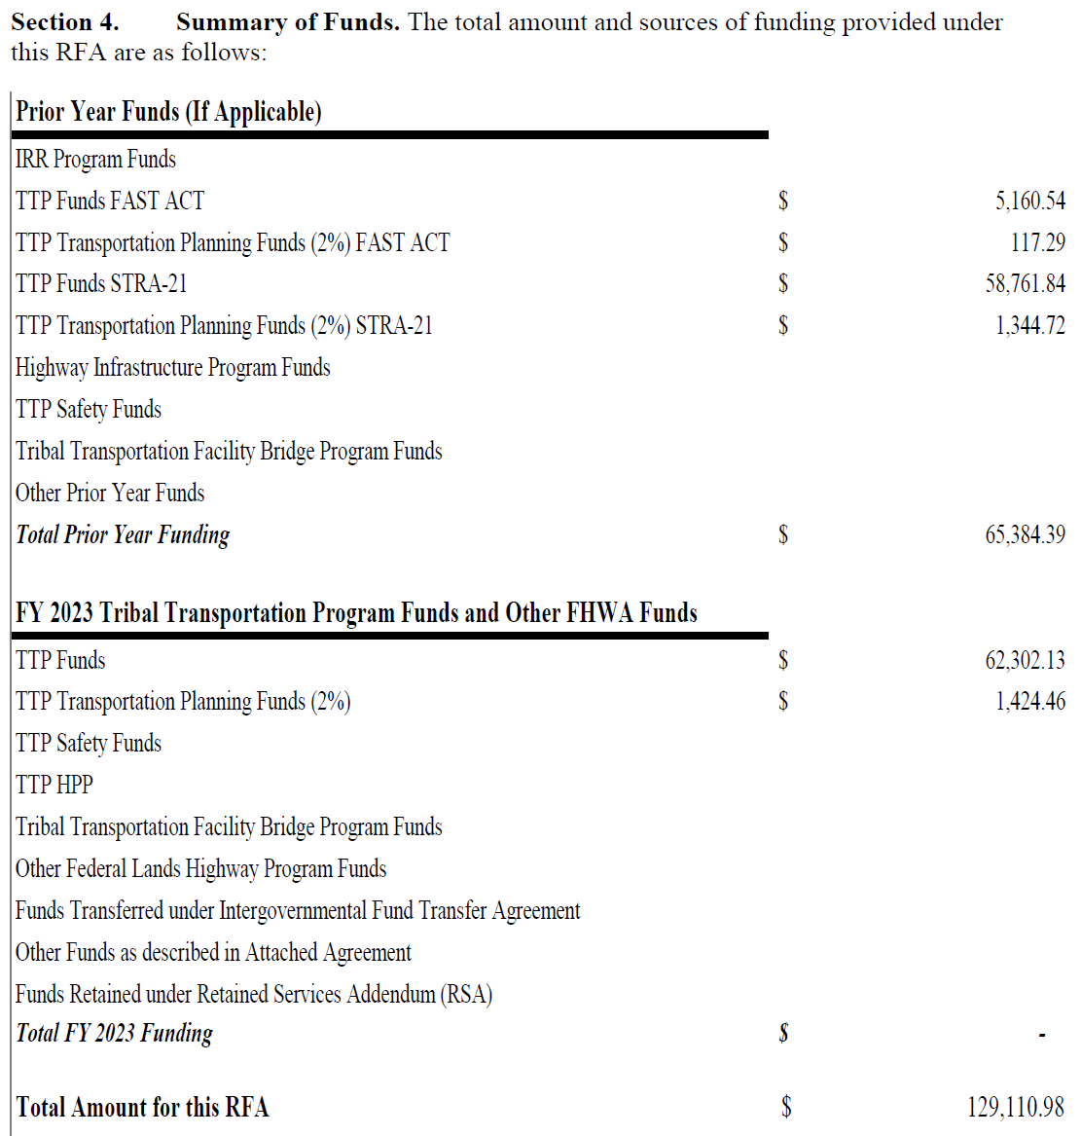
BIA TTPA Program Agreement & RFA

Slide 9
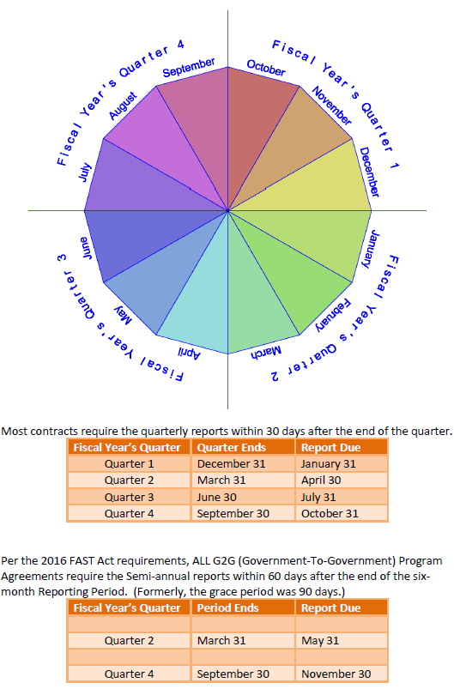
Federal Financial Reporting Calendar

Slide 10
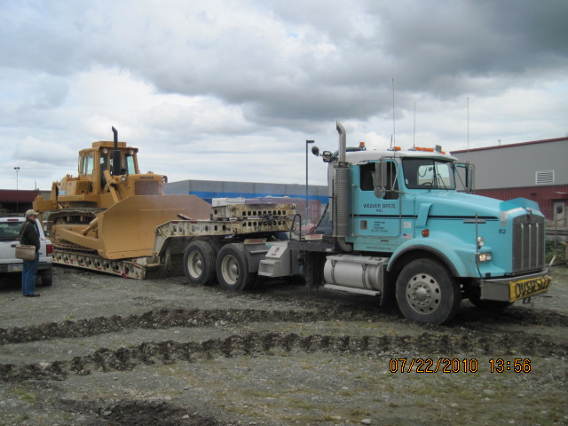
Program Agreement Close-Out
Close-Out Packet
  Close-out Letter
  Property Record
  Contract Certification Statement
  Release of Claims
  Final Financial Report, SF 425
  Final Narrative

Slide 11
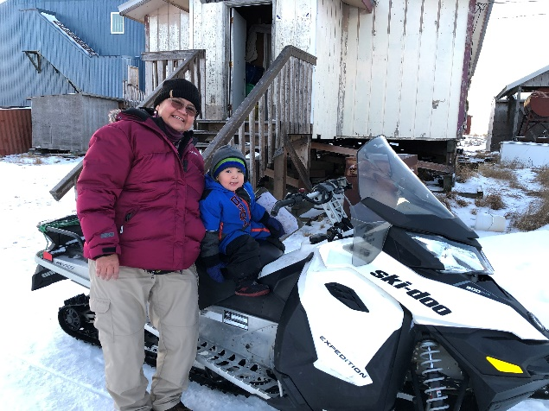
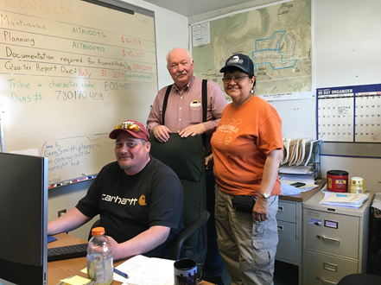
Questions?
BIA Alaska Region
MARLENE D. WATSON, M.S., M.A., Mdiv.
Civil Engineer - TTP
3601 C. Street, Suite 1278
Anchorage, AK 99503
(907) 271-2286
Marlene.Watson@bia.gov
FAX: (907) 271-6163
11
Notes:
11

