Slide 1
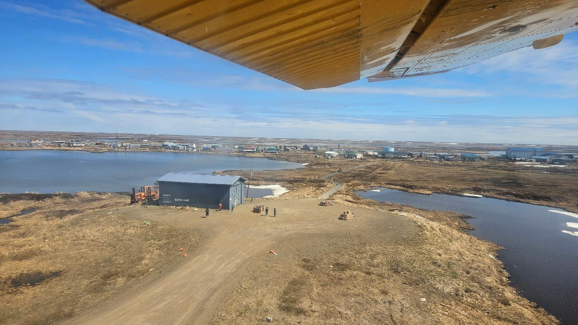



Newtok: An Example of Tribal Resilience
Tracy McKeon, PE
RESPEC
Newtok Village Council Project Manager
Contact Information: tracy.mckeon@respec.com

Slide 2
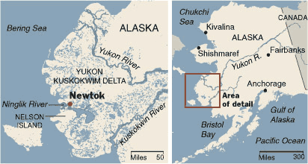
Introduction to Newtok
Newtok
Population: 202 – 2020 census
Remaining population: 1 person
Mertarvik
Population: 301
Location: Bethel Census Area
Lifestyle: Active subsistence
Newtok History Story Map:
A Brief History of the Settlement of Newtok and Village Relocation Efforts.

Slide 3
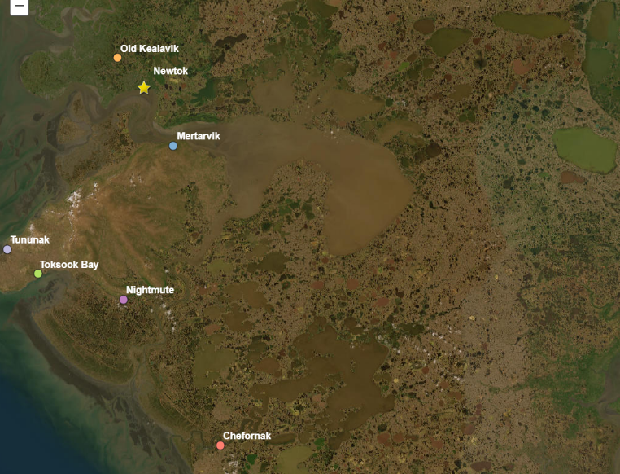
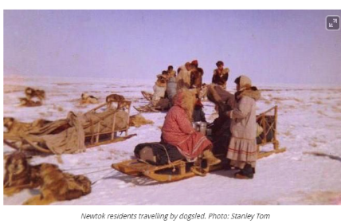
The Qaluyaarmiut: People of the Dip Net
Known as the Qaluyaarmiut, or “dip net people”.
Reside primarily in five villages: Newtok to the north of Nelson Island, the Nelson Island villages of Tununak, Nightmute, and Toksook Bay, and Chefornak to the south.
Ancestors of the Qaluyaarmiut people have lived on the Bering Sea Coast for the last 2000 years.

Slide 4
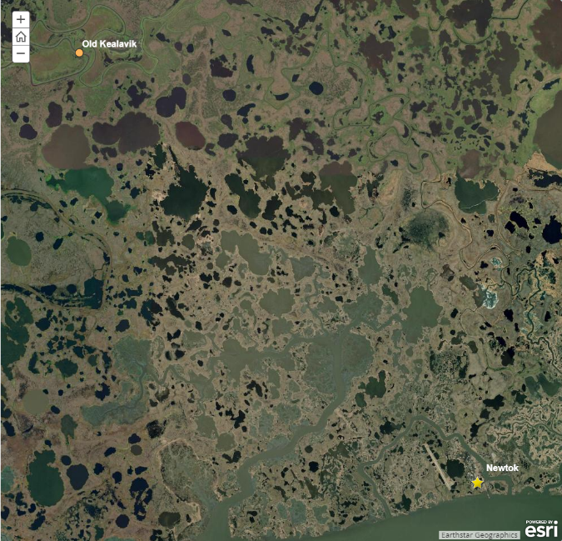
Settlement at Newtok
First reported in 1949 by the U.S. Geologic Survey
Community moved from Old Kealavik, the seasonal winter camp located to the northwest of Newtok. Old Kealavik experienced flooding - unsuitable location for a school.
Newtok site was the farthest point upriver that the BIA barge could navigate to offload school building materials.
BIA school was built in 1958 -- village developed around the school.
Old Kealavik
Newtok

Slide 5
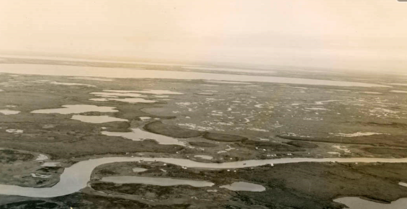

Slide 6
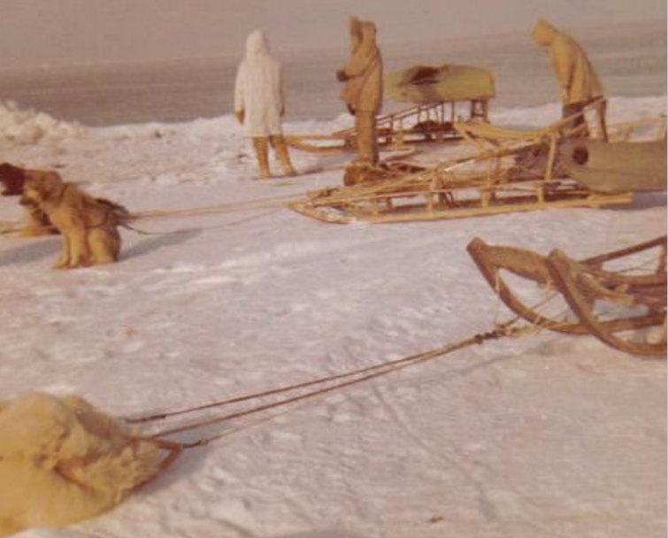
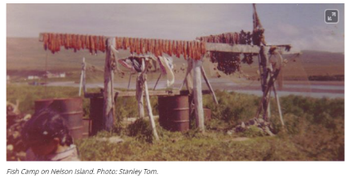
Ties to Nelson Island and a Subsistence Way of Life
Availability of subsistence resources determined where people lived at different times of the year.
In the 1960s, the Newtok village site served primarily as a winter camp for the residents.
People would move by dog team in April, before ice break-up, to the summer fish camp on Nelson Island.
Winter months were spent at the Newtok village site.

Slide 7
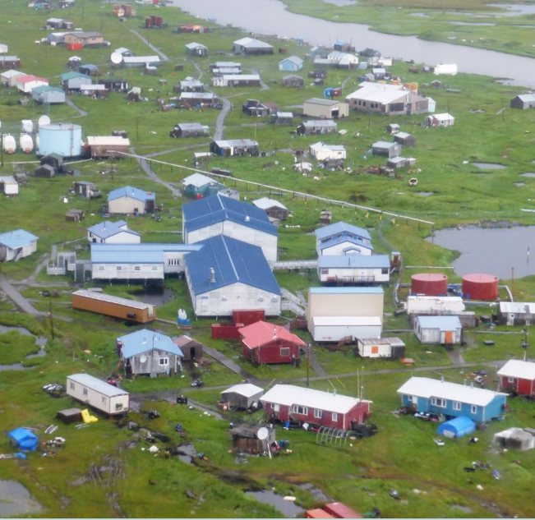
Outside Contact and Permanent Buildings Bring Change
Development of a modern village community with a school, clinic, airstrip and modern housing influenced a more stationary, year-round population at Newtok.
Snowmobiles eventually replaced dogteams.
The last qasgiq was abandoned in 1970s and the first HUD housing projects were built.

Slide 8
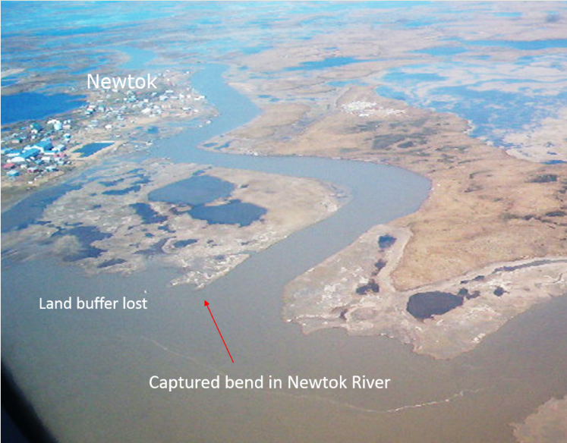
Early Efforts to Address Erosion
In 1970s, residents became increasingly aware that the north bank of the Ninglick River was rapidly losing ground.
Community initiated their own community-based monitoring effort using stakes.
Community received funding through the Alaska Legislature for erosion assessment.
“Relocating Newtok would likely be less expensive than trying to hold back the Ninglick River.”

Slide 9
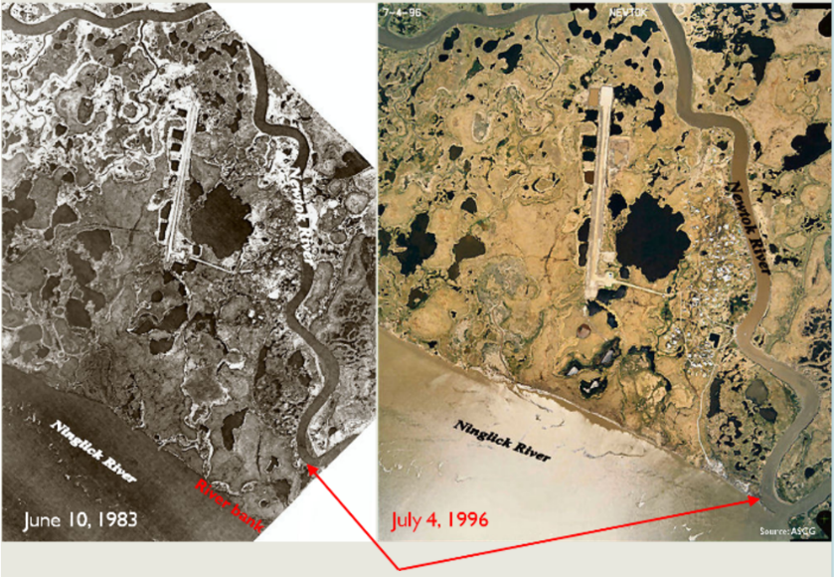
Early Relocation Planning
In 2000, Newtok’s tribal council initiated a relocation planning process and assessed six potential village relocation sites. Mertarvik, which in Yup’ik means “getting water from the spring” was selected.
Community developed early reports on early planning and geotechnical analysis o Mertarvik.

Slide 10
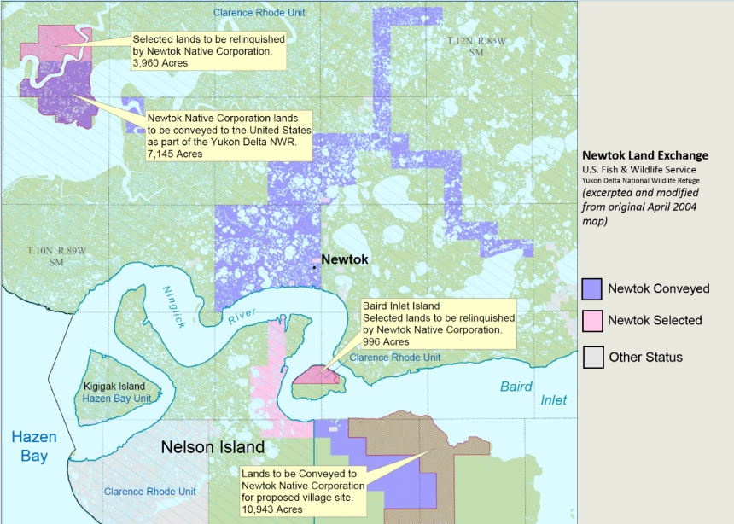
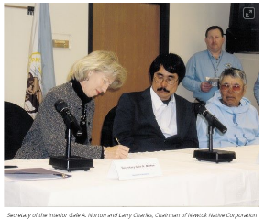
An Act of Congress: The Land Exchange
In November 1996, the Newtok Native Corporation passed resolution authorizing negotiation of land exchange within the Yukon Delta National Wildlife Refuge with the U.S. Fish and Wildlife Service (USFWS).
On November 17, 2003, United States Public Law 108-129 was signed into law.

Slide 11
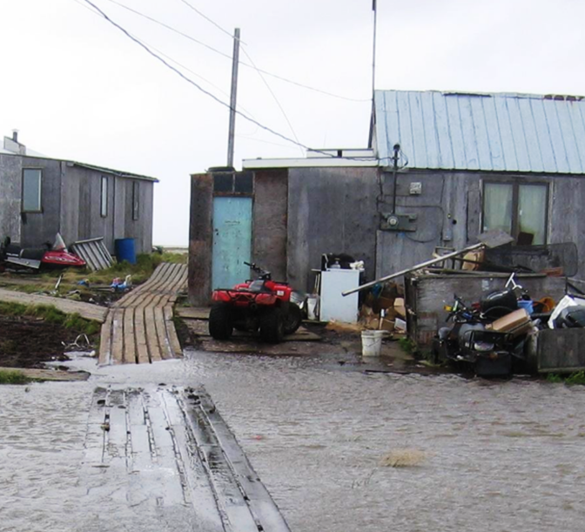
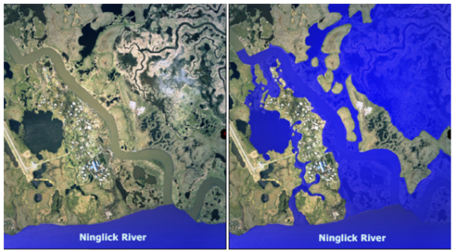
Compromised Public Health and Safety
Progressive erosion led to serious public health threats to community.
2006 study concluded that existing conditions “appear(ed) to result from an initial lack of infrastructure development and failure to properly maintain existing infrastructure."

Slide 12
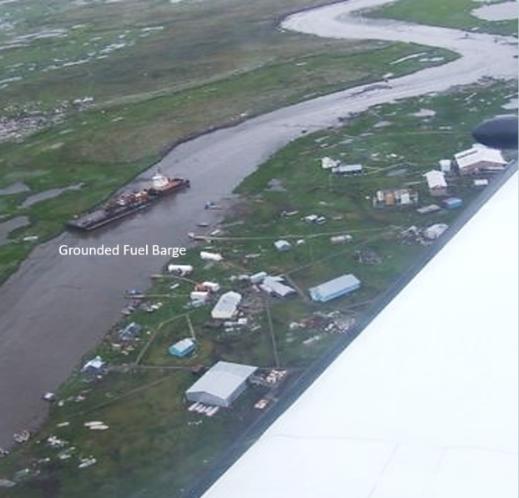

Difficulties Delivering Fuel
Village barge landing lost to erosion of the Ninglick River in 2005 impacting delivery of construction materials or other large items.
In August 2006, a fuel barge was grounded in the Newtok River for three days (right). Fuel had to be flown into the village when delivery could not be made by barge.

Slide 13
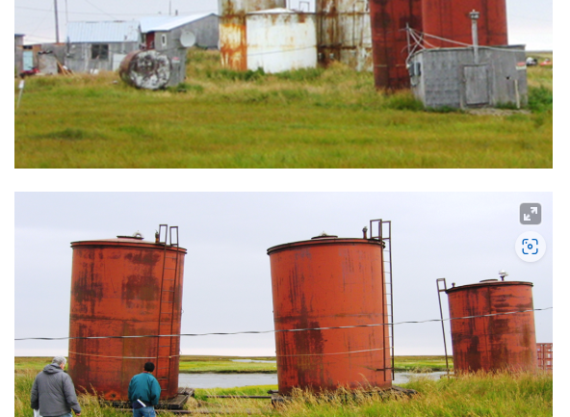
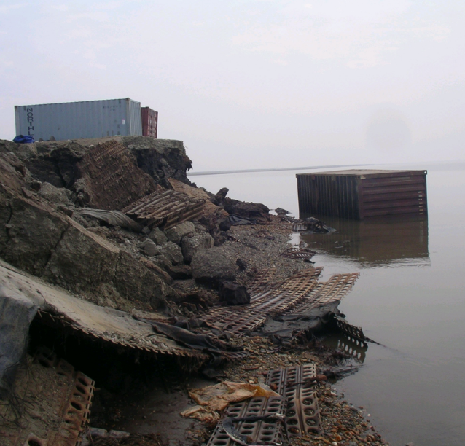
Deferred Community Maintenance and Investment

Slide 14
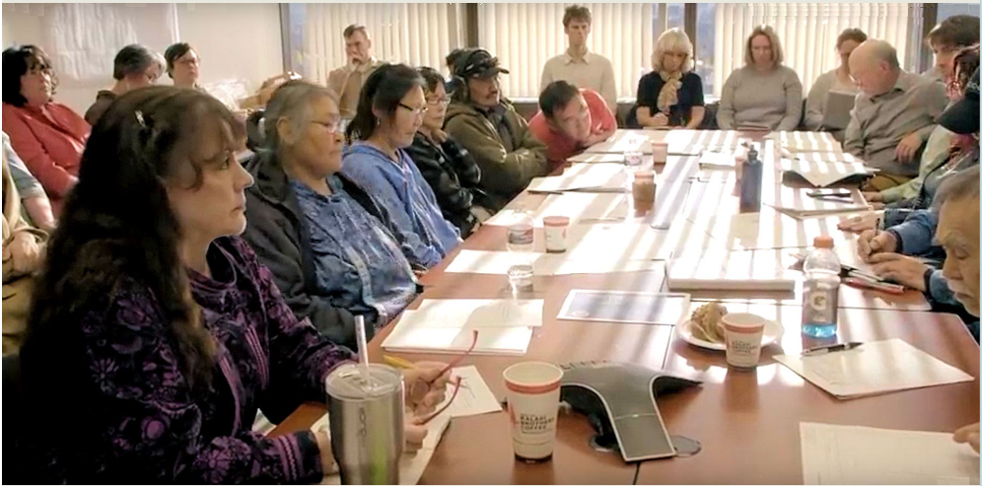
The Newtok Planning Group (2006 - present)
Notes:
In early 2006, the Newtok's Tribal Council requested the assistance of the Division of Community and Regional Affairs (DCRA) within the Department of Commerce, Community and Economic Development (DCCED) with Newtok's relocation effort. Newtok had scaled several significant hurdles by reaching consensus on the decision to relocate, evaluating and selecting a feasible relocation site, and acquiring site control of the new village site. Despite these accomplishments, the community was being met with substantial obstacles to carrying out the physical relocation. No state or federal agency was authorized to relocate a village. Government policy guidelines posed barriers to investing in new communities where no population was established. Several agency policies set population thresholds in order for investments to be made. Meanwhile, Newtok continued to lose land to the Ninglick River, the community was becoming increasingly vulnerable to coastal sea storm, storm surges and flooding, critical community infrastructure was deteriorating, and public health issues were increasing.
DCCED is directed by two Alaska Administrative Orders (AO 231 and AO 239) "to act as the state coordinating agency to coordinate with the other state and federal agencies to propose long-term solutions to the ongoing erosion issues in... affected coastal communities..." Consistent with this directive, DCRA organized the Newtok Planning Group (NPG) to coordinate assistance to Newtok on the relocation effort.
The concept of the Newtok Planning Group is simple: bring together on a regular basis representatives of state and federal agencies and regional organizations that are currently working with Newtok within their respective agency authorities in order to pool multi-disciplinary expertise, leverage resources, and brainstorm a strategy to make Newtok’s relocation to Mertarvik a reality. DCRA has organized and facilitated the meetings, and the Newtok Village Council and Newtok Native Corporation are at the table with state and federal agency partners. Membership in the planning group is voluntary, but participation is strong because members recognize the value of the meetings to the work they doing for Newtok.
The NPG has convened regularly since its formation, working with Newtok and across agencies to leverage resources, secure funding, and to establish a framework and strategy for moving the relocation process forward. Download a list of the participants in the NPG.

Slide 15
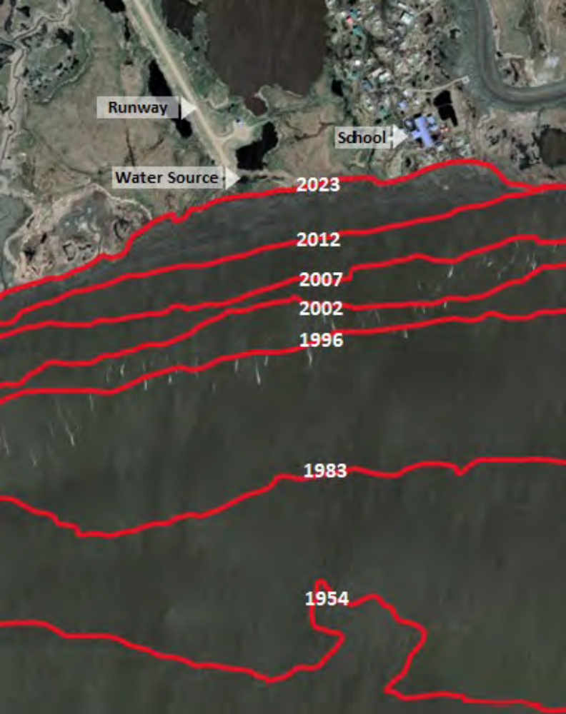
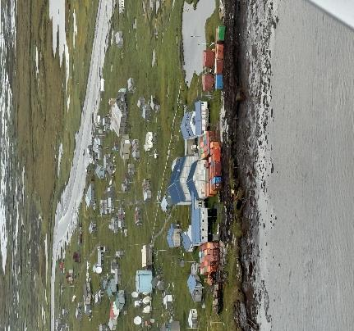
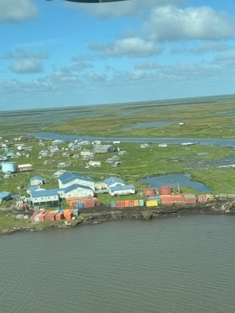
Newtok Shoreline Erosion Then and Now
Newtok Shoreline Erosion
Erosion Graphic: ASCG, Inc. and Google Earth
Photo credit: Daniel Maczynski, LKSD

Slide 16
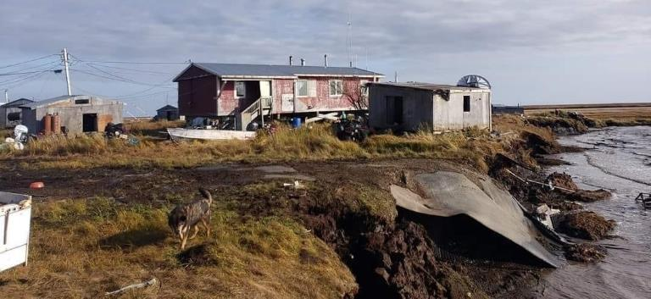
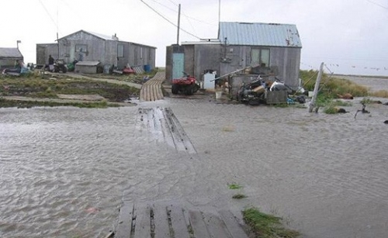
Newtok - A Community in Crisis
Power plant
School
Clinic
Airport
Corporation / Store
Water Source
Landfill
Telecommunications

Slide 17
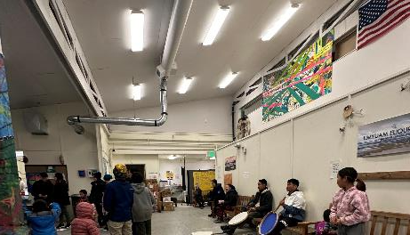
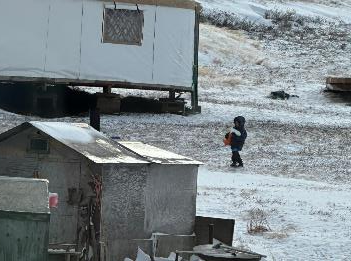
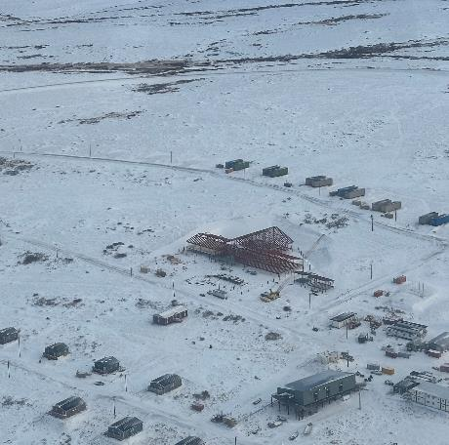
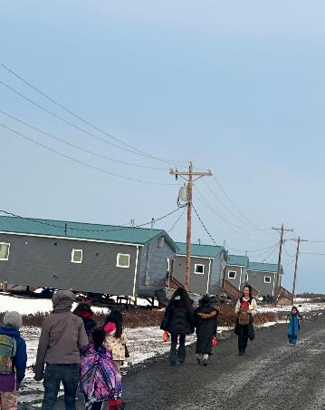
Mertarvik – Reuniting the Community
Housing
Power
Washeteria
MEC
Barge Landing
School
Clinic
Water/Sewer
Social / Emotional / Traditions

Slide 18
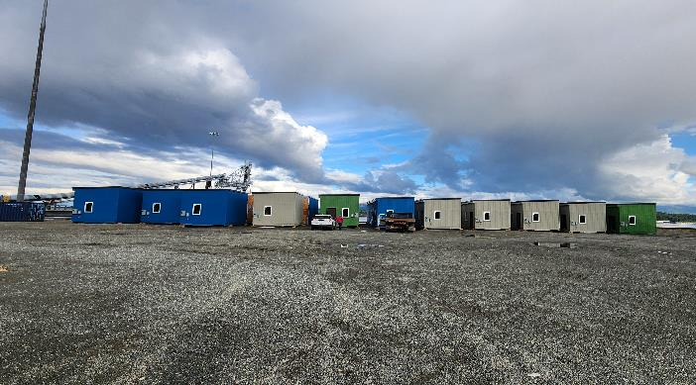
More Housing Photos
Community Input and Feedback for Design
Chest Freezer space
Arctic Entries
Space for Washer (NIC)
Ranges included with homes
Space for Refrigerators (NIC)
Bedroom space for two queens
Storage space
Toyo Stove for Heating
Wood Stove consideration (NIC)
Portable generator provided
Large family consideration
Minimum R-value
Water tank – gravity fed
Community power hookup with
power switch

Slide 19
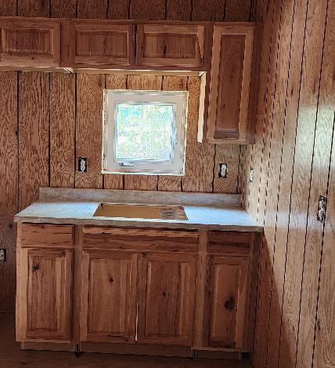
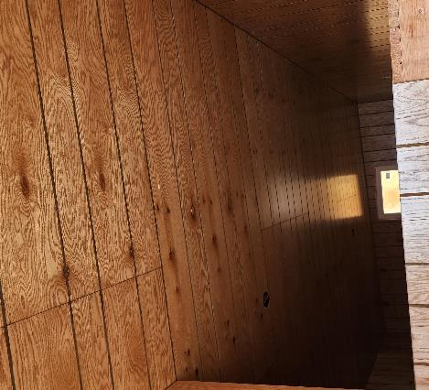
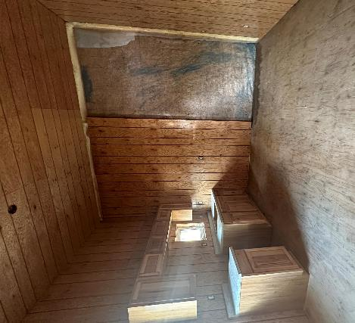
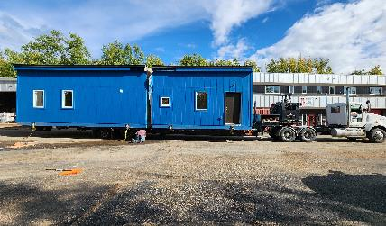
Remote Building

Slide 20
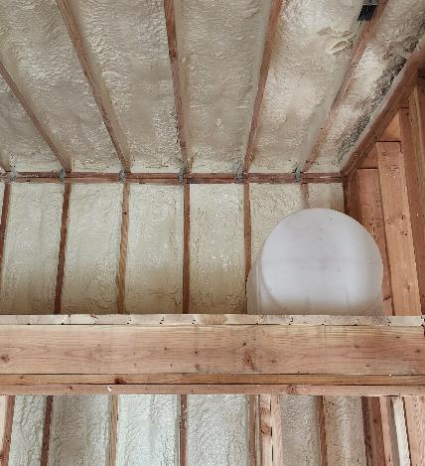
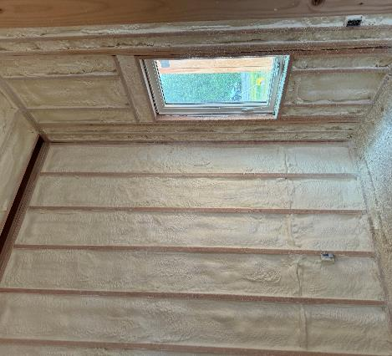
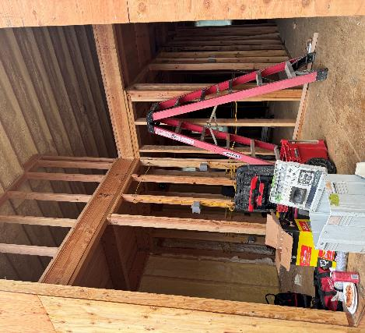
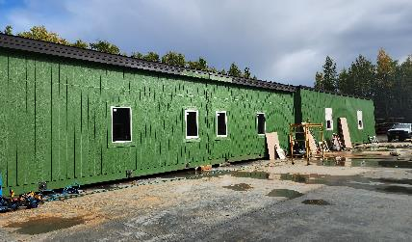
Housing
Remote Building

Slide 21
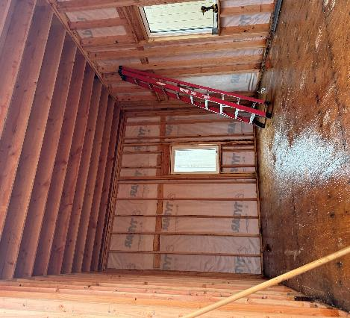
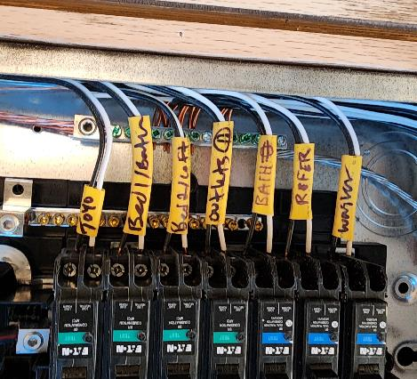
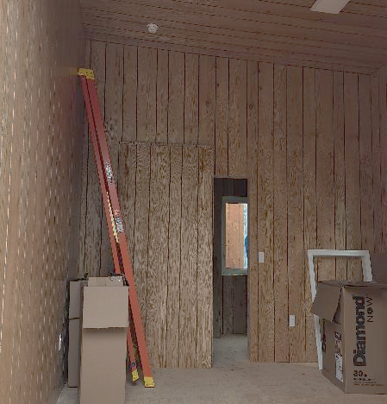
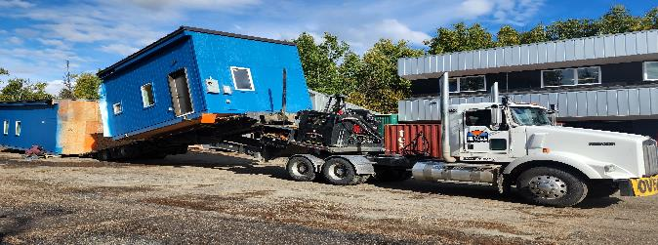
Housing
Remote Building

Slide 22
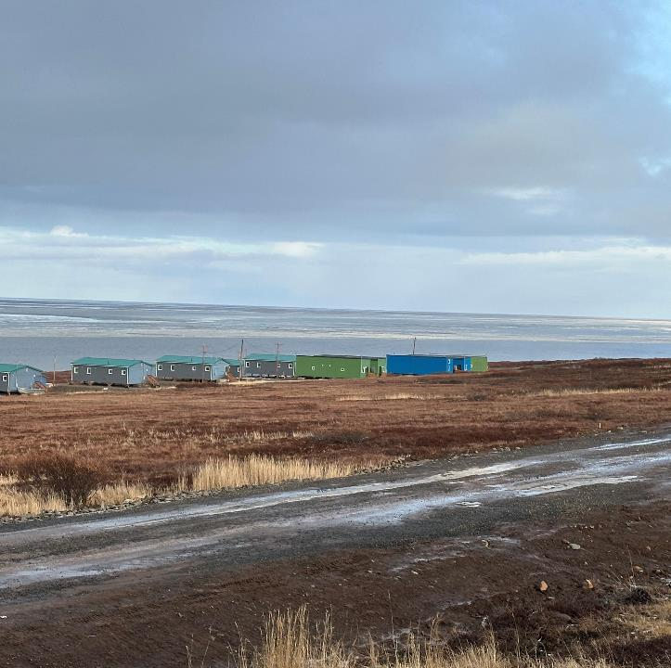
Transitional Homes
In 7 weeks
2-6 Residents per single family residence
  13 Single Family Homes
  5 Duplexes
Built in Wasilla
Shipping from Point McKenzie to Mertarvik
Arrived September 29, 2024

Slide 23
On Going Work
Mertarvik – Relocation / Community Building
  LKSD School Construction
  Permanent Clinic
  Power Plant Expansion
  1st Service Water Sewer
  Water Treatment Plant
  Sewage Lagoon
  Landfill ADEC Compliance
  New Washeteria
  Church
Newtok - Decommissioning
  Power plant
  Water Treatment Plant
  School
  Washeteria
  36 Home Acquisition and Demolition
  Landfill
  Clinic
  Bulk Fuel

Slide 24
Some of the Agencies and Participants in the Newtok Planning and Relocation Efforts
Newtok Village
Newtok Village Council
Newtok Native Corporation
State of Alaska
Department of Commerce, Community, and Economic Development
  Division of Community and Regional Affairs
Alaska Department of Environmental Conservation
  Village Safe Water Program
Alaska Department of Military and Veterans Affairs
  Division of Homeland Security and Emergency Management
Alaska Department of Education and Early Development
Alaska Department of Labor and Workforce Development
Alaska Department of Transportation and Public Facilities
Alaska Energy Authority
Alaska Governor’s Office
Alaska Housing Finance Corporation
Alaska Legislative Representatives:
  Senator Lyman Hoffman's Office
  Representative Zach Fansler’s Office
Regional, Non-Profit, and Other
Association of Village Council Presidents, Regional Housing Authority (AVCP-RHA)
Alaska Tribal Health Consortium (ANTHC)
Cold Climate Housing Research Center
Harvard law School
Rural Alaska Community Assistance Corporation
RurAL CAP
Lower Kuskokwim School District
Yukon-Kuskokwim Health Corporation

Slide 25
Some of the Agencies and Participants in the Newtok Planning and Relocation Efforts
Federal
Congressional Delegations
Senator Lisa Murkowski Office
Senator Dan Sullivan’s Office
Representative Don Young’s Office
Representative May Petola’s Office
Denali Commission
U.S. Department of Agriculture
Natural Resources Conservation Service
Rural Development
U.S. Department of Commerce
Economic Development Administration
National Oceanic and Atmospheric Administration
U.S. Department of Defense
  Army Corp of Engineer
  Innovative Training Readiness Program
U.S. Department of Energy
U.S. Department of Homeland Security
  Federal Emergency Management Agency (FEMA)
U.S. Department of Housing and Urban Development
U.S. Department of the Interior
  Bureau of Indian Affairs
  Fish and Wildlife Services
U.S. Department of Transportation
  Federal Aviation Administration
U.S. Environmental Protection Agency

Slide 26
Any Questions?

