Slide 1
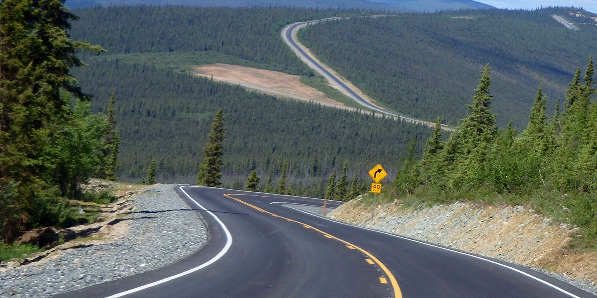
Bureau of Indian Affairs, Alaska Region
Tribal Transportation Program Update
Andrew E. White, MCE, Regional Road Engineer
3601 C Street, Suite 1278, Anchorage, AK 99503
(907) 271-4565 / Andrew.White@bia.gov
Notes:
Good afternoon folks. I’m Stu Hartford, the Regional Road Engineer for the BIA, Alaska Region. In that capacity, my staff and I oversee the AK Region Tribal Transportation Program.
It’s been a pleasure serving you as Regional Road Engineer for 13 years. I’m sure many of you have worked with my staff or myself and I hope we’ve served you well.
The theme for this gathering is “Working Together for a Better Tomorrow”. Those are good words and the Tribal Transportation Team, all of us, work every day toward achieving those same goals, especially looking out for the next generation.

Slide 2
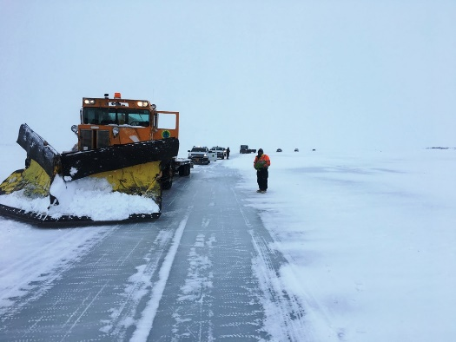
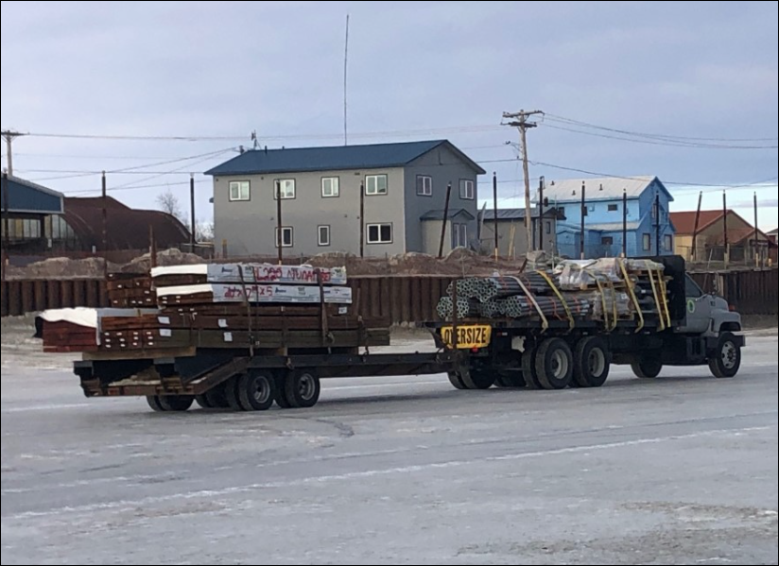
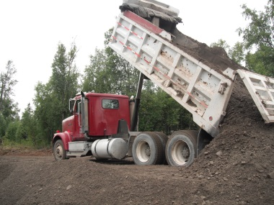
Talking Points
  Organization/Staffing/Office Location
  Current Transportation Act
  6 Elements of TTP/Spending Profile
  Multi-Year Funding Profile
  TTP Funds Flow / Program Delivery
  Notice of Funds Availability (NOFA)
  Program Deliver Methods
  FY24 Funds Obligation
  Contracts / Agreements
  Multi-Year Financial Transaction Profile
  Self Determination Contract Proposals
  Government-to-Government Program Agreements
  Reporting / Audits
  National Tribal Transportation Facility Inventory
  Safety Program
  “202” Transfers
  ERFO Program
  Excess Federal Property
  Dear Tribal Leader Communications
  Questions?
Notes:
I’ll try not to get too deep in the weeds. Among other things, we’ll discuss:
How we use our resources to support you
Describe legislation, past and present authorizing and funding our program
Discuss contract roles and responsibilities
Various topics pertaining to funds
Road Inventory
Repeat things that bear repeating
My goal is to leave you with a better understanding of how we manage the program and how we serve you as our customer. With a common understanding we can work together more effectively to get desirable outcomes from the program.

Slide 3
Announcements
One on One appointments available on the first floor for:
  Minerva Chavez, BIADOT
  Thomas Llanos, BIA AK REGION POC
  Karen Mighell, BIA AK REGION POC
  Dawna Pearson, BIA AK REGION POC
  Gregory Smith, BIA AK REGION POC
  Marlene Watson, BIA AK REGION POC
  As well as many others . . .
Hiring positions for:
  Civil Engineer, POC, GS13
  Civil Engineering Technician, GS11
  Program Coordinator, GS9/11/12

Slide 4
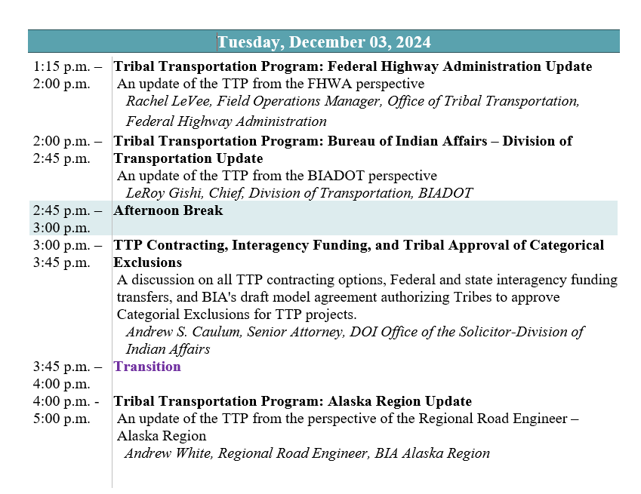
Transportation Agenda
Notes:
Here’s the agenda for the Transportation track. As you can see we have 12 presentations over the next two days.
I hope you partake of some or all of these.

Slide 5
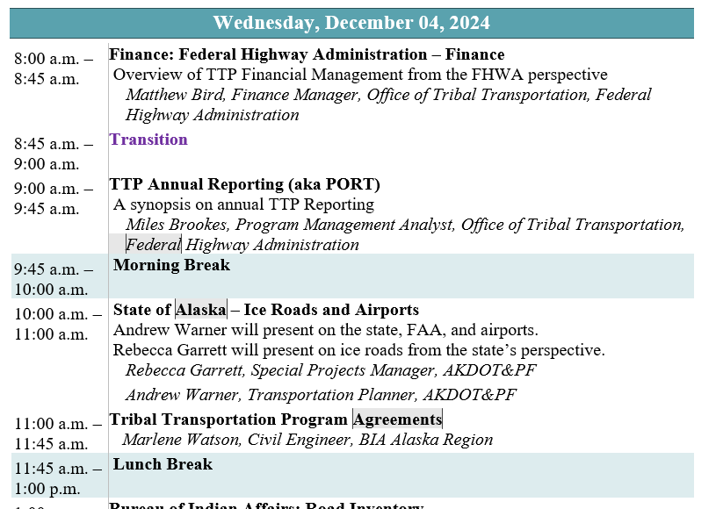
Transportation Agenda
Notes:
Here’s the agenda for the Transportation track. As you can see we have 12 presentations over the next two days.
I hope you partake of some or all of these.

Slide 6
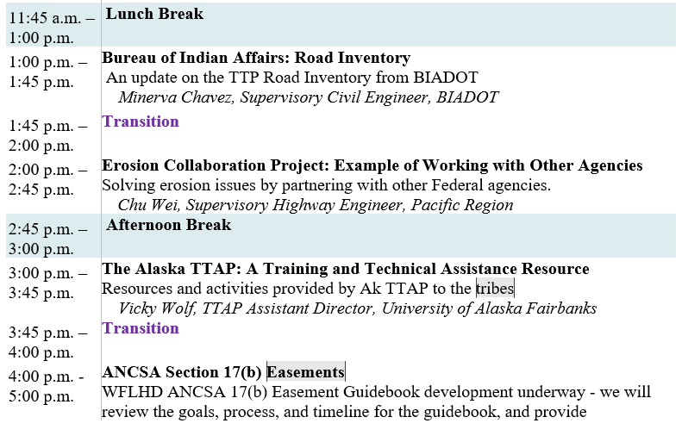
Transportation Agenda
Notes:
Here’s the agenda for the Transportation track. As you can see we have 12 presentations over the next two days.
I hope you partake of some or all of these.

Slide 7
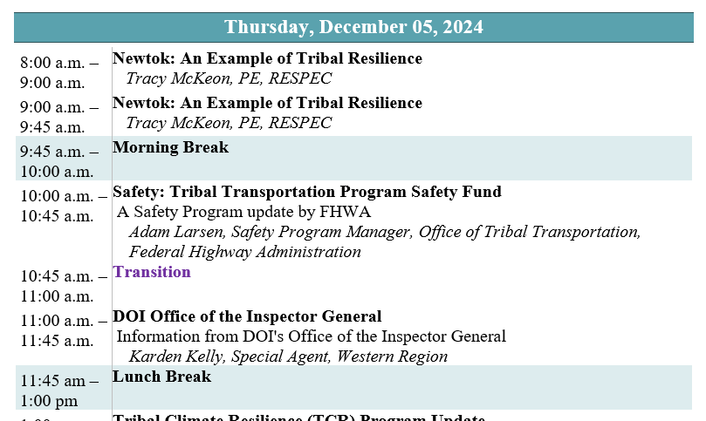
Transportation Agenda
Notes:
Here’s the agenda for the Transportation track. As you can see we have 12 presentations over the next two days.
I hope you partake of some or all of these.

Slide 8
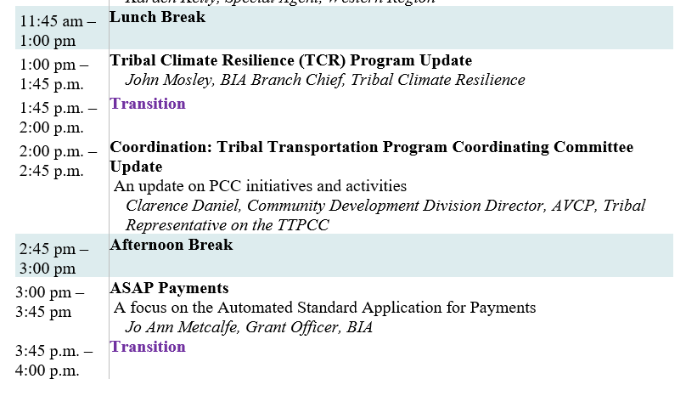
Transportation Agenda

Slide 9
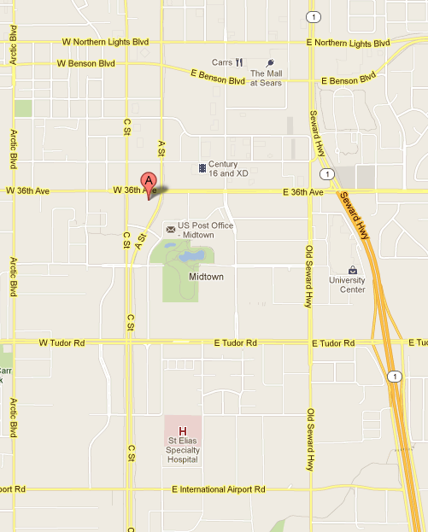
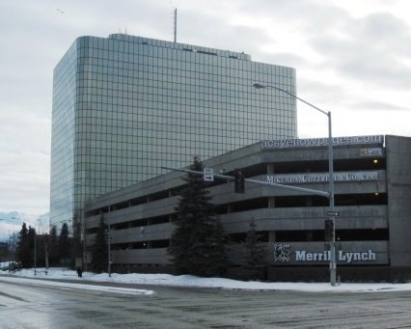

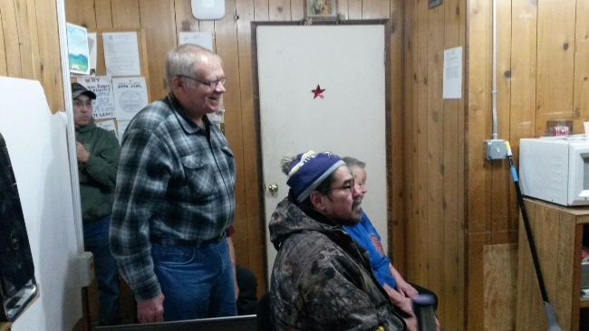
Where We Are
Frontier Building Midtown Anchorage
36th and C. Street
Address:
Branch of Transportation
3601 C Street, Suite 1278
Anchorage, AK 99503
Alaska.Transportation@bia.gov
Notes:
Our office is physically located in the Frontier Building at 36th and C in Midtown Anchorage.
We’re on the 12th floor in suite 1278. Resumption of normal operations in the aftermath of COVID is complete and we have the entire Transportation Staff working predominantly in the office.
We’ve reopened for office visits and I’d like to extend an open invitation to come by and see us. All we ask is a little advance notice. We’ll adjust our schedule to fit you in.
And we have also resumed travel. My staff is required to travel. We averaged a couple dozen trips to the field each year before the pandemic. We are looking forward to once again getting out to admire your work and provide assistance any way we can.

Slide 10
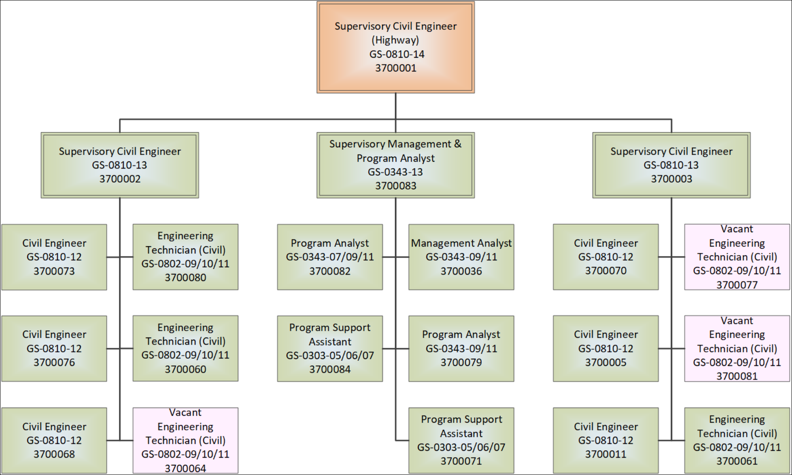
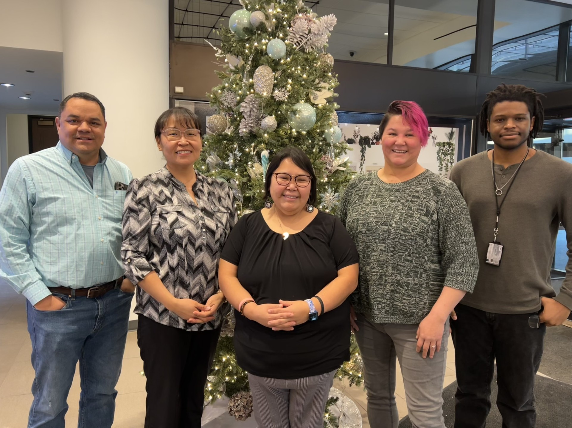
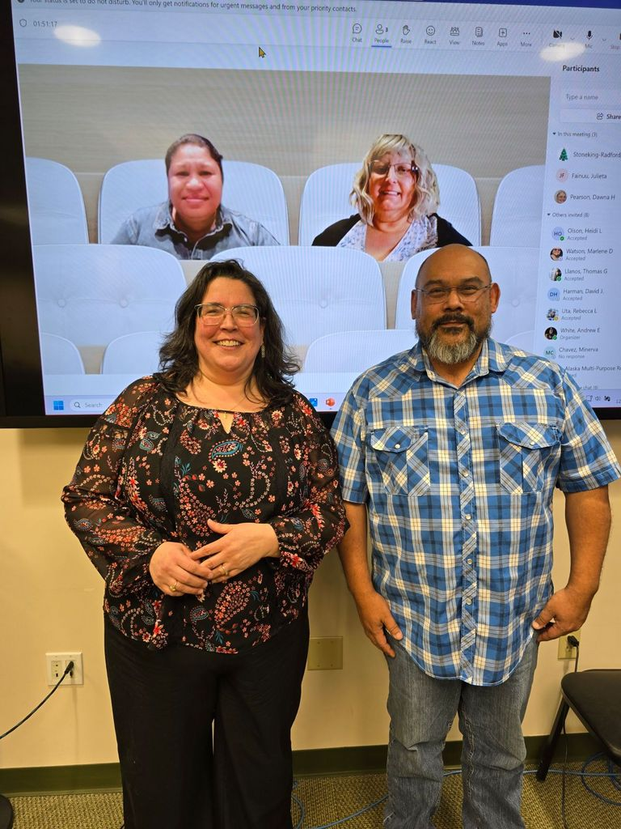
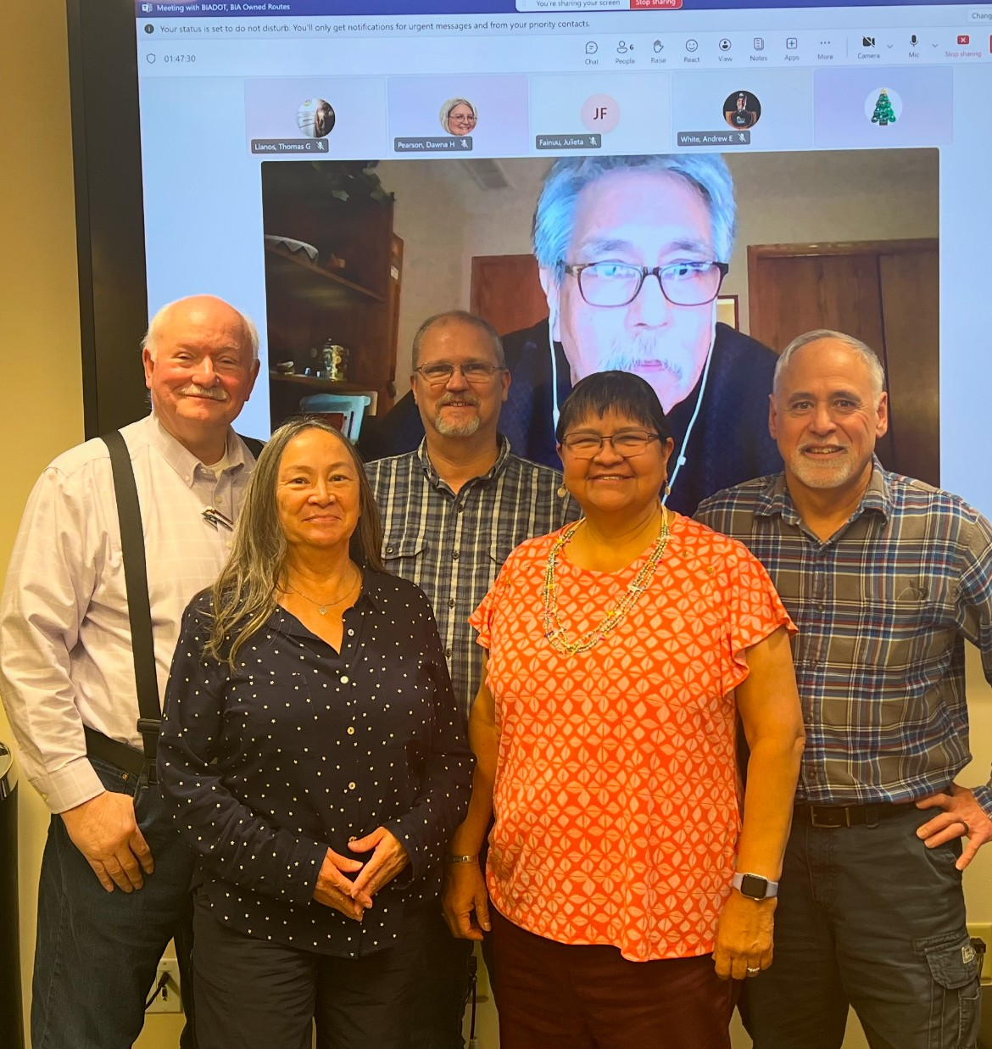

Organization Chart
Notes:
Our organization is built to serve tribes. With 229 tribes we need to be organized and efficient. With just 6 civil engineers on staff, that’s 38 tribes assigned to each engineer. Compared to other regions, that’s more tribes assigned to a single Alaska Region engineer than the total number of tribes in 9 other BIA regions. This organization structure is the key to getting the job done and has withstood the test of time.
There are three guiding concepts to our management approach:
1. One Tribe/One POC – every tribe is assigned a POC Engineer at all times. Whatever the issue, the tribe goes to the one POC. Every tribe should know who their POC is and develop a relationship with the POC.
21 funded positions. Filling positions is a priority. We work hard to keep positions filled, however, we have turnover and typically have a few vacancies. Right now our focus is on filling vacant technician and analyst positions.
RRE phone calls
Regional Visits, the importance

Slide 11
TTP
TTP
Planning
Design
Construction
Maintenance
Transit
Safety
Notes:
There are 6 main categories of work, much like a state DOT. Indeed tribes are DOTs unto themselves.
Allowable activities fall into six broad categories of planning, design, construction, maintenance, transit and safety. Funds are allocated across these elements through the TIP approval process where the tribe develops a Tribal Transportation Improvement Program, based on the Long Range Transportation Plan, which then becomes the FHWA-approved TIP, authorizing the tribe to perform any or all of these activities.
A successful transportation program consists of some or all of these parts. For many tribes, tribal shares are insufficient to fund activities in all elements, so priorities must be established.

Slide 12
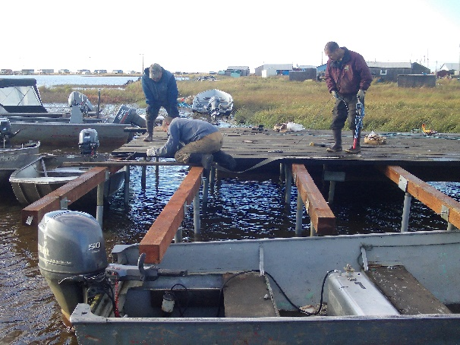
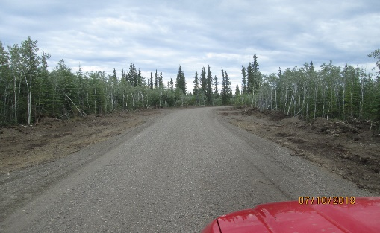

Infrastructure Investment and Jobs Act
(Surface Transportation Reauthorization)
IIJA/STRA-21
  Replaced FAST Act
  Signed by POTUS on 11/15/2021
  $550 billion, 5 year Highway Bill (FY22-FY26)
  Serves 567 Federally-Recognized Tribes
Funding (increases each yr)
  FY22 - $578M
  FY23 - $589M
  FY24 - $602M
  FY25 - $613M
  FY26 - $628M
Safety and Planning set-asides at 4%
Bridge program
  3% set-asides removed
  $165M per year + $20M per year
PM&O 5%
High Priority Project Program refunded, $9M
Data Collection Requirement – Due 31 December!
  New system for Annual reporting
  Names of projects and activities
  Obligations and expenditures
  Jobs created and retained
Nunapitchuk City Dock
Chalkyitsik Landfill Access Road
Making Ice Road Markers
Notes:
The FAST Act is history, but still relevant as most of the funding in your contracts is FAST-Act money. So we can’t lay it to rest just yet.
FAST stands for Fixing America’s Surface Transportation
All funds went to tribes in the form of annual tribal shares with the exception of several set-asides which also mostly went to tribes
Safety and Planning set-asides at 4% each
Removed Bridge program set-asides at 3%
PM&O set-aside to pay for federal oversight of 5%
HPP refunded
The FAST-Act mandated an annual report due at the end of December. The report is completed using the PORT reporting tool developed by FHWA which everyone should now be very familiar with.

Slide 13
Annual TTP Funding ($Ms)
Total Funding = $928M (18 Years)
$M
SAFETEA-LU
Notes:
Approximately 10% of the TTP program comes to AK Region tribes.
18 year Funding Profile - this is what the region has received in TTP funds over the last 18 years through 4 authorizations, SAFETEA-LU, MAP-21, FAST-Act and BIL.
Includes funds from the American Reinvestment and Recovery Act (ARRA)—that’s why the number is so much bigger in FY09. Also includes COVID funds in FY2021.
FY05 – FY12 (Gold Bar): HPP ($80M)
$928M over 18-year period, average of $4M / tribe
Trend: Under SAFETEA-LU you can see over time we had a nice upward trend in the total amount received over time, as the region built up road inventory
Trend: Under MAP-21, you can see in FY14 and FY15 funding reduced by approximately$2M each year, and that continued to a lesser extent in FY16 under the FAST Act and seemed to stabilize in FY17. Since then it’s been about the same at approximately $45M.
In FY22, under BIL we saw a plus up of approximately15%. Given current inflation rates we may not gain much in real buying power.

Slide 14



TTP Funds
Treasury
USDOT
To Tribe, OSG, By Compact
USDOT
FHWA, OTT
To Tribe, Program Agreement
BIADOT
DOI, OSG
To Tribe, OSG, Compact
AK REGION
To Tribe:
-PL93-638
-Program Agreement
Notes:
The tribe’s program delivery choice determines the flow of funding
Transportation funds flow from the Highway Trust Fund in the US Treasury and are first provided to USDOT, however, Tribal Shares are calculated by BIA DOT in Albuquerque using the statutory formula
5 pathways for funds distribution
DOT Self-Governance
FHWA Program Agreement
DOI Self-Governance Compact
BIA Government-to-Government Program Agreement
BIA 638 Self-Determination Contract
Most efficient method for receiving funds within BIA is the Government-to-Government program agreement. There’s less paperwork, funds are obligated at Central Office instead of in the region and 100% of available funds are paid in lump sum.

Slide 15
Notice of Funds Availability (NOFA)
NOFA Letters
Sent whenever TTP funds are available
  Identifies available funding amounts
  Estimates final tribal share amounts
  Identifies BIA POC by tribe
Tribes Respond
  Tell BIA what contract
  Proposal
    Supporting contract documents
Templates, available upon request
FY | Date Sent | Serial # | Subject
. . . | . . . | . . . | . . .
FY22 | 3/1/2022 | G-1025 | 64-Day NOFA
FY22 | 5/19/2022 | G-1030 | 162-Day NOFA
FY22 | 6/9/2022 | G-1034 | Final NOFA
FY23 | 11/23/2022 | G-1097 | 77-Day NOFA
FY23 | 11/28/2023 | G-1163 | Final NOFA
FY24 | 12/8/2023 | G-1307 | 48 – Day NOFA
FY24 | 02/29/2024 | G-1315 | 111 – Day NOFA
FY24 | 06/27/2024 | G-1333 | Final NOFA
FY25 | TBD | TBD | 81 – Day NOFA
FY25 | TBD | TBD | (through mid March)
Notes:
NOFAs are vitally important!
Each time we receive funds we send a notice of funds availability.
Ideally, we’d send one NOFA each year for your full tribal share amount
Congress seldom passes a budget, historically requiring the government to operate on continuing resolutions which results in piecemeal funding
Piecemeal funding is inefficient and creates tremendous duplication of effort
Due to the inability of congress to pass a budget, we’ve received funding in 16 increments over the past 5 years as displayed here.
For FY22 we’ve issued only one NOFA covering the first continuing resolution for the first 64-days of the fiscal year. It was sent on 1 March. That’s all the funds we’ve received to date. We do anticipate 100% funding in the next increment of funds.

Slide 16
Funds Responsibility
Goal is to obligate
Letters of Intent
  On tribal letter
  Response to the NOFA
  Documents engagement
  Will be used for Point of Obligation (POO)
August Redistribution
Undelivered Order (UDO)s
  Engagement
  Tribe to Tribe resolutions

Slide 17
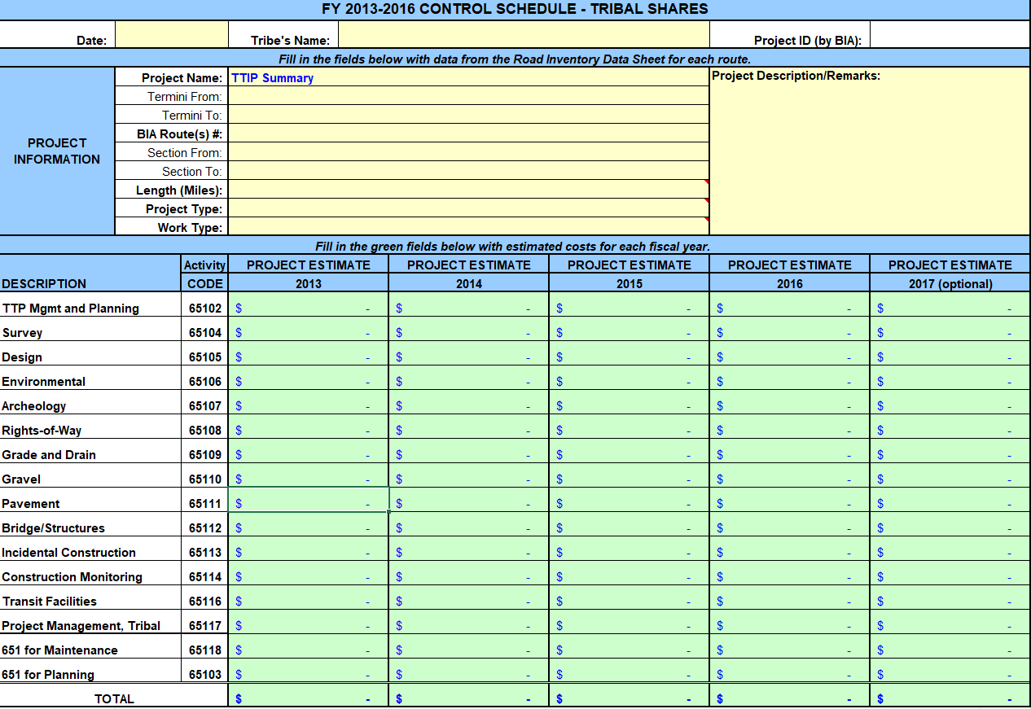
CSTIP
Notes:
a Control Schedule is a vital component of the Transportation Improvement Program, as it promotes effective project management, accountability, funding oversight, and stakeholder engagement. By establishing clear timelines and monitoring progress against established milestones, a Control Schedule helps ensure the successful delivery of transportation projects that meet the needs of the community and comply with regulatory requirements.
Public Review Process
Implementing a comprehensive Transportation Public Review Process not only enhances project transparency and accountability but also empowers the community to have a meaningful voice in transportation planning.
Establish Objectives
Identify Stakeholders
Outreach Plan
Project Overview
Documentation
Formal Public Hearings
Report Findings

Slide 18
Program Delivery Methods
Notes:
Tribes get to choose their program delivery method—you might wonder how they’ve chosen and how that has changed over time.
In 2010 there were 3 choices, a BIA Title I self-determination contract, a Title IV compact through the Office of Self-Governance, or a program agreement with FHWA.
Now, there are 4 choices, with the newest option being the BIA OSG Compact.
The majority (139) are “BIA” Tribes, that is, the BIA provides program management and oversight. Thirty-eight of our 139 tribes are on program agreements.
Tribes on Self-Governance compacts number 7 at the present, down from 36 in 2010. Funds are provided through a funding agreement administered by OSG. BIA is responsible for technical support, monitoring and reporting and assisting OSG with funding agreement negotiations.
Currently we have 71 Tribes that are served by FHWA,
In 2010 25% of tribes were on program agreements. In 2023 42% of tribes are on either FHWA or BIA program agreements.

Slide 19
Funds Obligated in FY2024
($38.5M, Title I Tribes, Includes POOs, TCR)
Notes:
Once tribes respond to the NOFA, the contract or agreement is awarded and funds are obligated.
Obligation: an important milestone—the starting point of TTP activity—the contract is awarded or modified, funding is on the table and you can go to work performing transportation activities.
Though the primary focus is on current year funds, every year we also obligate funds appropriated in earlier years.
Fortunately, prior year funds do not expire. They remain available to obligate next year if not obligated in the current year.
In FY23 48% of our obligations were current year TTP funds, 32% were TCR funds and 20% were prior year funds

Slide 20
Financial Transactions: Obligations and Payments
FY2012 - FY2023
10,391 Financial Transactions / $526M
Notes:
My engineers wear many hats and one area they spend a lot of time on is financial management.
Sound financial management is a top priority.
This is my “green and gold” slide which quantifies financial transactions over past 10 years
Obligations in green (1 obligation = 1 funded contract line item)
Payments in gold
The number at the top of the bars is the number of transactions and the dollar amount in $1Ms is on the left vertical axis
In all 9,290 financial transactions occurred during this 10 year period totaling $429M.
All transactions involve a coordinated effort between the tribe, Transportation and self-determination. There’s a significant amount of documentation and record keeping associated with each one of these transactions.
We’ve become adept at obligating and paying funds because we get more practice than anybody else.

Slide 21
How Do AK Tribes Spend TTP Funds?
How Tribes Spent TTP Funds
FY2012 – FY2023 ($M)
How Tribes Spent TTP Funds
FY2024 Only ($M)
Notes:
Here are the program elements depicted as a pie chart showing how the TTP dollar is allocated by tribes in Alaska Region.
If you compare the past 11 years FY2010 to FY2023 (circle on left) with FY2024 (circle on right), the following is evident.
42% going to planning and maintenance for the 11 years vs 46% for FY23, a 4% increase
Increasing amounts for design, 6% to 10% and
Decreasing amounts for construction, 42% to 14%
Under the FAST-Act and BIL the upper limit for maintenance was $500K or 25% of tribal shares, whichever is greater. Under SAFETEA-LU the maintenance upper limit was 25% of tribal shares, period.
Our database allows us to analyze each tribes program in the same way which allows us to provide advice on where future resourcing should go and how you might plan to employ that next TTP dollar.

Slide 22
Payment (2013-2024)

Slide 23
Contracts and Agreements
FY25 Goal: Close contracts faster then opening them!
New contracts in FY24 = 36
Notes:
When we get your response to the NOFA funds go into a contract
All work is done under a contract which consists of 4 elements: a statement of work, a fund amount, a timeline and reporting.
Those are the things we look at in our oversight of the program. We offer technical assistance on all aspects of a contract.
We’ve learned over time it’s best to keep contracts pure by work scope
Therefore we have separate contracts for Planning, Maintenance, Design, Construction
Average of 4 open contracts per tribe.
We carry records on 1832 contracts in the region. 102 are closed. It benefits tribes to close contracts when the work is done and funds expensed.
We can also close G2G program agreements
Closed contract records go to the archives, but we maintain electronic records, to include deliverables

Slide 24

Self-Determination
Contract Proposals
New contract required every 5 years
Tribes must submit a proposal to enter into a new self-determination contract
  BIA required to provide technical assistance
Proposal contents outlined in 25 CFR Part 900 Subpart C (13 Items)
For Transportation Proposals, Regional Director is approval authority
  2 Days – Send Acknowledgement of Receipt
  15 Days – Notify Applicant of Deficiencies
  90 Days – Complete Review / Accept or Decline Proposal
Recommendation for approved proposal sent to Awarding Official with Purchase Requisition - Awarding Official awards contract
Finish!
Start
Contract Proposal
Receipt
Review Approve/Decline
Award
Monitor
Close-Out
90-days to review!
Management Systems check
Notes:
Self-Determination comes with some red tape.
TTP gives you tribal shares under the law and authorizes every FRT to perform TTP
Self-Determination, however, requires you to submit a proposal, subject to further approval, to get your funds
S-D also says you have to start a new contract every 5 years and to start a new contract you need to submit a proposal
New contract = new proposal.
We encourage tribes to contact your POC to initiate the proposal process and help with any technical assistance you may need.
During the review approval stage, the self determination office is responsible for the management systems check for the tribes ability to perform as a government. Contracting will review a tribes ability to perform: Governance and Leadership, Financial Management, Budgeting Processes, Accounting Systems, Procurement Policies, Program Management, Human Resource Management, Community Engagement and Communication, Records Management,

Slide 25
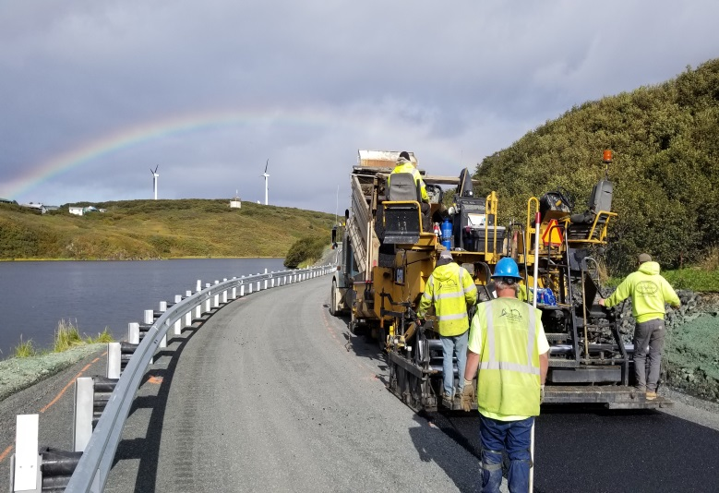
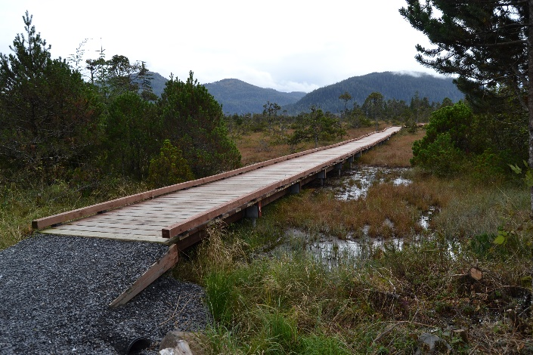
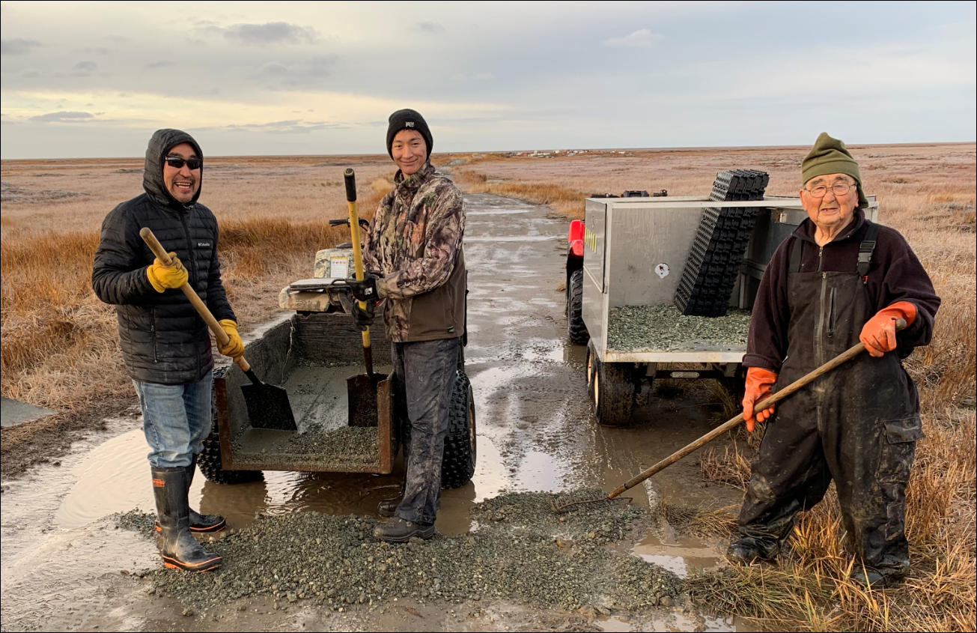
Government to Government (G2G) Program Agreements
BIA Director Signs Agreement
  New Highway Legislation = New Agreement
100% payment when agreement is signed
RFAs/RFA Amendments for funding increases
Semi-Annual reporting (submitted within 60 days after end of reporting period)
Oversight required at final Inspection
Tribal Administration of Program
  More autonomy at Tribal level
  Flexibility between projects/activities on FHWA-approved TIP
  No request/approval for payment
Risk Assessment - Yes (annually)
Technical Assistance – Yes
123 Open G2G Agreements (21 SAFETEA-LU, 30 Map-21, 35 FAST-Act, BIL Act)
  2013 projects (planning, design, construction, safety, transit)/$17.6M
Notes:
G2G program agreements are a good thing! An alternative to 638 contracts.
The program agreement is a government-to-government agreement between the Director of the BIA and the Tribal President
Big advantage for the tribe is we can obligate the full amount more quickly than the 638 process and funds are available in full immediately upon obligation. Also reports are due every six months instead of quarterly. In addition, proposals are eliminated and funds can be reallocated across approved activities at the tribes discretion without a contract modification.
Tribes can proceed with construction without a NTP
BIA provides technical assistance upon request
We have implemented 86 of these across 38 tribes with a cumulative award amount of $17.6M
The new BIL requires the establishment of all new program agreements

Slide 26
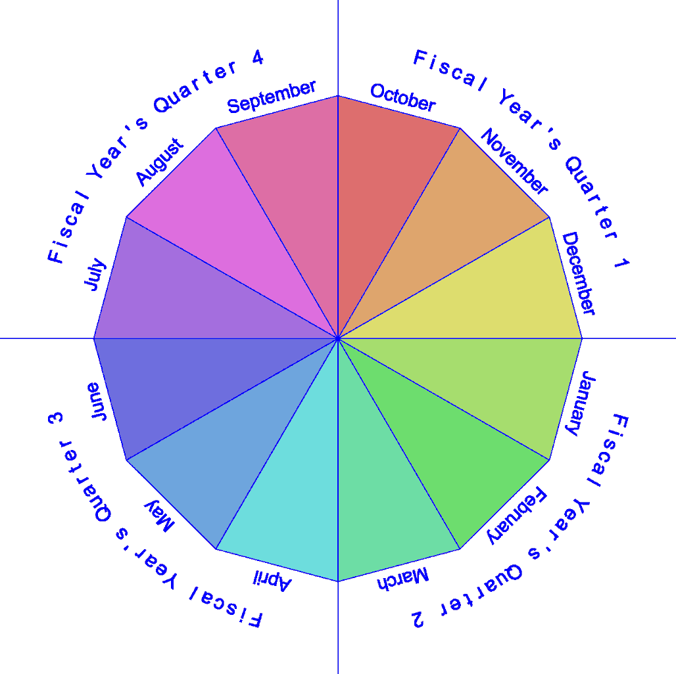
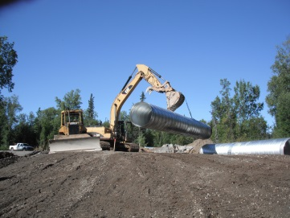
Federal Financial Reporting Calendar
Most contracts require quarterly reports within 30 days after the end of the quarter.
Fiscal Year’s Quarter | Quarter Ends | Report Due
Quarter 1 | December 31 | January 31
Quarter 2 | March 31 | April 30
Quarter 3 | June 30 | July 31
Quarter 4 | September 30 | October 31
G2G Program Agreements require semi-annual reports within 60 days (previously 90 days) after the end of the six-month reporting period.
Fiscal Year’s Quarter | Period Ends | Report Due
Quarter 2 | March 31 | May 31
Quarter 4 | September 30 | November 30
Notes:
It’s imperative you report on your contracts—compliance with reporting is the first thing we check when a contract payment is requested
Reporting is a contractual requirement—failure to report is a sign that something’s not right.
Graphic indicates the reporting deadlines for quarterly and semi-annual reports.
The end of March is the end of the 2nd quarter, so those reports will be due by the end of April.
Remember the COVID funds require a separate SF425 report. Every tribe received these funds, as a plus-up to the TTP program, in FY2021
Reports are also required semi-annually for program agreements. The next report, for the first 6 months of FY2022, will be due by the end of May. The annual PORT report due at the end of December will suffice as the report for the 2nd semi-annual report.

Slide 27
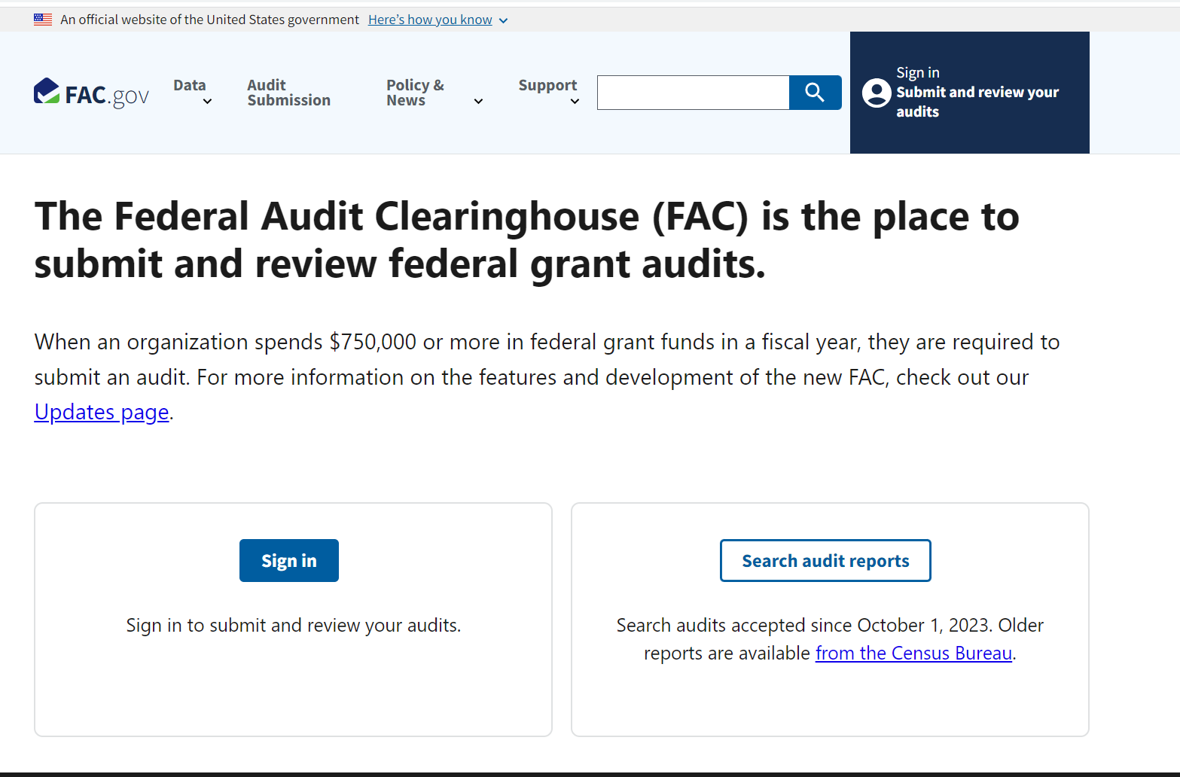

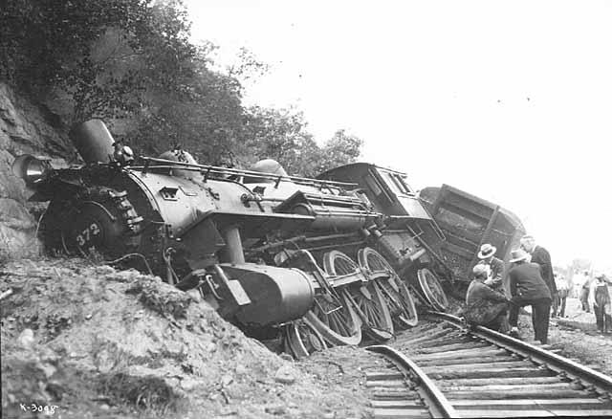
Single Audits
Required by the 2 CFR
Detailed guidance provided in 5 Indian Affairs Manual
  https://www.bia.gov/policy-forms/handbooks
Required if $750,000 in Federal funds expended in a given year
  Failure to Complete Audits Results in Sanctions
  Monthly Drawdowns
  Withhold of Contract Support Funds
To be completed by 3rd party consultants
  Checking for inconsistencies
  Deferred revenue most common finding
$1,000,000
Manage Funds Meticulously!
Single Audits – Stay On Track!
New Single Audit Process
Email sent: October 12, 2023
  Federal Audit Clearinghouse (FAC) has transitioned from the U.S. Census Bureau (Census) to the U.S. General Services Administration (GSA) on October 1, 2023
  all SA/SAC's are to be submitted: https://www.fac.gov/
  must send a copy of your SA/SAC's to DIEA at oiea@bia.gov.
Notes:
Single audits are required if $750K in Federal funds are expended in a fiscal year.
Failure to complete required audits results in sanctions.
Deferred revenue shortfalls (sometimes called questioned costs) seem to be the most common finding. A deferred revenue shortfall occurs when funds have been advanced, but cash is not on hand, and the contract work associated with the advance has not been completed. It’s a serious situation that suggests advanced funds were used for something other than their intended purpose. This can lead to contract termination, collection and sanctions.
Unfortunately the TTP program is frequently cited for deferred revenue shortfalls. Where audit findings involve TTP funds, my office will be involved to ensure corrective actions have been taken and that funds fully accounted for.
TTP funds are not discretionary funds and therefore shouldn’t be pooled in a general fund. TTP funds should not be transferred to general fund account, lent to such an account, or expended for programs not authorized by the laws, regulations and contracts that govern use of the funds.

Slide 28
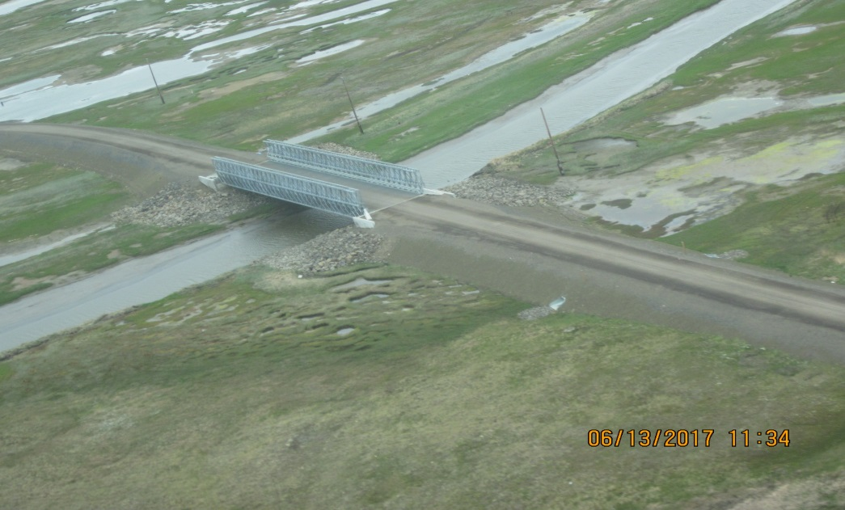
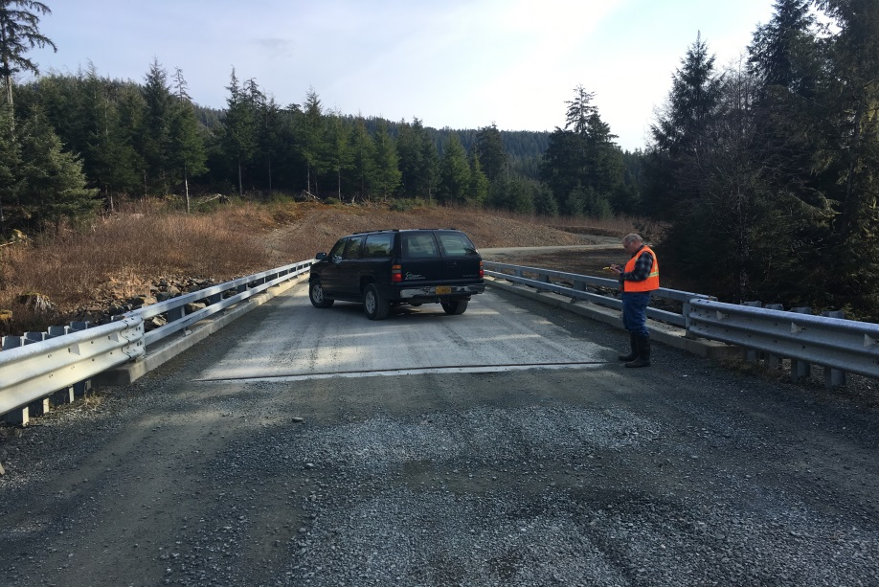
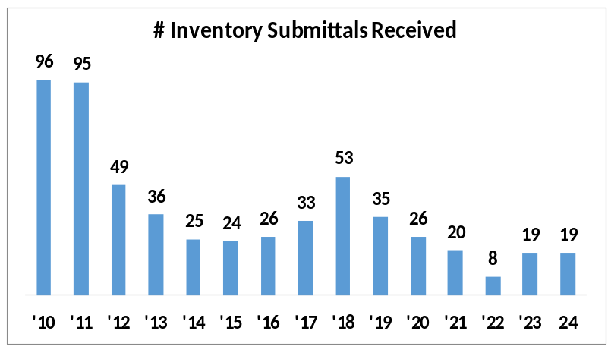
National Tribal Transportation Facility Inventory Milestones
Nov 1: BIA provides tribes copy of inventory
  Serial Letter sent early November w/Inventory Data Sheets
Mar 15: Tribes submit changes and authorizing resolution
  Facilities (existing and proposed) must be identified in LRTP
May 15: BIA notifies Tribes of required corrections by letter
Jun 15: Tribes submit corrections
Jul 15: BIA Region submits updates to BIADOT
  BIADOT must review and approve before route is “official”
  Route must be “official” for TTP funding
  Aug: BIA sends letter advising tribe of results
Annual Milestones
Notes:
The National Tribal Transportation Facility Inventory is a key component of our program—only transportation assets in the inventory are eligible for funding
Inventory updating is a basic responsibility of tribes under planning contracts
New additions to the inventory are processed on an annual timeline
2022 cycle kicked off last November
Copy of inventory provided to tribes on 11/4 to start the cycle
Inventory updates for all Alaska tribes goes through the BIA. If a tribe seeks to add a new proposed road to the inventory a separate BIA/FHWA quality assurance team will also review the submittal to ensure all documentation requirements are met.
Only 8 Tribes submitted inventory updates in 2022, the lowest amount in the last 13 years.
Corrections to the inventory can be made at any time.

Slide 29
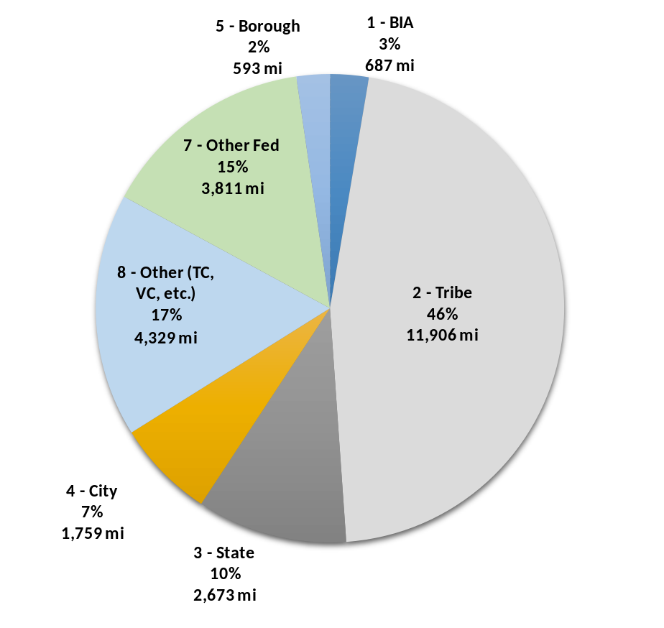
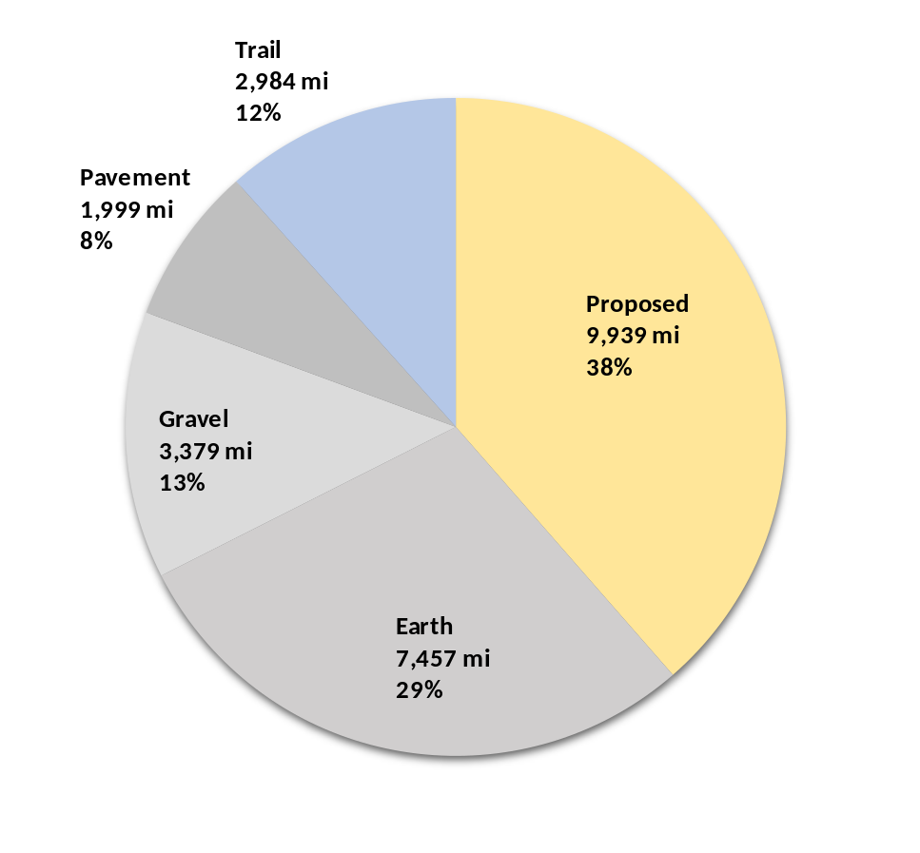
Road Inventory
(25,758 miles)
Ownership
Surface Type
Notes:
Alaska Region’s road inventory is now well over 25,000 miles
Biggest owner is Category 2, “Tribes”, followed by Category 8, “Other” which includes Tribal Entities such as Regional Corporations, Village Corporations and Tribal Corporations. The third largest category of owners is Category 7, other Federal Agencies, such as BLM, USFS, USFWS, DOD, etc., followed by State, City and Borough owned roads.
When you analyze by surface type, biggest category is proposed roads at 38%, followed by earth, gravel trail then pavement. Only 8% of roads in our inventory are paved.
----------------------------------------------------------------------------------------
§ 170.443 What is required to successfully include a proposed transportation facility in
the NTTFI?
(a) In order to have a proposed facility placed on the NTTFI, a Tribe must submit all of the following to the BIADOT/FHWA Quality Assurance Team for consideration:
(1) A Tribal resolution or other official action identifying support for the facility and its placement on the NTTFI.
(2) A copy of the Tribe’s LRTP containing:
(i) A description of the current land use and identification of land ownership within the proposed road’s corridor (including what public easements may be required);
(ii) A description of need and outcomes for the facility including a description of the project’s termini; and
(iii) The sources of funding to be used for construction.
(3) If the landowner is a public authority other than the Tribe or BIA, documentation from the public authority that the proposed road has been identified in their LRTP, STIP approved by FHWA, or other published transportation planning documents.
(4) Documentation clearly identifying that easements or rights-of-way have been acquired or a clear written statement of willingness to provide a right-of-way from each landowner along the route.
(5) Certification that a public involvement process has been carried out for the proposed road.
(6) A synopsis discussing the project’s anticipated environmental impacts as well as the engineering and construction challenges.
(7) Documentation that the project can meet financial or fiscal constraint requirements including financial information demonstrating that the project can be implemented using existing or reasonably available funding sources, and that the project route can be adequately maintained after construction. (See 23 U.S.C. 134 and 135.)
(8) Documentation identifying the entity responsible for maintenance of the facility after construction is completed.
(b) For those proposed roads that currently exist in the NTTFI, the requirements identified above as paragraphs (a)(1) through (a)(8) of this section, must be completed and submitted for approval to BIA and FHWA within March 6, 2020, in order to remain on the inventory.

Slide 30
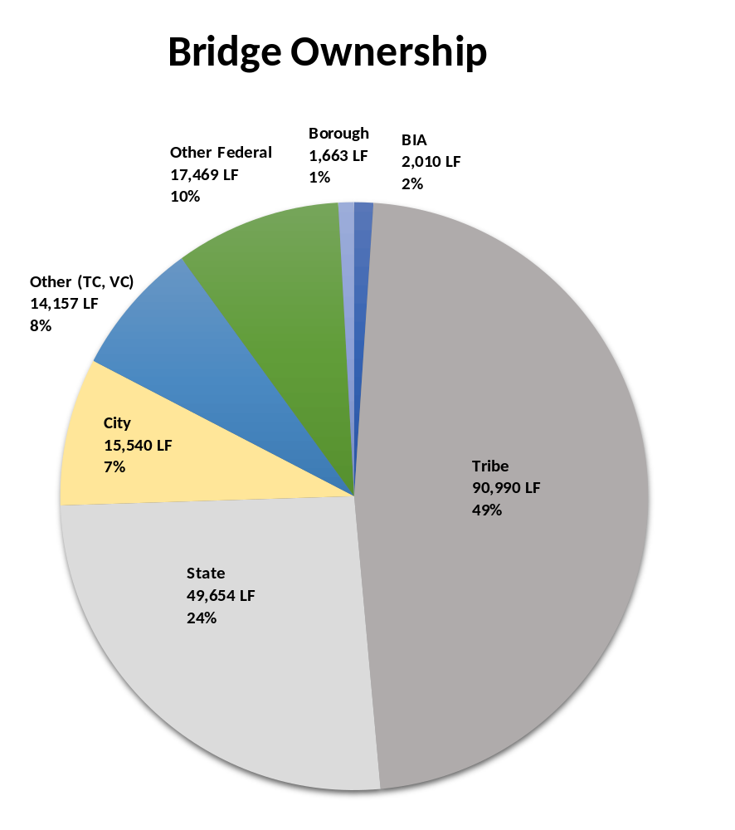
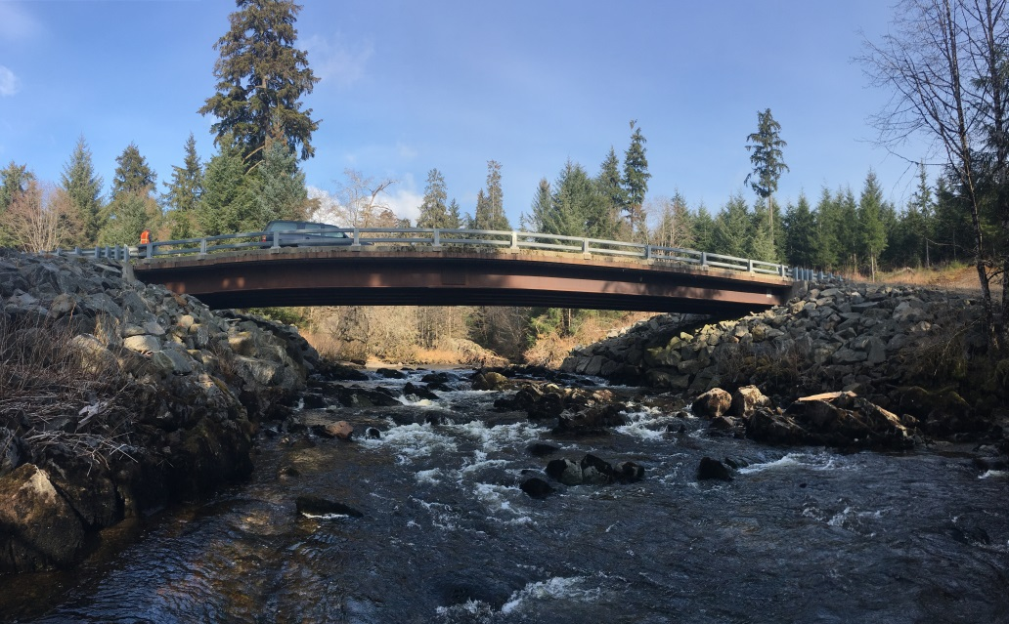
Bridge Inventory
Owner | Count | Length (ft)
1 – BIA | 33 | 2,010
2 – Tribe | 303 | 90,990
3 – State | 211 | 49,654
4 – City | 69 | 15,540
5 – Borough | 14 | 1,663
7 – Other Fed | 235 | 17,469
8 – Other | 73 | 14,157
Total | 938 | 191,483
Notes:
This slide summarizes the Alaska Region Bridge Inventory. We have 938 bridges in the system tallying over 191,000 linear feet.
The biggest owner category is Tribes with 49% of the linear footage. The next biggest owner is the State with 24% of the linear footage.
Bridge owners must formally inspect bridges every two years so tribes should know if they own bridges and, if so, they bear responsibility to get them inspected.
Inspections will identify deficiencies which could then lead to funding for upgrades or replacement through the bridge program.
Challenges: The definition of a highway bridge.

Slide 31
1) A Tribal resolution
2) A copy of the Tribe's LRTP i) A description of the current land use ii) A description of need and outcomes iii) The sources of funding
3) If the landowner is a public authority other than the Tribe . . . documentation from the public authority
4) Row
5) Certification that a public involvement
6) anticipated environmental impacts
7) financial or fiscal constraint requirements
8) entity responsible for maintenance
§ 170.443 What is required to successfully include a proposed transportation facility in the NTTFI?
Notes:
A proposed transportation facility is any transportation facility, including a highway bridge, that will serve public transportation needs, meets the eligibility requirements of the TTP, and does not currently exist. It must meet the eligibility requirements of the TTP and be open to the public when constructed. In order to have a proposed facility placed on the NTTFI, a Tribe must submit all of the following to the BIADOT/FHWA Quality Assurance Team for consideration:
(1) A Tribal resolution or other official action identifying support for the facility and its placement on the NTTFI.
(2) A copy of the Tribe's LRTP containing:
(i) A description of the current land use and identification of land ownership within the proposed road's corridor (including what public easements may be required);
(ii) A description of need and outcomes for the facility including a description of the project's termini; and
(iii) The sources of funding to be used for construction.
(3) If the landowner is a public authority other than the Tribe or BIA, documentation from the public authority that the proposed road has been identified in their LRTP, STIP approved by FHWA, or other published transportation planning documents.
(4) Documentation clearly identifying that easements or rights-of-way have been acquired or a clear written statement of willingness to provide a right-of-way from each landowner along the route.
(5) Certification that a public involvement process has been carried out for the proposed road.
(6) A synopsis discussing the project's anticipated environmental impacts as well as the engineering and construction challenges.
(7) Documentation that the project can meet financial or fiscal constraint requirements including financial information demonstrating that the project can be implemented using existing or reasonably available funding sources, and that the project route can be adequately maintained after construction. (See 23 U.S.C. 134 and 135.)
(8) Documentation identifying the entity responsible for maintenance of the facility after construction is completed.
(b) For those proposed roads that were included in the NTTFI as of November 7, 2016, the information in paragraphs (a)(1) through (8) of this section may be submitted for approval to BIA and FHWA at any time, but is not required in order for those proposed roads to remain in the NTTFI, unless any changes or updates to the proposed road were (or are) made after that date.

Slide 32
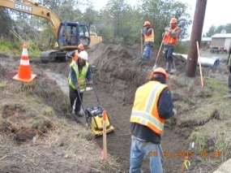

Safety Program
Increased from 2% to 4% under BIL
Application Due Date: Jan. 15th
Application website:
  https://highways.dot.gov/federal-lands/tribal/safety/ttpsf-application-documents
Scope of Safety Projects
  Safety plans
  Data assessment, improvement, and analysis
  Systemic roadway departure countermeasures
  Infrastructure improvements and other eligible activities
Notes:
The region has received over $12.3M in safety funds over the past 11 FYs
Activities funded by the safety program:
Safety plans
Data assessment, improvement, and analysis
Systemic roadway departure countermeasures
Infrastructure improvements and other eligible activities
Every tribe should have a safety plan. If you don’t have a $12,500 grant to prepare a safety plan, be sure to apply as soon as possible. The justification to receive these funds is as simple as stating that you don’t have a safety plan.
If you have safety plan funds, be sure to complete your plans in a timely manner—FHWA asks us for the status of our safety funds every year and funds not used must eventually be returned.
Applications for FY2023 – 2026 will be due by 15 January each year.
We have a complete update on the safety program on the agenda for tomorrow
Increased from 2% to 4% under BIL

Slide 33
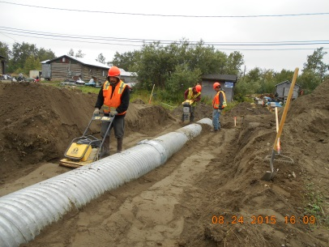
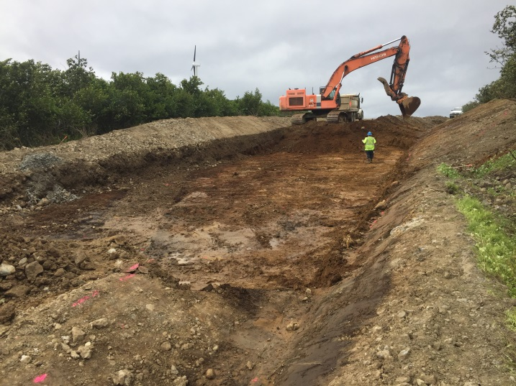

Fund Transfers to Tribes
“202” Agreements
MAP-21 and FAST-Act Authorize Cooperation of State, Local, Tribal Governments
23 U.S.C. §202 (a)(9)
  The cooperation of states, counties, or other local subdivisions may be accepted in construction and improvement of a Tribal Transportation facility
  Any funds received from a state, county or local subdivision shall be credited to appropriations available for the tribal transportation program.
  25 CFR §170.627 requires an agreement among Tribe, State and BIA/FHWA describing source and use of funds – a model agreement is now available.
Tribe Receives Funds in Same Manner as TTP Funds
  Intergovernmental Fund Transfer Agreement
  Scope of Work Must be Defined!
  Oversight transferred from State to BIA
  Tribe responsible for performance in full compliance with plans and specs
FY17 - Barrow Arctic Research Center Road ($3.0M)
FY18 - Crooked Creek Community Streets ($2M)
FY19 - Iqurmiut Street Lighting ($7,480)
FY22 – Kiana Road/Drainage Improvements
Notes:
Section 202(a)(9) of Title 23, United States Code gives State DOTs and tribes the ability to collaborate to get projects completed
First enabled in MAP-21, then the FAST-Act and codified in 25 CFR 170
Section 202(a)(9) of title 23 encourages cooperation between States and Tribes by allowing any funds received from a State, county, or local government to be credited to appropriations available for the Tribal Transportation Program (TTP). This provision allows State funds to be transferred to BIA, which in turn provides the funds to a Tribal recipient. The tribe would then complete the project.
The transfer is documented in an Intergovernmental Fund Transfer Agreement which describes the scope of the project, transfers oversight from the State to BIA and makes the tribe responsible for construction in full compliance with the plans and specs.
We’ve implemented three of these to date as you can see listed on the slide and have one in the works.

Slide 34
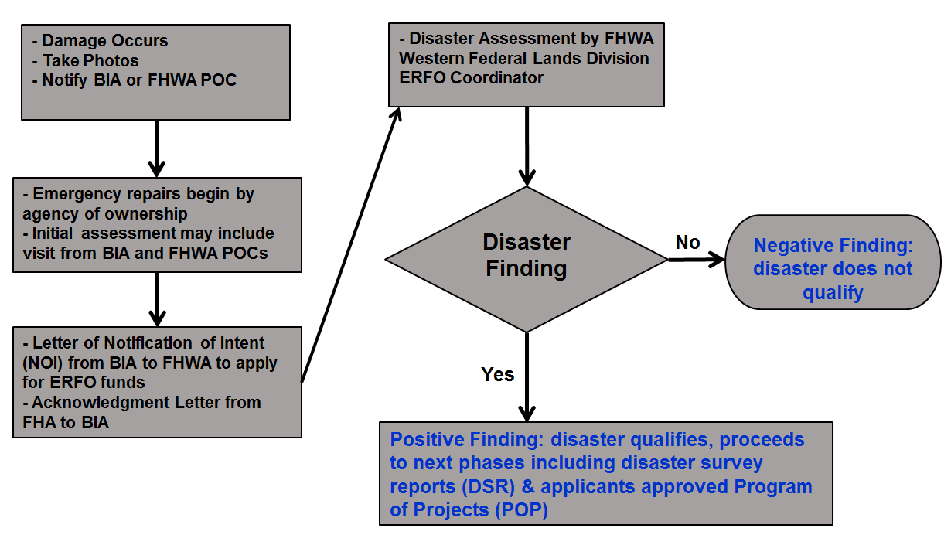
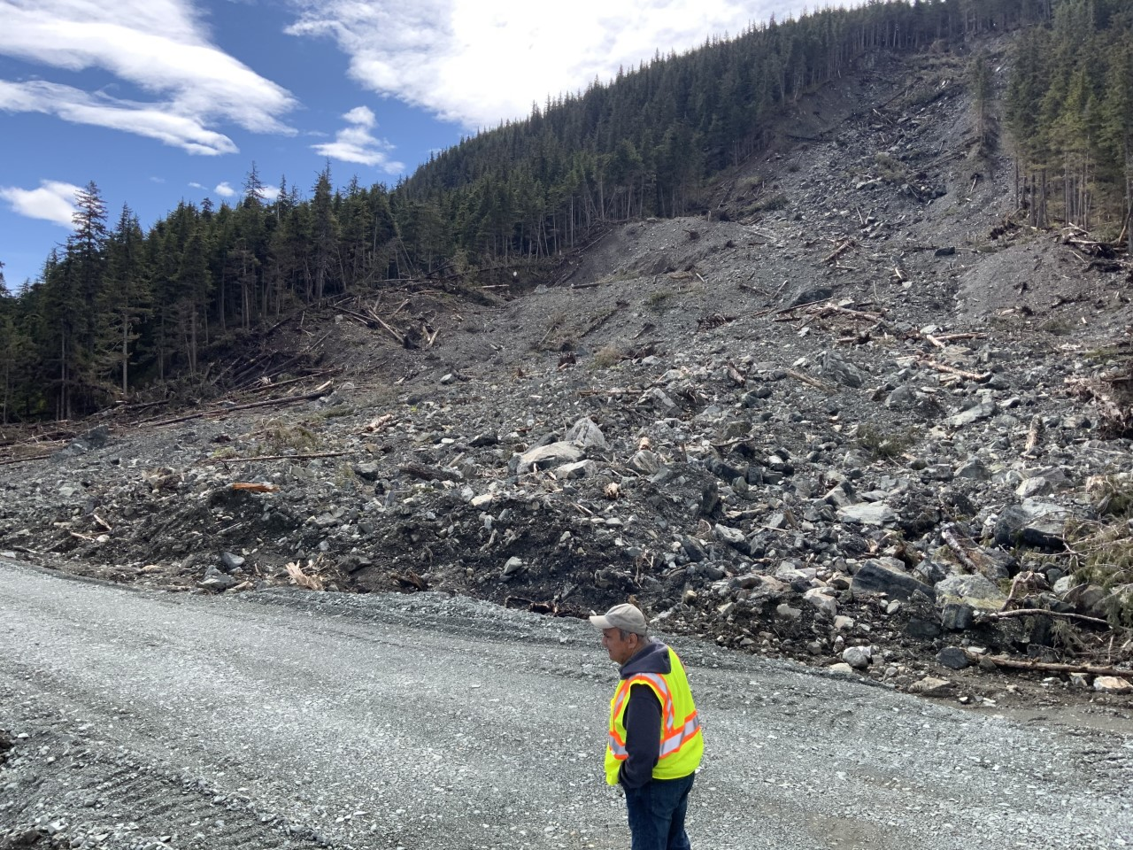
ERFO Program
(Emergency Relief Funding for Federally Owned Roads)
  Notification
    All tribes (BIA and FHWA Tribes) should notify BIA if an event potentially qualifies for ERFO
    Take photographs ASAP after event
    AK Region ERFO Coordinator: Julie Stoneking-Radford
    Julie.Stoneking-Radford@bia.gov, (907) 271-4093
  Damage Threshold
    $700,000 total for one disaster event to qualify
    $5,000 each site to qualify within the disaster event
    ERFO restores to pre-disaster conditions
  Ownership of TTP Routes
    Must be in the National Tribal Transportation Facility Inventory for a tribe to qualify as an ERFO recipient
  BIA/FLH Actions
    BIA files NOI with FLH to start ERFO process
    BIA/FLH complete Damage Survey Reports (DSRs)
    BIA Submits Program of Projects (POP) to FLH
    FLH approves POP, establishes funding limit
    BIA transfers funds via G2Gs, PL 93-638 contracts
    BIA/FLH monitor work and submit status reports
Notes:
Every year we see catastrophic damage due to weather, flooding, landslides or erosion
BIA is lead agency for ERFO, all Alaska tribes must coordinate their ERFO requests through the Alaska Region office
ERFO can help repair damage
$700,000 total for one disaster event to qualify
Must be in the National Tribal Transportation Facility Inventory for a tribe to qualify as an ERFO recipient
Our coordinator for ERFO is Julie Stoneking-Radford.

Slide 35
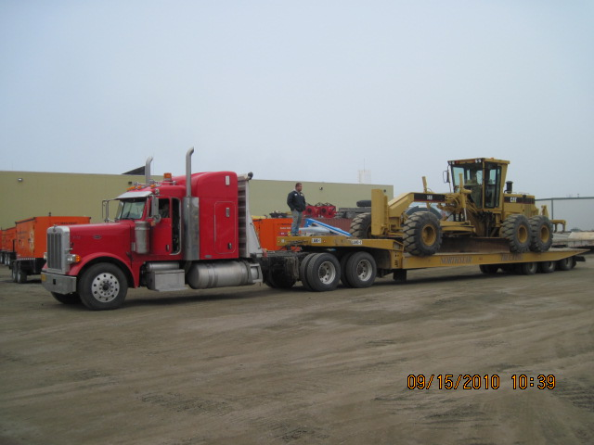

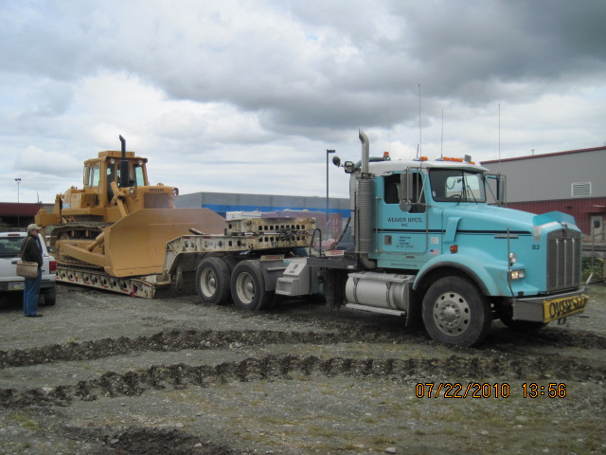
Excess Federal Property
GSAXcess Website
GSA Activity Address Code (AAC)
Eligibility based on Contract, Compact, or Program Agreement
Vehicle Registration – Certificate to Obtain Title
Visit GSA’s Federal Excess Property website for
information and training: https://gsaxcess.gov/
GSA Auto Choice – tribes can purchase new vehicles and equipment at the government rate
Property Management
  Teresa Stowe
    (907)310-0887
    Teresa.Stowe@bia.gov
Notes:
Excess federal property is frequently available—take advantage of this lucrative source for vehicles and equipment.
GSAXcess Website
Shopping List of Excess Federal Property
Items may have acquisition and shipping costs
Work with BIA and GSA to acquire surplus property
GSA Activity Address Code (AAC)
Must be sponsored by BIA
Submit an Activity Address Code request to BIA Property Management
Activity Address Code authorizes participation
A tribe must be sponsored by BIA to obtain an Activity Address Code
Eligibility based on Contract, Compact, or Program
Agreement
Equipment must support a contracted program
Awarding Official reviews and authorizes participation with a Findings and Determination (F&D)
F&D ensures items are used to perform contract work
Example: An active road maintenance contract typically justifies heavy equipment and general purpose vehicles
BIA involved because this is government property purchased with tax dollars. So even though excess, the government wants assurance that the equipment will be used on gov’t programs.
For that reason eligibility is based on a contract or agreement. The equipment must be used in support of a contracted program. So the awarding official in conjunction with Tribal Transportation issues a determination that items are used to perform contract work. As an example an active road maintenance contract will typically justify the acquisition of excess construction equipment and general purpose vehicles.
Tribes can also participate in the GSA Auto Choice program which allows for purchase of new vehicles at the government rate.
Vehicle Registration – Certificate to Obtain Title
Standard Form 97 prepared by BIA Property Management Office
Visit GSA’s Federal Excess Property website for
information and training: https://gsaxcess.gov/
GSA Auto Choice – tribes can purchase new vehicles and equipment at the government rate
Our point of contact for excess Federal Property and Auto Choice is Glenn Ivanoff and the slide shows his contact information.
Property Management
Glenn Ivanoff
(907) 271-4508
glenn.ivanoff@bia.gov

Slide 36
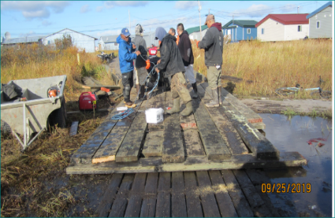
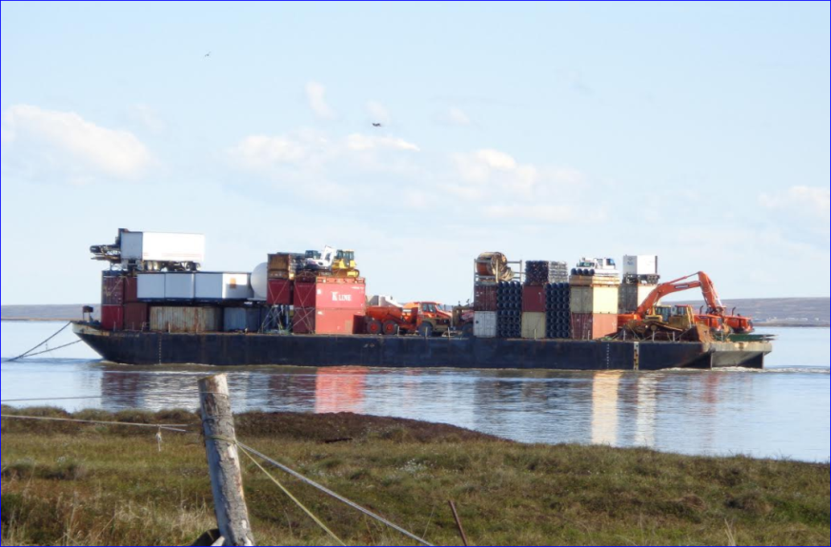
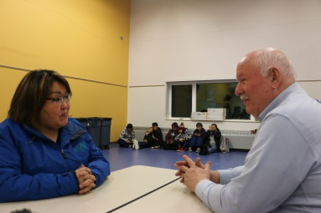
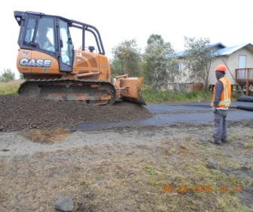
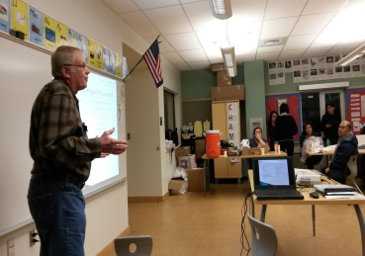

“Dear Tribal Leader” Emails
Date | Subject | Deadline
1/25/2022 | FHWA Announces $17.8M for Tribal Technical Assistance Program Centers | 3/25/2022
3/18/2022 | NOFO National Scenic Byways Program FY2022 Grants (FHWA - $22M) | 6/60/2022
3/30/2022 | Funding for Major Infrastructure Projects (FHWA - $2.9B) | 5/23/2022
5/2/2022 | Tribal Climate Resilience Solicitation (DOI, $46M) | 7/6/2022
5/16/2022 | Grant Opportunity: Safe Streets and Roads for All (FHWA - $1B) | 9/15/2022
6/8/2022 | TTP Bridge Program Questions and Answers (BIA) | N/A
6/9/2022 | Notification of 100% Funds Availability (BIA) | N/A
7/14/2022 | Reconnecting Communities Discretionary Grants (FHWA - $B) | N/A
8/1/2022 | Placemaking Cooperative Agreements to Spur Economic Growth (USDA - $4M) | N/A
9/19/2022 | USDOT Announces Grants for Smart Transportation Technology ($160M) | 11/18/2022
10/3/2022 | Accepting Applications for FY23 TTP Safety Fund (FHWA – $42M) | 1/15/2023
10/6/2022 | Thriving Communities Program (FHWA - $30M) | NA
10/24/2022 | Safety Technical Assistance from the FHWA Match Program | N/A
10/24/2022 | National Culvert Removal, Replacement, Restoration Grants (FHWA - $1B) | N/A
10/24/2022 | Safe Ice Roads for Alaska – Open for Applications (AKDOT) | N/A
11/3/2022 | Innovation Exchange – Unstable Slope Management Plan (FHWA) | N/A
Notes:
Communication is critical
Email is our #1 tool for getting the word out
We use an all-electronic approach to delivering correspondence
So it’s critical that we have a good email address for you.
We are committed to getting the word out to you via email on various issues like training opportunities, funds availability and deadlines that come around every year for inventory.
Pay close attention to the instructions in these letters. If you follow the instructions and meet deadlines your program will function a lot more effectively and you might obtain additional funding awards from various grant opportunities that frequently come our way.

Slide 37
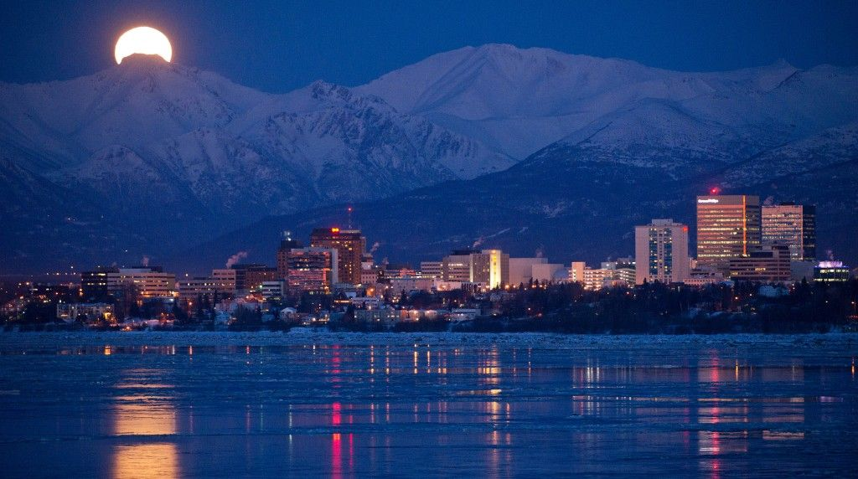
Questions?
Andrew White, MCE
3601 C Street, Suite 1278
Anchorage, AK 99503
Andrew.White@bia.gov
Alaska.Transportation@bia.gov
Office: (907) 271-4400
Direct Line: (907) 271-4565
FAX: (907) 271-6163
37
Notes:
37
It’s been a pleasure updating you on the Alaska Region Tribal Transportation Program. I hope you found it useful.
My staff stands ready to assist you any way that we can.
The Transportation Branch values our partnership with tribes and looks forward to our continued mutual success as we plan for the future generations.
Thank you for your time.
Questions?

