Slide 1
Just in Time Assistance: TTP Annual Report
Miles Brookes– Tribal Coordinator Alaska Region
FHWA - Office of Tribal Transportation
October 26, 2023

Slide 2
Before we begin…
This session provides examples and suggestions for completing a TTP Annual Report
Some of the report questions discussed in this session may not be applicable to Tribes that deliver their transportation program through non-FHWA Program Agreement methods (i.e., PL 93-638 contracts, BIA Program Agreements)
The projects, programs, documents, etc. used as examples in this presentation(including the availability of such) may vary from your Tribe.

Slide 3
Why do we need to do an annual report?
25 CFR 170.240:
“no later than 90 days after the last day of each fiscal year, any entity carrying out a project under the TTP under 23 U.S.C. 202 shall submit to the Secretaries, based on obligations and expenditures under the TTP during the preceding fiscal year, the following data:
(1) The names of projects and activities carried out by the entity under the TTP during the preceding fiscal year.
(2) A description of the projects and activities identified under paragraph (1) of this section;
(3) The current status of the projects and activities identified under paragraph (1) of this section; and
(4) An estimate of the number of jobs created and the number of jobs retained by the projects and activities identified under paragraph (1) of this section.”
And, if you are a FHWA TTP Program Agreement (PA) Tribe:
TTP Agreement Art. III, § 7 (B):
“…Tribe shall be responsible for inputting all of its required data…no later than December 30, of each year…Tribe
acknowledges its understanding that timely submission of its data is mandated by statute…”

Slide 4
Does my Tribe have to use the online reporting tool?
YES!
25 CFR 170.240(b):
“FHWA and BIA shall provide an electronic portal to assist Tribes in submitting the data needed to fulfill the requirements of 23 U.S.C. 201(c)(6)(C).”
And, if you are a FHWA TTP Program Agreement (PA) Tribe:
TTP Agreement Art. III, § 7 (B):
“BIA and FHWA have established an electronic data reporting system known as the Tribal Transportation Program Online
Reporting Tool (PORT). The Tribe shall be responsible for inputting all of its required data into PORT…”

Slide 5
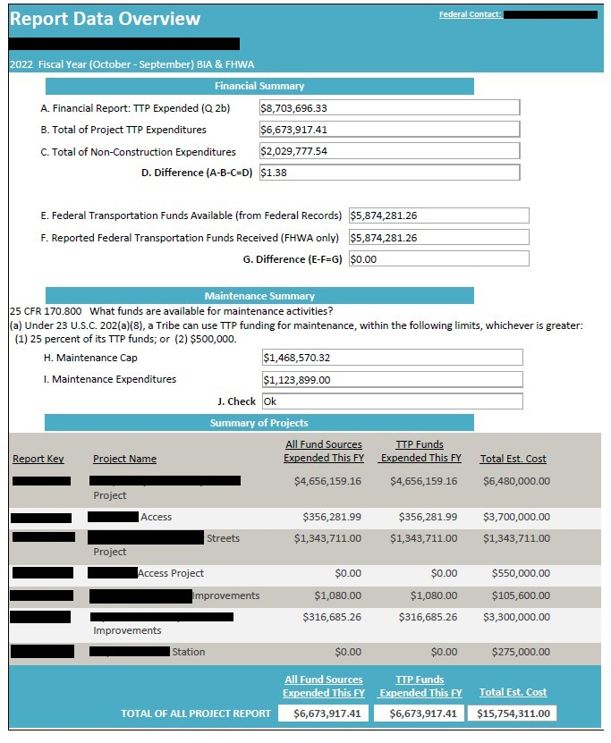
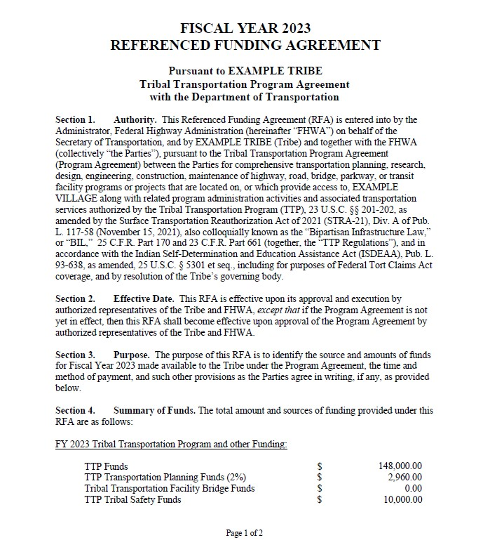
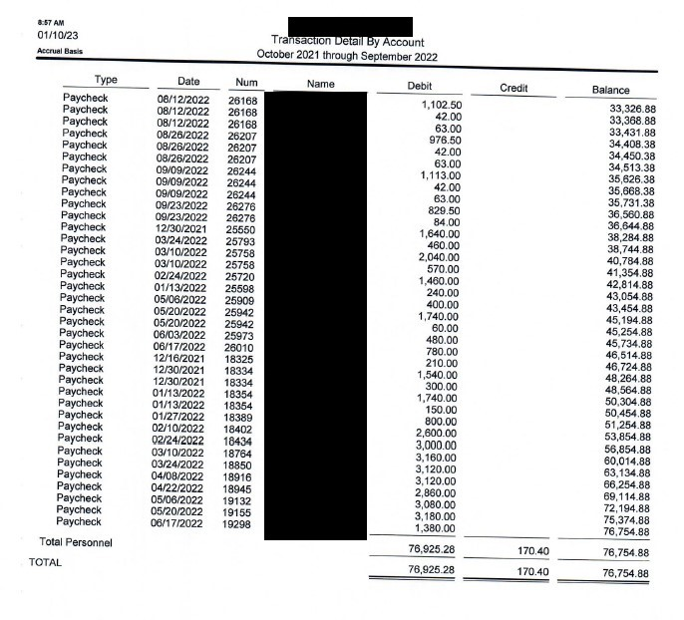
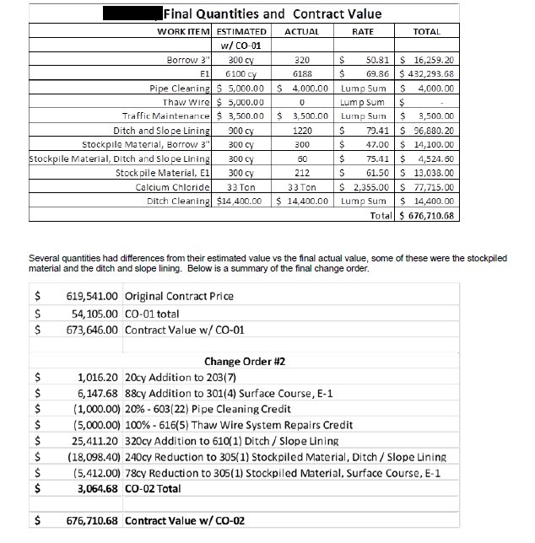
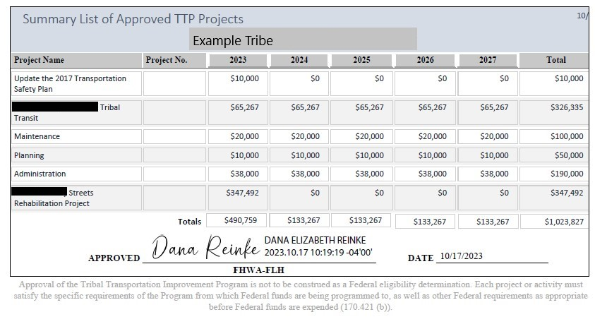
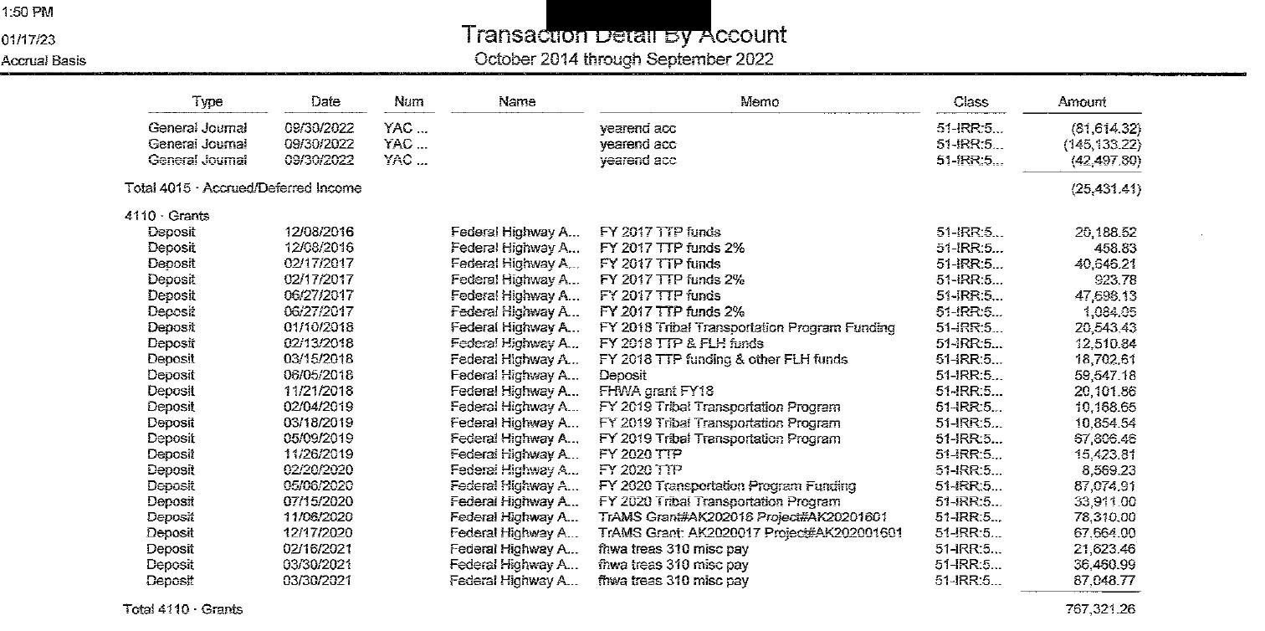
What documents are helpful for the completing the annual report?
Previous year’s TTP Annual Report
All executed Referenced Funding
Agreements (RFA) since signing FHWA
Current approved TTIP with reporting year included
Tribe revenue reports (current and historical)
Tribal payroll and expense reports for reporting period
Construction reports, daily diaries, etc.
Others as needed
Coordinate with other Tribal departments early for needed documents.

Slide 6
Who may I need to coordinate with for TTP reporting?
Tribal Administrator
Tribe’s finance office or bookkeeper
Tribal transportation staff
FHWA Tribal Coordinator (TC)
BIA Point of Contact (POC) Engineer
Tribal Administrator
Finance Manager
Payroll Coordinator
Accounts Payable Technician
Transportation Director
Construction Manager

Slide 7
TTP Financial Report:
The Financial Report:
Is required from all Tribes
Includes Tribe’s TTP financial data for the reporting period (federal fiscal year)

Slide 8
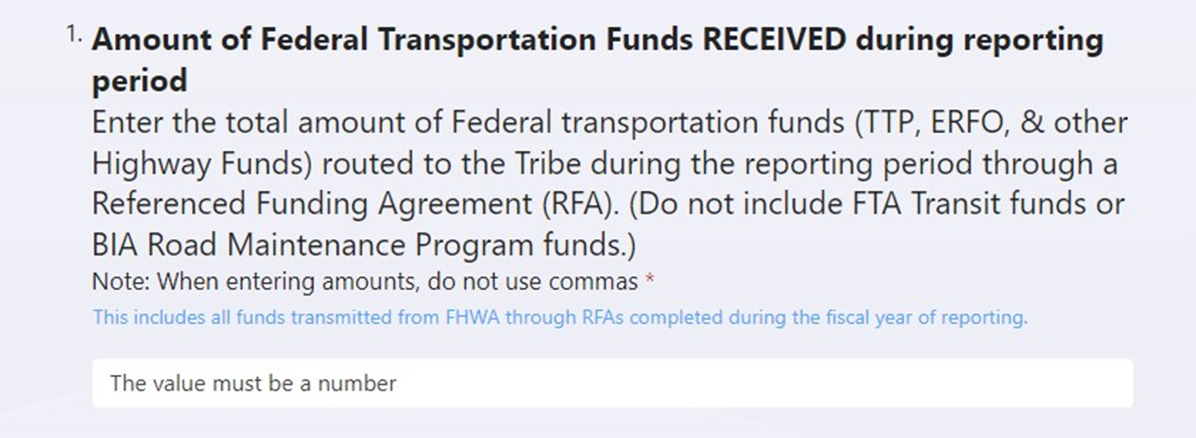
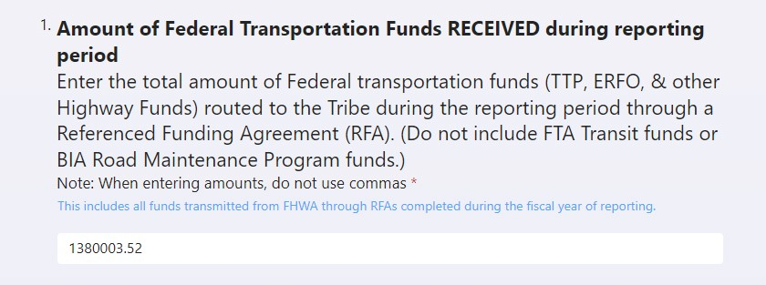
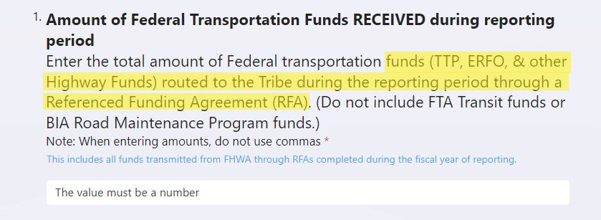
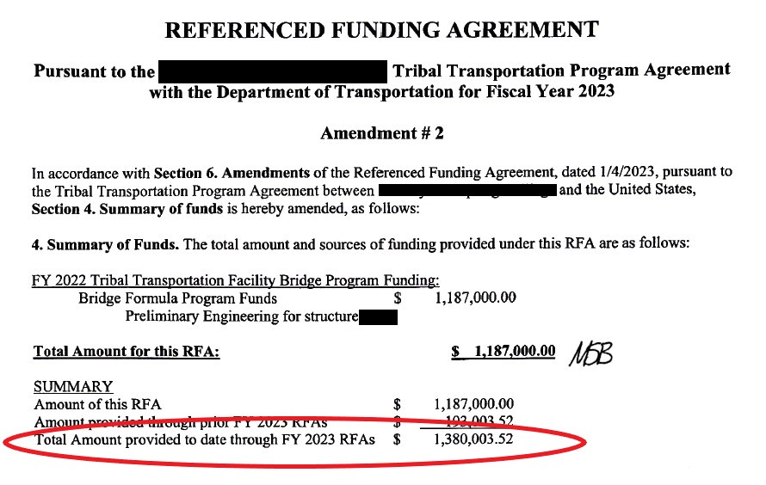
TTP Financial Report: Question 1
Suggested documents for reference:
Last Referenced Funding Agreement (RFA) executed in FY23
Tribe revenue reports
Suggested Tribal staff to consult:
Tribal Finance
Carry this “total” from the latest executed RFA

Slide 9
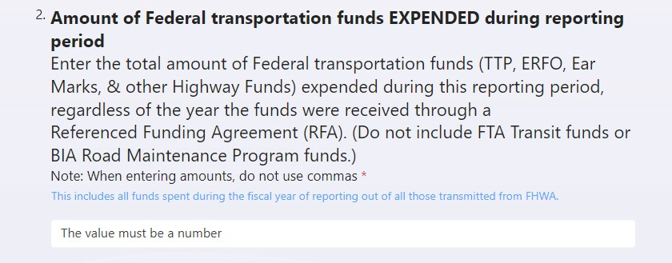
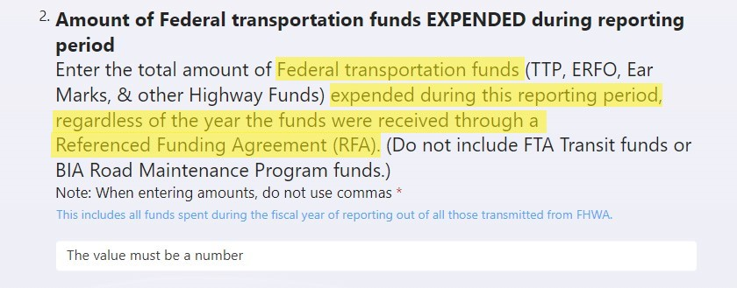
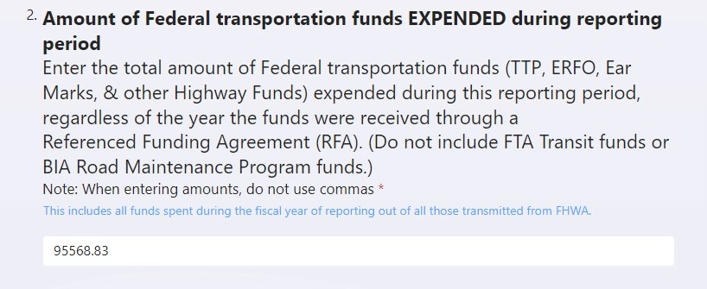
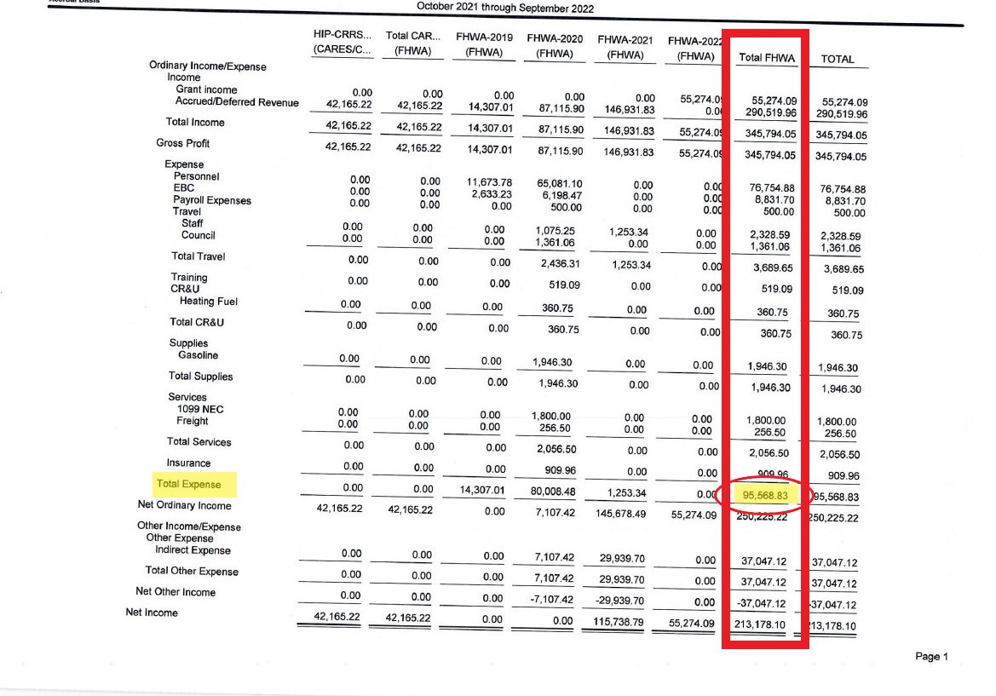
TTP Financial Report: Question 2
Suggested documents for reference:
Tribal finance expenditure report(s)
Payroll reports
Suggested Tribal staff to consult:
Tribal Finance
This is an example of where to find this information. Your Tribe’s amounts and report structure may vary.

Slide 10
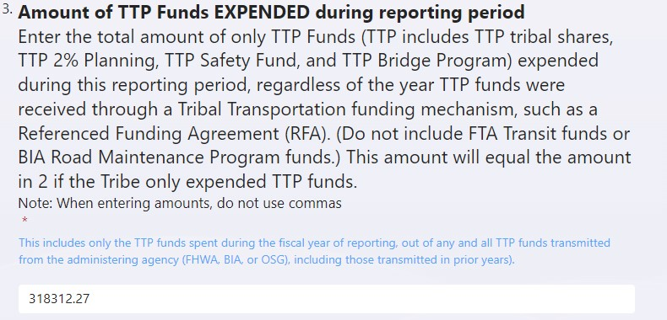
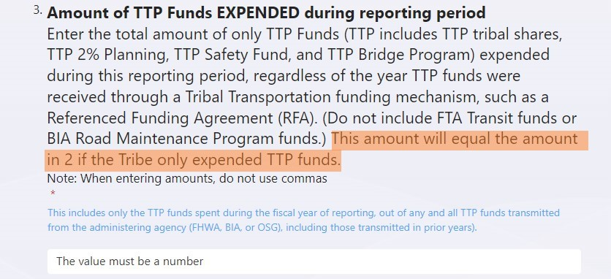
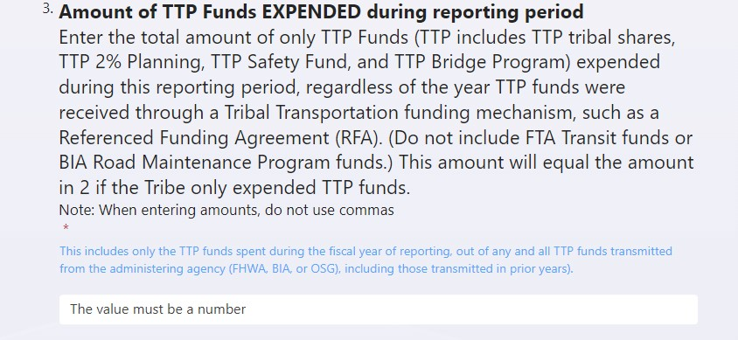
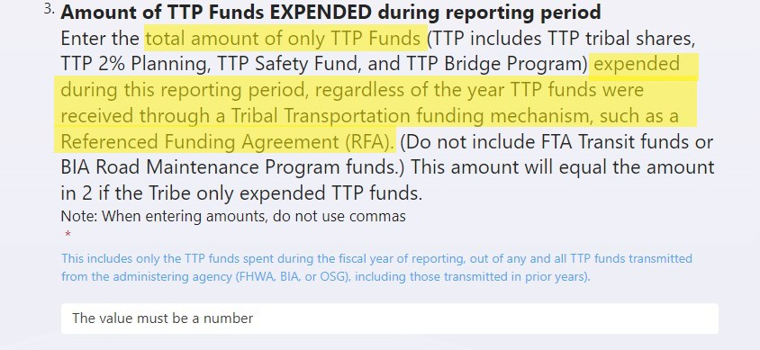
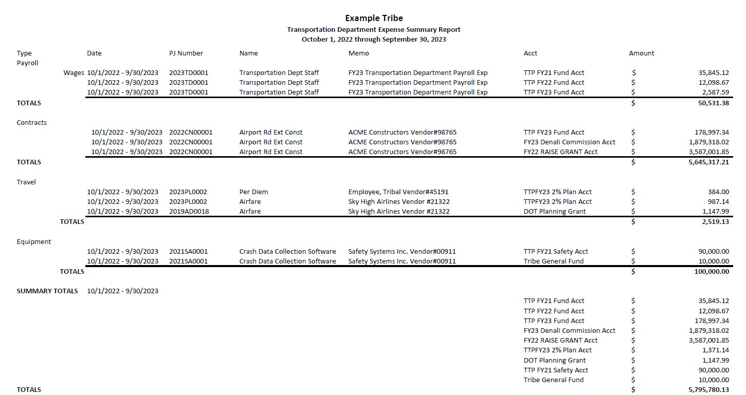
TTP Financial Report: Question 3
Suggested documents for reference:
Tribal finance expenditure report(s)
Payroll reports
Suggested Tribal staff to consult:
Tribal Finance
This is an example of where you may find this information. Your Tribe’s report structure may vary.
Only TTP Funds =
$318,312.27

Slide 11
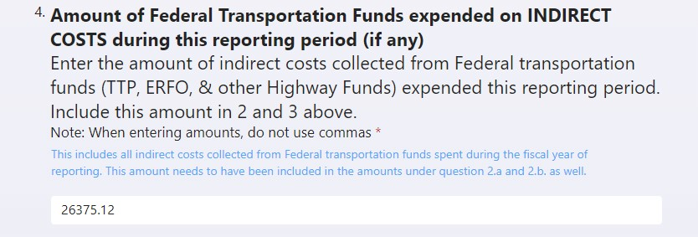
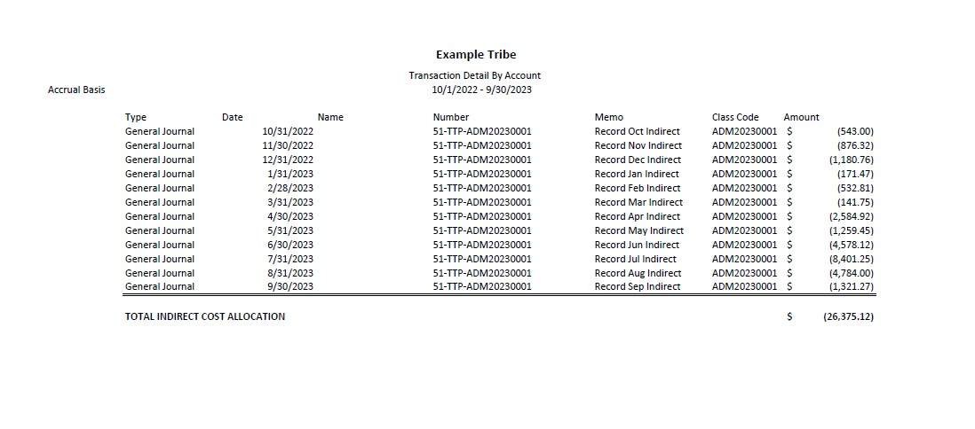
TTP Financial Report: Question 4
Suggested documents for reference:
Tribal finance expenditure report(s)
Suggested Tribal staff to consult:
Tribal Finance
This is an example of where to find this information. Your Tribe’s amounts and report structure may vary.

Slide 12
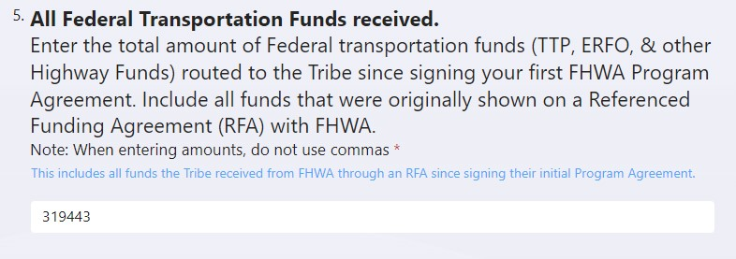
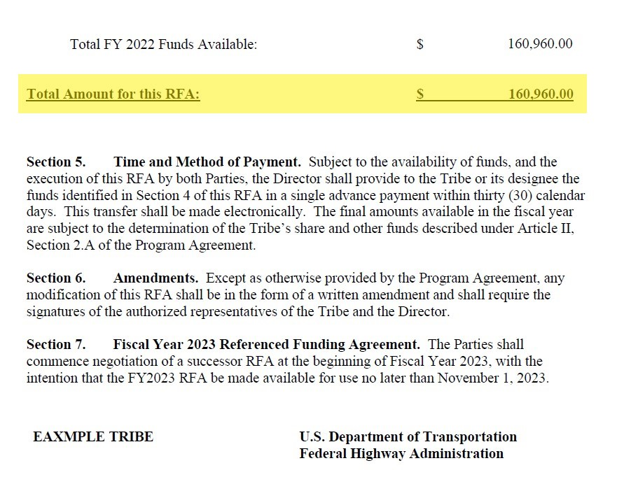
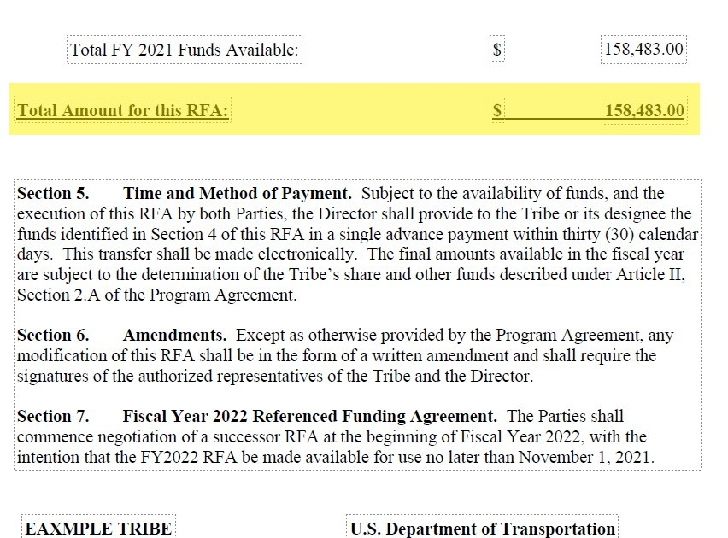
TTP Financial Report: Question 5
Suggested documents for reference:
Tribal revenue report(s)
Previous year’s Annual TTP Report (if accurate)
All executed RFAs
Suggested Tribal staff to consult:
Tribal Finance
Transportation Director
$ 160,960.00
+ $ 158483.00
$ 319,443.00
Repeat as necessary for all RFAs!

Slide 13
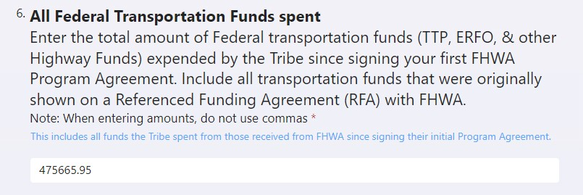
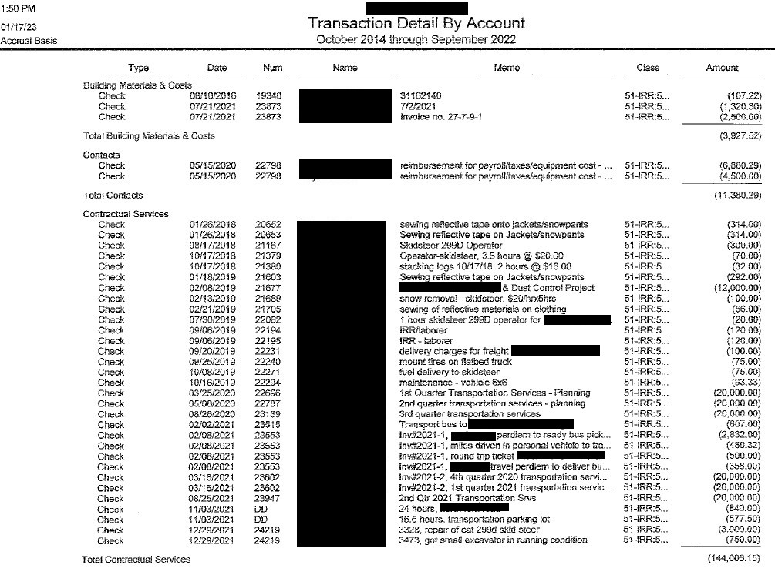
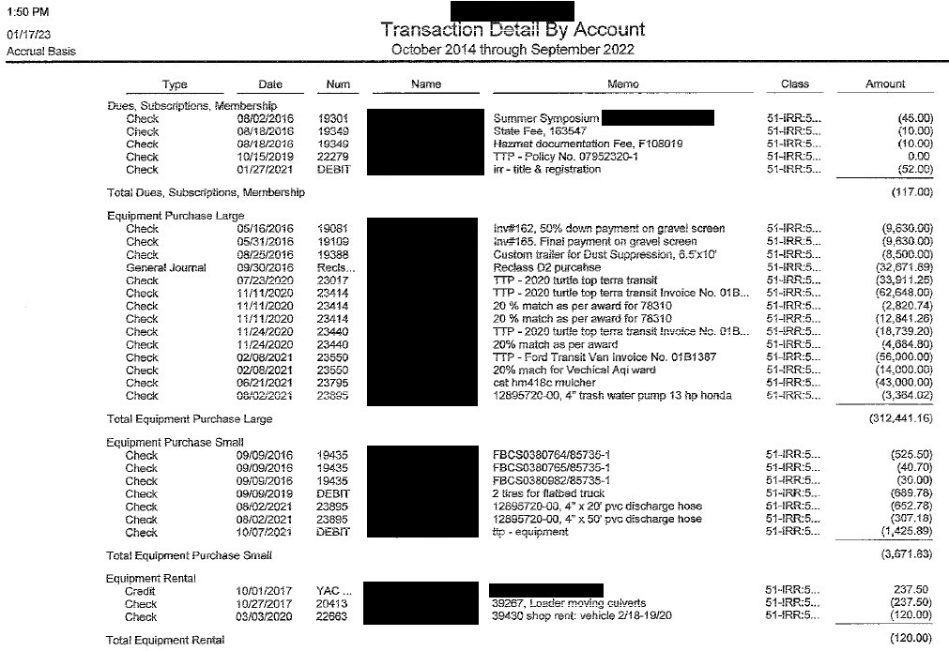
TTP Financial Report: Question 6
Suggested documents for reference:
Previous year’s Annual TTP Report (if accurate)
Tribal expense reports
Suggested Tribal staff to consult:
Tribal Finance
Transportation Director
$ 3,927.52
+ $ 11,380.29
+ $ 144,006.15
+ $ 117.00
+ $ 312,441.16
+ $ 3,671.83
+ $ 120.00
= $ 475,665.95
This is an example of where to find this information. Your Tribe’s amounts and report structure may vary.

Slide 14
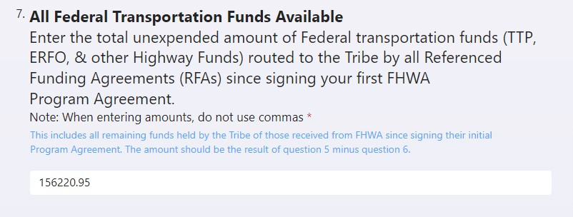
TTP Financial Report: Question 7
Suggested documents for reference:
This year’s TTP report (if Financial Report Qs 5 and 6 are accurate)
Tribe financial reports
Suggested Tribal staff to consult:
Transportation Director
Tribal Finance
If accurate, Q6 amount minus Q5 amount
$ 475,665.95
$ 319,443.00
$ 156,220.95

Slide 15
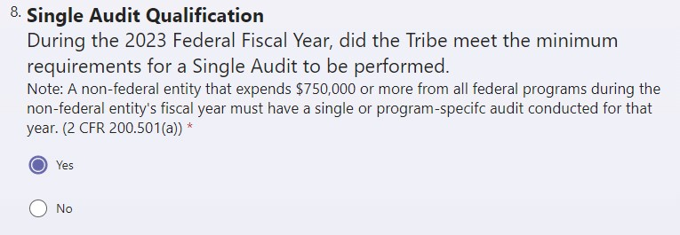
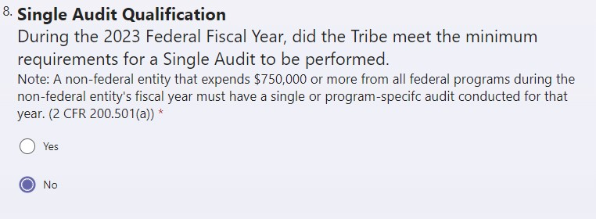
TTP Financial Report: Question 8
Suggested documents for reference:
Tribal finance expenditure report(s)
Suggested Tribal staff to consult:
Tribal Administrator
Tribal Finance
Consult with Tribal Finance Department or accountants. If the Tribe spent $750,000 or more in federal funds during the fiscal year, select yes.
Consult with Tribal Finance Department or accountants. If the Tribe spent less than $750,000 in federal funds during the fiscal year, select no.

Slide 16
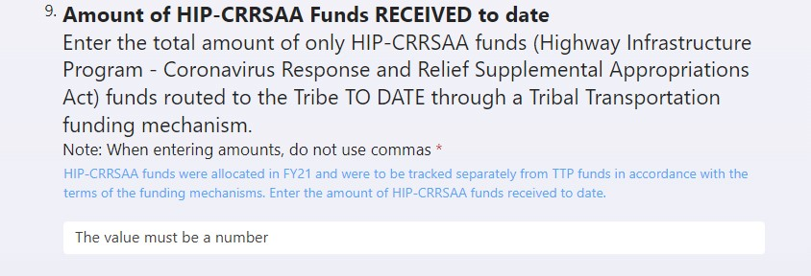
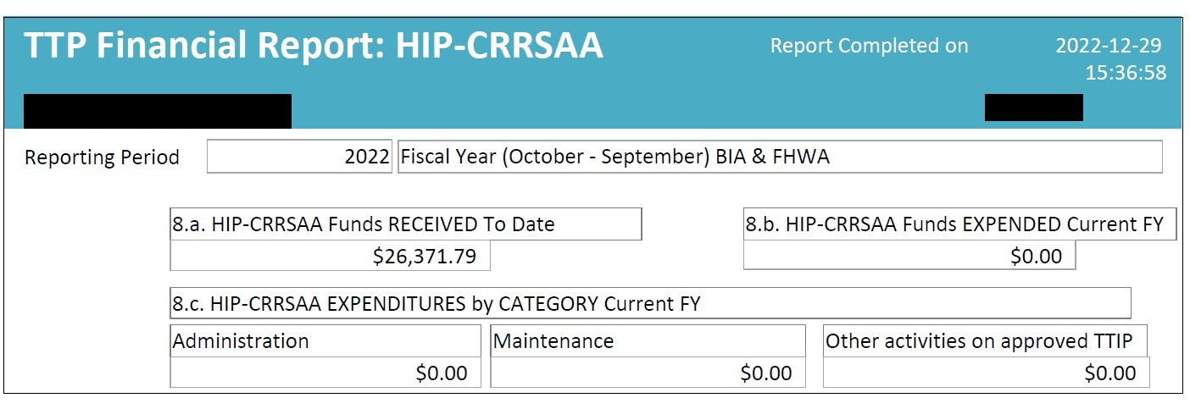
TTP Financial Report: Question 9
Suggested documents for reference:
Tribal revenue report(s)
Previous year’s Annual TTP Report
FY21 RFA
Suggested Tribal staff to consult:
Tribal Finance
Transportation Director
Use can use this number if last year’s Annual TTP report is accurate.

Slide 17
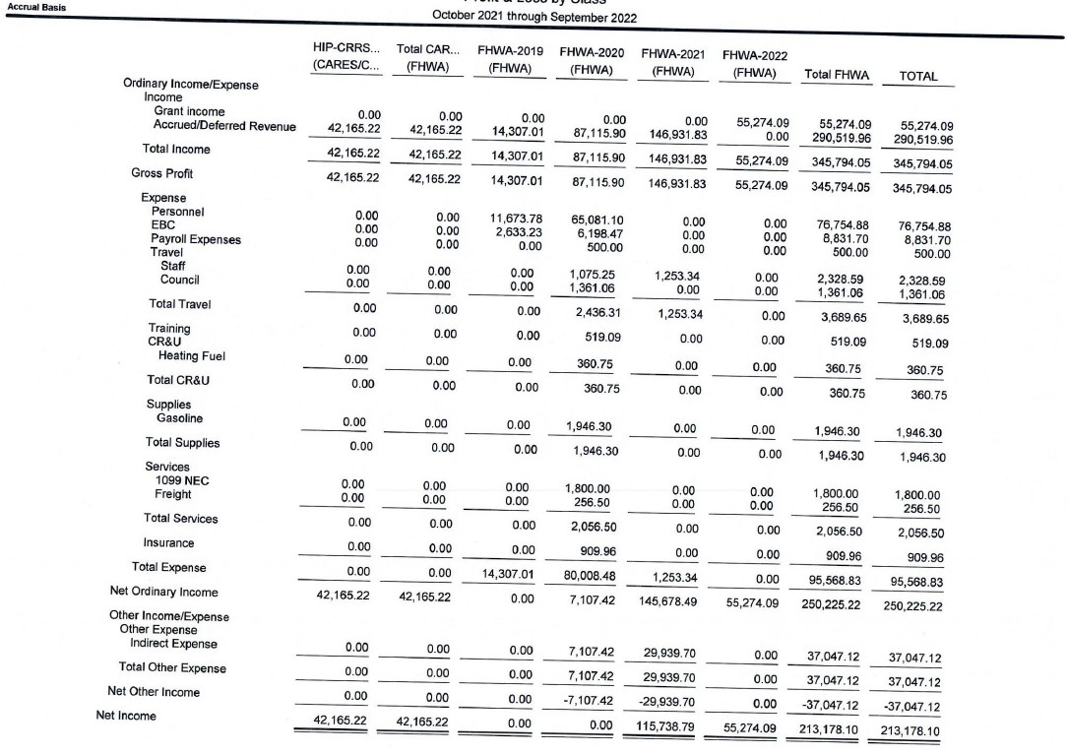
TTP Financial Report: Question 10
Suggested documents for reference:
Tribal expense report(s)
Suggested Tribal staff to consult:
Tribal Finance
Transportation Director
This is an example of where to find this information. Your Tribe’s amounts and report structure may vary.

Slide 18
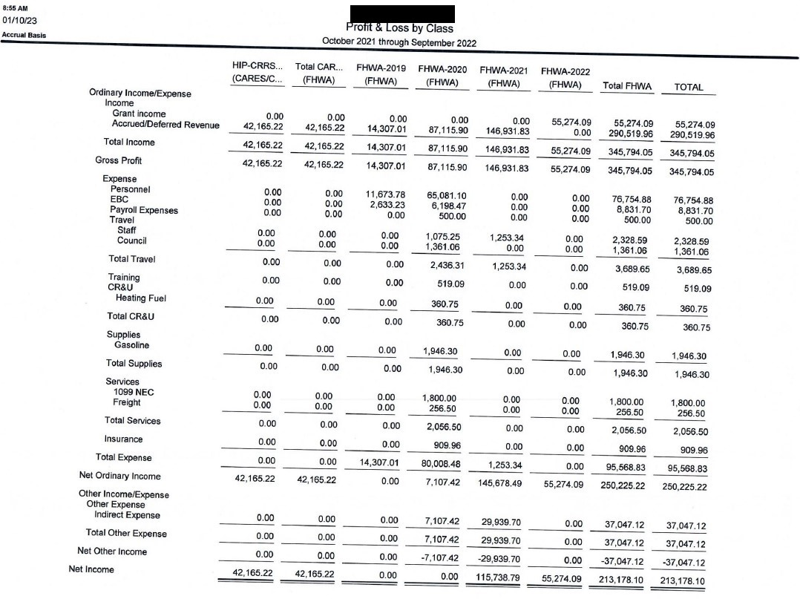
TTP Financial Report: Question 11
Suggested documents for reference:
Tribal expense report(s)
Suggested Tribal staff to consult:
Tribal Finance
Transportation Director
This is an example of where to find this information. Your Tribe’s amounts and report structure may vary.

Slide 19
TTP Financial Report: Question 12
Suggested documents for reference:
Tribal expense report(s)
Suggested Tribal staff to consult:
Tribal Finance
Transportation Director
This is an example of where to find this information. Your Tribe’s amounts and report structure may vary.

Slide 20
TTP Financial Report: Question 13
Suggested documents for reference:
Tribal expense report(s)
Suggested Tribal staff to consult:
Tribal Finance
Transportation Director
This is an example of where to find this information. Your Tribe’s amounts and report structure may vary.

Slide 21
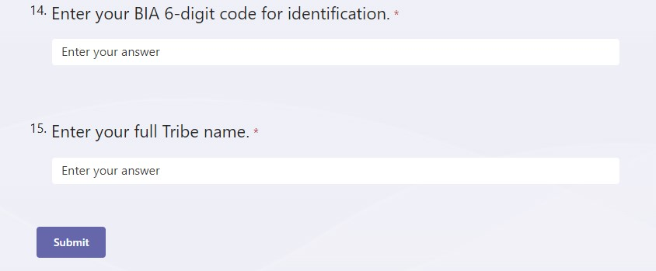
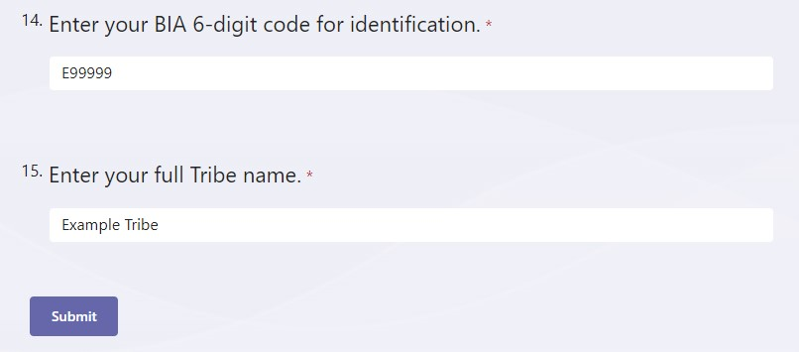
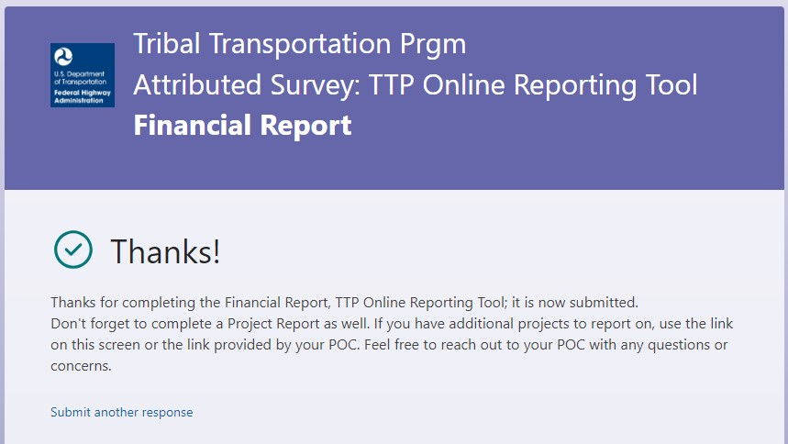
TTP Financial Report: Questions 14 & 15
You should receive a confirmation message that looks like:
Click submit when all fields are filled.

Slide 22
TTP Non-Construction Activities Report:
Commonly referred to as the:
S
T
A
M
P
Report
Commonly referred to as the:
Safety
Transit
Administration
Maintenance
Planning
Report
The Non-Construction Report:
Is required from all Tribes
Includes Tribe’s TTP non-construction activity and finance data for the reporting period (federal fiscal year)

Slide 23
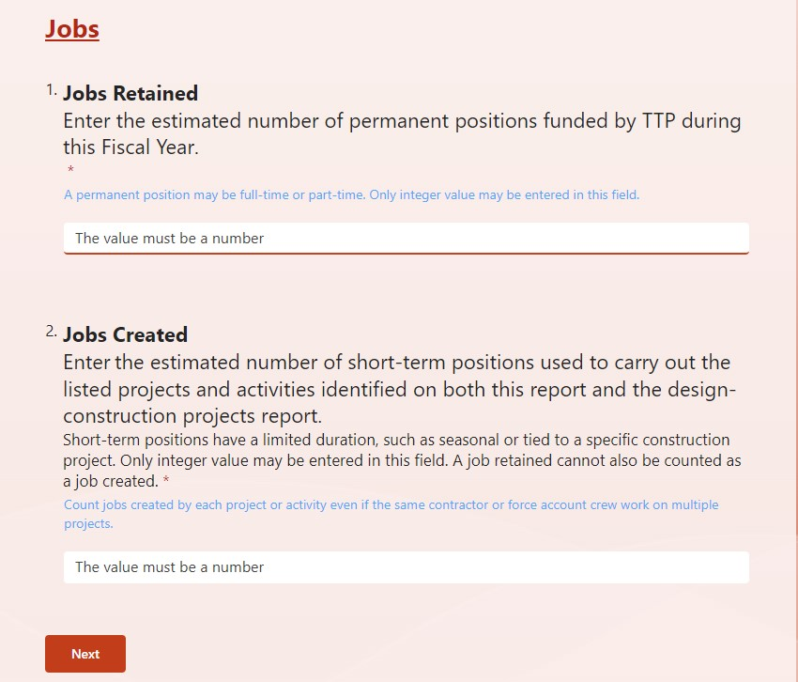
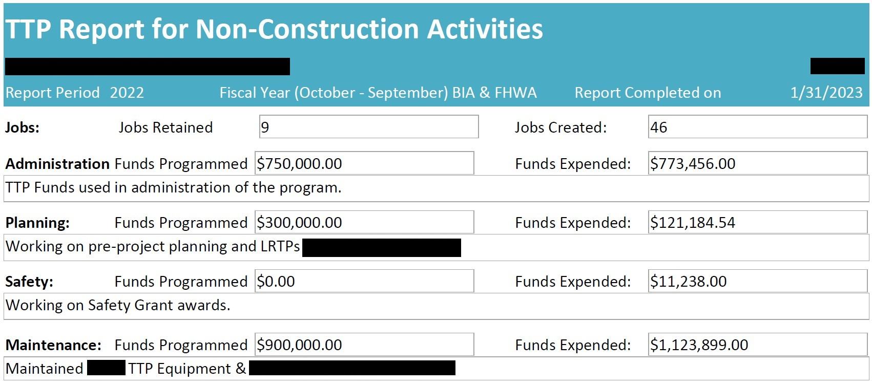
TTP Non-Construction Activities Report: Questions 1 & 2
Suggested documents for reference:
Tribal HR/staffing report(s)
Previous year’s Annual TTP Report
Suggested Tribal staff to consult:
Tribal Administrator
Tribal HR Department
Transportation Director

Slide 24
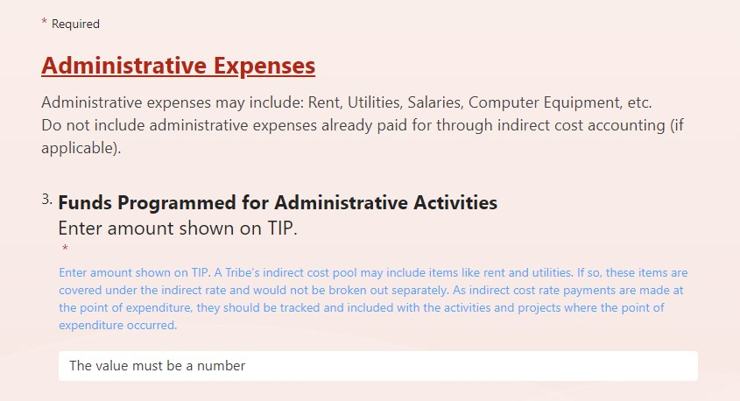
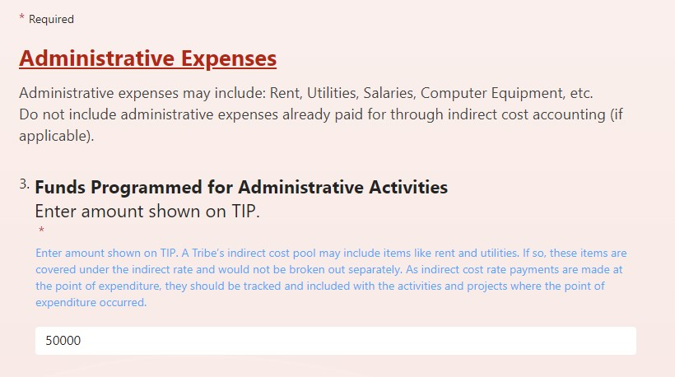
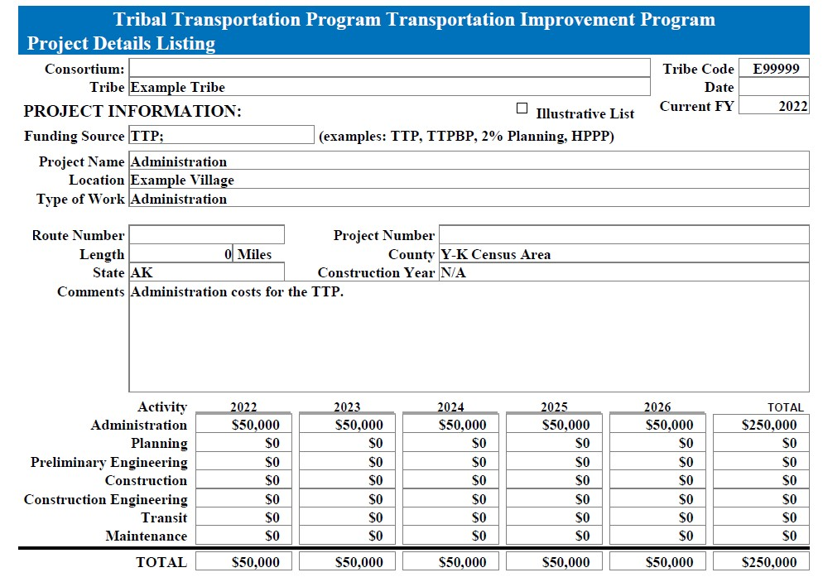
TTP Non-Construction Activities Report: Question 3
Suggested documents for reference:
Current Approved TTIP
Suggested Tribal staff to consult:
Transportation Director
Refer to you current TTIP for this field.

Slide 25
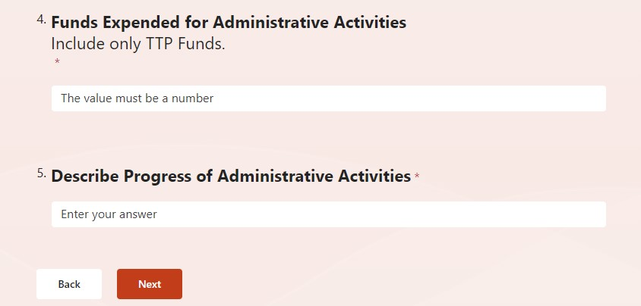
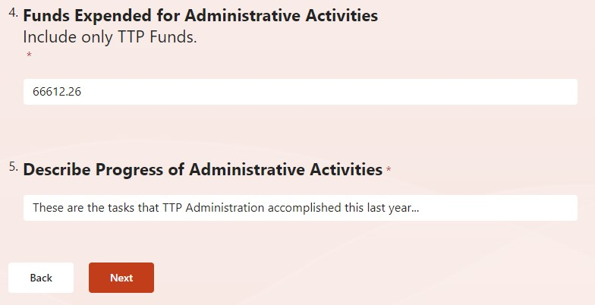
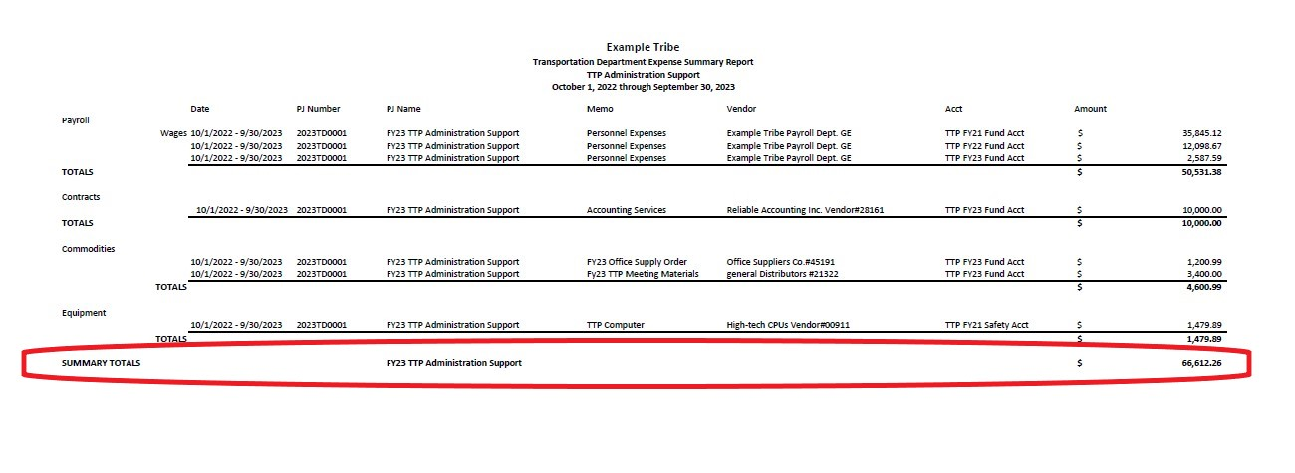
TTP Non-Construction Activities Report: Questions 4 & 5
Suggested documents for reference:
Tribal expense report(s)
Suggested Tribal staff to consult:
Tribal Finance
Transportation Director
This is an example of where to find this information. Your Tribe’s amounts and report structure may vary.
Enter a brief description of what Administrative tasks were completed during the fiscal year.

Slide 26
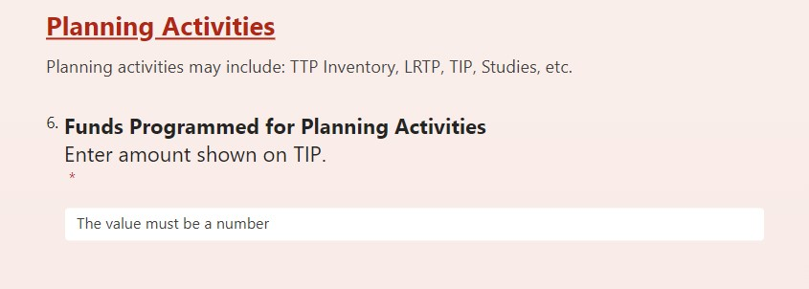
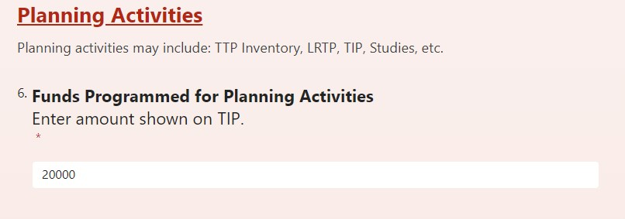
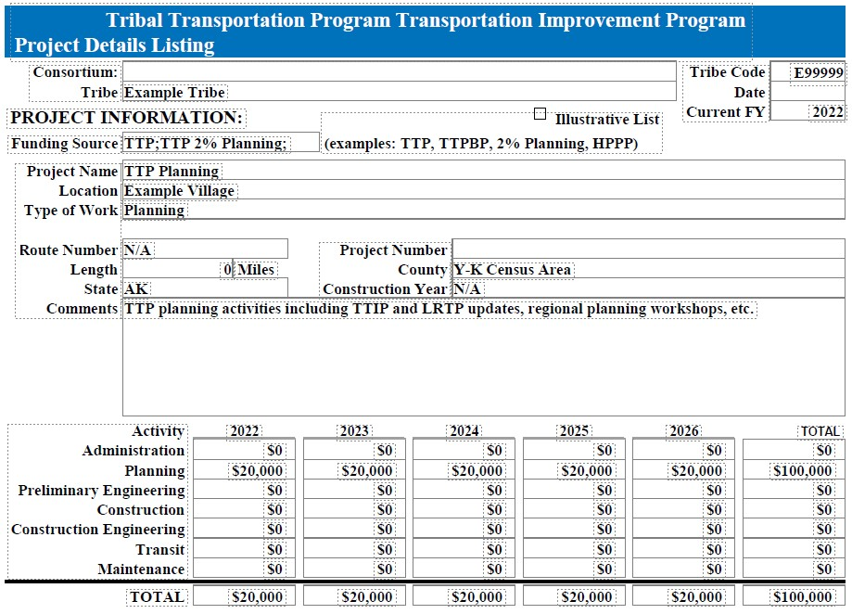
TTP Non-Construction Activities Report: Question 6
Suggested documents for reference:
Current Approved TTIP
Suggested Tribal staff to consult:
Transportation Director
Refer to you current TTIP for this field.

Slide 27
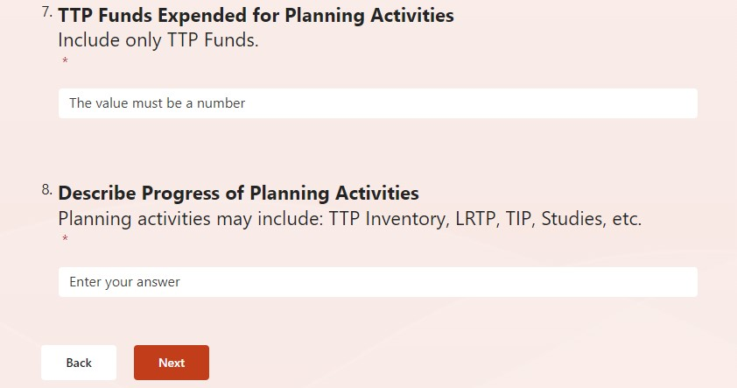
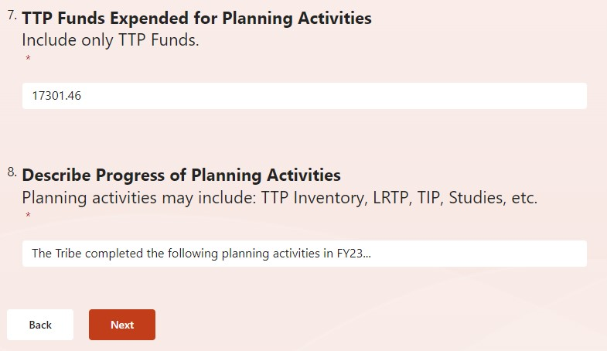
TTP Non-Construction Activities Report: Questions 7 & 8
Suggested documents for reference:
Tribal expense report(s)
Suggested Tribal staff to consult:
Tribal Finance
Transportation Director
This is an example of where to find this information. Your Tribe’s amounts and report structure may vary.
Click “Next”

Slide 28
TTP Non-Construction Activities Report: Question 9
Suggested documents for reference:
Current Approved TTIP
Suggested Tribal staff to consult:
Transportation Director

Slide 29
TTP Non-Construction Activities Report: Questions 10 & 11
Suggested documents for reference:
Tribal expense report(s)
Suggested Tribal staff to consult:
Tribal Finance
Transportation Director
This is an example of where to find this information. Your Tribe’s amounts and report structure may vary.
Click “Next”
Enter a brief description of what safety tasks were completed during the fiscal year.

Slide 30
TTP Non-Construction Activities Report: Question 12
Suggested documents for reference:
Current Approved TTIP
Suggested Tribal staff to consult:
Transportation Director
Refer to you current TTIP for this field.

Slide 31
TTP Non-Construction Activities Report: Questions 13 & 14
Suggested documents for reference:
Tribal expense report(s)
Suggested Tribal staff to consult:
Tribal Finance
Transportation Director
This is an example of where to find this information. Your Tribe’s amounts and report structure may vary.
Enter a brief description of what maintenance tasks were completed during the fiscal year.

Slide 32
TTP Non-Construction Activities Report: Question 15
Important note:
This question is a known bug within the report!
Provide a general “N/A” or “None” type response (even if the Tribe has transit activities to report) and move on to Question 16.

Slide 33
TTP Non-Construction Activities Report: Question 16
Suggested documents for reference:
Current Approved TTIP
Suggested Tribal staff to consult:
Transportation Director
Refer to you current TTIP for this field.

Slide 34
TTP Non-Construction Activities Report: Questions 17 & 18
Suggested documents for reference:
Current Approved TTIP
Suggested Tribal staff to consult:
Transportation Director
This is an example of where to find this information. Your Tribe’s amounts and report structure may vary.
Enter a brief description of what transit tasks were completed during the fiscal year.

Slide 35
TTP Non-Construction Activities Report: Questions 19 & 20
You should receive a confirmation message that looks like:
Click “Submit”

Slide 36
TTP Projects Report:
The Project Report:
Is required from all Tribes with a project programmed in their TTIP with the following activities:
Preliminary Engineering
Construction
Construction Engineering
Is required for each project programmed in a Tribe’s TTIP

Slide 37
Project Activities Report: Questions 1 through 3
If you do not see this number on your TTIP, enter “None” in the answer box
If your Tribes does not use project numbers, enter “None” in the answer box
Suggested documents for reference:
Current TTIP
Suggested Tribal staff to consult:
Tribal Finance
Transportation Director
This is an example of where to find this information. Your Tribe’s TTIP and projects may vary.

Slide 38
Project Activities Report: Questions 4 & 5
Suggested documents for reference:
Current TTIP
Suggested Tribal staff to consult:
Tribal Finance
Transportation Director
This is an example of where to find this information. Your Tribe’s TTIP and projects may vary.

Slide 39
Project Activities Report: Questions 6 & 7
Suggested documents for reference:
Current TTIP
Suggested Tribal staff to consult:
Transportation Director
This is an example of where to find this information. Your Tribe’s TTIP and projects may vary.

Slide 40
Project Activities Report: Questions 8 & 9
Suggested documents for reference:
Current TTIP
Suggested Tribal staff to consult:
Transportation Director
This is an example of where to find this information. Your Tribe’s TTIP and projects may vary.

Slide 41
Project Activities Report: Question 10
Suggested documents for reference:
Current TTIP
Suggested Tribal staff to consult:
Transportation Director
This is an example of where to find this information. Your Tribe’s TTIP and projects may vary.

Slide 42
Project Activities Report: Question 11
Suggested documents for reference:
Construction records
Paid work invoices
Suggested Tribal staff to consult:
Transportation Director
Tribal Finance
Tribe’s consultants and contractors
This is an example of where to find this information. Your Tribe’s construction reports and project progress may vary

Slide 43
Project Activities Report: Question 12
Suggested documents for reference:
Construction records
Paid work invoices
Suggested Tribal staff to consult:
Transportation Director
Tribal Finance
Tribe’s consultants and contractors
Suggested documents for reference:
Construction records – did you pay construction contractors or Tribal employees for construction work?
Paid work invoices – did you pay consultants for PS&E development?
Suggested Tribal staff to consult:
Transportation Director – what project activities occurred?
Tribal Finance – whom were project funds paid to?
Tribe’s consultants and contractors – what project tasks did you complete?
ANSWERS

Slide 44
Project Activities Report: Question 13
This is an example of where to find this information. Your Tribe’s reports and amounts may vary.
Suggested documents for reference:
Construction records
Tribe financial reports
Suggested Tribal staff to consult:
Transportation Director
Tribal Finance
Tribe’s consultants and contractors
$ 984.12
+ $ 16,032.55
+ $ 24,782.00
= $ 41,798.67

Slide 45
Project Activities Report: Question 14
Suggested documents for reference:
Construction records
Paid work invoices
Suggested Tribal staff to consult:
Transportation Director
Tribal Finance
Tribe’s consultants and contractors
This is an example of where to find this information. Your Tribe’s reports and amounts may vary.

Slide 46
Project Activities Report: Question 15
This is an example of where to find this information. Your Tribe’s reports and amounts may vary.
Suggested documents for reference:
Construction records
Paid work invoices
Current TTIP
Suggested Tribal staff to consult:
Transportation Director
Tribal Finance
Tribe’s consultants and contractors
$ 143,234.01 (PE/Design)
+ $ 989,000.00 (Contract Award)
+ $ 100,000.00 (CE Est. [TTIP])
= $ 1,232,234.01 (Anticipated)

Slide 47
Project Activities Report: Questions 16 & 17
Suggested documents for reference:
Construction records
Paid work invoices
Suggested Tribal staff to consult:
Transportation Director
Tribe’s consultants and contractors
This is an example of where to find this information. Your Tribe’s construction progress and completion date may vary.

Slide 48
Project Activities Report: Questions 18 & 19
You should receive a confirmation message that looks like:
Click “Submit”

Slide 49
Project Activities Report: Subsequent Projects
Repeat this process (slides 37-48) for every active project programmed in the Tribe’s TTIP with one or more of the following activities:
Preliminary Engineering
Construction
Construction Engineering
Click “Submit another response” to report more projects

Slide 50
Final Thoughts, Questions, Comments…
TTP Annual Reports are due Saturday, December 30, 2023
Coordination with other Tribal departments and staff is likely
Begin report work as early as possible
Work with your TCs (FHWA) or POCs (BIA) if further assistance is needed on the report itself or the reporting tool
If you need to make corrections to a submitted report, contact your TC of POC to discuss best course of action to make change.

