Slide 1

How to Prepare an: SF-425
Dawna Pearson
BIA Transportation

Slide 2
PURPOSE:
FREQUENCY OF SUBMITTING THE SF-425:
The SF-425 is required to be submitted on a quarterly basis throughout the life of the contract and/or grant.
The Standard Form (SF) 425 is a post award reporting requirement. It is the required reporting tool to be utilized to report the financial status of grant and cooperative agreement funds and cash transactions using those funds.
FINAL SF-425:
The reporting period for the final financial report ends on the last day of performance period or when the funds are completely expended or when the award is terminated, whichever is first.
The final SF-425 must cover all expenditures. The final report is required for award closeout and must be submitted no later than 90 days after the reporting period or expenditure of all funds.

Slide 3
FISCAL YEAR (FY) QUARTERS
Q1 | Q2 | Q3 | Q4
OCTOBER | JANUARY | APRIL | JULY
NOVEMBER | FEBRUARY | MAY | AUGUST
DECEMBER | MARCH | JUNE | SEPTEMBER
Last day of Q1: December 31st Report Due: January 31st | Last day of Q2: March 31st Report Due: April 30th | Last day of Q3: June 30th Report Due: July 31st | Last day of Q4: September 30th Report Due: October 31st

Slide 4
CALENDAR YEAR (CY) QUARTERS
Q1: | Q2 | Q3 | Q4
JANUARY | APRIL | JULY | OCTOBER
FEBRUARY | MAY | AUGUST | NOVEMBER
MARCH | JUNE | SEPTEMBER | DECEMBER
Last day of Q1: March 31st Report Due: April 30th | Last day of Q2: June 30th Report Due: July 31st | Last day of Q3: September 30th Report Due: October 31st | Last day of Q4: December 31st Report Due: January 31st

Slide 5
FILLING OUT THE SF-425
Step-by-Step
Notes:
Do not report special funding, with TPA funds i.e. Coronavirus Response and Consolidated Appropriations Act (CARES) or American Rescue Plan (ARP) Funding.
These special funding are reported on separately.

Slide 6
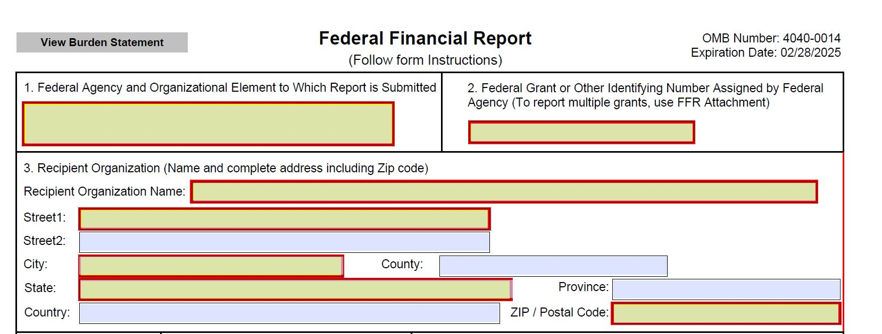
1.
Bureau of Indian Affairs-Alaska Region
Bureau of Indian Affairs-Alaska Region
A23AV00123
2.
Contract or Grant Number here:
Ex. A23AV00123
Tribe of Sleeping Lady
P.O. Box 1234
Sleeping Lady
N/A
Alaska
N/A
3.
Fill out Tribe address here.
For county and province put “N/A”
USA
99500

Slide 7
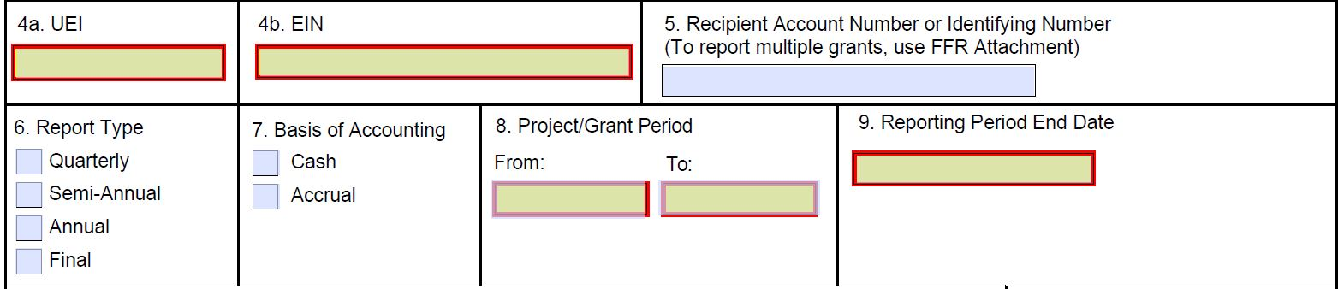
4a.
UEI-Unique Entity Identifier (from SAM.GOV Registration)
AB1234567C89
92-0123456
4b.
EIN-Employer Identification Number (corporate equivalent to a SSN)
X
X
12/31/22
10/01/22
09/30/24
5.
Leave blank. This number is for the recipient's use only and is not required by the Federal agency.
6.
Select “Quarterly”
7.
Select based on Tribe decision. (See definitions below)
8.
Utilize dates listed in “Contract Agreement”. (usually 3 years)
9.
Date entered is based on Quarter being reported.
Cash Accounting: An accounting method where receipts are recorded during the period they are received, and expenses are recorded in the period in which they are actually paid.
Accrual Accounting: An accrual allows an entity to record expenses and revenues for which it expects to expend cash or receive cash, respectively, in a future reporting period.

Slide 8
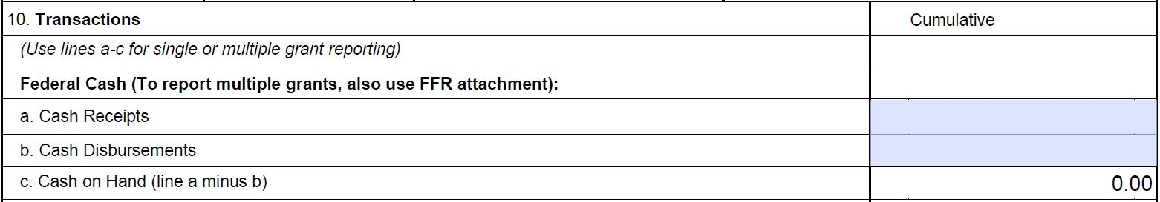
FEDERAL CASH:
10a. Cash Receipts: Enter the cumulative amount drawn down from ASAP from the beginning of the period to the reporting period end date.
200,000.00
50,000.00
150,000.00
10b. Cash Disbursements: Enter the cumulative amount of actual disbursements made from Federal funds drawn down as of the reporting period end date. Cumulative total of actual cash expenditures made for direct charges for goods and services, indirect expenses charged. (10b CANNOT exceed amount in 10a)
10c. Cash on Hand: This is calculated automatically. It is the sum of (10a - 10b).

Slide 9
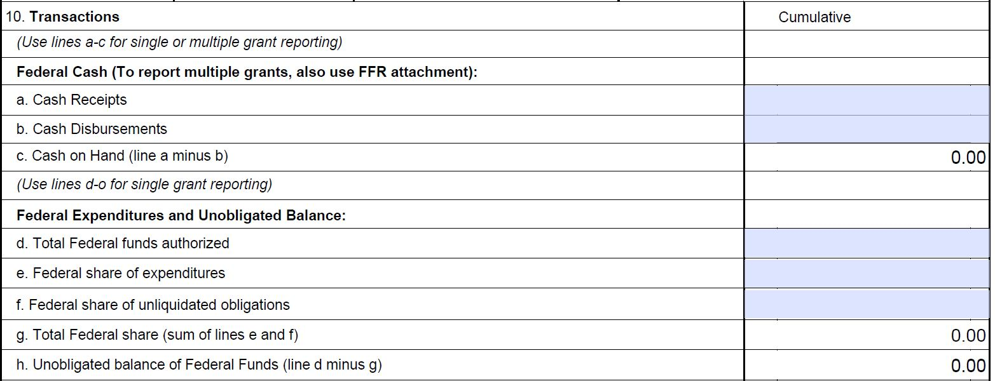
10. Transactions (continued)
FEDERAL EXPENDITURES AND UNOBLIGATED BALANCE:
10d. Total Federal funds authorized: Enter the initial amount in award PLUS total of modifications within quarter you are reporting.
200,000.00
50,000.00
10e. Federal share of expenditures: Enter the cumulative amount of actual disbursements made from Federal funds as of the reporting end date (usually the same as 10b).
0.00
50,000.00
150,000.00
10g. Total Federal share: This is calculated automatically. It is the sum of (10e - 10f).
10f. Federal share of unliquidated obligations:
Enter obligates not yet paid.
10h: Unobligated balance of Federal Funds: This is calculated automatically. It is the sum of (10d” - ”10g).
This is also the amount available to spend. (When the 3rd year is complete and you reach a zero balance, the contract is ready for closeout, and you are ready to complete the final report).

Slide 10
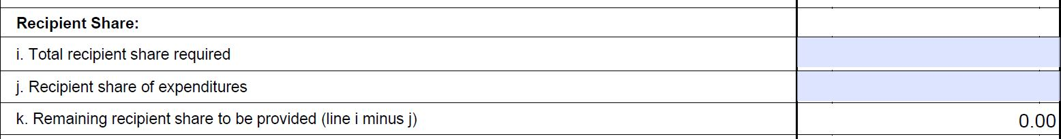
10. Transactions (continued)
RECIPIENT SHARE:
10i – 10k
Not applicable.

Slide 11
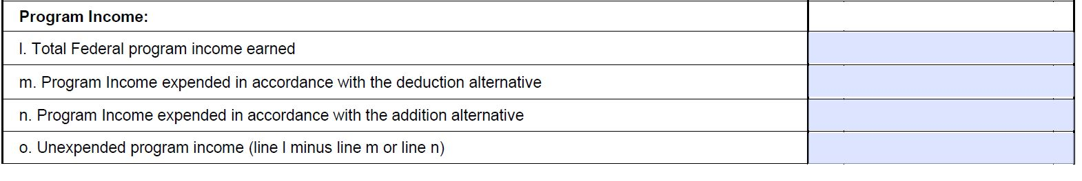
10. Transactions (continued)
Program Income:
10l – 10o.
Not applicable.

Slide 12
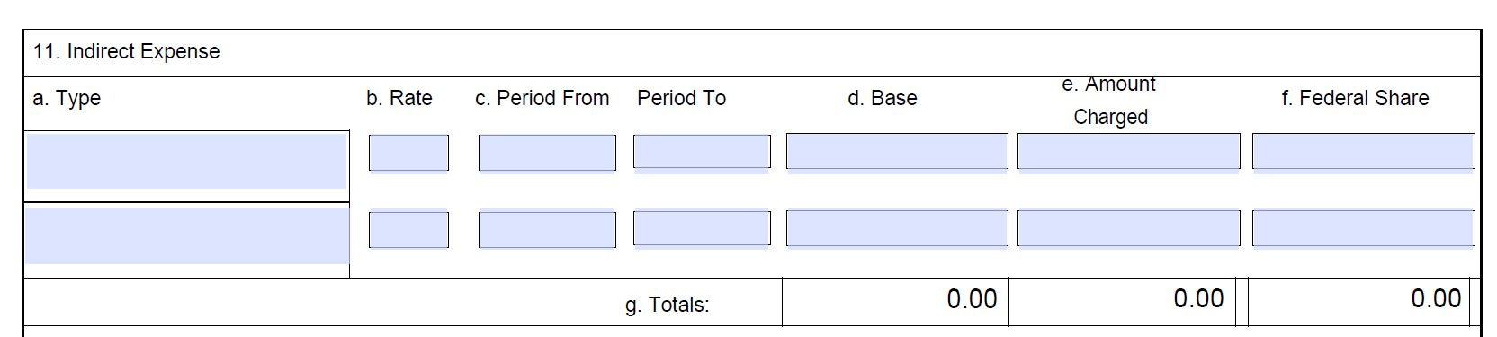
INDIRECT EXPENSE:
11a – 11g: Tribes are not required to report on their Indirect Expenses (Contract Support funds)

Slide 13
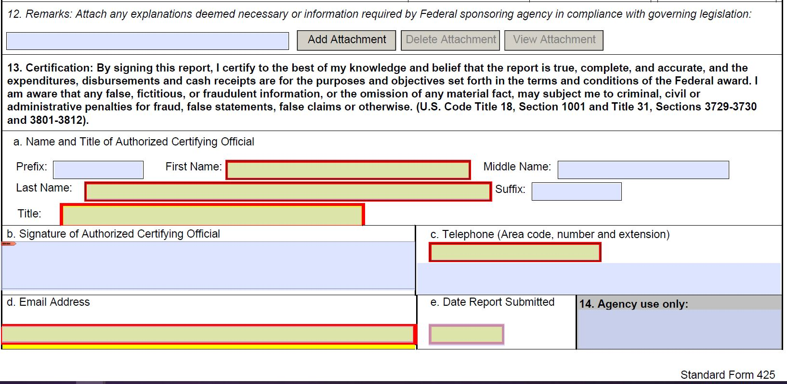
REMARKS & CERTIFICATION
12. Remarks: Enter any explanations or additional information required. If there is excess cash stated in 10c an explain further here.
13a. Name and Title of Authorized Certifying Official: Enter the name and title of the authorized certifying official.
Joseph
Sleeping Lady
Tribal President
13b. Signature of Authorized Certifying Official: The individual listed in 13a must sign here.
Joseph Sleeping Lady
907-000-1234
13c. Telephone: Enter the phone number of the individual listed in item 13a.
j.sleepinglady@tribe.org
12/30/22
13d. Email Address: Enter the e-mail address of the individual listed in item 13a.
13e. Date Report Submitted: Enter the date the SF-425 is submitted to the agency listed in item 1.
14. Agency use only: Leave blank.

Slide 14
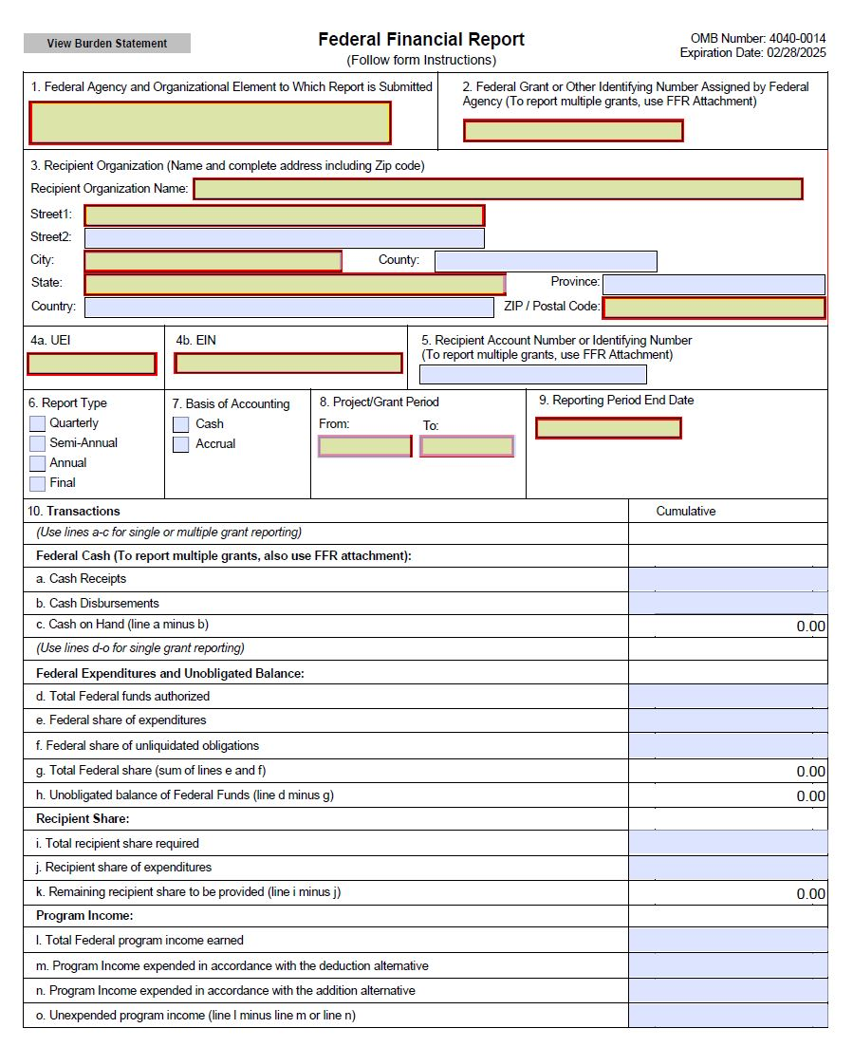
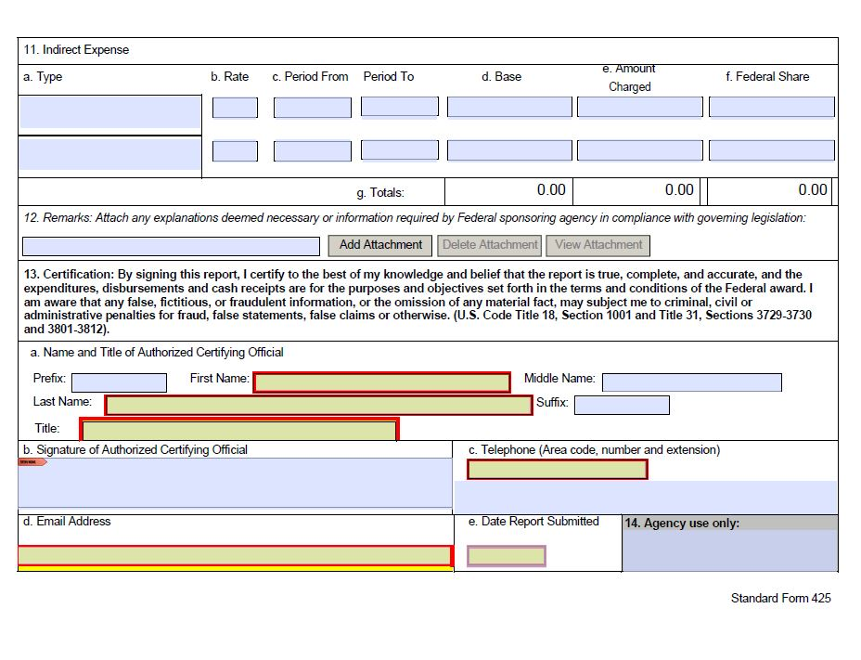

Slide 15
SF-425 Instructions 10a – 10h
10 a. Enter the Cumulative amount drawn down from ASAP from the beginning of the contract period to the reporting period end date.
10 b. Enter the cumulative amount of actual disbursements made from Federal funds drawn as of the reporting period end date. Cumulative total of actual cash expenditures made for direct charges for goods and services, and any indirect expenses charged.
10 c. Line 10a – 10b *This will automatically calculate*
10 d. Contract Total – Initial award amount plus the total of all modifications.
10 e. Enter the cumulative amount of actual disbursements made from federal funds as of the reporting period end date. (Usually the same as Line b )
10 f. Unliquidated obligations on a cash basis are obligations of Federally authorized funds which are incurred, but not yet paid as of the end of the reporting period. Normally not used.
10 g. Line 10e plus 10f *This will automatically calculate*
10 h. Line 10d – 10g *This will automatically calculate*

Slide 16
PROFIT & LOSS
The profit and loss statement is a financial statement that summarizes the revenues, costs, and expenses incurred during a specified period.
The profit and loss statement is submitted annually, along with the SF-425.
Supplemental to SF-425

Slide 17
Profit & Loss Statement
income:
Total federal funds received from contract you are reporting on.
COMMON Expenses to include:
Payroll
Payroll Taxes
Utilities
Supplies
Travel & Per Diem
Any expenses paid from associated contract/grant you are reporting on.

Slide 18
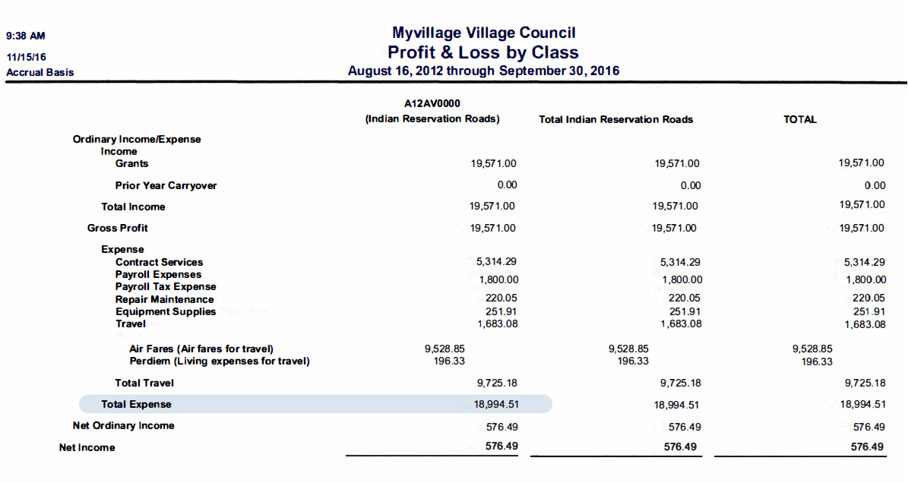
Profit & Loss

Slide 19
Enter Total expense from Profit and Loss on Line 10b.
Line 10e and 10g autofill with expense entered on Line 10b.
(You can overwrite this amount if it is different but that is not likely).

Slide 20
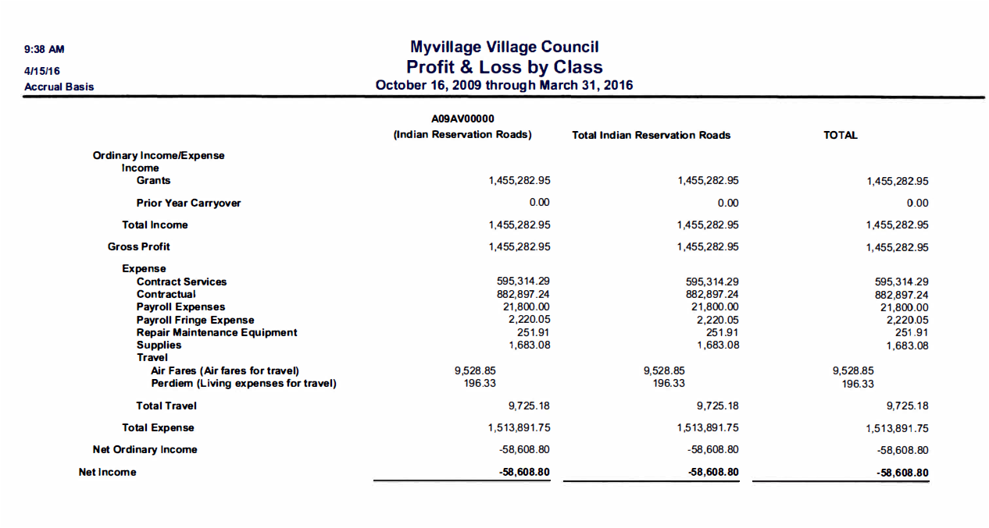
Profit & Loss
Note: Net Income, which should correspond with line 10c. Cash on Hand, can be negative. If this is negative, you need to request a drawdown.
Line 10h. Can NOT be negative.

Slide 21
Line 10c. Can be negative – this means you need to request a drawdown
Line 10h.
Can NOT be negative. You can’t spend funds that are not in the contract.

Slide 22
Cumulative reporting
The SF-425 requires cumulative reporting of expenditures. Cumulative reporting provides a sum of expenditures for the life of the contract. To arrive at your cumulative total, add all expenses incurred to date. (Please note that each contract must be reported separately. Cumulative refers to the total all quarters, not the total of all contracts.)
In the following example, “Block 10e. Federal share of expenditures” continues to grow in each successive SF-425 to show the total amount of expenditures to date. If the tribe finds a reporting error has occurred, a deduction from either block is necessary to correct the SF-425, and the tribe is required to make a notation in “Block 12. Remarks.”

Slide 23
Example of cumulative reporting
A tribe is awarded a new transportation planning contract on 02/24/2016. The initial contract award is for $19,277.96 and the tribe submits a planning budget and uses ASAP to draw the entire $19,277.96 on 03/05/2016
For the reporting period 02/24/16 to 03/31/16, a tribe has spent the following on authorized planning expenses:
$7,947.33
On 06/29/2016 modification 1 to the contract is signed to add $20,000 of remaining tribal shares to the contract.
For the reporting period 04/01/16 to 06/30/16, a tribe has spent the following on authorized planning expenses:
$9,185.87
On 07/19/2016 the tribe uses ASAP to draw the remaining $20,000.
For the reporting period 07/01/16 to 09/30/16, a tribe has spent the following on authorized planning expenses:
$8,263.41

Slide 25
SF-425 form

Slide 26
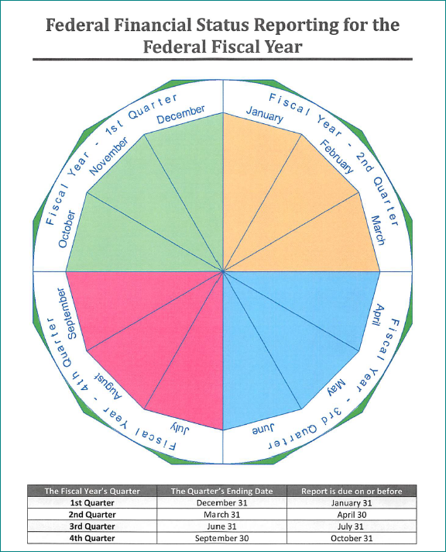
Remember a report is due at the end of every fiscal quarter for every open contract

Slide 27
Delinquent reporting
A tribe is required to submit an SF-425 every quarter, even if the tribe is delinquent in prior period reporting, once the project has begun or at least one report has been submitted. If the tribe is delinquent in reporting on multiple quarters, the tribe will be required to submit one SF-425 for each delinquent quarter.
Example of delinquent reporting
The current reporting period is for the quarter ending on 09/30/16, and the grant is not yet expired. The tribe’s last quarterly report was submitted for the quarter ending on 12/31/15. The tribe must submit individual quarterly reports for the reporting periods ending on the following dates:
· 03/31/16
· 06/30/16
· 09/30/16
The tribe should report expenses in the quarter in which they were incurred and carry the cumulative totals forward to the next reporting quarter. Please contact your Tribal Transportation POC to discuss bringing SF-425 reporting up to date.

Slide 28
Any Questions??

