Slide 1
FHWA ERFA & ERFO: Overview and FAQs
Aaron Eklund
ERFO Coordinator
Western Federal Lands Highway Division (FHWA)
Providers Conference
November 30, 2023

Slide 2
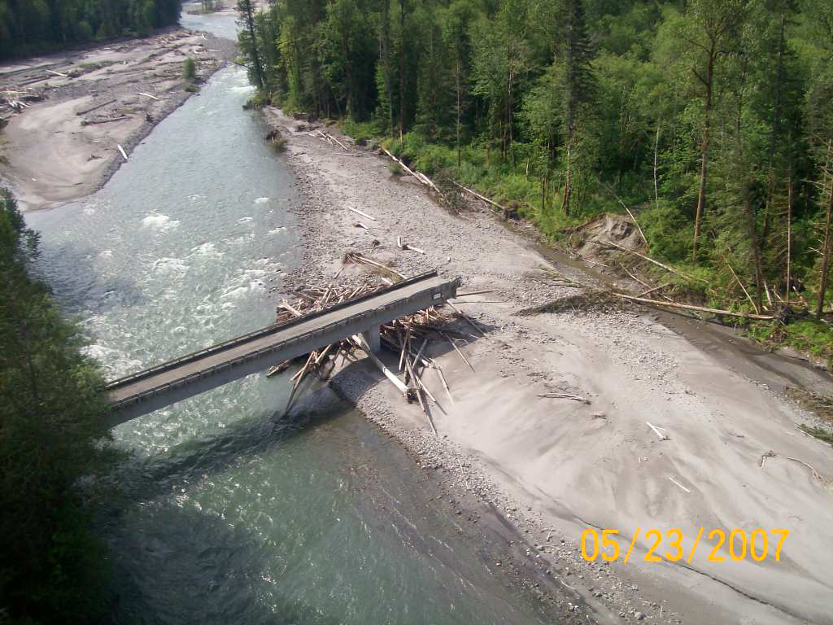
What is ERFO?
ERFO: Emergency Relief for Federally Owned Roads
U.S.C. Title 23 program administered by FLH
Applies to Federal & Tribal transportation facilities
Pays to repair seriously damaged transportation facilities

Slide 3
What ARE THE ERFA & ERFO ProgramS?
U.S.C. Title 23 programs administered by FHWA
(23 U.S.C., § 101, 120, and 125) CFR, Part 668 – Emergency Relief Program
Subpart A - Procedures for Federal-Aid Highways (ERFA)
Subpart B – Procedures for Federal Agencies for Federal Roads (ERFO)
Pays to repair seriously damaged transportation facilities
Notes:
‘Sister’ programs ( not parent child)
also known as ERFA & ERFO

Slide 4
ERFA & ERFO Program Intent
To pay the unusually heavy expenses to repair serious damage to eligible facilities caused by natural disaster or catastrophic failure
Not heavy maintenance
Not routine emergency repair activities
Not repair of facilities affected by long term, pre-existing conditions, or predictable developing situations
Not a preventative program
Not an improvement program

Slide 5
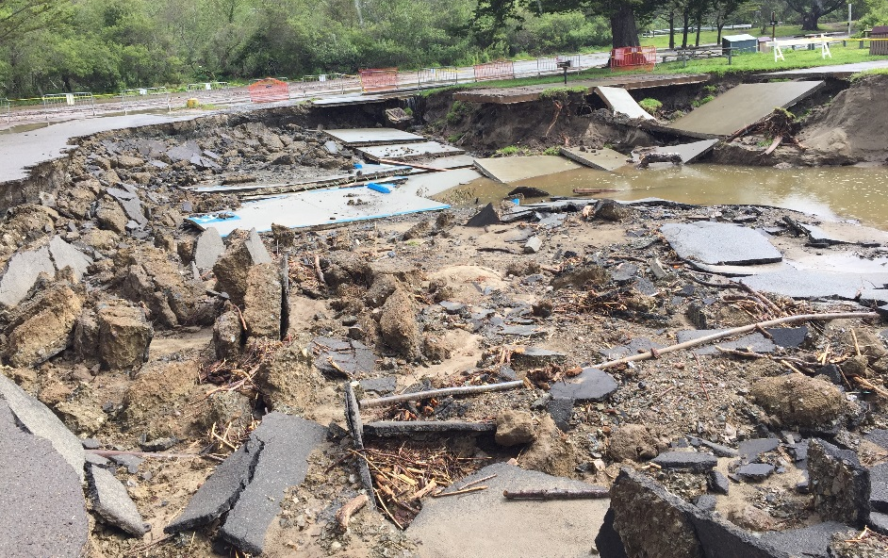
FHWA Emergency Relief Program Applicants
ERFA
States apply to Federal-aid Division Offices
Counties & Cities are sub-applicant to the State
ERFO
Federal Agencies (including BIA) apply to FLH Division Offices
Tribes are a sub-applicant to BIA

Slide 6
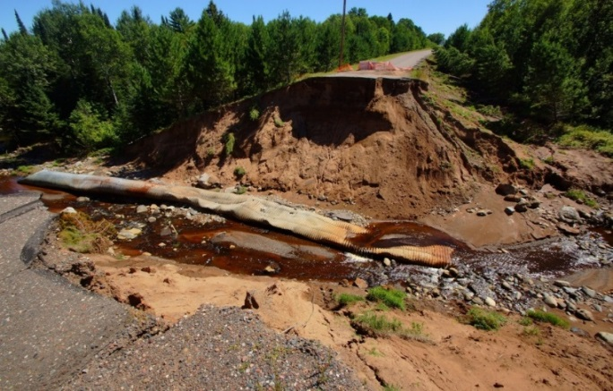
FHWA Emergency Relief Program Approval
ERFA
Presidential or Governor’s disaster declaration with the FHWA concurrence
Federal Share ~80%
ERFO
Federal Lands Highway Division Director approval
Federal Share 100%
Notes:
ERFO does not require a State, Tribal, or Presidential declaration

Slide 7
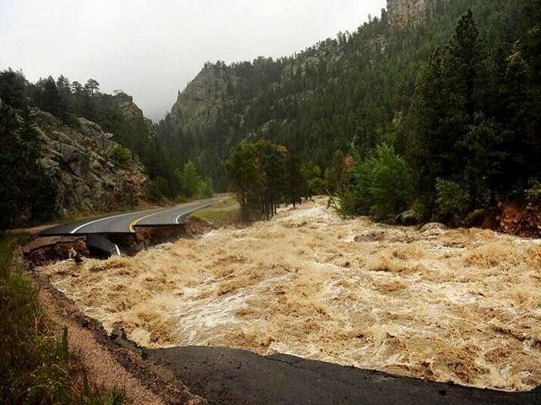
FHWA Emergency Relief Program Eligible Facilities
ERFA
Federal-aid Highways
Arterials
Urban Collectors
Major Rural Collectors
ERFO
Tribal Transportation Facilities on TTP Inventory (NTTFI)
Federal Lands Transportation Facilities on the FLTP Inventory (NFLTFI)
NPS, FS, FWS, BLM, COE, BOR
Other Federally Owned Roads
Eligible Facility types include: Roads, Trails, Parking areas, & Transit

Slide 8
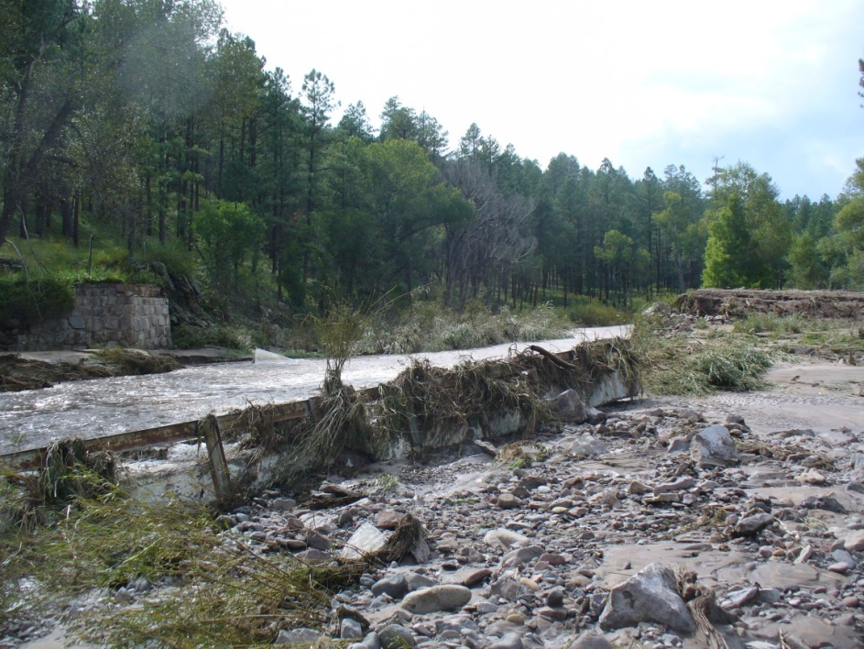
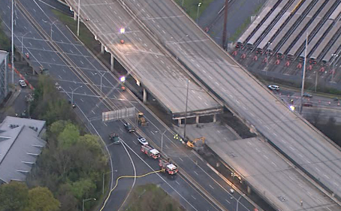
Disaster Types
FHWA requires a disaster to have occurred before funding can be made available
Two Types of disasters:
Natural
Catastrophic

Slide 9
ERFO & ERFA Eligible Disasters
Natural Disasters must:
Be Unusual natural occurrence which causes serious damage
Floods, hurricanes, tornados, earthquakes, severe storms, landslides
And Occurs over a wide area
Several counties, federal land
units, or major drainages
And Over $700,000 of damage
Unusual Event
Serious Damage
Widespread Impacts
Cost Threshold
Notes:
SERIOUS DAMAGE – OVER 5K PER SITE & MAJOR OR UNUSUAL DAMAGE THAT SEVERELY IMPAIRS THE SAFETY OR USEFULNESS OF THE FACILITY
STORMS OF UNUSUAL INTENSITY OCCURRING OVER A SMALL AREA DO NOT MEET THESE CONDITIONS
WIDESPREAD NOMINAL ROAD DAMAGE IN THIS RANGE DOES NOT JUSTIFY A POSITIVE FINDING

Slide 10
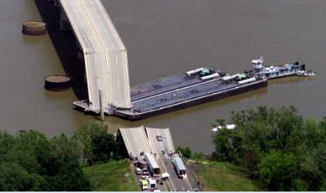
ERFO & ERFA Eligible Disasters
Catastrophic Disasters must:
Be Sudden failure of a major element or segment of an eligible facility from an external cause
And Failure is not primarily attributable to progressive deterioration or lack of maintenance
And Over $700,000 of damage

Slide 11
ERFO Disaster Declaration
All Tribes apply through BIA to Federal Lands Division
Federal Lands Highway Division Director declares the disaster separately from other programs
Does not require a Presidential or Governor’s disaster declaration

Slide 12
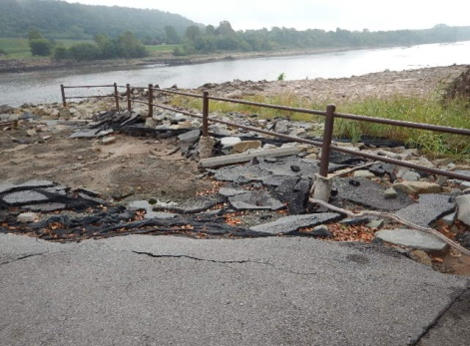
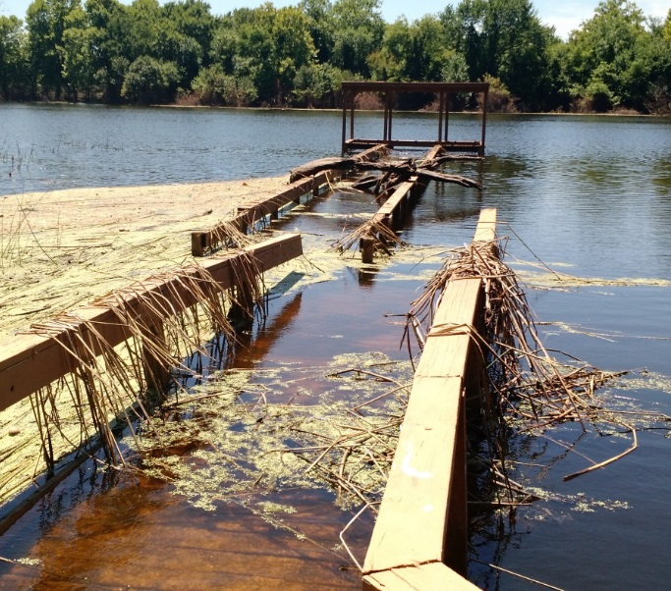
ERFO Eligible Facilities
Facilities must be:
Open to Public
On official Inventory
Actively maintained
Roads accommodate standard passenger vehicles
Notes:
passenger car 6” to lowest point frame or body – honda accord

Slide 13
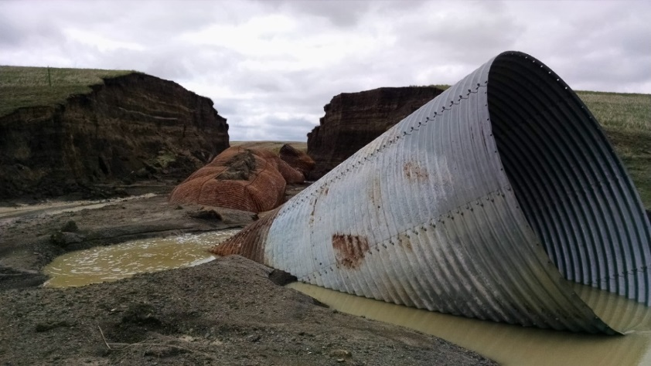
ERFO & ERFA Damage Eligibility
Disaster related damage only
Only ‘Serious Damage’ is eligible
Repairs must exceed $5,000 per site
Not maintenance or routine repair activities
ERFO Covers Emergency & Permanent repairs at 100%

Slide 14
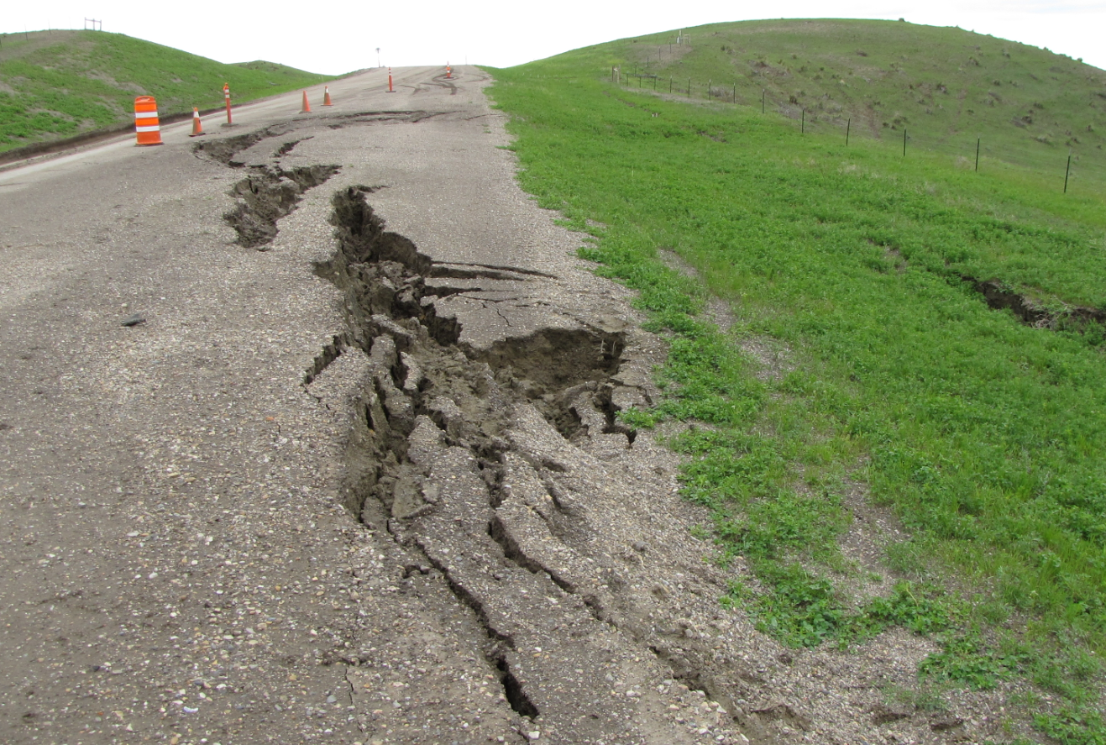
Damage Documentation
Detailed Damage Inspection Report (DDIR) completed for each site
DDIR includes site data, location, damage pictures, sketches, cost estimate, calculations
Includes Emergency and Permanent repairs
ERFO uses MSAR for DDIR and disaster event tracking

Slide 15
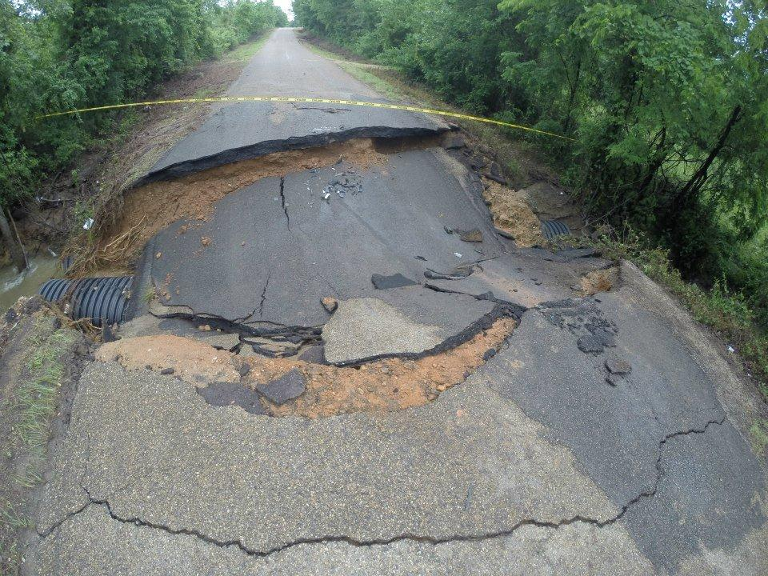
ERFO & ERFA Key Policies
Least cost, repair in-kind programs
Funds can only be used on approved sites
Funding is based on documented actual costs
Reimbursement program; however, when funds are available it may provide upfront funds

Slide 16
ERFO Key Policies
Permanent repairs must have approval prior to starting
ERFO repairs must be prioritized over non- emergency programs
ERFO repairs must be completed within 2 fiscal years following the disaster fiscal year
Time extensions for ERFO are rare and must be requested 60 days prior to expiration date
ERFO reporting must be completed or funds may be withheld or withdrawn

Slide 17
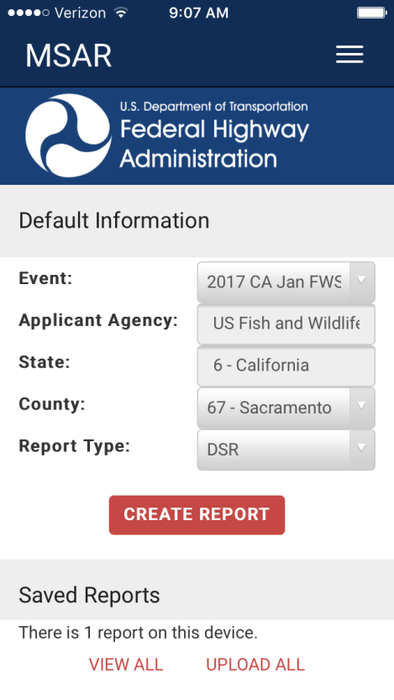
ERFO Key Policies
ERFO projects must follow all applicable laws and regulations (MUTCD, FP, CFR, NEPA, Davis-Bacon, etc)
ERFO repairs may be delivered by a variety of agencies including the Tribe, BIA, FLH, or others depending on the circumstances
ERFO does not cover utilities,
bathrooms, recreational facilities,
boatramps, or decorative items
ERFO is all digital! All disasters use
the FHWA MSAR app & web portal
for all ERFO approvals and tracking

Slide 18
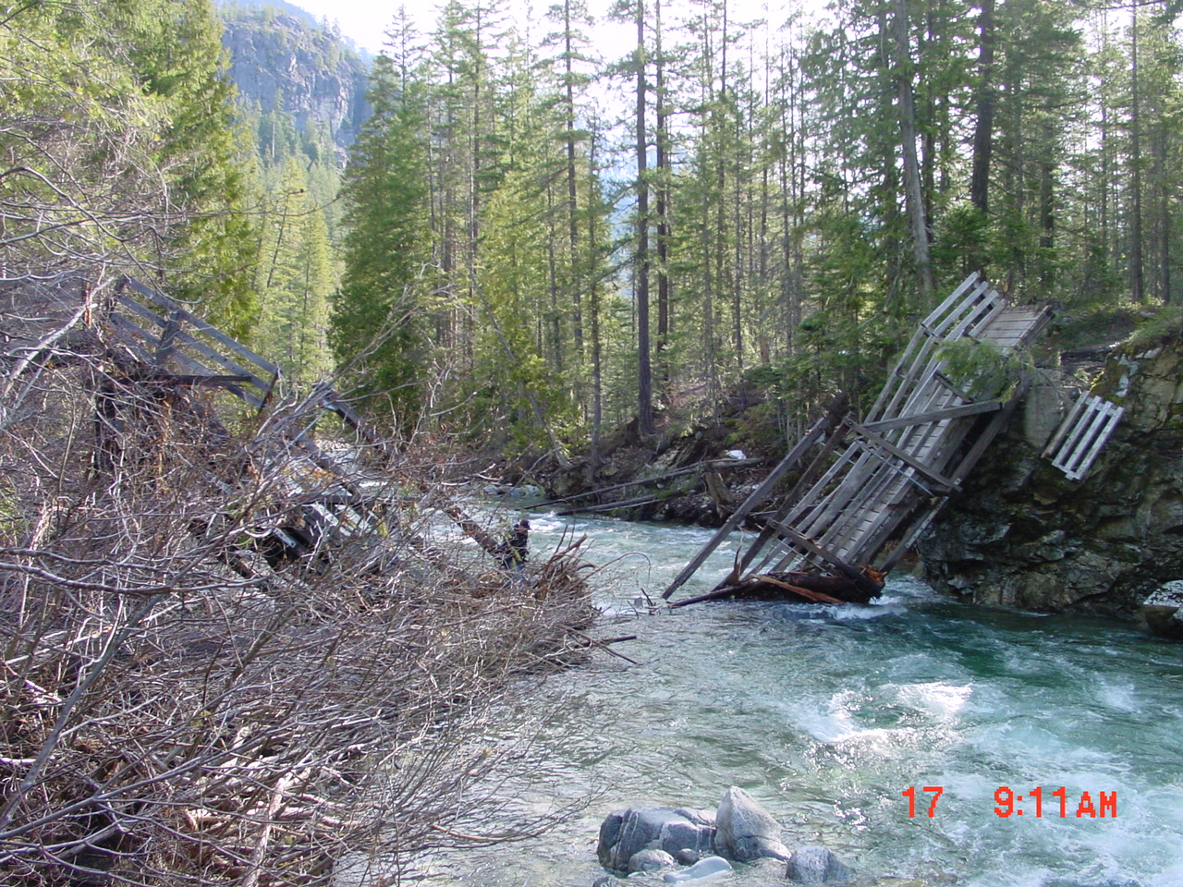
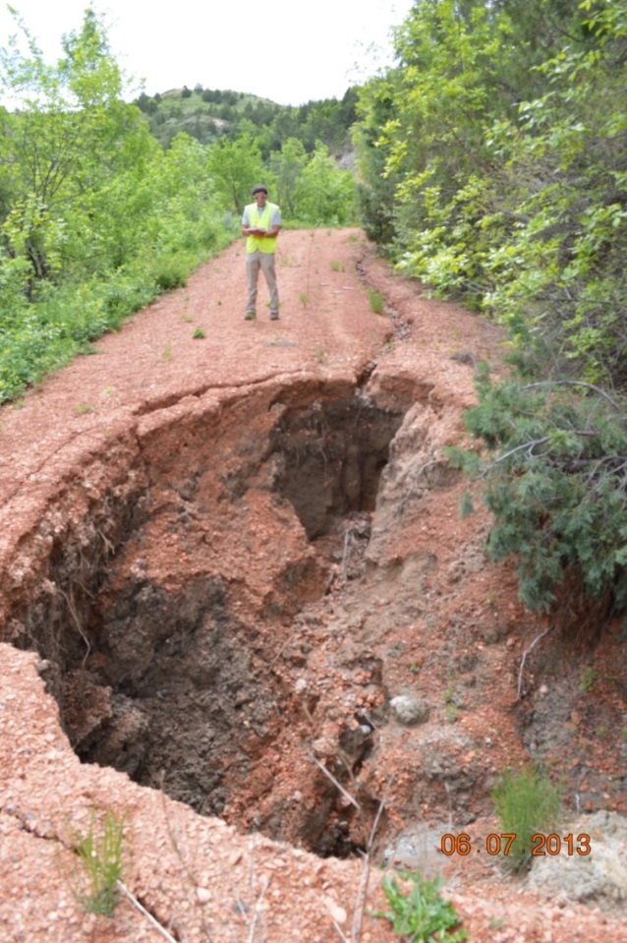
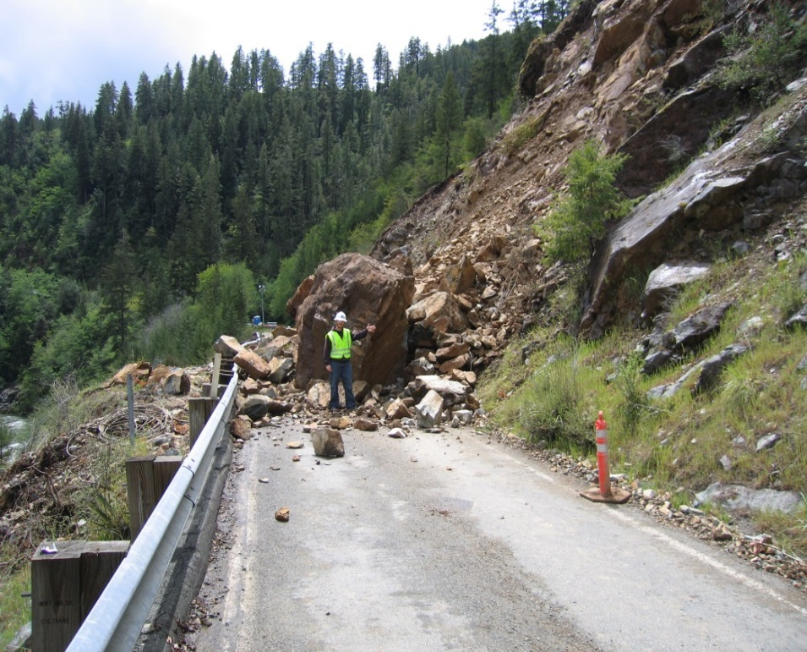
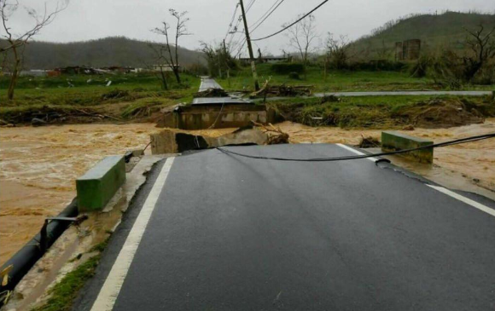
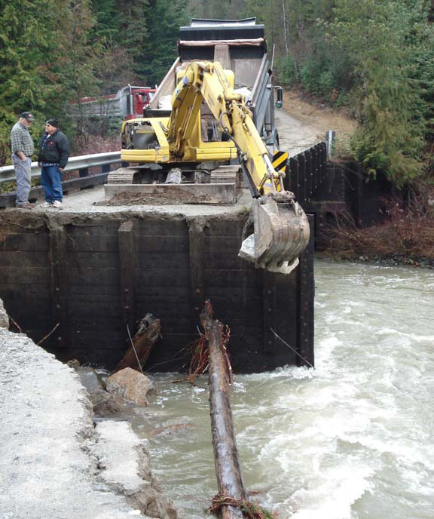
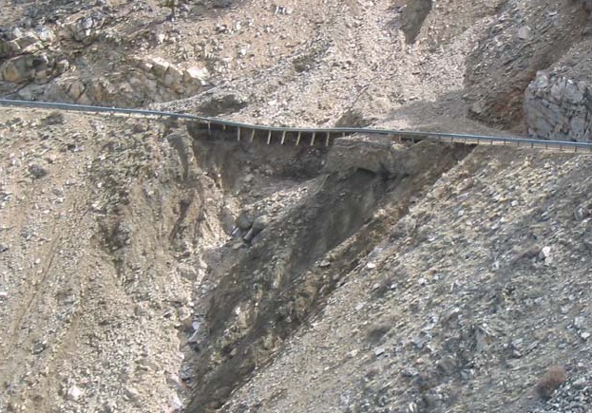
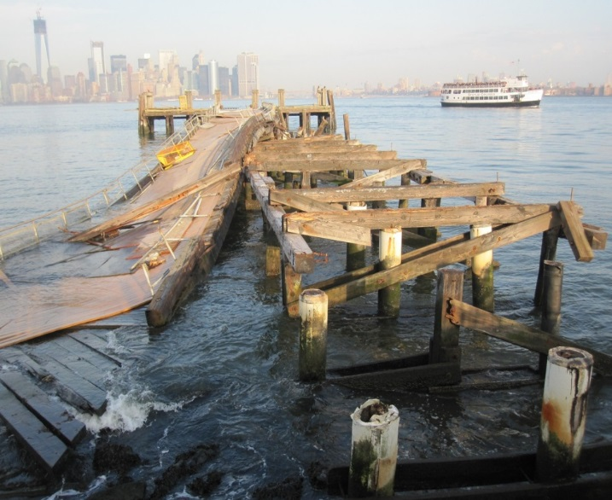
Been there, fixed that. FHWA can HELP fix yours too!

Slide 19
Where Can I Learn More?
ERFO Coordinators:
EFLHD – Eric Wright (571) 434-1547
CFLHD – Lorell Duteil (720) 963-3425
WFLHD – Aaron Eklund (360) 619-7718
ERFO Disaster Assistance Manual
http://flh.fhwa.dot.gov/programs/erfo/
Program Guidance
Templates, Forms, Checklists
Free indepth ERFO Training available
Free MSAR training webinars offered

Slide 20
Other Disaster relief for transportation
FEMA - Robert T. Stafford Disaster Relief and Emergency Assistance Act (42 U.S.C.) Public Assistance Grants Program
Provides federal technical and financial assistance to states, tribes, & LPAs
Applicants must respond to disaster/ emergency using plan & the event must exceed applicant’s capability before requesting declaration
Covers Public, Tribal, & Non-profit Infrastructure including transportation
Presidential declaration required
Emergency measures & Permanent Repairs
Federal Share ~75%
Tribes pursue ERFO for transportation damages prior to FEMA

Slide 21
FEMA Public Assistance Grant Program
Tribes should pursue ERFO for transportation damages prior to FEMA
FEMA has similar yet different eligibility so some items not eligible for ERFO may be FEMA eligible
FEMA has some pre-event planning requirements so important to establish relationship prior to disaster
For more information, FEMA Tribal contacts can be found at https://www.fema.gov/tribal-contacts
All the disaster relief programs have time limitations so reach out and apply as soon as possible following an incident

Slide 22
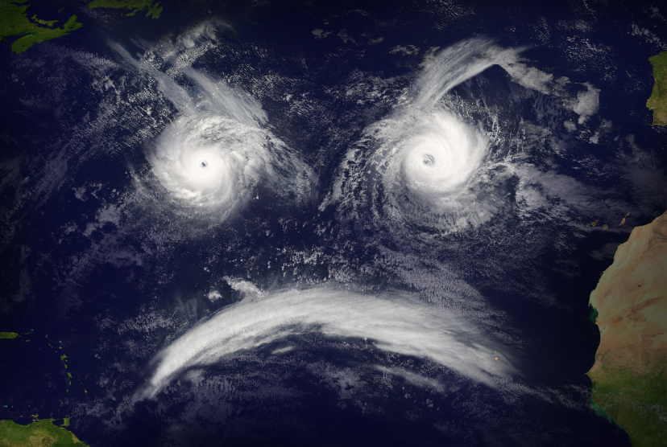
Disasters Happen, Be Prepared! QUESTIONS?

