Slide 1
Tribal Transportation Program
Coordinating Committee
(TTPCC) 2023 BIA Providers Conference
Anchorage, AK
November 30, 2023
Presented by: Clarence Daniel, Alaska Region

Slide 2
TTPCC Overview
Background
Purpose
Responsibilities
Business
FY 2023 Leadership
BIA Regions / Members
FY 2023 Accomplishments
FY 2024 Annual Work Plan
FY 2024 Meeting Schedule
TTPCC Input & Website

Slide 3
Background
1991 – Intermodal Surface Transportation Efficiency Act (ISTEA) - 25 CFR Part 170.135
The ISTEA established the Indian Reservation Roads Program Committee (IRRPCC) – 2 Representatives from each of the 12 BIA Regions
1998 – Transportation Equity Act for the 21st Century (TEA-21) - IRRPCC
2005 – Safe, Accountable, Flexible Transportation Equity Act: A Legacy for Users (SAFETEA-LU) - IRRPCC
2012 – Moving Ahead For Progress in 21 Century (MAP-21) – TTPCC
Renamed Indian Reservation Roads (IRR) to Tribal Transportation Program (TTP) and established TTPCC
2015 – Fixing America’s Surface Transportation Act (FAST ACT) – TTPCC
2021 – Bipartisan Infrastructure Law (BIL) (Infrastructure Investment and Jobs Act) - TTPCC
Notes:
The committee is one of the only committee’s set forth by regulations. It has been in regulations all the way back to ISTEA in 1991. The TTP was formerly known as the Indian Reservations Roads (IRR) program and the committee the IRRPCC.
Alaska Tribes were introduced to the program in 2005 under SAFETEA-LU and the program was renamed to the Tribal Transportation Program in 2012 through MAP-21.

Slide 4
Purpose
§ 170.135 What is the TTP Coordinating Committee?
Under this part, the Secretaries will establish a TTP Coordinating Committee that:
Provides input and recommendations to BIA and FHWA in developing TTP regulations, policies and procedures; and
Supplements government-to-government consultation by coordinating with and obtaining input from Tribes, BIA, and FHWA.
TTPCC DOES NOT REPLACE NOR IS A SUBSTITUTE FOR TRIBA CONSULATION!
The Committee consists of 24 Tribal regional representatives (two from each BIA Region) and two non-voting Federal representatives (FHWA and BIA).
The Secretary must select the regional Tribal representatives from nominees officially submitted by the region's Tribes.
To the extent possible, the Secretary must make the selection so that there is representation from a broad cross-section of large, medium, and small Tribes.
Notes:
The purpose, responsibilities, and business of the committee are direct from the regulations 25 CFR Part 170 sections 135, 136, and 137.

Slide 5
Purpose
Tribal nominees must be Tribal governmental officials or Tribal employees with authority to act for their Tribal government.
Members are appointed by the Secretary
For continuity appointments are for three-year terms
Appointments are staggered so that only one of a region's two members will be appointed in any one year.
If a member’s employment or position with the Tribal Government should terminate during a term, the representative must notify the Secretary of this change and their membership to the Committee will cease.
Once the Secretary is notified, BIA will seek nominations from the region to replace the member for the remainder of the term.
Should the need arise, the Secretary will replace any member

Slide 6
Responsibilities
§ 170.136 What are the TTP Coordinating Committee's responsibilities?
Committee responsibilities are to provide input and recommendations to BIA and FHWA during the development or revision of:
BIA/FHWA TTP Stewardship Plan;
TTP policy and procedures;
TTP eligible activities determination;
TTP transit policy;
TTP regulations;
TTP management systems policy and procedures; and
National Tribal transportation needs.
And any other program that might have an impact on the TTP in general
The Committee may establish work groups to carry out its responsibilities.

Slide 7
Business
§ 170.137 How does the TTP Coordinating Committee conduct business?
At least 2 meetings a year
Committee shall submit proposed meeting dates & location not later than October 1st each fiscal year to the Secretary
Committee may submit for additional meetings with 1/3 consent by members or by BIA and FHWA.
A quorum consists of representation from eight BIA Regions.
The Committee will operate by consensus or majority vote, as determined by the Committee in its protocols.
Any Committee member can submit an agenda item to the Chair.
The Committee will work through a committee-approved annual work plan and budget.

Slide 8
Business
§ 170.137 How does the TTP Coordinating Committee conduct business?
Annually, the Committee elects a Chair, Vice-Chair, and other officers.
Officers will be responsible for preparing for and conducting Committee meetings and summarizing meeting results.
These officers will also have other duties that the Committee may prescribe.
The Committee must keep the Secretary and the Tribes informed through an annual accomplishment report provided within 90 days after the end of each fiscal year.
The October/November meeting is usually when we provide this report to the Secretary and FHWA leadership
The Committee's budget will be funded through the TTP management and oversight funds, not to exceed $150,000 annually.

Slide 9
FY 2023 Leadership
Chair – Dakota Longbrake – Great Plains Region
Vice-Chair – Chris McCray– Southern Plains
Secretary – Terry Holman – Eastern Oklahoma
LeRoy Gishi, BIADOT – Non-Voting Federal Representative
Erin Kenley, FHWA – Non-Voting Federal Representative

Slide 10
Members
Eastern Region
Barak Myers
Vacant
Midwest Region
Mike Moilanen
Brett Blackdeer
Southern Plains Region
Chris McCray
Twyla Blanchard
Alaska Region
Clarence Daniel
Stephen Ivanoff
Great Plains Region
Dakota Longbrake
Harold Frazier
Navajo Region
Jonah Begay
Vacant
Notes:
10

Slide 11
Members
Pacific Region
Jacque Hostler-Carmesin
Vacant
Rocky Mountain Region
Connie Thompson
Winslow Friday
Southwest Region
Sheri Bozic
Christopher Little
Northwest Region
Mary Beth Frank-Clark
Portia Shields
Western Region
Sandra Shade
Vacant
Eastern Oklahoma
Harold LaSarge
Terry Holman
Notes:
11

Slide 12
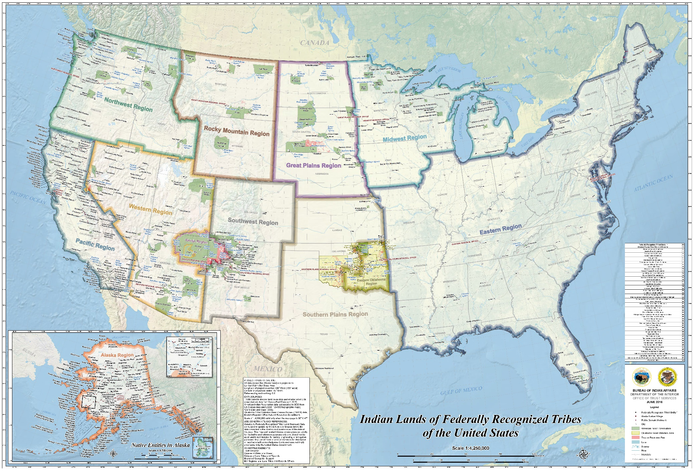
Committee Members
BIA Regions
https://www.bia.gov/sites/default/files/dup/assets/bia/ots/webteam/pdf/idc1-028635.pdf
Notes:
12

Slide 13
FY 2023 Accomplishments
FY 2023 Annual Report to USDOT/USDOI Secretaries
USDOT allowed TTP match for SS4A grants because of last year’s letter from the TTPCC
Letter of Support to Secretaries Buttigeg and Haaland Benchmarking Equity and Mobility needs for Tribal Governments
ROW & NEPA consistency across 12 BIA Regions/Dual NEPA Processes
TTPCC Membership: 8 appointments
2 renewals
6 new members
TTPCC Website
Road Maintenance Study

Slide 14
FY 2024 Annual Work Plan
Obligation Limitation
TTP Funds as non – Federal Match for all grants and use of TTP Funds for Tribal Transportation Facility Bridge Inspections
ROW & NEPA consistency across 12 BIA Regions/Dual NEPA Processes
TTAP Monitoring
NTTFI transition to GIS & Issues with accessibility to RIFDS
Access Roads
Road Maintenance Study
Vehicle Miles Traveled and Funding Future Highway Bills Funding
Equity for Tribes
TTP Funding Formula

Slide 15
FY 2024 Meeting Schedule
Meeting 1: October 31-November 2, 2023: Washington, DC
Meeting 2: February 27-29, 2024, in the Eastern Region
Alternate Location – Phoenix, AZ
Meeting 3: May 21-23, 2024, in Oklahoma
Meeting 4: July 30-August 1, 2024, in Albuquerque
Alternate Location – Great Plains Region
Meeting 5: November 19-21, 2024, in Washington DC
Alternate Location – Phoenix, AZ

Slide 16
TTPCC Input and Website
TTPCC seeks Tribal input on the issues that are impacting your transportation program.
Email issues and concerns to your Regional representative(s).
For TTPCC member contact information, TTPCC meeting locations, dates, and times, and links to virtual public meetings, please visit the following website:
https://highways.dot.gov/federal-lands/programs-tribal/coordinating-committee

Slide 17
Quyana – Thank you
Questions?
Alaska Representatives
Clarence Daniel
clarence@avcp.org
Stephen Ivanoff
sivanoff@kawerak.org

