Slide 1
FHWA Tribal Transportation Program Online Reporting Tool (PORT)
Presented by: David Garcia

Slide 2
Overview
Overall Changes
Changes for Tribes
Documents Release Date

Slide 3
Overall Changes
Data Collection Application
Data Storage Application
Email Received
Changes After Submission

Slide 4
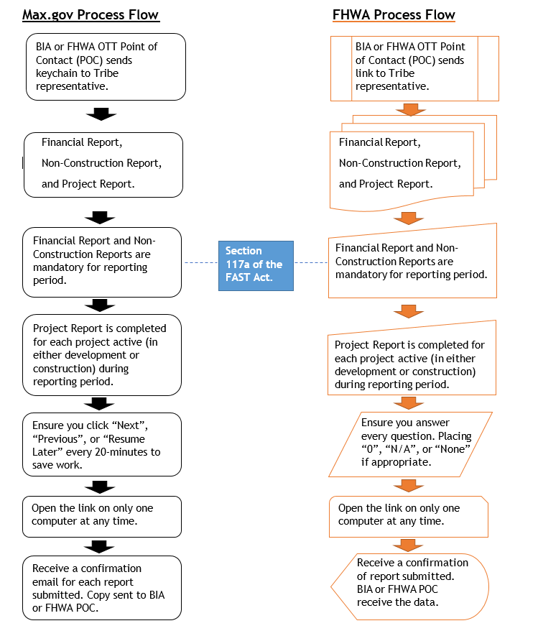
Overall Changes

Slide 5
Changes For Tribes
Submittal Process
Keychain: Type of Password Management System to Allow Users Access
Link: An Attachment to Permit Connection
No Attachments

Slide 6
Documents Release Date
Communicate with FHWA Tribal Coordinator and BIA Point of Contact
Emails Commence on October 2, 2023

Slide 7
Summary
System Changes for FHWA
Tribes Will See Little Changes
Email Links Sent Beginning October 2nd

Slide 8
Thank you
David Garcia
Email: d.l.garcia@dot.gov
Title: Management & Program Analyst

