Slide 1


Bureau of Indian Affairs, Alaska Region
2023 Tribal Transportation Program
TTPA 101 Overview
Anchorage, AK 29 November, 2023
MARLENE D. WATSON, M.S., M.A., Mdiv.
Civil Engineer - TTP
3601 C Street, Suite 1278
Anchorage, AK 99503
(907) 271-2286
Marlene.Watson@bia.gov
BIA Tribal Transportation Program Agreements

Slide 2
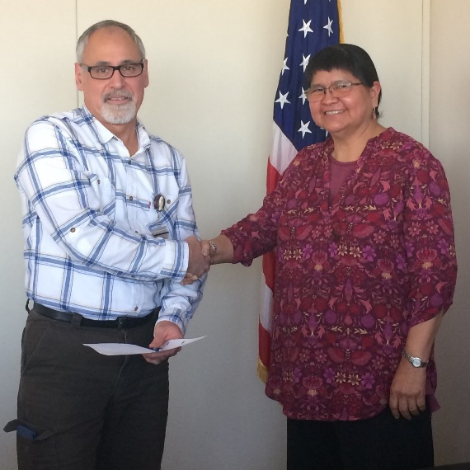


Speaker – Marlene D. Watson
Education
Masters of Civil Engineering
Masters of Architecture
University of California, Berkeley
ANGEL ROCK
BIA - TTP
Enjoy
Joined April 2019
Awarding Official Technical Representative (AOTR)
Hiked to top of Angel Rock
Photo moment with moose and calves

Slide 3
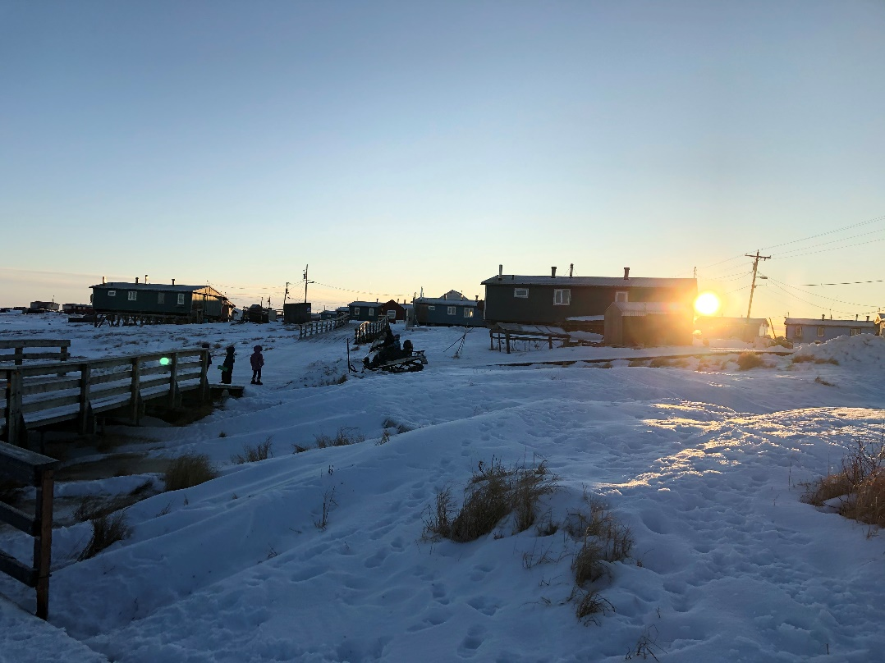
Talking Points
BIA TTPAs: How to Open a New One to Close-Out
  G2G Historical Agreement
  Tribal Transportation Program Agreements (TTPAs)
  2024 Fiscal Year Funding and Program Agreement Timelines
  Notice of Funds Availability (NOFA)
  TTP Funds Under One Roof
  Program Agreement (PA)
  Reference Funding Agreement (RFA)
  Federal Financial Reports (FFR)
  Program Agreement Close-Out
  Questions?

Slide 4
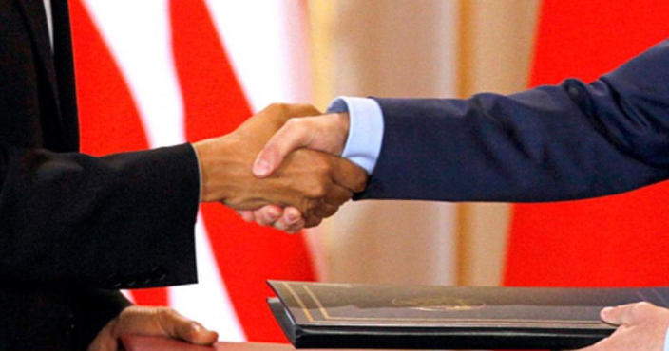

BIA G2G Agreements
Historical Agreement Took Place
  For Immediate Release: December 15, 2002
  On a chilly, overcast day, leaders from twenty-nine tribal nations stood next to Bureau of Indian Affairs officials, a pen was put to paper and a historic agreement establishing the first government-to-government consultation policy between the BIA and the tribal nations was signed on December 13, 2000 in Seattle, Washington.

Slide 5
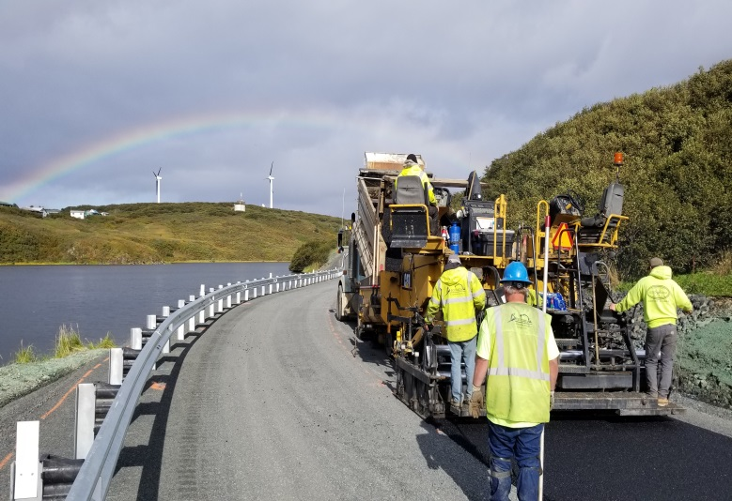


Tribal Transportation Program Agreements (TTPAs)
BIA Director Signs Agreement
  New Highway Legislation = New Agreement
100% payment when agreement is signed
  Lump Sum Payment processed by BIADOT
  Dedicated TTP account required
RFAs/RFA Amendments for funding increases
  1st CR is an RFA
  Any after are RFA Amendments
Semi-Annual reporting (submitted within 60 days after end of reporting period)
Sand Point Boat Harbor Road
Petersburg Hungry Point Trail
Karluk Transit Project

Slide 6
Tribal Transportation Program Agreements (TTPAs)
Oversight during construction
  Required at final Inspection
  Site Visit at agreed milestone(s)
Tribal Administration of Program
  More control at Tribal level
  Flexibility between projects/activities on FHWA-approved TIP
  No request/approval for payment
Risk Assessment - Yes
BIA Technical Assistance – Yes
91 G2G Agreements (20 SAFETEA-LU, 31 Map-21, 31 FAST-Act, 9 STRA-21)
  Projects include planning, maintenance, design, construction, safety and transit
Sand Point Boat Harbor Road
Petersburg Hungry Point Trail
Karluk Transit Project

Slide 7
2024 Fiscal Year (Oct. 1, 2023)
Funding and Program Agreement Timelines
Date
xx/01/2023 | NOFA, FY2024 TTP xx-Day Tribal Shares
 | - NOFA Letter and Tribal Shares List.
xx/01/2024 | NOFA, FY2024 TTP Final Tribal Shares List.
 | - NOFA Letter and Tribal Shares.
 | No 93-638 Contract Proposal, No 2-day,15-day or contract approval letters.
Begin FY2024 | BIADOT Creates a New TTP Program Agreement, RFAs, & RFA Amendment Templates.
FY2024 | Tribe Submits TTIPs/Certs/Tribal Resolution/ 3 Yrs Single Audit Cert (SACs) or SARs.
FY2024 | BIA TTP Prepares Risk Assessment (RA)/FHWA TIPs.
FY2024 | BIA TTP Sends a Program Agreement and FY24 RFA Tribe to sign.
FY2024 | BIA TTP Creates a PR and Assembles a Program Agreement/FY24 RFA/Items above.
FY2024 | BIA TTP Submits PR/PA/RFA/SACs/Tribal Resolution/RA/FHWA TIP & Certs.
End FY2024 | BIADOT Signs and Approves a New TTP PA, RFAs or RFA Amendment w/ submittal.
TBD | Tribe withdrawals TTP funds in its entirety or as needed.
TBD | No Drawdown Request Letter or Supporting Documents Required
TBD | Tribe Receives Funds, Expends Entire TTP Program Agreement and Submits Deliverables
TBD | BIA and Tribe Close-Out TTP Program Agreement
Subject

Slide 8

Notice of Funds Availability (NOFA)
Sent whenever TTP funds are available
  Identifies available funding amounts
  Estimates Final Tribal Share amounts
  Identifies BIA POC by Tribe
  NOFA Letter includes response instructions
Tribes Respond
  Signed Resolution to enter into Program Agreement
  Tribal Transportation Improvement Program (TTIP)
  TTIP Certification OR Prior Year TIP Certification
  Single Audit Certification (SAC) OR Report (SAR)
  Signed Program Agreement (PA) & Referenced Funding Agreement (RFA)
Templates
  TTIP Template(s)
  Certification Template(s)
  TTPA Tribal Resolution Template
  Single Year Audit Certification Template(s)
  Program Agreement, RFA, & RFA Amendment Templates.

Slide 9
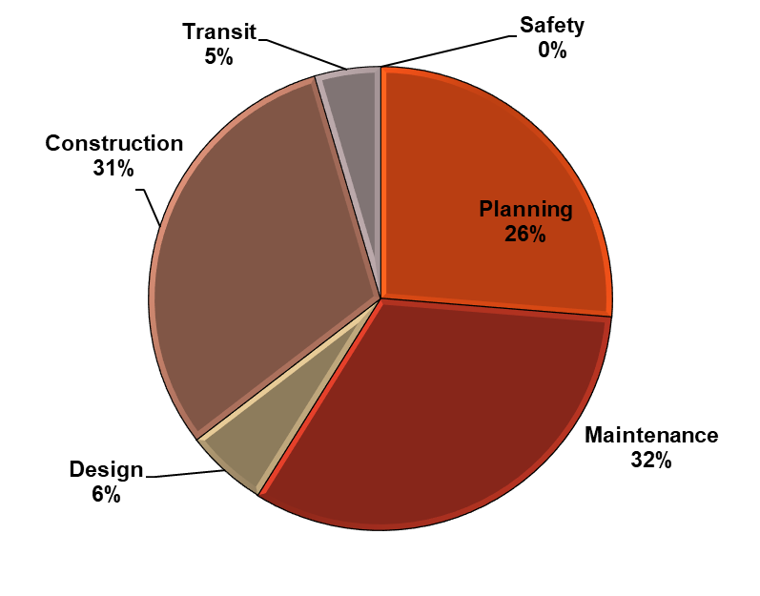
Types of TTP Funds are Under
One Roof for TTPA Tribes
How Do Tribes Spend TTP Funds?
FY2019 Only

Slide 10
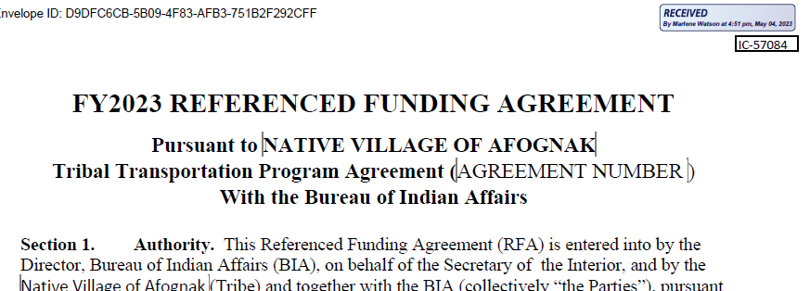
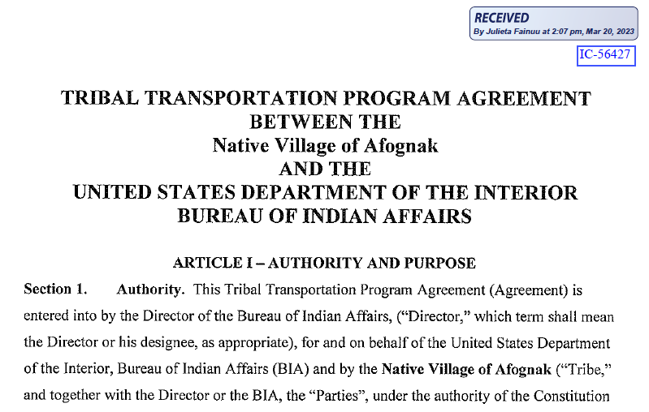
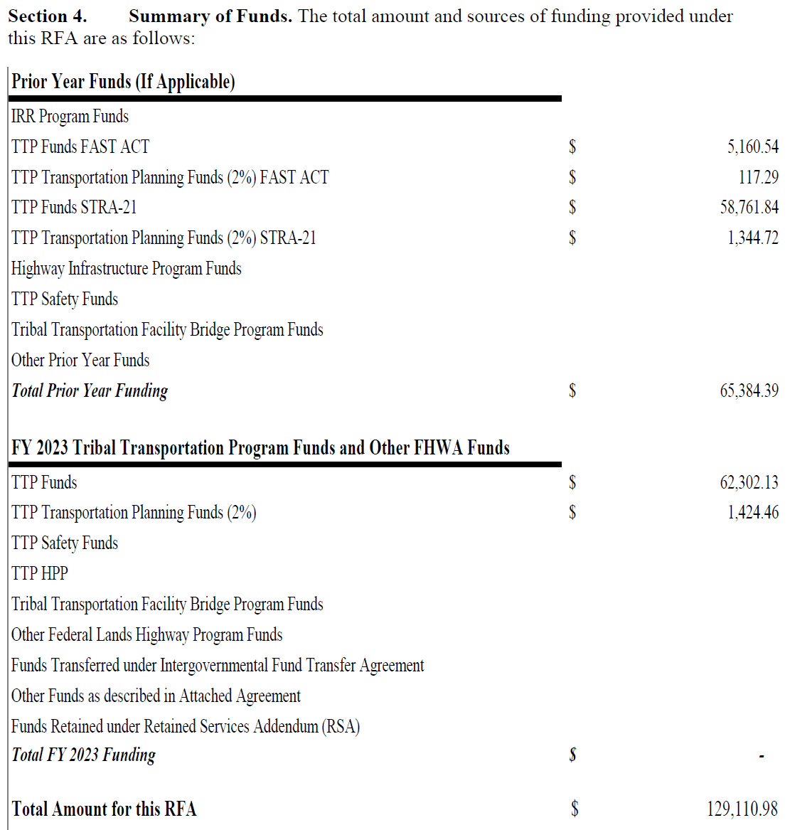
BIA TTP Program Agreement & RFA

Slide 11
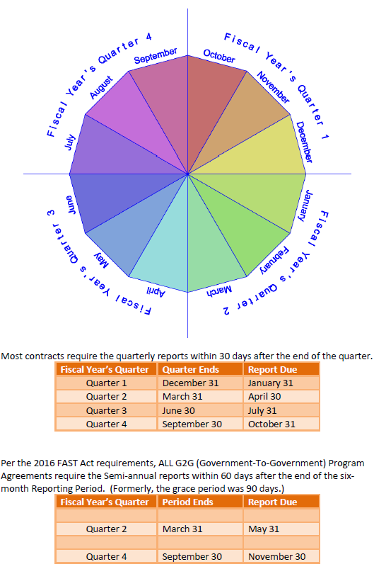
Federal Financial Reporting Calendar

Slide 12

Program Agreement Close-Out
Close-Out Packet
  Close-out Letter
  Property Record
  Contract Certification Statement
  Release of Claims
  Final Financial Report, SF 425
  Final Narrative

Slide 13

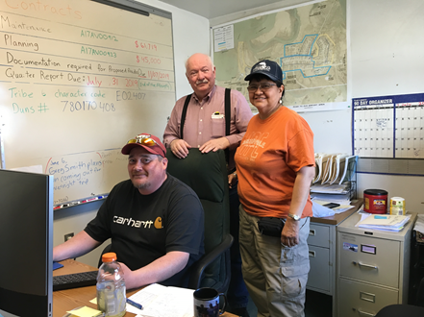
Questions?
BIA Alaska Region
MARLENE D. WATSON, M.S., M.A., Mdiv.
Civil Engineer - TTP
3601 C. Street, Suite 1278
Anchorage, AK 99503
(907) 271-2286
Marlene.Watson@bia.gov
FAX: (907) 271-6163
13
Notes:
13

