Slide 1
Transportation Safety Funding Update
Adam Larsen
Adam.Larsen@dot.gov
360-619-2601

Slide 2
Topics
Safety Funding Updates
Review IIJA/BIL Tribal safety topics (and gaps)
Tribal safety research projects

Slide 3
Topics
Safety Funding Updates
Tribal safety
research projects

Slide 4
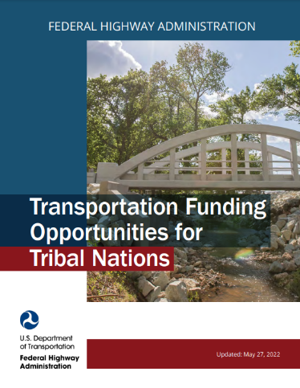
Transportation Safety Funding Opportunities
State-managed
  Highway Safety Improvement Program
  Transportation Alternatives
  Safe Routes to School
  Highway-Rail Grade Crossing Program
Federal Discretionary Grants
  Safe Streets and Roads for All
  Rural Surface Transportation Grants
  Wildlife Crossing Pilot Program
  BIA Indian Highway Safety Program
www.TribalSafety.org/Funding
Notes:
Information on other transportation funding options for Tribes:
https://highways.dot.gov/federal-lands/programs-tribal
www.TribalSafety.org/Funding

Slide 5
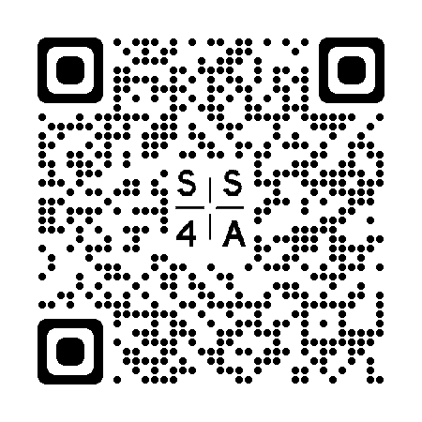
Safe Streets and Roads for All (SS4A)
$1-billion per year, 2021-2026
20% match required
Only available to Tribes, local governments, regional organizations
Comprehensive Safety Action Plans
Implementation Grants
Next Notice of Funding Opportunity
February 2024
https://www.transportation.gov/grants/ss4a/

Slide 6
SS4A Planning and Demonstration Activities
Action Plan
Develop or complete a Comprehensive Safety Action Plan
8 components to an Action Plan
Supplemental Planning
Topical safety plans
Road safety audits
Additional safety analysis and data collection
Targeted equity assessments
Follow-up stakeholder engagement
Demonstration Activities
Feasibility studies using quick-build strategies
Pilot programs for behavioral or operational activities
Pilot programs for new technology
Manual on Uniform Traffic Control Device (MUTCD) engineering studies
Notes:
Planning and Demonstration grants can be used for a variety of activities, including developing or updating an Action Plan, conducting supplemental planning, or completing demonstration activities. Communities that do not already have a qualifying Action Plan should apply for funds to develop an Action Plan, but may include supplemental planning and/or demonstration activities in their application.
First let’s talk about Action Plans. There are eight main components to it. Planning uses data and analysis to identify a community’s safety problems. The community also engages the public and other stakeholders in a process-oriented approach, and based on all that information a list of projects and strategies are developed to address the identified safety problems. The NOFO and the Action Plan webinar give more detail about what constitutes a “comprehensive safety action plan” than in this presentation, but that’s the quick version.
Note that project-level planning such as environmental reviews such as NEPA, as well as preliminary engineering and design, for specific projects in an Action are not considered supplemental planning nor demonstration activities, and cannot be funded using a Planning and Demonstration Grant. NEPA and project engineering design is an eligible activity for Implementation Grants, however.
Let’s talk through supplemental planning and demonstration activities next.
Supplemental planning updates or further elaborates on the components of an Action Plan. It can be updating an existing plan, or adding bells and whistles, or deep dives based on the identified needs of a community.
Topical safety sub-plans could be speed management, vulnerable road users, accessibility for individuals with disabilities, Americans with Disabilities Act of 1990 (ADA) transition plans, health equity, safety-focused Intelligent Transportation System implementation, lighting, or other relevant safety topics.
Maybe there’s a high injury network series of roads that you want to do road safety audits on, or additional data analysis to identify contributing factors.
You can also further engage your community, or assess how different groups such as kids, the elderly, or communities of color should be considered in the implementation of projects and strategies.
Demonstration activities:
The Department is anticipating awarding at least $250 million in funding to demonstration activities.
Demonstration activities are not new per se, but in the latest NOFO we have clarified and elevated them based on our experience in the last funding round.
Demonstration activities are temporary in nature, and meant to test changes that will advance safety before you spend millions on projects and strategies.
Demonstration activities tie back to information the Action Plan, especially the list of projects and strategies.
Here are a few examples:
Quick-build strategies also known as tactical urbanism, that inform permanent projects in the future. For example, say you want to re-allocate road space to test out a new separated bike lane. You use paint and plastic bollards to see if it works before making permanent changes.
Various Manual on Uniform Traffic Control Device (MUTCD) engineering studies that further safety applications of the MUTCD (e.g., evaluating warrants for traffic signal installation, high-visibility crosswalk markings, bike lane treatments).
Pilot programs for behavioral or operational activities that include at least one element of the Safe System Approach (e.g., test out a new education campaign’s messaging at a small scale, trial changes to how Emergency Medical Services respond to crashes).
Pilot programs that demonstrate safety benefits of technologies not yet adopted in the community (e.g., variable speed limits, technology for adaptive signal timing, adaptive lighting, Intelligent Transportation Systems, vehicle-to-infrastructure technology). Eligible technologies must be commercially available and at a prototype or advanced technological readiness level.

Slide 7
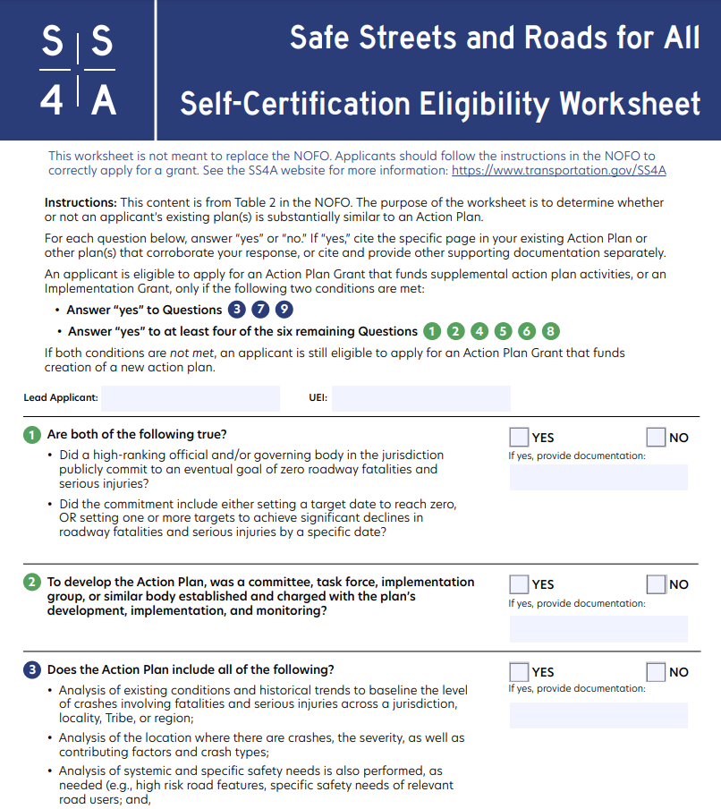
SS4A
Self-Certification Eligibility Worksheet for safety plans
https://www.transportation.gov/grants/ss4a/self-certification-worksheet
https://www.transportation.gov/grants/ss4a/

Slide 8
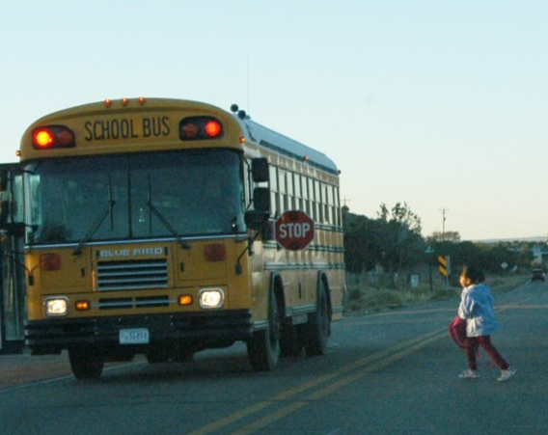
SS4A Implementation Grants
Implementation Grants applications must fund projects and strategies identified in an Action Plan that address a roadway safety problem.
Infrastructure, behavioral, and operational safety activities are all eligible.
Applicants must have an qualifying Action Plan in place to apply for Implementation Grants.
Implementation applications may also include supplemental planning and demonstration activities.
Source: FHWA
https://www.transportation.gov/grants/ss4a/
Notes:
Applicants who have an existing plan, or plans, that align with the Comprehensive Safety Action Plan process can apply for Implementation grants
These could include Vision Zero plans, Local Road Safety plans, etc.
Implementation Grants must be used to fund projects and strategies identified in an action plan. These should be pretty apparent to an applicant because they have already been identified as a solution to a pressing safety need.
Projects and strategies can be varied, and can be infrastructure, behavioral, and/or operational in nature.
Implementation Grants may also fund associated planning and design activities to implement a project (that’s the NEPA environmental review and construction design work), as well as supplemental planning and demonstration activities.
Applicants can bundle activities together, so it doesn’t have to be one project in one location.
We are especially encouraging demonstration activities in Implementation Grants, which I talked about previously.

Slide 9
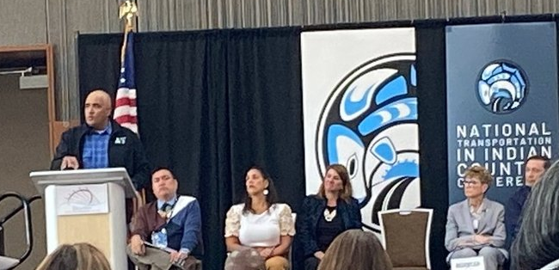
Q:
Should I apply for the
Safe Streets and Roads For All (SS4A) or the Tribal Transportation Program Safety Fund (TTPSF)?
Maybe both. The SS4A and TTPSF have shared goals of improving transportation safety. SS4A will now allow TTP or TTPSF to be used as the non-federal match.

Slide 10
SS4A / TTPSF
An award from TTPSF or SS4A does not guarantee selection by the other program.
TTPSF applications must be for independent components of a larger project.
Match requirements:
  SS4A – 20% non-federal or TTP match requirement
  TTPSF – no match required

Slide 11
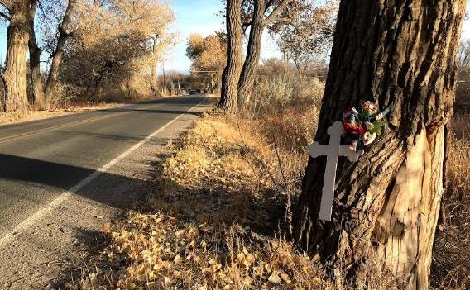
Tribal Transportation Program
Safety Fund Overview
~$21-million per year (2022-2026)
Competitive grant
Tribes are the only eligible applicants
Strategic safety plans encouraged
Multi-year NOFO
Prior year awards listed at https://highways.dot.gov/federal-lands/programs-tribal/safety/funds
Join the Mailing List at TribalSafety.org

Slide 12
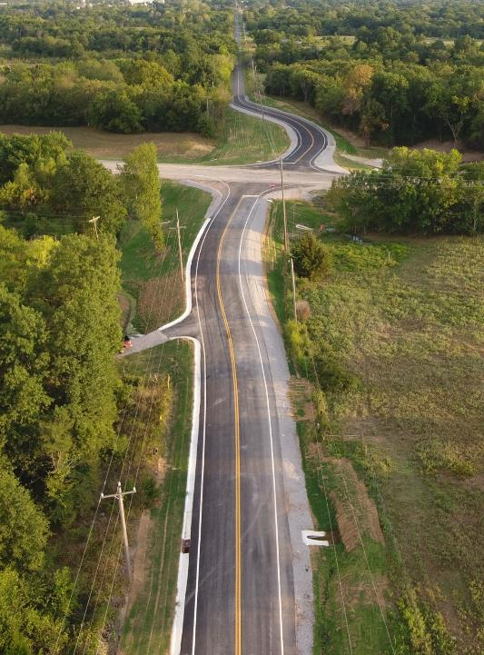
TTPSF Important Dates
Source: Cross Timbers Consulting
2023 Application Period | CLOSED: January 15, 2023
2024 Application Period | Open Now until deadline of January 15, 2024
2025-2026 Application Period | October 1 - Jan 15, each year
Award selection announced about 5 months after deadline.

Slide 13




TTPSF Categories

Slide 14
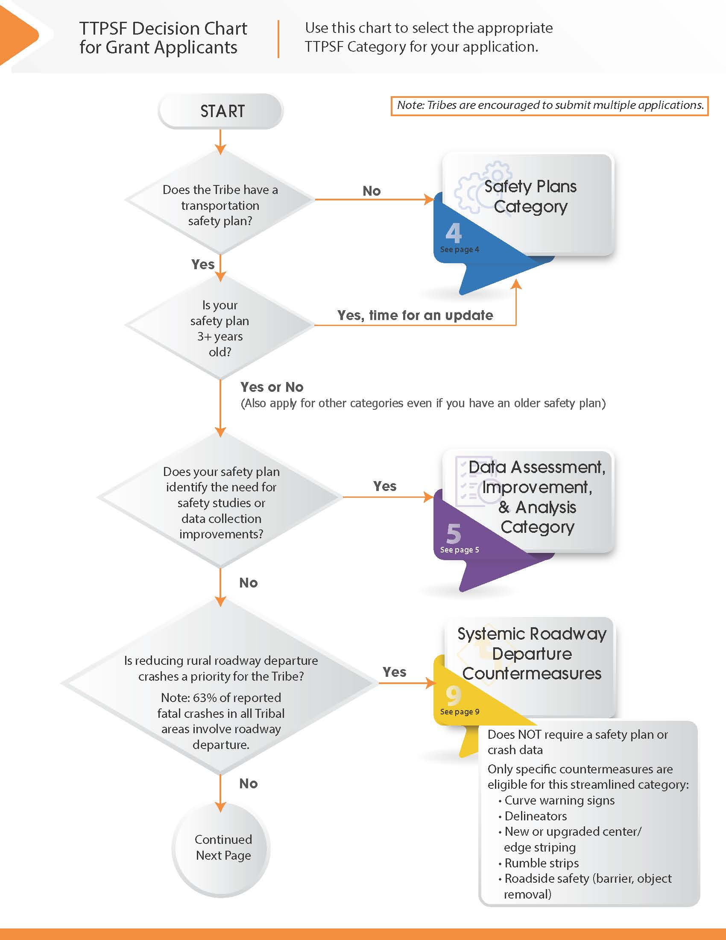
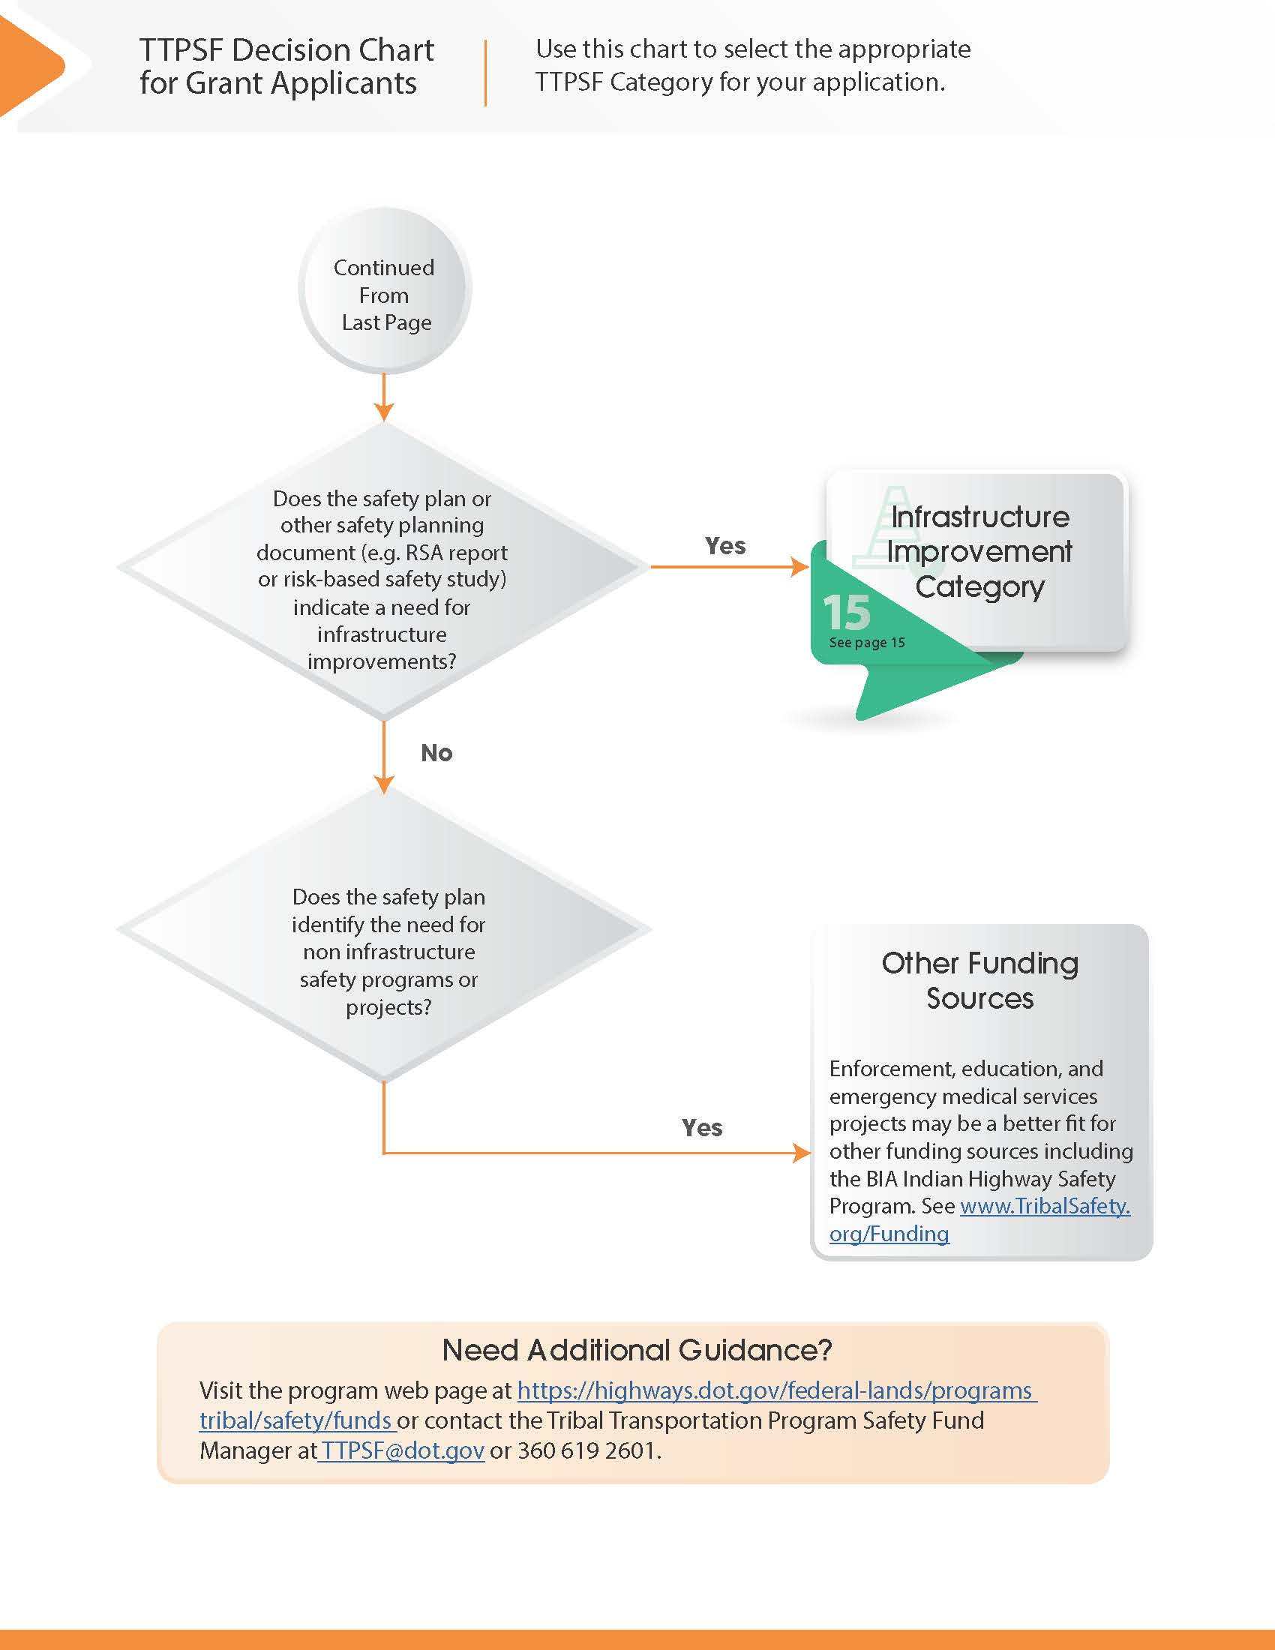
Application Guide - Decision Chart

Slide 15
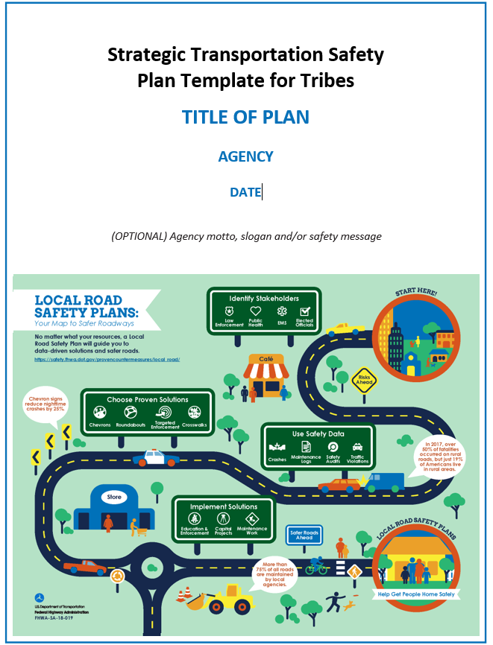

Safety Plans
Safety Plan Funding
  $15,000 TTPSF for new plans
  $10,000 TTPSF to update an existing plan
  No cap on SS4A safety action plans
Safety Planning Resources at
https://www.tribalsafety.org/safety-planning-resources
  Template safety plan
  Do-it-yourself website with videos and tools
  Safety Plans Library
SS4A criteria for “safety action plans”
  See “Resources” at www.Transportation.gov/SS4A

Slide 16
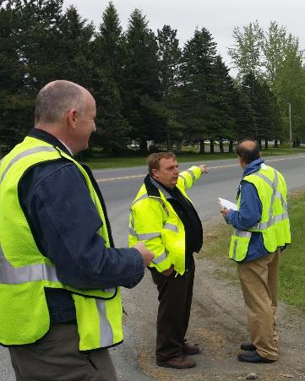
Data Assessment, Improvement, and Analysis Examples
Analysis
  Road Safety Audits for a specific location
  Systemic Safety Study - Study of an issue across road network to identify high risk locations
  Safety risk assessment (usRAP)
  Crash data mapping
  https://www.tribalsafety.org/data-analysis
Data Assessment & Improvement
  Study or improve safety data

Slide 17
Systemic Intersection
Safety Study
Muscogee Creek Nation
Study risk factors at 100 intersections with high crash experience, apply results across network.

Slide 18
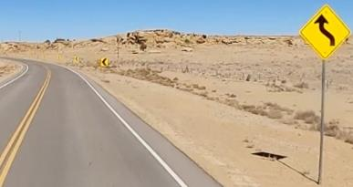
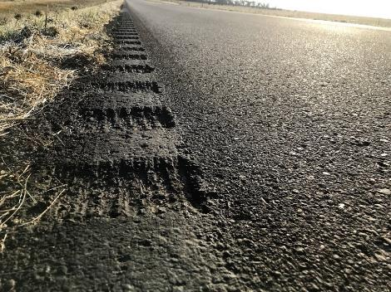
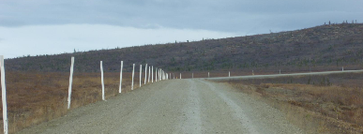
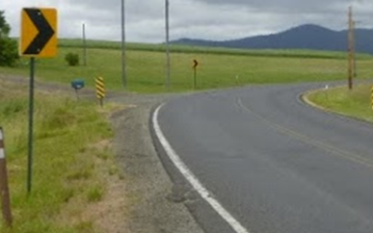
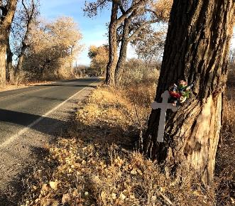
Roadway Departure is involved in 2 out of every 3 fatal crashes in Tribal areas
25% funding goal (about $5-million)
Reduced application burden
Only specific countermeasures eligible
  Curve warning signs
  Delineators
  Rumble strips
  Striping
  Roadside safety (guardrail, object markers, clearing fixed objects)
Navajo Nation
Native Village of Minto
Lake Traverse Reservation, SD
Source: Sisseton Wahpeton Oyate
Coeur d'Alene Tribe
Ohkay Owingeh

Slide 19
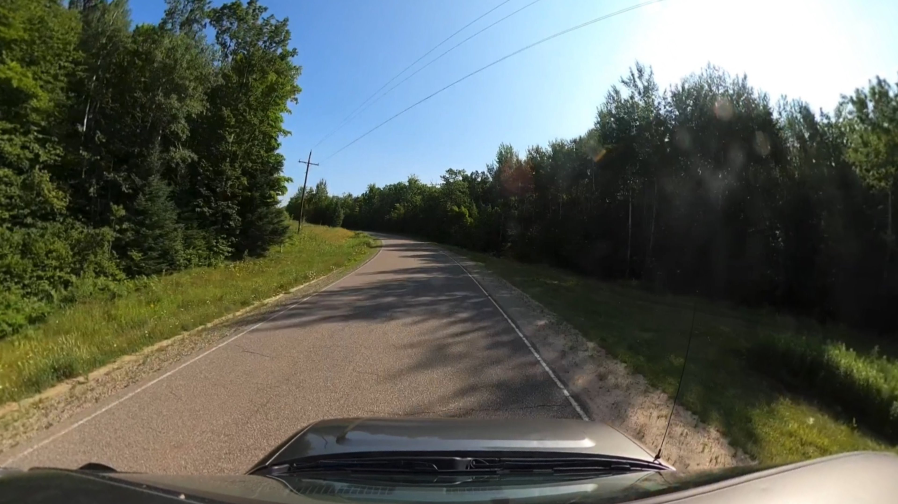
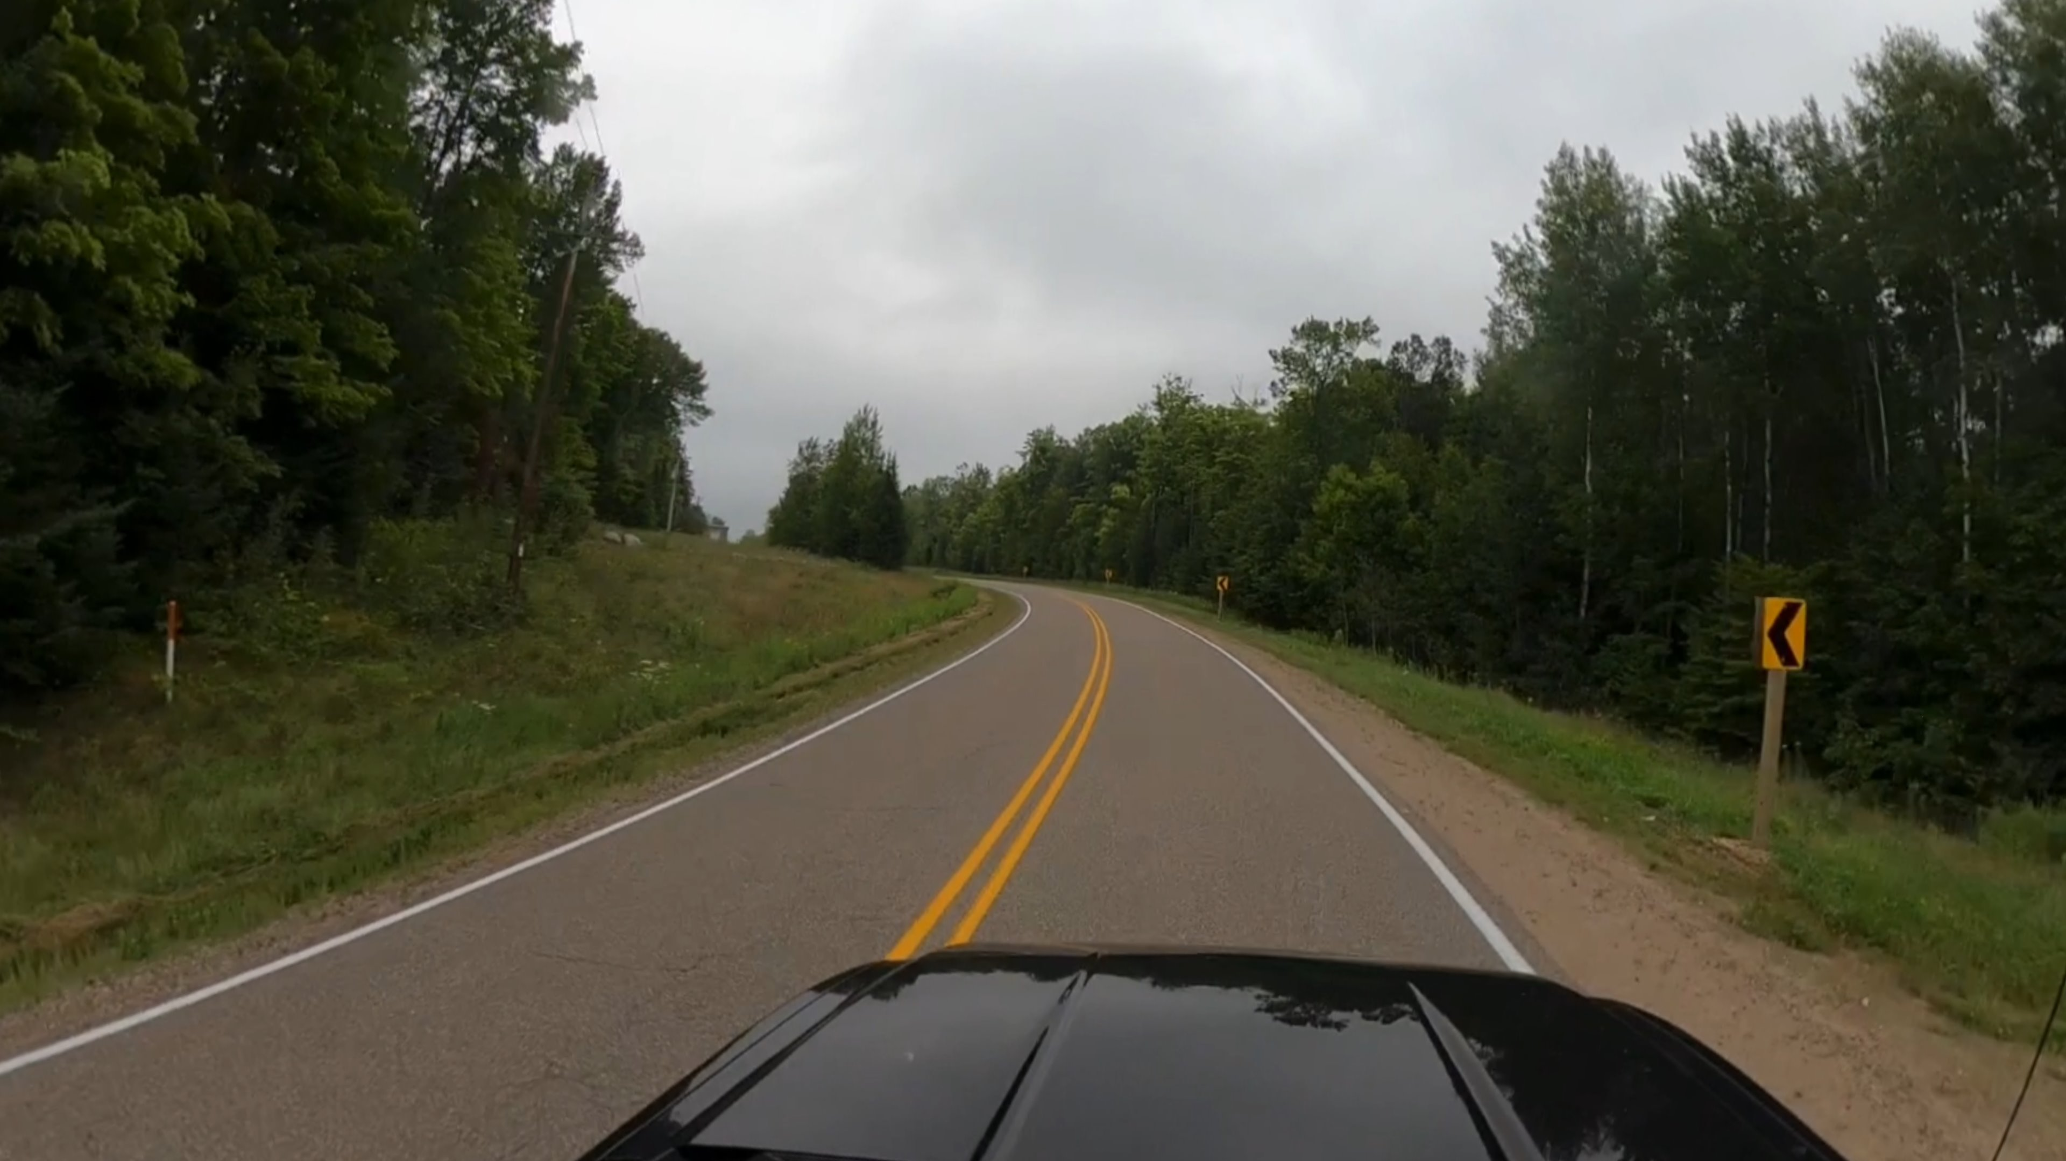

County H
BEFORE->
<-AFTER

Slide 20
Notes:
For those who have considered this category in the past, please know that we are using a new, less complicated form this year.

Slide 21
Simplified roadway departure request form
Where?
Why?
What?

Slide 22
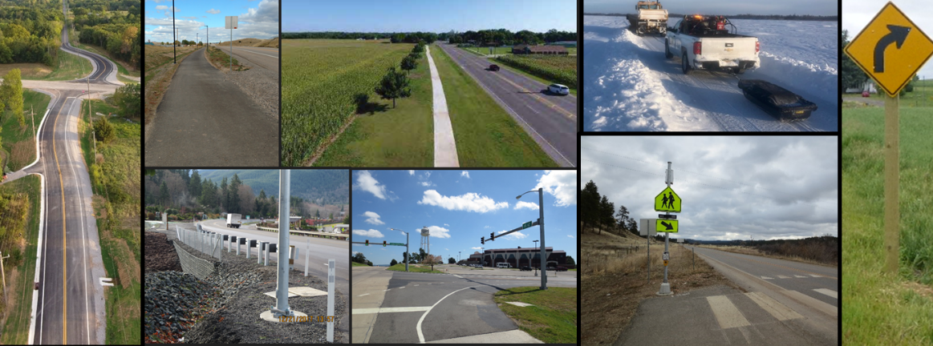
Infrastructure Improvement Category
  Other Eligible Activities as listed in 23 USC 148(a)(4)
(xxviii) A physical infrastructure safety project…

Slide 23
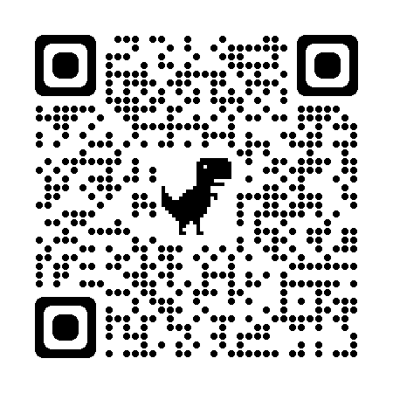
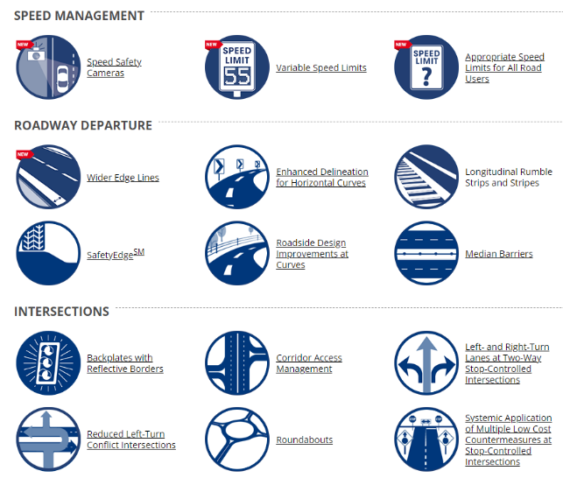
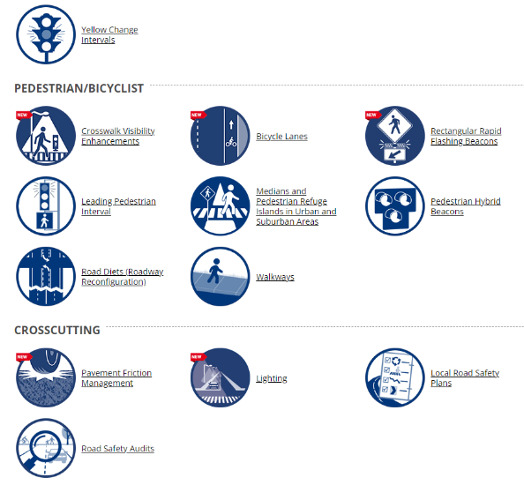
Proven Safety Countermeasures
https://safety.fhwa.dot.gov/provencountermeasures/
Notes:
FHWA Proven Safety Countermeasures http://safety.fhwa.dot.gov/provencountermeasures/

Slide 24
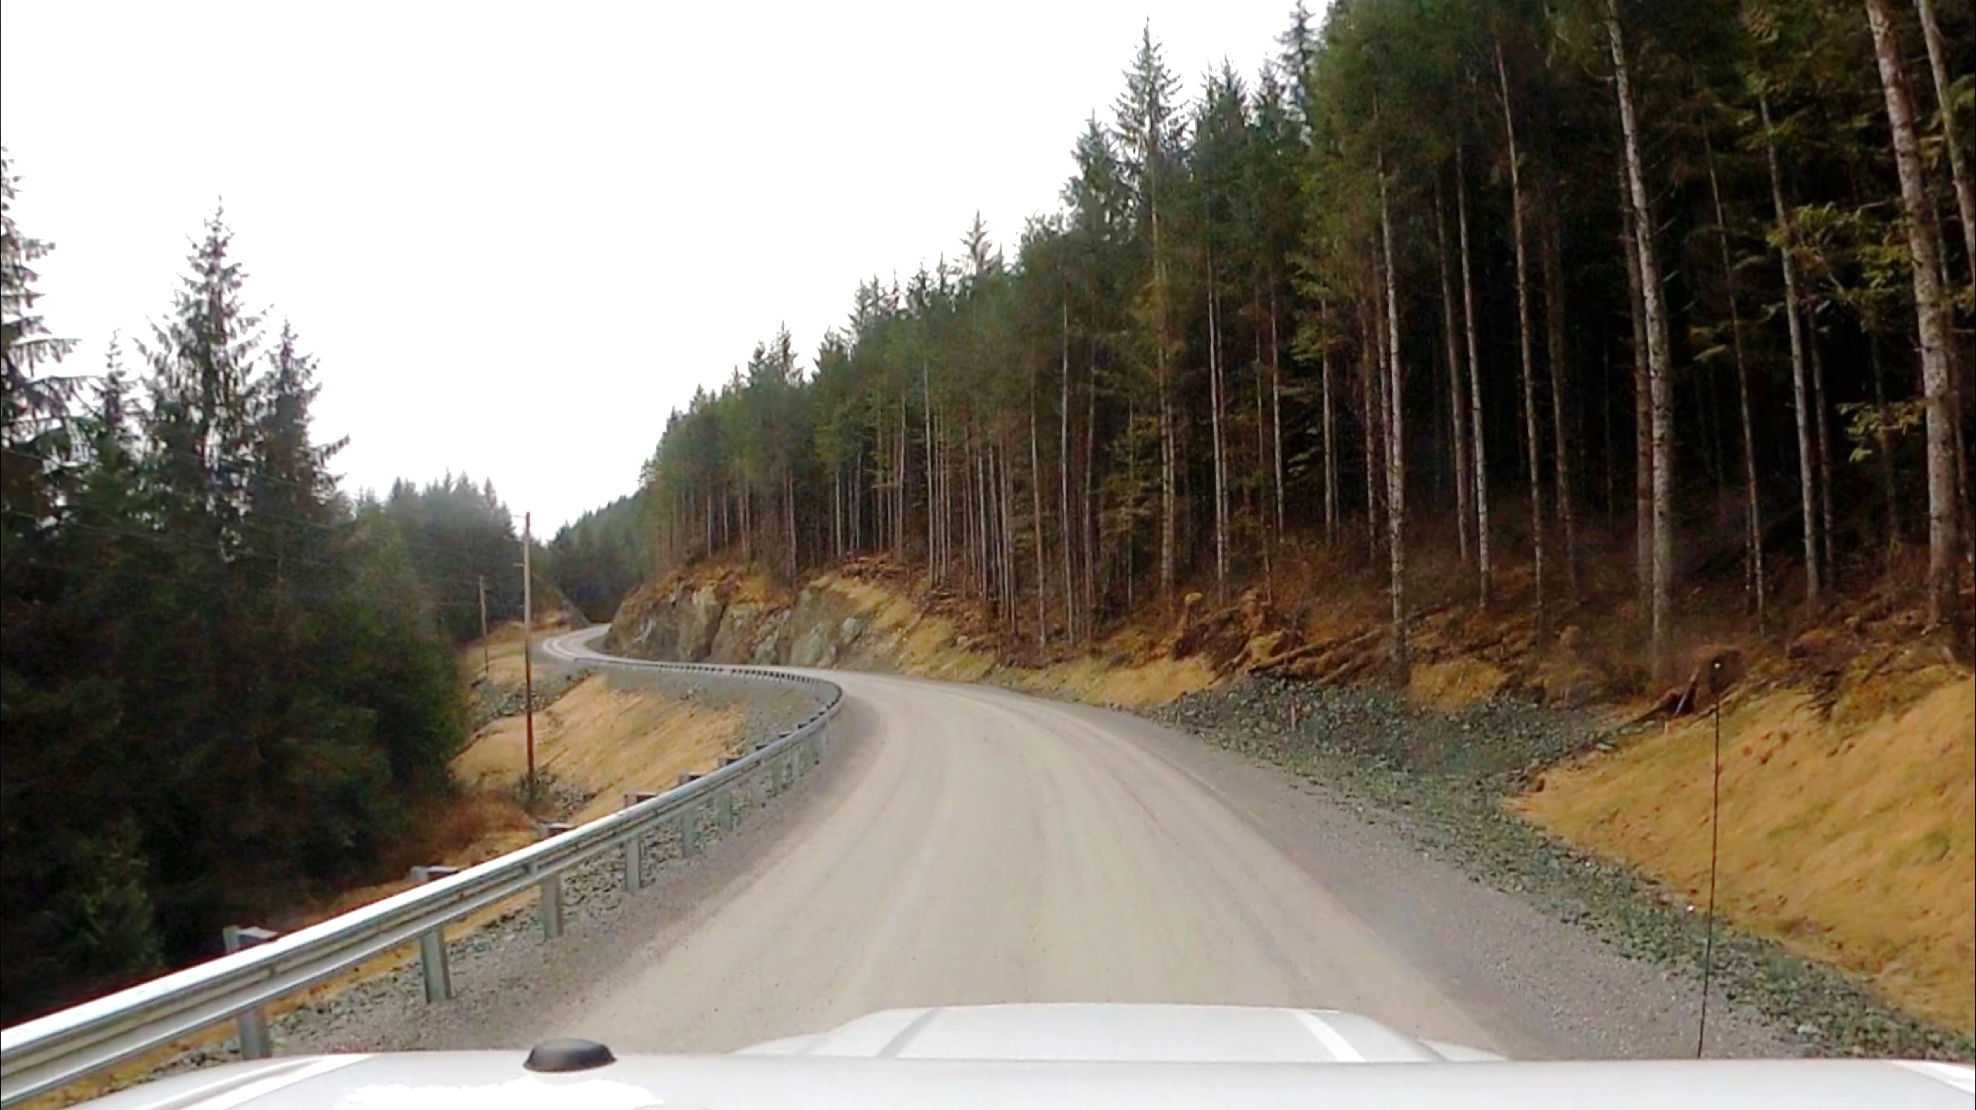
New Guardrail & Realignment
Organized Village of Kasaan (AK)
Source: FHWA

Slide 25
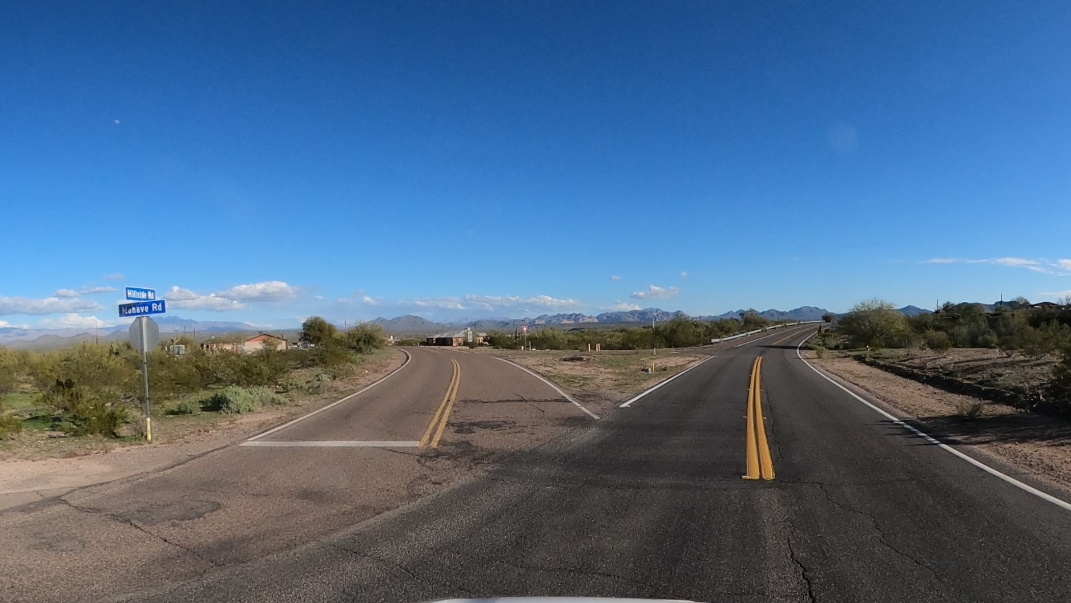
Intersection Realignment
Fort McDowell Yavapai Nation
Source: FHWA

Slide 26
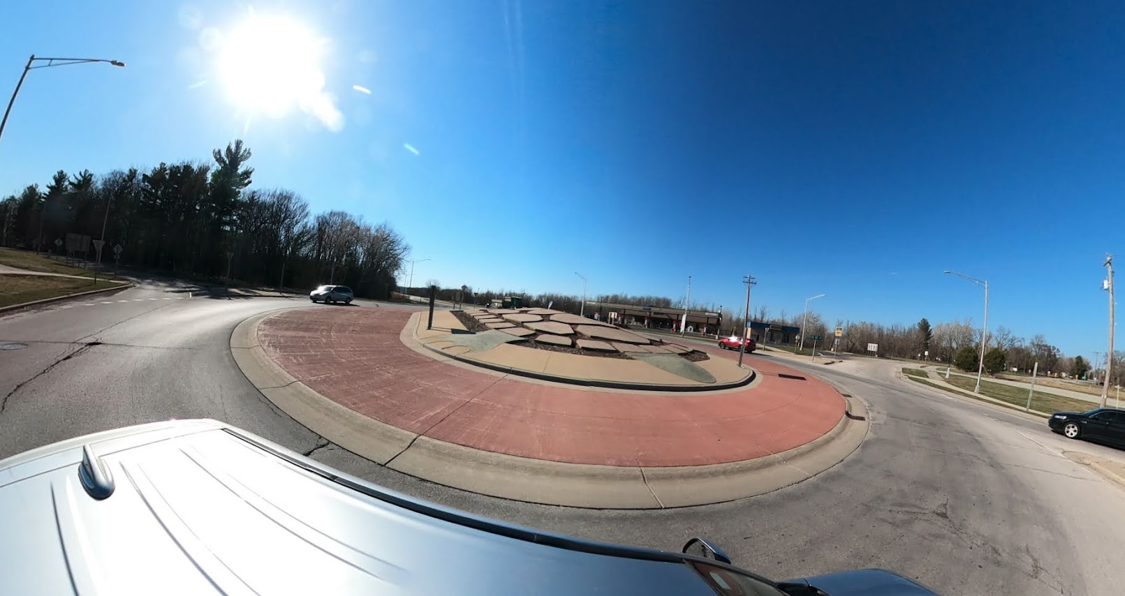
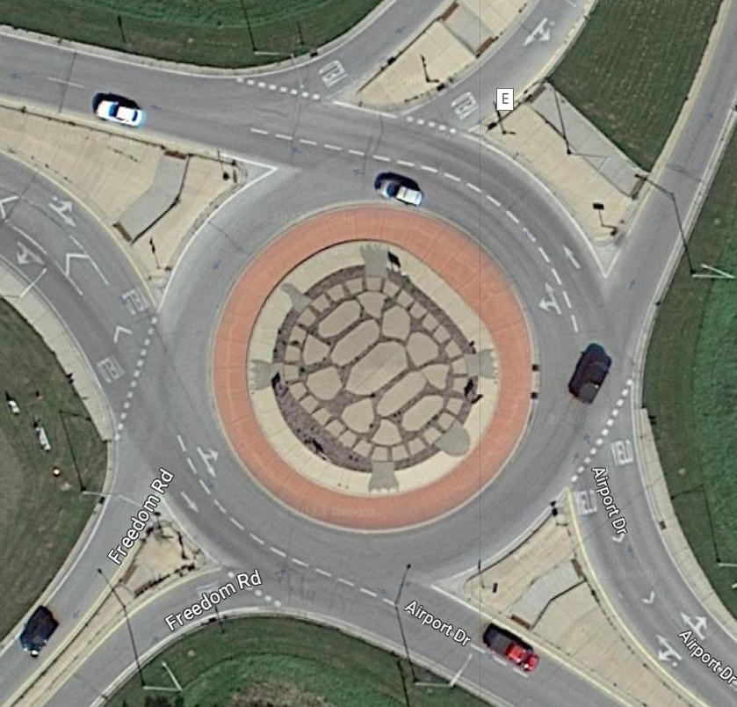
Roundabouts
Oneida Indian Nation (WI)
Source: FHWA
Source: Google

Slide 27
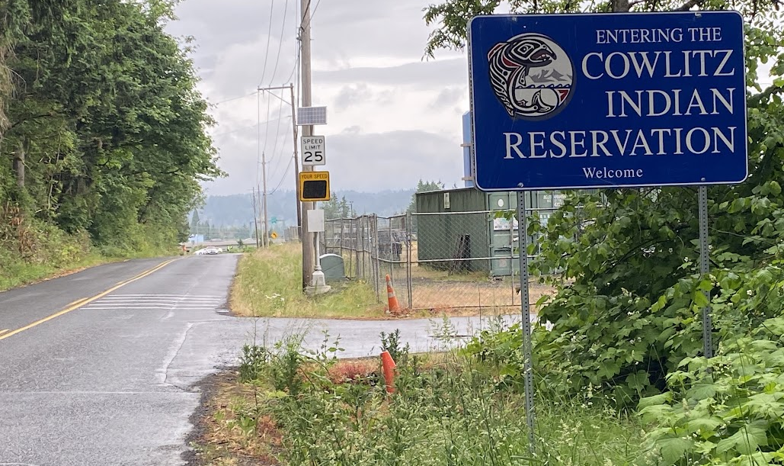
Traffic Calming Project
Cowlitz Indian Reservation, WA
Source: FHWA

Slide 28
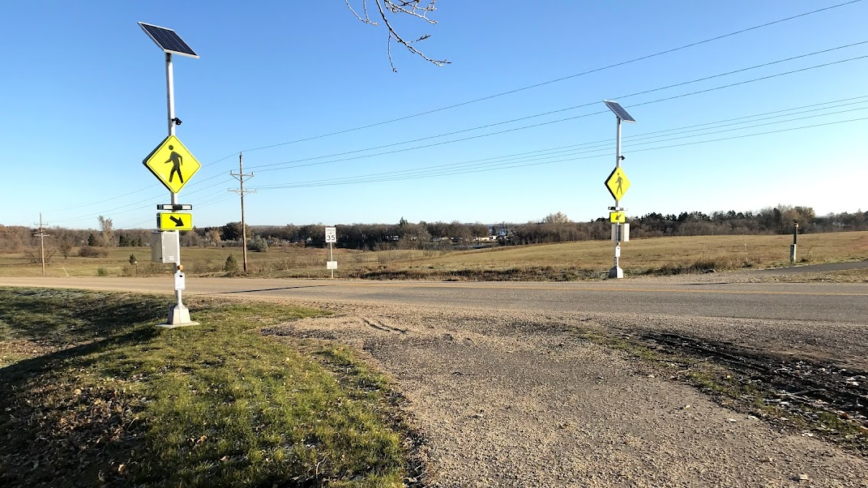
Pedestrian Crossing Improvements
Sisseton Wahpeton Oyate
Source: FHWA

Slide 29
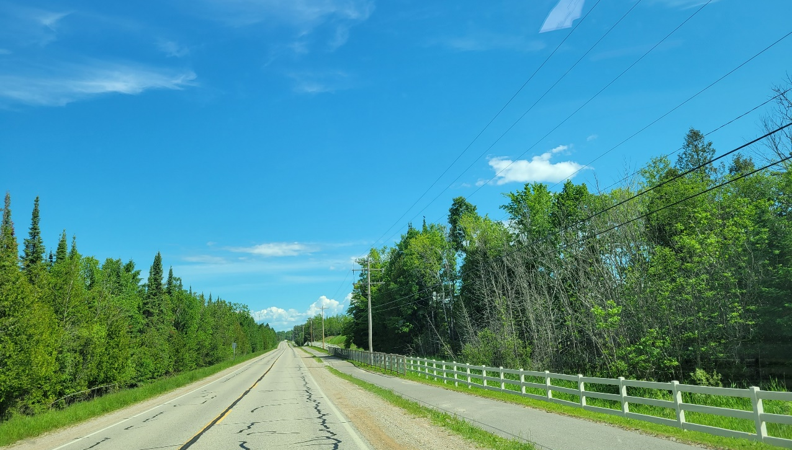
Separated Pedestrian Walkway
Hannahville Indian Community Band of Potawatomi
Photo: Hannahville Indian Community Band of Potawatomi

Slide 30
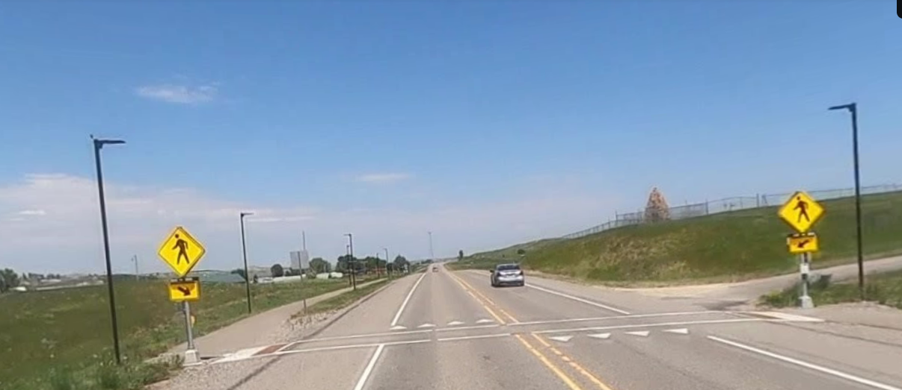
Busby Separated Pathway
Northern Cheyenne Tribe

Slide 31
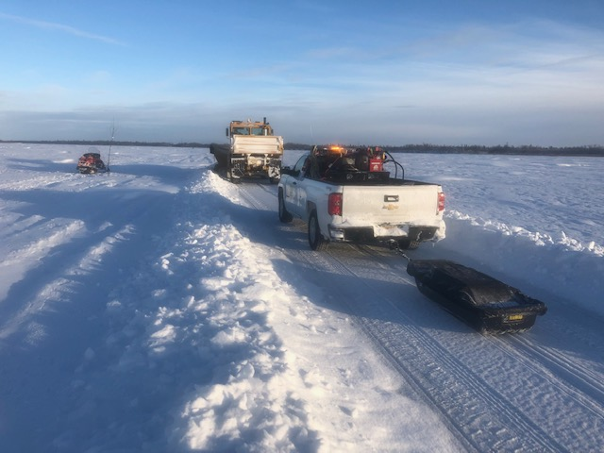
TTPSF Projects in Alaska
Safety Plans & Studies
Winter Trail Safety Shelters
Winter Trail Marking
Street Lighting
Sidewalks
Pathways
Ice Road Monitoring Pilots
Guardrail
Full awards list online
Notes:
Note: We can’t pay for routine, ongoing activities but can issue grants to get something new started. Example: Grant issued to buy GPR and try it out for the first year; Following years other funding needed to continue operations.

Slide 32
Not Eligible
TTPSF is currently NOT able to fund:
  Building evacuation routes
  Proposed Roads
  Routine Maintenance Activities
  Emergency Services and Law Enforcement Equipment
Notes:
>> Evacuation routes – TTPSF addresses injuries and fatalities from use of transportation facilities. It is not within the scope of our mission to address disaster preparedness.
>> Proposed roads – Routes must be official and existing on the inventory.
>> Routine Maintenance Activities
>>

Slide 33
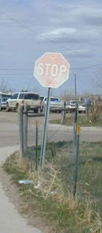
Safety Enhancements and Upgrades are eligible
Cannot supplant routine maintenance
Common Issues with Applications

Slide 34
OTT Safety Research Projects
Crash Data Collection & Analysis Tools
Roadway Safety Data / Risk Based Safety Planning Pilot
Pedestrian Safety in Tribal Areas

Slide 35

Tribal Crash Reporting Toolkit
  Self-Assessment
  Facts & Fiction Tool
  Data Analysis Tool
  Crash Reporting Tool
  Officer’s Instruction Tool
  Quality Control Tool
  Database Tool
https://www.tribalsafety.org/tribal-crash-reporting-toolkit

Slide 36
Report to Congress: Safety Data Collection, Analysis, and Use in Tribal Areas (Section 14008)
–(b) Best Practices, Standardized Crash Report Form.--
(1) Secretary of Transportation in consultation with (States, Tribes, BIA)… shall develop--
(A) best practices for the compiling, analysis, and sharing of motor vehicle crash data for crashes occurring on Indian reservations and in Alaska Native communities; and
(B) a standardized form for use by Indian tribes and Alaska Native communities to carry out those best practices.
(2) Purpose.--The purpose of the best practices and standardized form developed under paragraph (1) shall be to improve the quality and quantity of crash data available to and used by the Federal Highway Administration, State departments of transportation, Indian tribes, and Alaska Native villages.
(3) Report

Slide 37
CRASH DATA STUDY & PILOT PROJECT
The Tribal Transportation Safety Management System Steering Committee is implementing a special project to help Tribes improve crash data collection and analysis capabilities. This initial phase will encompass a Pilot Program for a small number of Tribes who would like to participate. The project will also seek to identify best practices in tribal crash data collection and analysis. Please complete the questionnaire online at www.TribalSafety.org

Slide 38
Risk-Based Safety Planning
Roadway Departure
Pedestrian
Intersections
Exploring safety planning methods to identify safety needs by examining roadway features known to be high-risk.

Slide 39
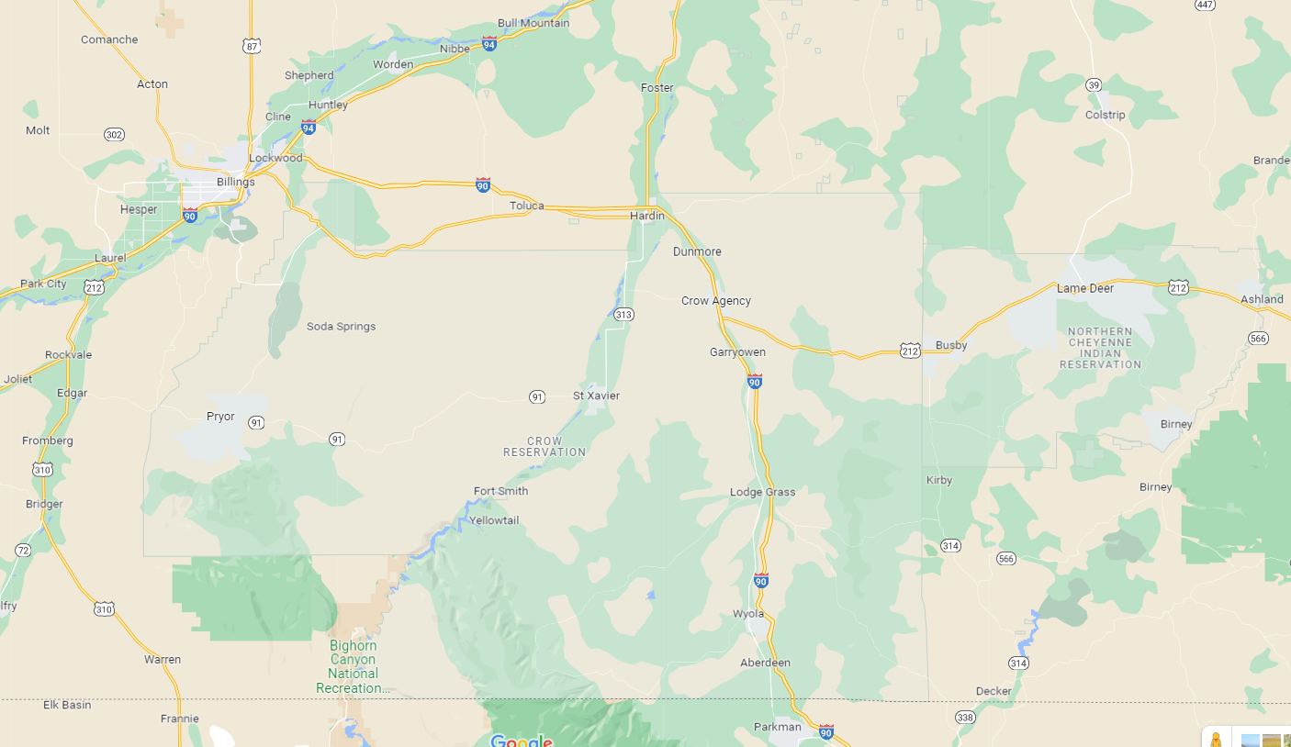
Goal:
Develop Roadway Departure Safety Implementation Plan
Crash data mostly limited to state system.
Very minimal roadway data
>1500 miles of low-volume, two-lane rural roads across both reservations

Slide 40
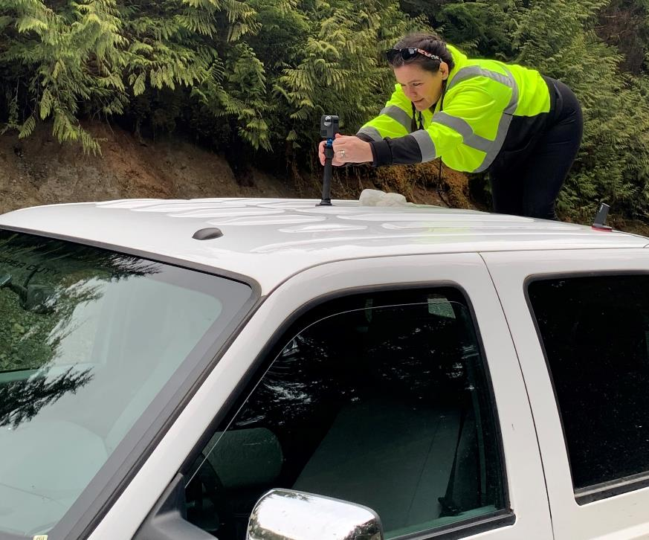
Virtual Tours Camera Kit
360 Camera has two lenses and captures spherical photos/video.
Mounts on top of vehicle.
View the photos/video in all directions as if standing at the camera location.
Notes:
Sara Yockey gave permission for use of her photos

Slide 41
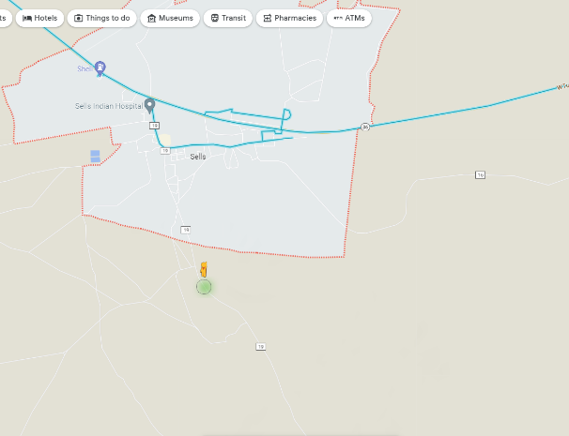
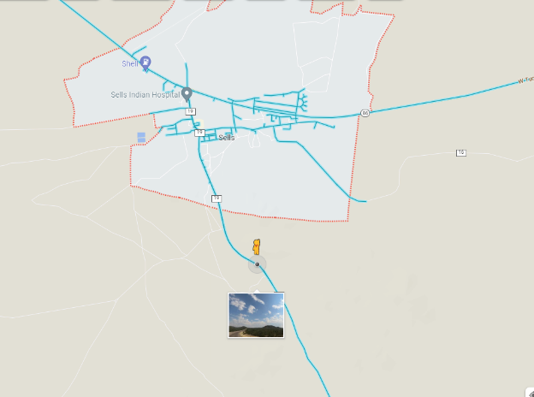
Update Google StreetView Imagery Example
Before
After

Slide 42
usRAP Data Elements

Slide 43

Road Assessment Program
usRAP, Road Assessment Program assigns safety star rating for each road based on:
  Road template and risk features observed in a video log
  Traffic volume
  Crash data, when available
Safer Roads Investment Plan

Slide 45
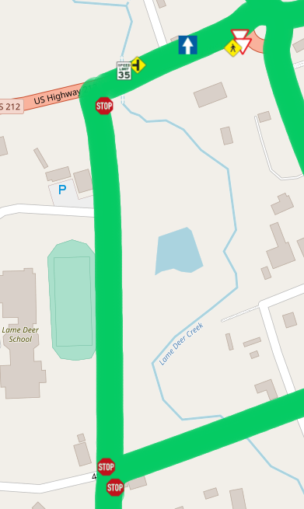
Outcomes
Photo log
Sign inventory
Asset data
Safety investment plan

Slide 46


PROJECT OVERVIEW
GOAL
Better understand safety risks faced by pedestrians in Tribal areas and practical approaches to reducing these risks.
STUDY ELEMENTS
Review fatal crashes involving pedestrians in Tribal areas to identify common risks
Document a method of identifying risk to pedestrians
Assemble an advisory committee
Learn from successful projects and programs
Identify a range of pedestrian safety countermeasures
Develop report and training

Slide 47
ADVISORY COMMITTEE
Monthly meetings during the project (18 months)
Report study progress
Present analyses, issues, and solutions
Ideally comprised of Tribal, Federal and State agencies
First meeting September 19, 2023
Please nominate or volunteer by sending a message to adam.larsen@dot.gov

Slide 48
Research: Pedestrian Safety in Tribal Areas
Advisory committee
Stakeholder engagement
Fatal crash reports
Location investigation
Report to recommend factors to be used when prioritizing investment in pedestrian safety
Kicked off in Summer 2023
Photo: Hannahville Indian Community Band of Potawatomi

Slide 49
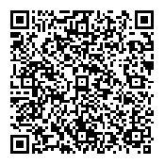
Adam Larsen
Safety Engineer & Safety Program Manager
Office of Tribal Transportation, FHWA
Adam.Larsen@dot.gov
office: 360-619-7751
cell: 360-619-2601
fax: 360-619-7846
https://highways.dot.gov/federal-lands/programs-tribal/safety/funds
http://www.TribalSafety.org/

