Slide 1
Contaminated ANCSA Lands Assistance Program Overview
Kenneth Andraschko
Program Coordinator
Jeff Estes & Mahri Lowinger
Contaminated ANCSA Lands Project Managers
U.S. Environmental Protection Agency | Region 10
Updated: 11/6/2023

Slide 2
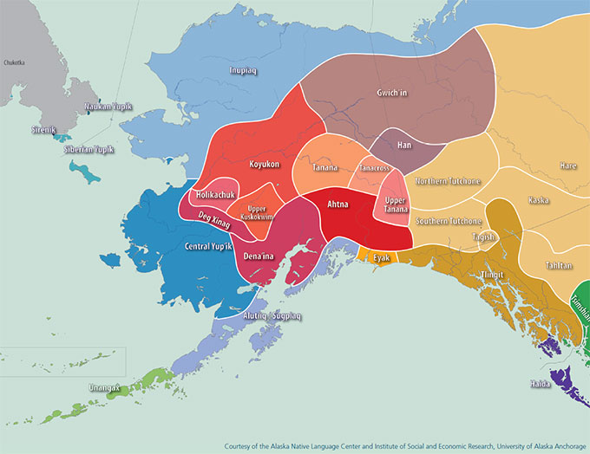
Contaminated ANCSA Lands Assistance Program
Congressional Supported Funding
Appropriation Act FY23
Appropriations language
Provides $18M for Assessments and Cleanups to
Eligible entities, and
Contaminated at the time of conveyance, and
who own the lands, and
are on the EPA inventory.
Funding provided to eligible applicants through a Cooperative Assistance Agreement.
Alaska Contaminated Sites: $20,000,000, to remain available until expended, shall be for grants, including grants that may be awarded on a non-competitive basis, inter agency agreements, and associated program support costs to establish and implement a program to assist Alaska Native Regional Corporations, Alaskan Native Village Corporations, federally-recognized tribes in Alaska, Alaska Native Non-Profit Organizations and Alaska Native Nonprofit Associations, and intertribal consortia comprised of Alaskan tribal entities to address contamination on lands conveyed under or pursuant to the Alaska Native Claims Settlement Act (43 U.S.C. 1601 et seq.) that were or are contaminated at the time of conveyance and are on an inventory of such lands developed and maintained by the Environmental Protection Agency: Provided, That grants awarded using funds made available in this paragraph may be used by a recipient to supplement other funds provided by the Environmental Protection Agency through individual media or multi-media grants or cooperative agreements: Provided further, That of the amounts made available in this paragraph, in addition to amounts otherwise available for such purposes, the Environmental Protection Agency may reserve up to $2,000,000 for salaries, expenses, and administration.

Slide 3
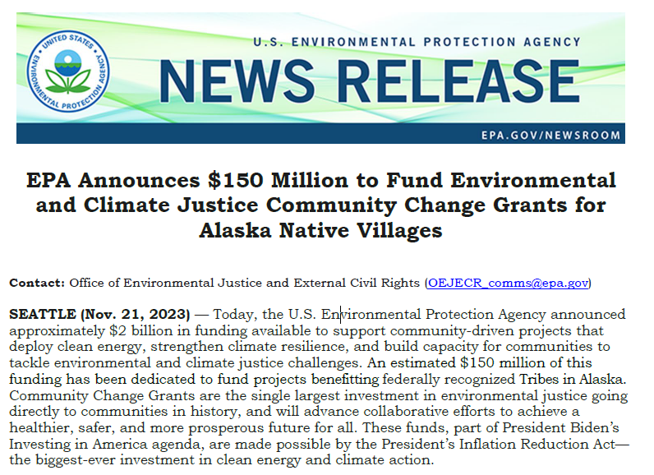
Climate Justice Community Change Grants for Alaska Native Villages
Targeted Investment Area that include :
• Focused on the clean-up of contaminated lands conveyed through ANCSA.
• Focused on other forms of pollution reduction.
• Focused on Alaska-specific climate action strategies.
Notice of Funding Opportunity
https://www.epa.gov/inflation-reduction-act/inflation-reduction-act-community-change-grants-program
Contact: Office of Environmental
Justice and External Civil Rights
OEJECR_comms@epa.gov

Slide 4
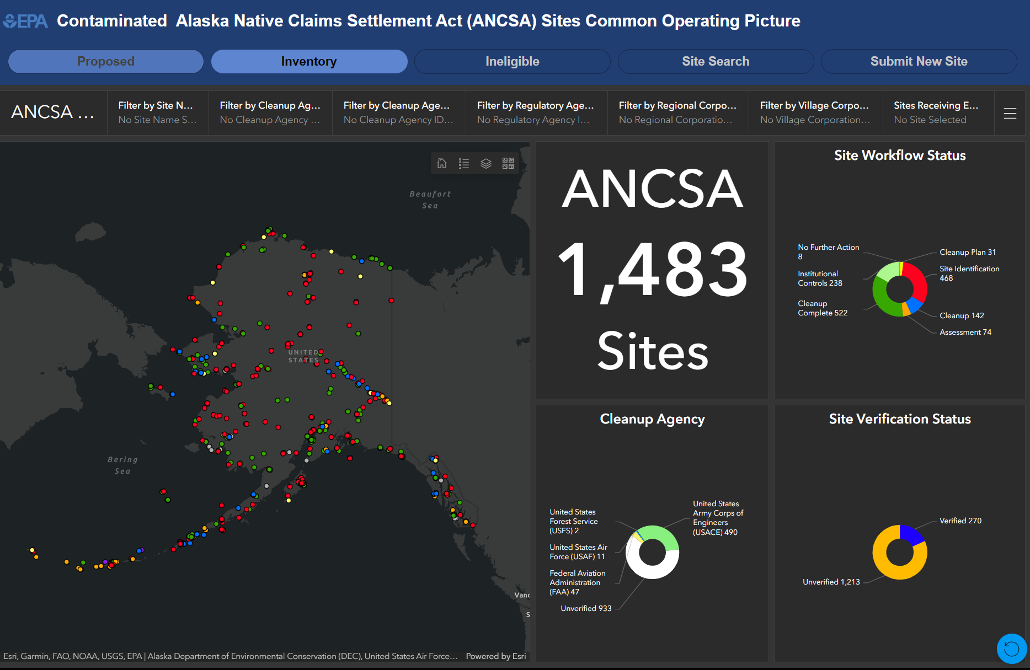
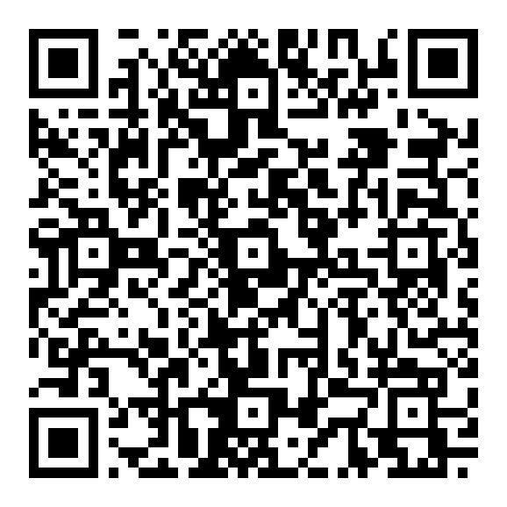
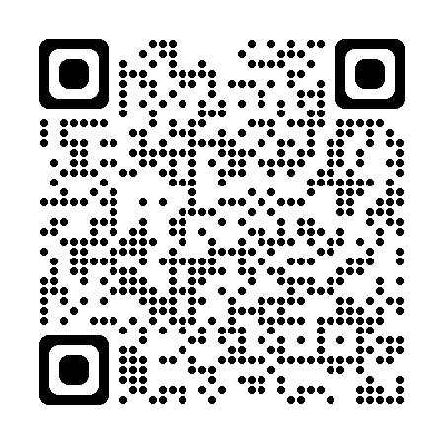
Contaminated ANCSA Lands Assistance Program
ANCSA Common Operating Picture (COP) Inventory
Key Features:
Constantly updated by EPA
Provides Cleanup Status
Allows Landowner to submit new site
Current Improvement in progress:
Process of submitting a new site
Aligning with ADECs Site Inventory
Website
QR Code
Website: https://experience.arcgis.com/experience/51479962643a49368433f43204d493e3

Slide 5
Contaminated ANCSA Lands Assistance Program
Eligible Activities
Community Engagement Activities
Assessment Activities
Cleanup Activities
Community engagement,
Developing culturally sensitive protocol for project implementation,
Applicable to both Assessment and Cleanups.
Conduct a site inventory,
characterize contaminants,
conduct site assessments.
Developing a site approach and site cleanup plan,
Conduct cleanup of contamination,
Conducting confirmation sampling post-cleanup.
Amongst other activities

Slide 6
Contaminated ANCSA Lands Assistance Program
Eligibility Requirements
Applicants
Land ownership
Contamination
Conveyance
Federally recognized Tribes,
Alaska Native Corporations,
Intertribal Consortia
Contaminated land is owned by applicant OR applicant has documentation of landowner's authorization.
From oil, either separated or comingled with hazardous substances, pollutants, and contaminants as defined by CERCLA at the time of conveyance.
Land or site that were conveyed pursuant to ANCSA

Slide 7
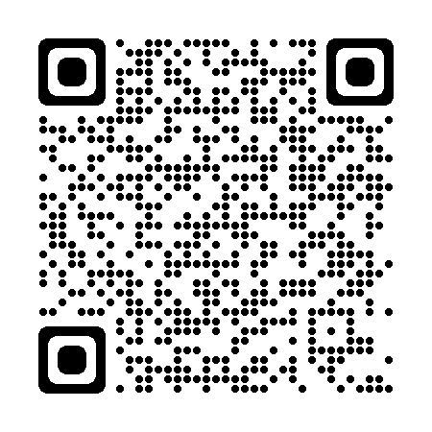
Contact Information – EPA Region 10
Kenneth Andraschko, PE ANCSA Program Coordinator Alaska Operations Office
Andraschko.Kenneth@epa.gov (907) 271-5079
Mahri Lowinger
Senior Contaminated ANCSA Lands Project Manager
Land, Chemical, & Redevelopment Division
lowinger.mahri@epa.gov
(907) 271-6334
Jeff Estes, PMP
Contaminated ANCSA Lands Project Manager
Land, Chemical, & Redevelopment Division
estes.jeff@epa.gov
(907) 271-6558
Website: https://www.epa.gov/r10-tribal/contamination-ancsa-conveyed-lands

Slide 8
Any Questions?

Slide 9
Eligibility Differences between Brownfields & ANCSA
Brownfields
ANCSA
1
Site must meet the definition of a Brownfield
2
Certain categories of sites not eligible (e.g., NPL sites, federally-owned sites)
3
Hazardous Substance sites – CERCLA liability defense
4
EPA Region 10 Eligibility Worksheet / State Petroleum Eligibility Determination
Petroleum sites – no “viable responsible party”
Reuse vision/plan needed
1
Eligibility | Site/Land conveyed under ANCSA
3
Eligibility | Tribal entities (including ANCs, consortia, Federal Tribes)
4
Eligibility | contamination that occurred pre-conveyance
NOTE
Does not require a reuse plan… …however, is an excellent idea for multiple funding
2
Site is verified and on the EPA COP Inventory
Reuse and revitalization will help EPA to prioritize applications
4

