Slide 1
Alaska Native Probate
Mary P. Thorstenson
Deputy Chief Judge
Office of Hearings and Appeals
Probate Hearings Division

Slide 2
OFFICE OF HEARINGS AND APPEALS (OHA)
Part of the Department of the Interior since 1971
Separate Agency from BIA and BTFA
BIA finalizes and submits probate cases to OHA, maintains land title, manages land
BTFA manages Individual Indian Money Accounts
OHA includes Probate Hearings Division and Interior Board of Indian Appeals
PHD issues probate decisions
IBIA hears appeals and issues published decisions

Slide 3
U.S. Department of the Interior
Assistant Secretary – Indian Affairs
Assistant Secretary for Policy, Management and Budget
Director, Bureau of Indian Affairs (BIA)
Director, Office of Hearings and Appeals (OHA)
BIA Regional Offices
OHA Boards and Hearings Divisions
BIA Agencies
Probate Hearings Division

Slide 4
Probate Hearings Division
5 Offices – Albuquerque, Billings, Rapid City, Sacramento, Twin Cities
10 Judges
40+ other employee positions
Attorneys, Paralegals, Legal Assistants
Judges and staff may hear cases in any region, not only those where they office

Slide 5
Probate Hearings Division Circle = Current Field Office; X = Office Has Been Closed

Slide 6
Trust Responsibility
“The Federal trust responsibility requires that every action undertaken by the Department of the Interior in Indian matters be executed in a fiduciary capacity. This trust responsibility extends to the conduct of Indian probate proceedings.”
Estate of Charles Webster Hills, 13 IBIA 188, 192 (1985) (citations omitted)

Slide 7
Federal Regulations
Department has been deciding federal probate cases for more than 100 years
BIA Regs at 25 CFR Part 15
Initiates Probate Case (must learn of death)
OHA Regs at 43 CFR Part 30
Authority of Probate Judges – Heirs, Wills, Claims
Probate Process – Hearing, Decision, Post-Decision
Certain Regs do not Apply in AK – Purchase, Directed Renunciation

Slide 8
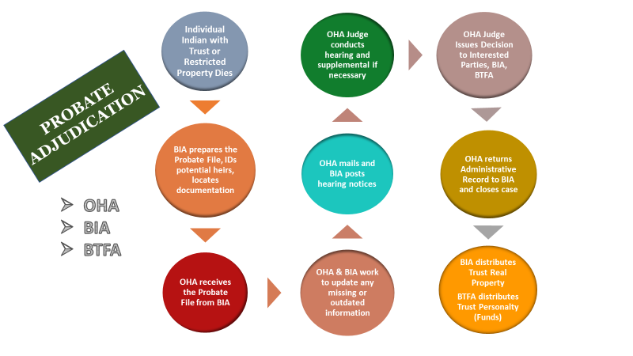

Slide 9
AK State Law Highlights
Spouse gets either the entire estate or a minimum dollar value
Step-parent adoptions do not affect inheritance
With a renunciation, person renouncing is treated as if they predeceased the decedent
When multiple generations inherit, people in each generation receive equal shares

Slide 10
Alaska Native Probate
Intestate Succession
Adoptions
Wills
Renunciations

Slide 11
Intestate Succession
Alaska Statutes Annotated
§ 13.12.102(a)(1) Surviving Spouse
Entire estate if—
(A) No descendant or parent survive
(B) Decedent’s surviving descendants are also spouse’s and no other descendant of spouse survives

Slide 12
Intestate Succession
§ 13.12.102(a) Surviving Spouse
(2) First $200,000 + 3/4 balance if—
No descendants survive but one or both parents survive

Slide 13
Intestate Succession
§ 13.12.102(a) Surviving Spouse
(3) First $150,000 + 1/2 balance if—
Decedent’s surviving descendants are also spouse’s and other descendants of spouse survive

Slide 14
Intestate Succession
§ 13.12.102(a) Surviving Spouse
(4) First $100,000 + 1/2 balance if—
All of decedent’s surviving descendants are not all spouse’s descendants

Slide 15
Intestate Succession
§ 13.12.102(a) Surviving Spouse
Appraisals
NOT needed in MOST cases
Decedent not married at death
Married but no children/parents surviving
Small estates

Slide 16
Intestate Succession
§ 13.12.103 No Surviving Spouse
Appraisals
NOT NEEDED

Slide 17
Intestate Succession
§ 13.12.103 No Surviving Spouse
(1) descendants by representation
§ 13.12.106 Representation
Per capita at each generation

Slide 18
Intestate Succession
Common Law Representation
Per stirpes: A beneficiary’s heir(s) receives the inheritance should the beneficiary die before the testator
 | Decedent
Child 1 | Child 2 | Child 3
1/3 | 1/3 | 1/3
(predeceased) | Living | (predeceased)
3 Children |  | 5 Children
1/9 each |  | 1/15 each

Slide 19
Intestate Succession
§ 13.12.106 Representation
Per capita at each generation:
 | Decedent
Child 1 | Child 2 | Child 3
1/3 | 1/3 | 1/3
(predeceased) | Living | (predeceased)
3 Children | D’s 8 <grandchildren> | 5 Children
1/12 each | 2/3 by 8 | 1/12 each

Slide 20
Intestate Succession
§ 13.12.106 Representation
Per capita at each generation:

Slide 21
Adoptions
13.12.114 Parent and Child
Inheritance within adopted family

Slide 22
Adoptions
Cultural adoption
25 U.S.C. § 372a – Only if:
By state or tribal court
Registered by Superintendent or Tribe
Estate of Frank Anasouk Topsekok, 43 IBIA 236 (2006)

Slide 23
Will Drafting
When describing land in a will, the more specific the description the better
Use BIA allotment numbers if available
Specify restricted or unrestricted if known
Make sure will witnesses know they could be asked to testify in a will contest
Changed circumstances

Slide 24
Wills
Federal Law not Alaska Law
Validity of Indian Wills
Self Proved Wills
Trust or Restricted Property

Slide 25
Validity of Indian Wills
Federal Law not Alaska Law
Testator over 18 Years
Testamentary Capacity
Document Signed by Testator
Witnessed by 2 disinterested adult witnesses

Slide 26
Self Proved Wills
Requires Affidavit of
Testator
Witnesses
Executed with will

Slide 27
Trust or Restricted Property
Retains status if:
Devisee is “Indian”
Otherwise passes from trust or restricted status

Slide 28
Finding of Death
43 C.F.R. § 30.124
25 C.F.R. § 15.106

Slide 29
Finding of Death
As to Heir/Devisee or other person
Upon determination by appropriate court
Upon clear and convincing evidence
Rebuttable Presumptions –
Presumed alive if any contact within 6 years
Presumed dead if no contact with prior or probable contacts for 6 or more years

Slide 30
Renunciation/Disclaimer
Alaska Statutes Annotated
§ 13.70.030
(a) may disclaim any interest in property
(c) in writing, describe interest disclaimed, signed and delivered or filed

Slide 31
Renunciation/Disclaimer
Alaska Statutes Annotated
§ 13.70.030
No provision for “directed” disclaimer in Alaska

Slide 32
What Family Members Should Be Included on the OHA-7?
All potential heirs – including guardians of minors or the legally disabled and any
All devisees named in a will to receive trust or restricted property
Other knowledgeable family members, especially those likely to attend hearing
Surviving brothers and sisters often helpful
Include “common law” spouses even though not legal heirs

Slide 33
QUESTIONS?

Slide 34
Alaska Native Probate
Thank
You!

